Slide 1
TITANIC
Exploratory Data Analysis
Patterns, trends, and anomalies in passenger survival
Task 5 · EDA Report · Based on notebook output (train.csv)

Slide 2
Objective & Dataset Structure
Objective
891
Explore the Titanic passenger dataset to uncover what influenced survival, using df.info(), df.describe(), and visual analysis.
Entries (rows)
Columns (from df.info())
12
PassengerId, Survived, Pclass, SibSp, Parch — int64 Age, Fare — float64 Name, Sex, Ticket, Cabin, Embarked — object
Columns — 7 numeric, 5 categorical
Dataset
train.csv — Kaggle "Titanic: Machine Learning from Disaster" — 891 rows × 12 columns.
38.4%
Overall survival rate
Titanic — Exploratory Data Analysis
2

Slide 3
Statistical Summary & Missing Data
From df.describe() and df.isnull().sum() — real output
 | Age | Fare ($) | Pclass
mean | 29.70 | 32.20 | 2.31
std | 14.53 | 49.69 | 0.84
min | 0.42 | 0.00 | 1
50% (median) | 28.00 | 14.45 | 3
max | 80.00 | 512.33 | 3
Observations
Average age is ~30, but Fare is heavily skewed — the mean ($32.20) is far above the median ($14.45), and the max fare ($512.33) is an extreme outlier. Median Pclass is 3, meaning most passengers traveled 3rd class. Cabin is missing for 687 of 891 passengers (77%) — too sparse to analyze reliably. Age is missing for 177 (~20%). Embarked is missing for only 2.
Missing Values (df.isnull().sum())
Column | Missing
Age | 177
Cabin | 687
Embarked | 2
Titanic — Exploratory Data Analysis
3

Slide 4
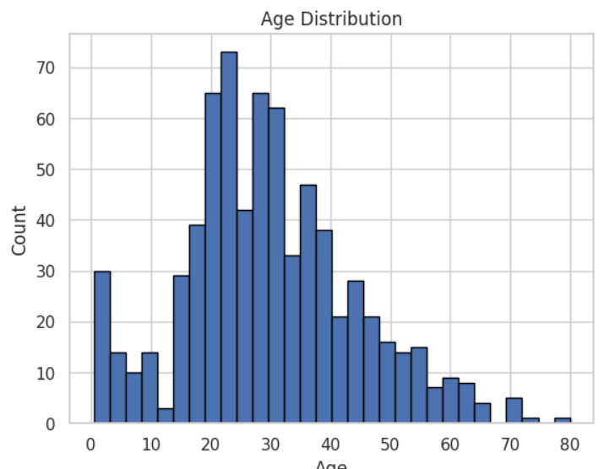
Age Distribution
df['Age'].hist(bins=30) — real notebook output
Observation
Most passengers were young adults between 20 and 40, with a clear peak around ages 20–25. There's a smaller secondary bump near age 0–5, reflecting infants and young children traveling aboard.
Titanic — Exploratory Data Analysis
4

Slide 5
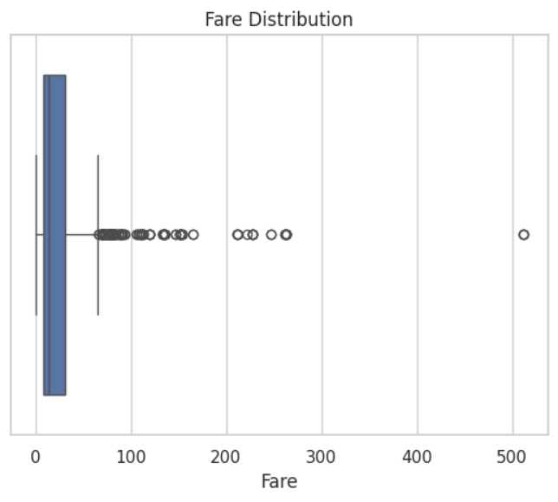
Fare Distribution & Outliers
sns.boxplot(x=df['Fare']) — real notebook output
Observation
Fare is heavily right-skewed: the bulk of tickets cost under $30, shown by the compressed box near zero. Numerous high-value outliers extend out past $100, with one extreme outlier above $500 — almost certainly a 1st-class ticket.
Titanic — Exploratory Data Analysis
5

Slide 6
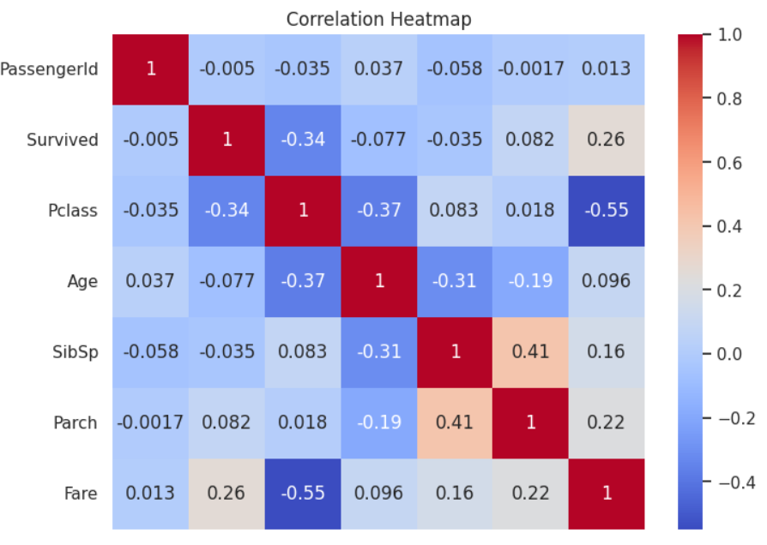
Correlation Heatmap
sns.heatmap(df.corr(numeric_only=True), annot=True) — real notebook output
Observation
Pclass has the strongest relationships in the dataset: it's negatively correlated with both Survived (-0.34) and Fare (-0.55). Fare is positively correlated with Survived (0.26) — passengers who paid more were somewhat more likely to survive. SibSp and Parch are moderately correlated (0.41), as expected — both relate to traveling with family.
Titanic — Exploratory Data Analysis
6

Slide 7
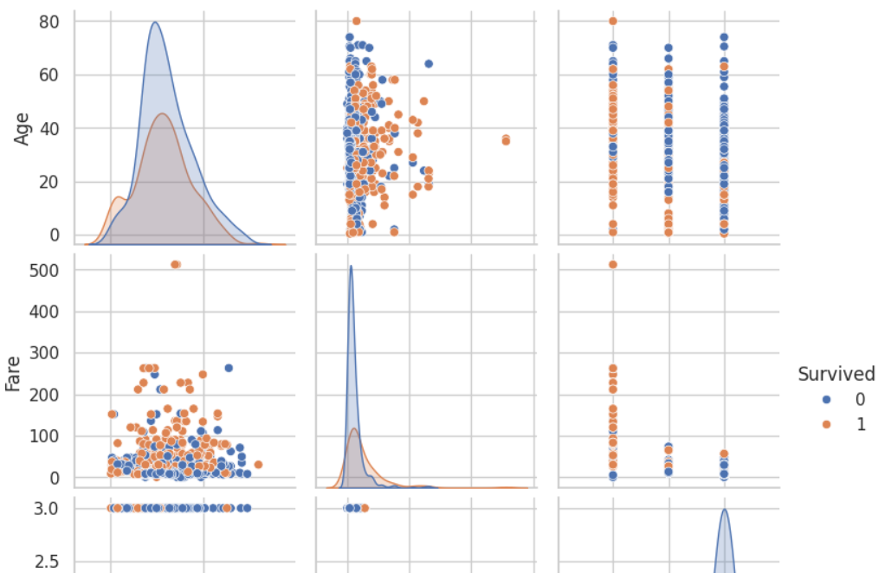
Relationships Between Variables
sns.pairplot(['Age','Fare','Pclass'], hue='Survived') — real notebook output
Observation
Age shows little separation between survivors (orange) and non-survivors (blue) — both groups span the full age range. Fare shows a clearer pattern: most high-fare passengers (upper portion of the Fare plots) survived, including the extreme ~$512 outlier.
Titanic — Exploratory Data Analysis
7

Slide 8
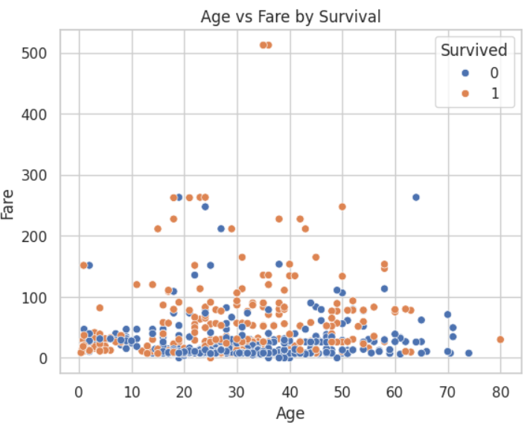
Age vs Fare by Survival
sns.scatterplot(x='Age', y='Fare', hue='Survived') — real notebook output
Observation
No strong linear relationship between Age and Fare — passengers of all ages paid a wide range of fares. Survivors (orange) are noticeably more concentrated at higher fare levels, while the low-fare cluster near the bottom is a mix of both outcomes, skewing more toward non-survivors (blue).
Titanic — Exploratory Data Analysis
8

Slide 9
Summary of Findings
1
The dataset has 891 rows and 12 columns; overall survival rate was 38.4%.
2
Fare is heavily right-skewed, with a mean ($32.20) far above the median ($14.45) and an extreme outlier near $512.
3
Pclass is the strongest correlate of survival among numeric features (-0.34), and also strongly linked to Fare (-0.55).
4
Higher-fare passengers survived at a noticeably higher rate, visible in both the heatmap and the pairplot/scatter.
5
Age shows little separation between survivors and non-survivors, and is missing for ~20% of passengers.
6
Cabin is missing for 77% of records — too sparse to draw reliable conclusions from.
7
SibSp and Parch are moderately correlated (0.41), consistent with families traveling together.
Conclusion: Fare and passenger class were the clearest numeric drivers of survival in this dataset; Age played a smaller role.

