Slide 1

Fun in Client Side Tech
By Manoj Patial

Slide 2
After This what You get
Client Side Technologies Ecosystem.
Client Interaction with Server.
JavaScript & juery.
Manipulation of the elements on browser.
Creating dynamic html.
OOPS in JavaScript
So are you guys Excited to learn all this .. Lets dive into it ;)

Slide 3

History
1994 Mozaic , First graphical interface to web.
1995 NetScape Navigator 2.02 .
Java Script Creator Brendan Eich .. In 10 days
1996 ECMA -262 Community , Standardization Body
1997 ES1
1998 ES2
1999 ES3
2006 jquery
2007 Google Chrome … v8 engine
2009 ES5 , NODE
ES6 2015

Slide 4
Java Script is
Dynamic eval(`2+8`);
Weakly type-check "23"*2 +false;
Functional map(f, [9,8,7,5,4]);
Object Oriented s= obj.toString();
Case-sensitive convention.useCamelCasing()
Simple Syntax like C if(somecondition){ execute some thing ;}
JavaScript is single threaded, meaning that two bits of script cannot run at the same time.

Slide 5
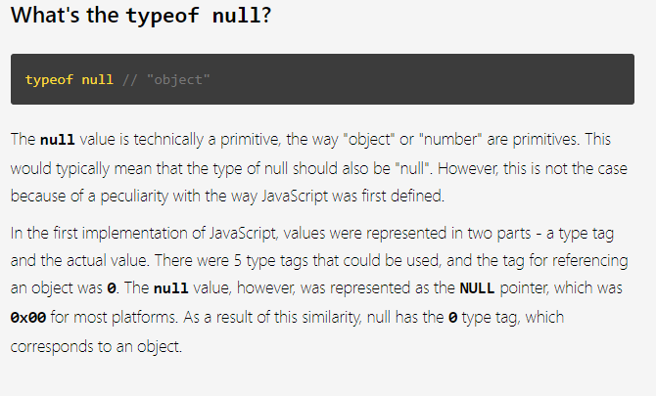
Basics OF java scripts
Data Types
typeof(function)

Slide 6
Basics OF java scripts
Variabless
Operators and Operands
Conditions
Loops
Objects
Functions and Function Literals
This
Call , Apply , Bind
Prototype
Exception Handling

Slide 7
Ways to create Objects
Object.create(prototype_object, propertiesObject)
Var obj ={}
Using a function constructor like
var newObject = new Object();
Or
function Human(firstName, lastName) {
this.firstName = firstName,
this.lastName = lastName,
this.fullName = function() {
return this.firstName + " " + this.lastName;
}
}
var obj = new Human( ‘Mike’ , ‘Tyson’ )

Slide 8
Interesting features
Closures
Hoisting
Use Strict

Slide 9
jQuery
$ -- Short Hand
$(document).ready(function(){})
It is Abstraction of JavaScript
Used for Dom Manipulation
Let’s Explore

Slide 10
Ajax and Promises
Asynchronous JavaScript and XML
Set of technologies working together
Basically, what Ajax does is make use of the JavaScript-based XMLHttpRequest object to send and receive information to and from a web server asynchronously, in the background, without interfering with the user's experience.
Gmail, Google Maps, Google Docs, YouTube, Facebook, Flickr, etc.
Different browsers implement the Ajax differently
jQuery simplifies the process of implementing Ajax
It offers simple methods such as load(), $.get() , $.post etc
jQuery Internal API return promises.

Slide 11
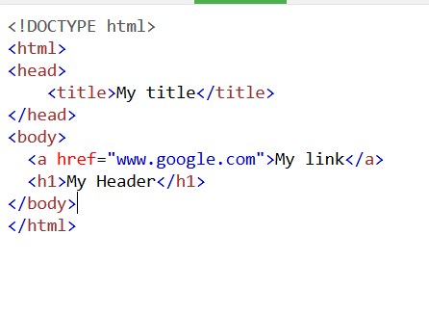
DOM ManiPulation
At the most basic level, a website consists of an HTML document. The browser that you use to view the website is a program that interprets HTML and CSS and renders the style, content, and structure into the page that you see.
In addition to parsing the style and structure of the HTML and CSS, the browser creates a representation of the document known as the Document Object Model. This model allows JavaScript to access the text content and elements of the website document as objects.

Slide 12
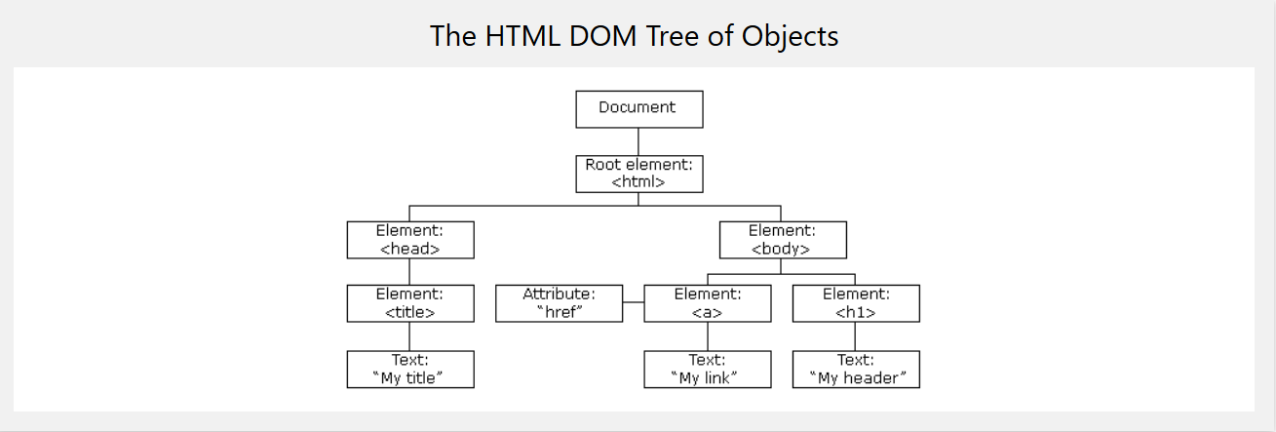
DOM ManiPulation

Slide 13
Working with JSON
{
"name":“john",
"age":30,
"cars":[ "Ford", "BMW", "Fiat" ]
}
for (i in myObj.cars) {
x += myObj.cars[i];
}
HTML Creation and DOM Manipualtion using Json Data.

Slide 14
Cool JS Libraries
High Charts
D3
UnderScore
Select2

Slide 15
OOPS in JavaScript
Object creation
Encapsulation
Inheritance
Design patterns … Module , Prototype, Observer , Singelton

Slide 16
FrameWorks and WEB Component
KnockOut , Moustache
React
Angular
Stencils
Vue.js
Virtual DOM and Shadow Dom

Slide 17
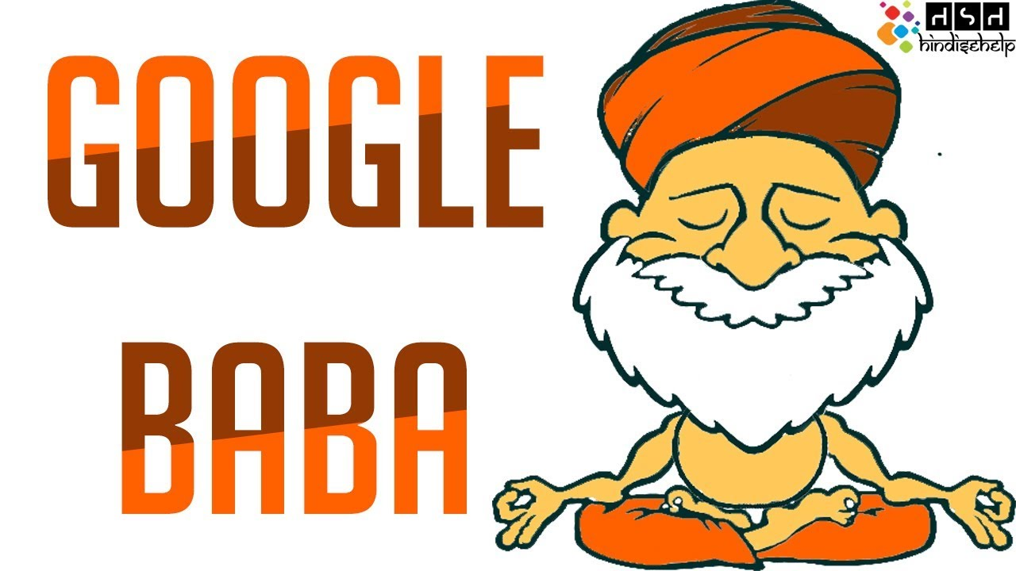
Reach Out TO ME mpatial@ivp.in
References :: Already embedded in slides
Special Thanks To.

