Slide 1
Title: LLM Fine-Tuning Comparison Study
Fine-Tuning BERT for Hate Speech Detection

Slide 2
Introduction
Base LLM: BERT (Bidirectional Encoder Representations from Transformers)
Fine-tuning BERT for Hate Speech Detection

Slide 3
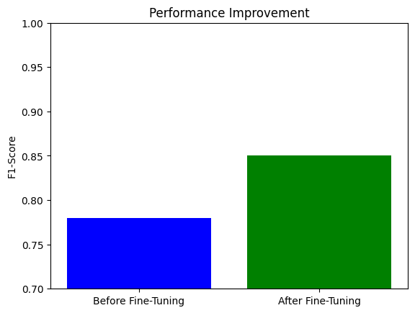
Performance Improvement
Before Fine-Tuning: F1-Score = 0.78
After Fine-Tuning: F1-Score = 0.85

Slide 4
Data Preparation Steps
Data Collection: Gather labeled data for hate speech detection.
Dataset: Hate Speech18
2. Data Cleaning: Remove noise, such as irrelevant text or symbols.
3. Tokenization: Convert text into tokens using BERT’s tokenizer.
Data Collection
Data Cleaning
Tokenization

Slide 5
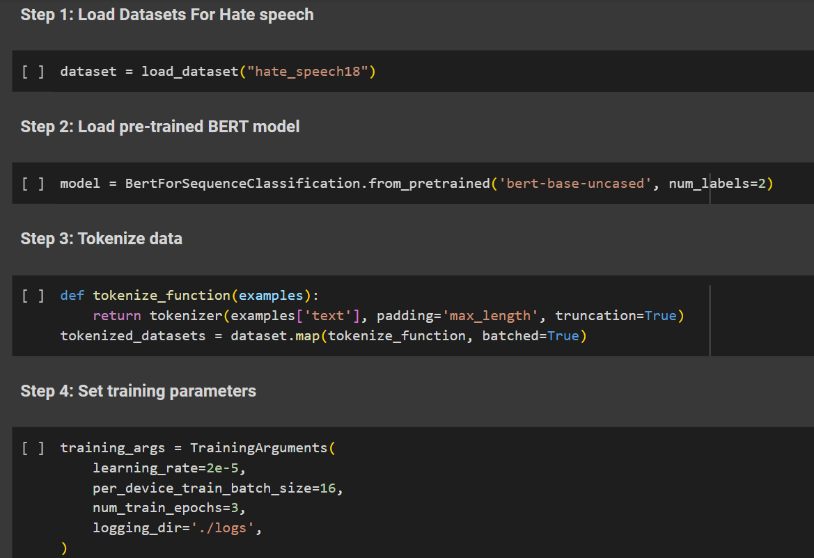
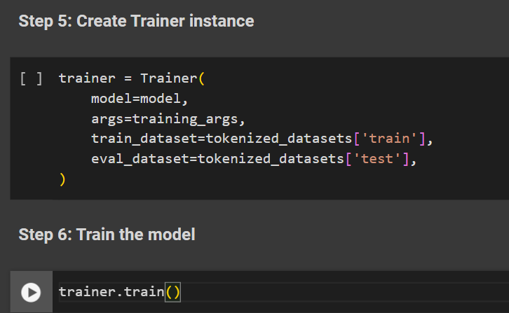
Fine-Tuning Approach

Slide 6
Challenges & Solutions
Challenge: Overfitting Solution: Use validation set and early stopping
Challenge: Limited Data
Solution: Data Augmentation and Transfer Learning.

