Slide 1
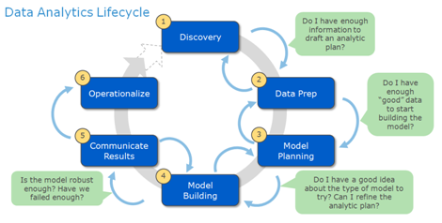
Hadoop
Data Analytycs

Slide 2
What data anlytytcs.
Why data analytytcs.
Feedback from users to improve services

