Slide 1
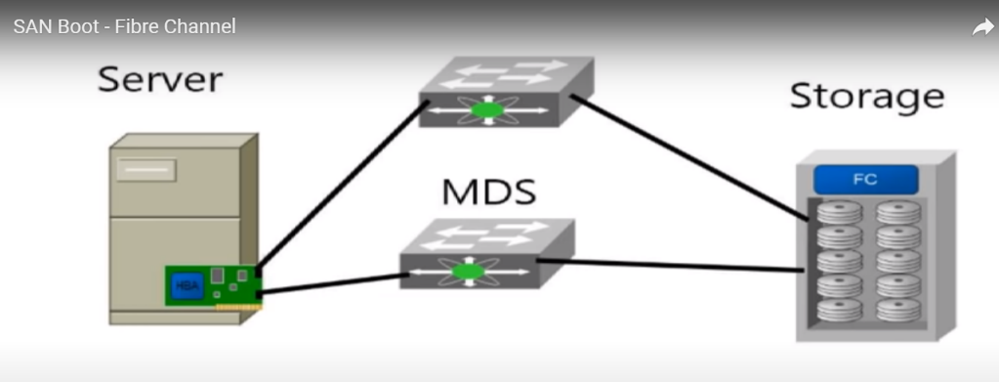
SAN

Slide 2
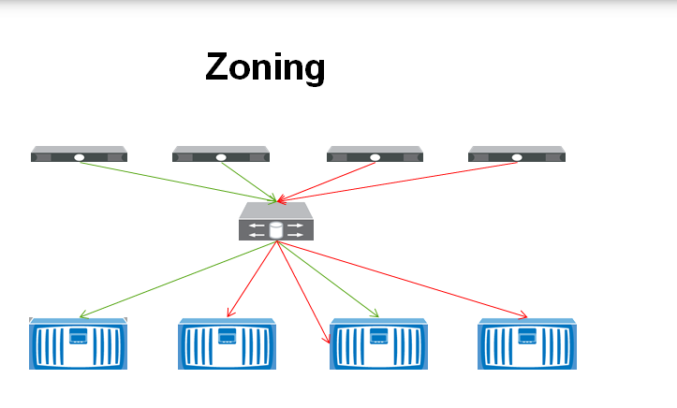
WWNN
8 byte address
Identifies the host in storage network.
WWNN is for per HBA adapter name.
WWPN
Assigned to individual port on a multiport HBA

Slide 3
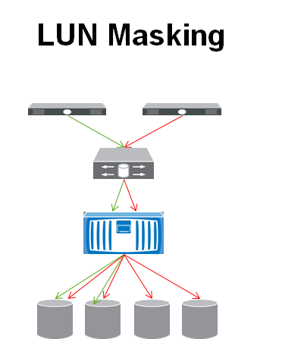
Authorization process that makes LUN available to few hosts and unavailable to few other hosts.

Slide 4
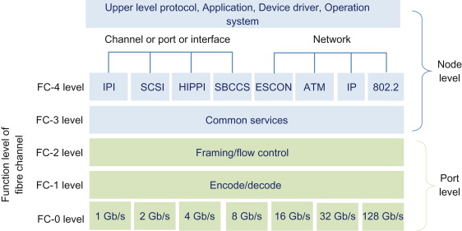
FC-4
SCSI_FCP Mapping b/w upper SCSI layer and lower FC layer protocol.
Each IO operation is mapped to a Fiber Channel Exchange through SCSI_FCP.

Slide 5
FLOGI (Fabric Login)
Establishing steady-state operating parameters between the end node and the switch
FCID: Domain ID is unique for all devices that are connected to the same switch, and the Port ID is unique to each device connected to the same switch.
node must register itself with the Fiber Channel Name Server (FCNS) by providing a record of its FC_ID, pWWN, nWWN.

Slide 6
PLOGI (Port Login): establish a session between two N_Ports (devices) and is necessary before any upper level commands or operations can be performed.
PRLI (Process Login):login to exact process.

