Slide 1
Introduction
Each server has a mezzanine slot
MENLO / PALO cards
Types of PALO
M81kr
VIC1240
VIC1280

Slide 2
VN TAGS
A frame tagging method
Cisco UCS Fabric Interconnect/IO Module combination use an additional header in Ethernet frames called VN-Tag, which uniquely identifies some remote port which will receive a virtual Ethernet port on the local switch
The same VN-Tag technology is used by the Cisco Virtual Interface Card (VIC, or Palo) to identify the virtual interfaces being supported by the card

Slide 3
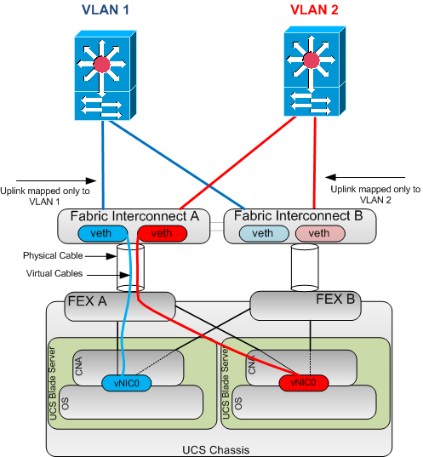
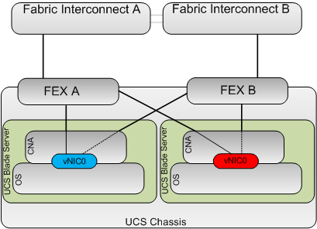

Slide 4
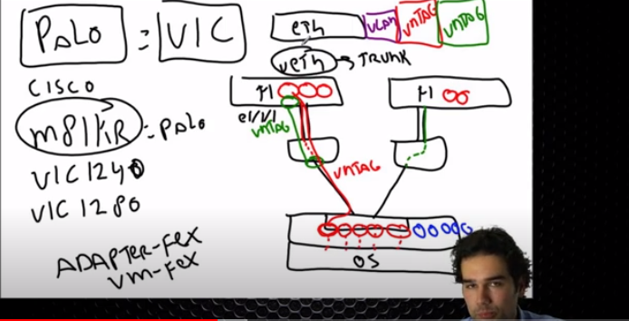

Slide 5
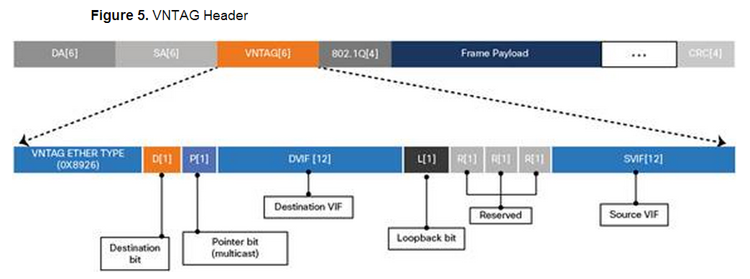

Slide 6
References
http://network.jecool.net/access-layer-technologies-in-virtual-environment/
https://www.unifiedcomputingblog.com/?p=42
https://ucsguru.com/2012/05/18/understanding-ucs-vif-paths/
https://ucsguru.com/2012/07/10/cisco-ucs-traffic-separation/
https://www.packetmischief.ca/2012/08/28/what-the-fex-is-a-fex-anyways/

