Slide 1
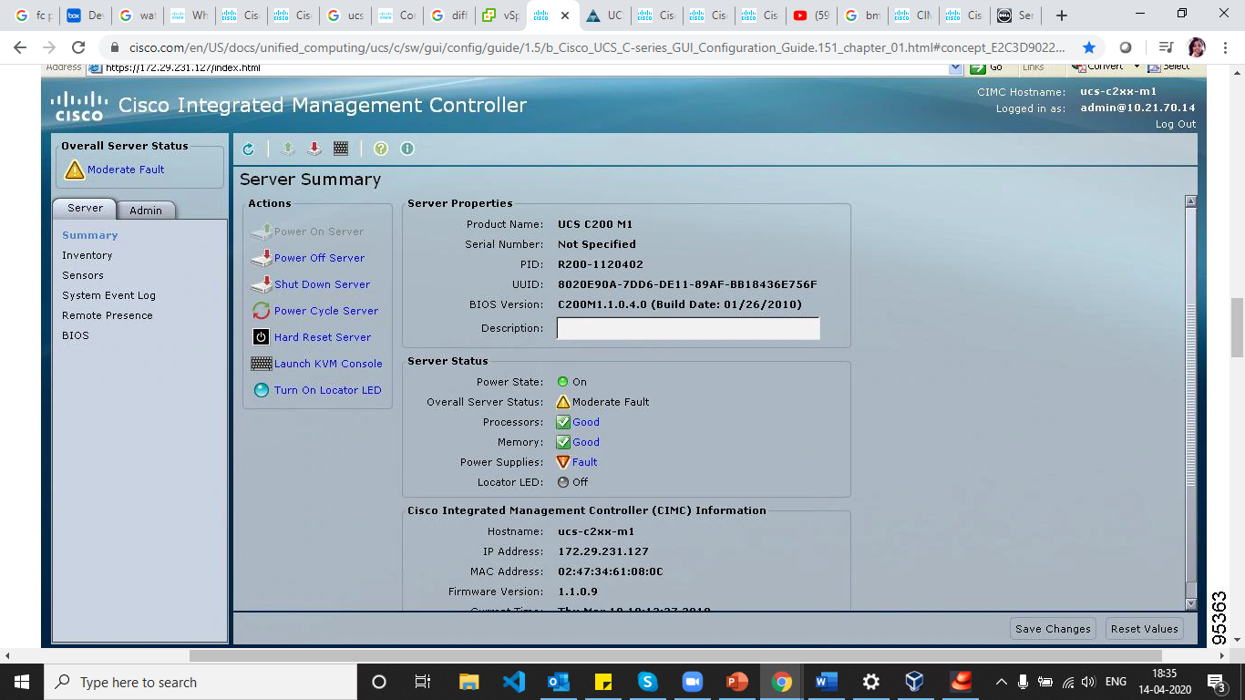
CIMC
Cisco Integrated Management Controller (CIMC) is used for management/monitoring servers
Interfaces like Web GUI, CLI and IPMI for management/monitoring tasks.

Slide 2
CIMC Firmware Management
CIMC separates the firmware update process into stages
Install
overwrites the firmware in the non-active slot on the server.
Through browser
TFTP Server
Activate
CIMC sets the non-active firmware version as active and reboots the server.

Slide 3
Managing user accounts
Active directory
LDAP
User Access Levels
Admin
User : can change host features but not CIMC
Read only

Slide 4
Managing Server Certificates
Generating CSR to obtain new certificate
Upload new certificate to replace old one.
Configuring platform event filtering
Platform event filter (PEF) can trigger an action and generate an alert when a critical hardware-related event occurs.
Alerts sent as SNMP traps

Slide 5
N/w related settings
Network security
Server Nic configuration
NIC mode
Dedicated
Cisco card
LOM
NIC Redundancy
NONE
Active-Active
Active-Standby

Slide 6
viewing server properties
CPU
Memory
Power supply
Storage
Managing server
Toggling LED
Power on/off server
Configuring server boot order

Slide 7
Server Utilities
Exporting technical support data to TAC
Rebooting CIMC
Resting CIMC to factory defaults
Backing up and importing CIMC configuration
Viewing Logs
Viewing CIMC log
Clearing log
Sending logs to remote server

Slide 8
Configuring communication services
Configuring HTTP
SSH
IPMI over LAN
Viewing server sensors
Current
LED
Fan
Power supply
Temperature
voltage

