Slide 1

Acropolis Institute Of Technology And Research
Subject : Evaluation Of Internship (Cyber Security)
Cyber security summer training
Submitted to :
Prof. Nidhi Nigam
Submitted by :
Pooja Patidar (0827CI201134)
1

Slide 2
Content
Layers of OSI model
Hacking and hackers
Password reset
1
3
5
2
4
IP addressing
N-map tool
2

Slide 3
Layers of OSI Model
OSI stands for Open Systems Interconnection. It has been developed by ISO – ‘International Organization for Standardization‘, in the year 1984. It is a 7 layer architecture with each layer having specific functionality to perform. All these 7 layers work collaboratively to transmit the data from one person to another across the globe.

Slide 4
No | Layer Name | Responsibility | Information Form (Data Unit) | Device
7 | Application Layer | Helps in identifying the client and synchronize Communication | Message
6 | Presentation Layer (Translation Layer) | Data from application layer is extracted and manipulated as required format for transmission | Message
5 | Session Layer | Establishes connection, maintenance, authentication and ensure security | Message | Gateway
4 | Transport Layer (Heart of OSI) | Take service from network layer and provide it to application layer | Segment | Firewall
3 | Network Layer | Transmission of data from one host to other. Located in different network | Packet | Router
2 | Data Link Layer | Node to node delivery of message | Frame | Switch , Bridge
1 | Physical Layer | Establishing physical connection between devices | Bits | Hub, Repeater, Modem, Cables

Slide 5
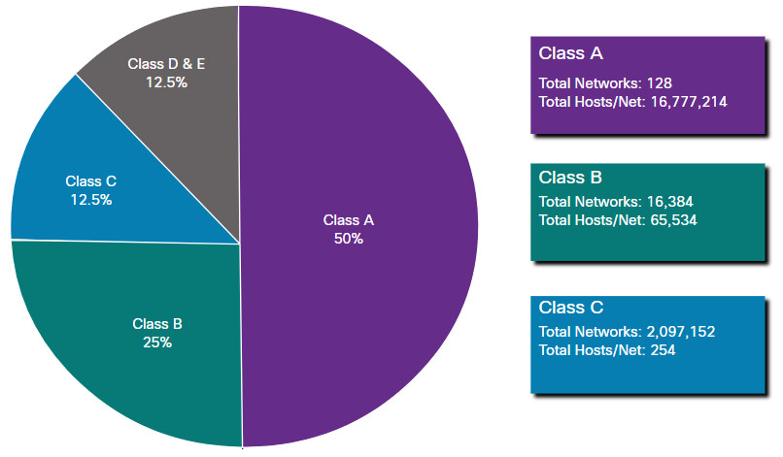
IP Address
IP address is an address having information about how to reach a specific host, especially outside the LAN.
The 32 bit IP address is divided into five sub-classes.
Class A
Class B
Class C
Class D
Class E

Slide 6
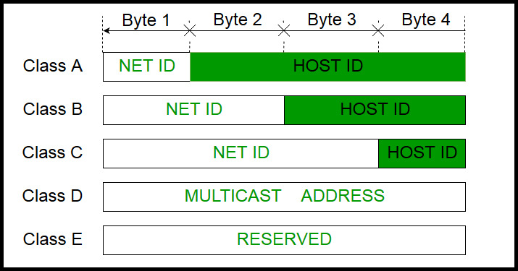

Slide 7
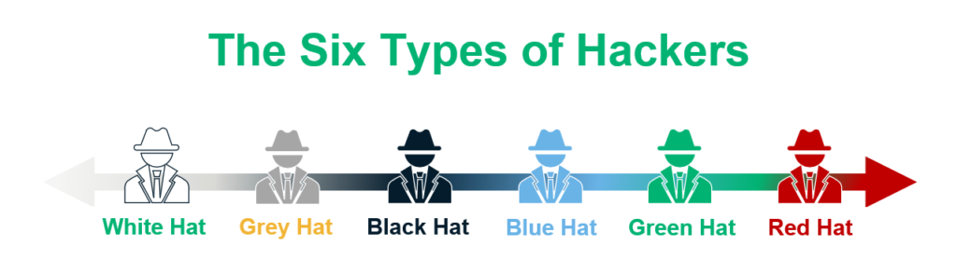
Computer hackers are unauthorized users who gain access to computers in order to steal, alter, or delete data, generally by installing malicious software without your knowledge or agreement. They can get access to the information you don’t want them to have thanks to their cunning techniques and in-depth technological knowledge. Any device is connected to the Internet is at risk from computer hackers and online predators. To distribute hazardous malware to your computer and damage your network security, these online criminals generally use spam messages, phishing emails or instant messages, and websites.

Slide 8
Types Of Hackers
Gray Hat Hackers:
They fall somewhere between the above-mentioned types of hackers, in that they gain illegal access to a system but do so without any malicious intent. The goal is to expose the system’s weaknesses.
Black hat hackers:
These types of hackers, often known as crackers and always have a malicious motive and gain illegal access to computer networks and websites
White Hat Hackers/Ethical Hackers:
White hat hackers (sometimes referred to as ethical hackers) are the polar opposites of black hat hackers. They employ their technical expertise to defend the planet against malicious hackers.
8

Slide 9
Green Hat Hackers:
They are also amateurs in the world of hacking but they are bit different from script kiddies. They care about hacking and strive to become full-blown hackers. They are inspired by the hackers and ask them few questions about. While hackers are answering their question they will listen to its novelty.
Blue Hat Hackers:
They are much like the script kiddies; are beginners in the field of hacking. If anyone makes angry a script kiddie and he/she may take revenge, then they are considered as the blue hat hackers.
Red Hat Hackers:
They are also known as the eagle-eyed hackers. Like white hat hackers, red hat hackers also aims to halt the black hat hackers. There is a major difference in the way they operate. They become ruthless while dealing with malware actions of the black hat hackers.

Slide 10
Nmap tool
Nmap (Network Mapper) is a network scanner created by Gordon Lyon .Nmap is used to discover hosts and services on a computer network by sending packets and analyzing the responses.
Nmap provides a number of features for probing computer networks, including host discovery and service and operating system detection. These features are extensible by scripts that provide more advanced service detection, vulnerability detection, and other features. Nmap can adapt to network conditions including latency and congestion during a scan.
Nmap started as a Linux utility and was ported to other systems including Windows, macOS, and BSD. It is most popular on Linux, followed by Windows.

Slide 11
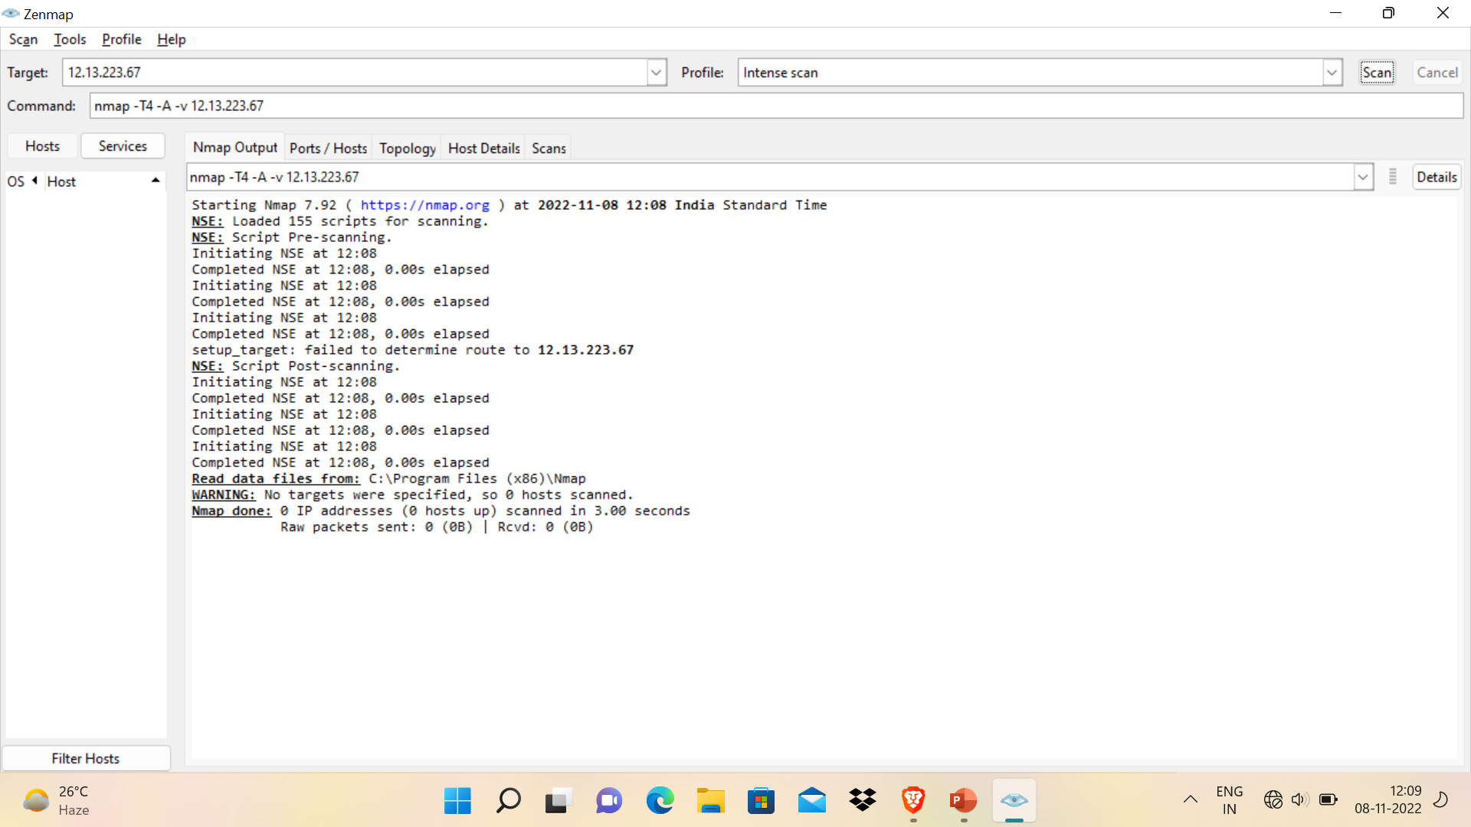

Slide 12
Steps to reset windows password
STEP 1.
First start windows server in which you want to reset password.
STEP 2.
Once you enter in to installation mode
Press key
SHIFT+F10
STEP 3.
Now restart machine in normal MODE…

Slide 13
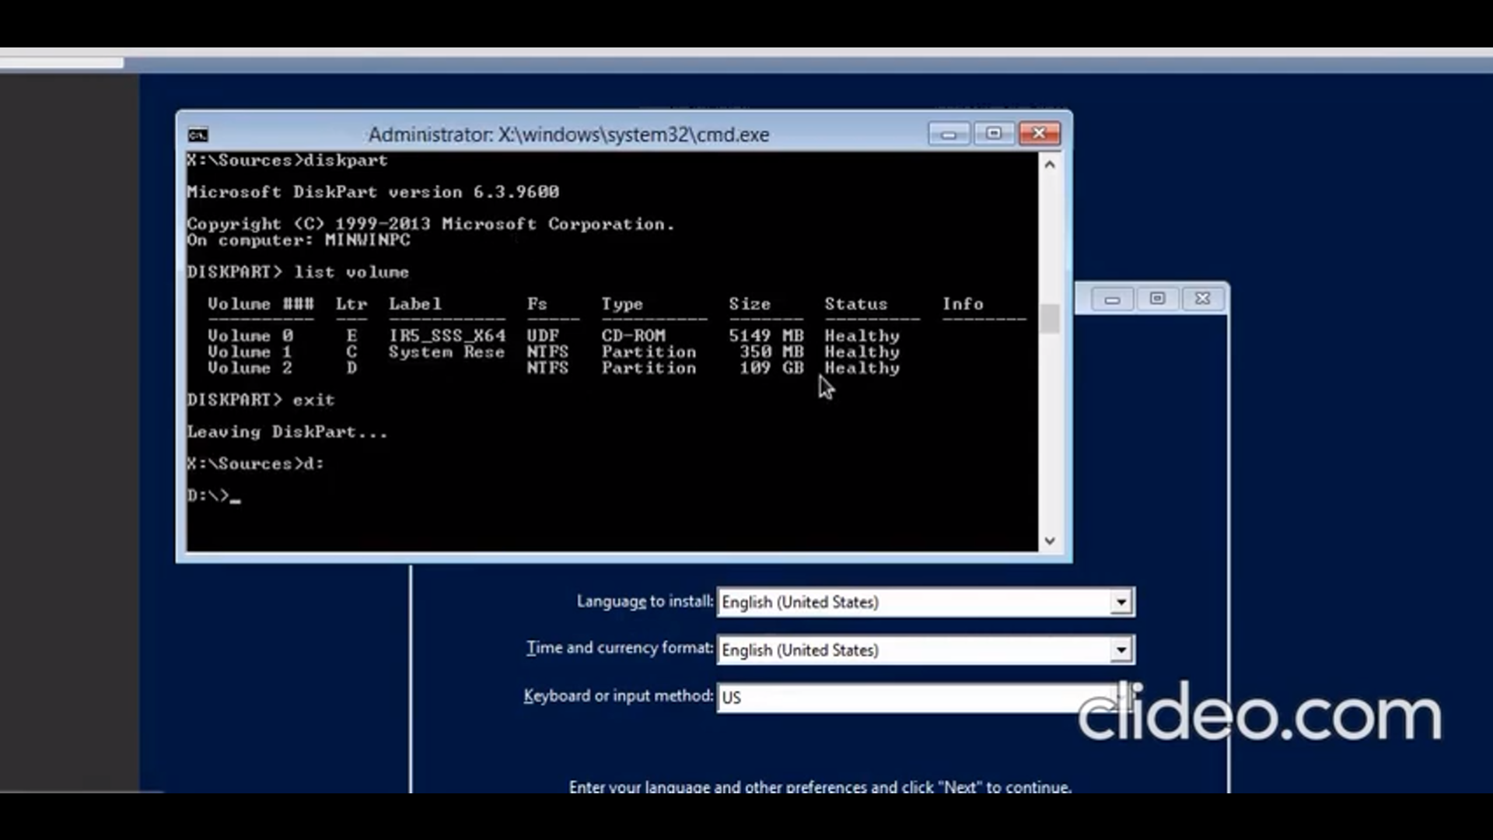

Slide 14
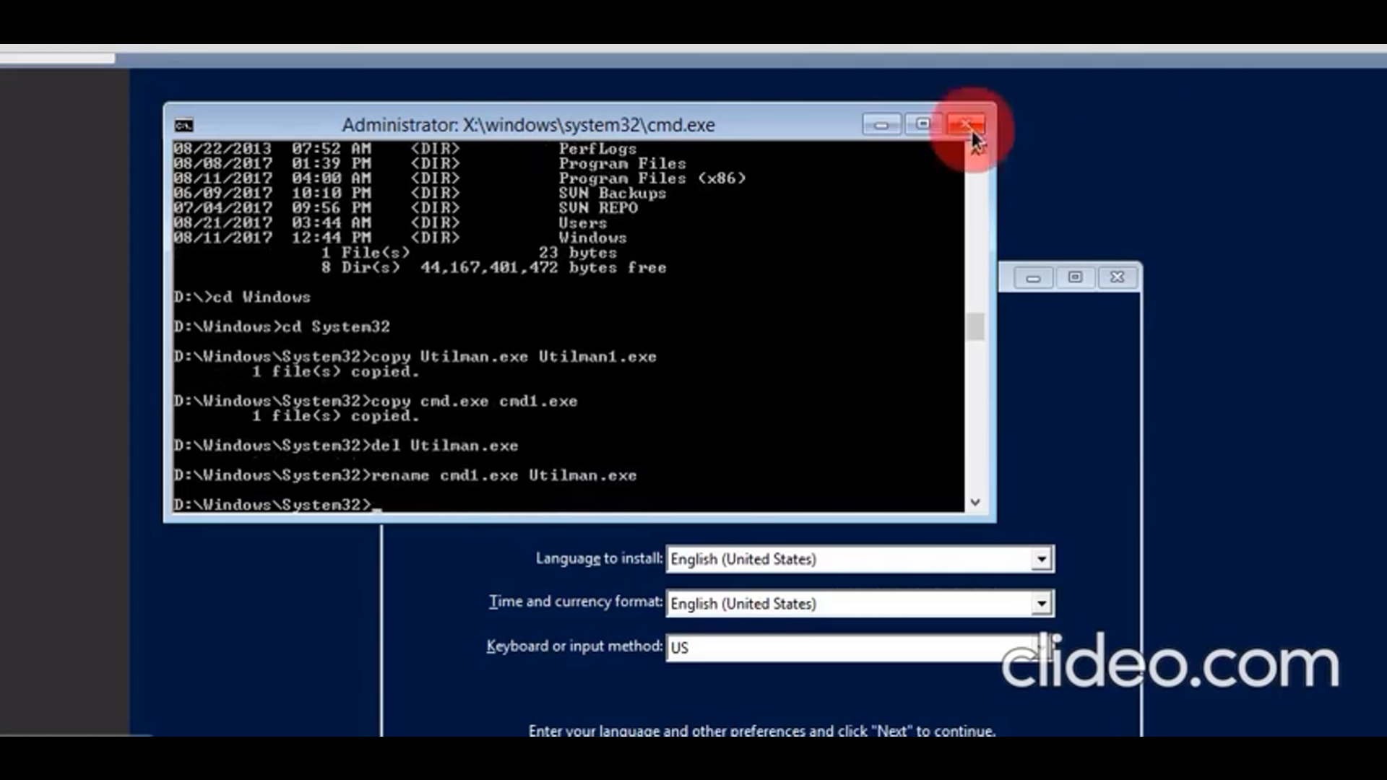

Slide 15
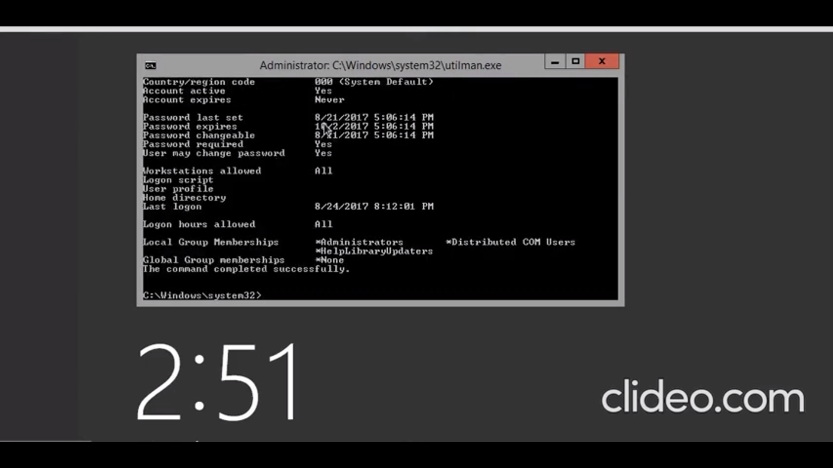

Slide 16
Thank you

