Slide 1
Development Today
Multitasking
Loose deadlines
Broad focus

Slide 2
A Better Way
No distractions
One goal at a time
Short timeframe

Slide 3
Code Sprint
A small team dedicates a
short period of time
entirely to one goal.

Slide 4
S.W.A.T. Team
5-10 people
Highly skilled
Startup mentality

Slide 5
Now’s the Time
Access to tools
Consolidated services

Slide 6
Now’s the Time
GitHub

Slide 7
Successful Code Sprints
NYS-ITS on GitHub
Open Data
DMV Registration Renewal

Slide 8
Successful Code Sprints
NYS-ITS on GitHub
Responsive Web Design
Sites
Go Responsive
NYS Division of Tax Appeals
Framework
Excelsior

Slide 9
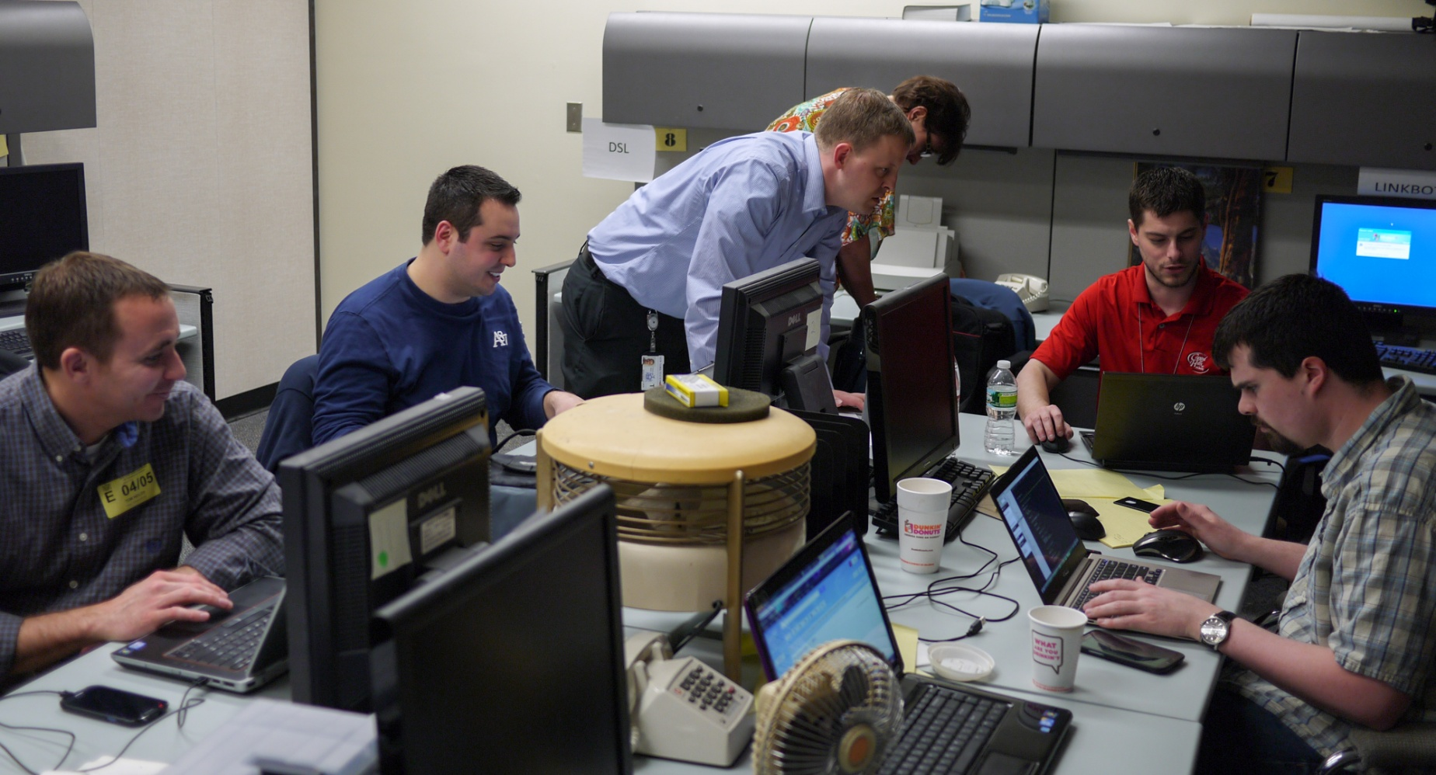
In the Thick of It

Slide 10
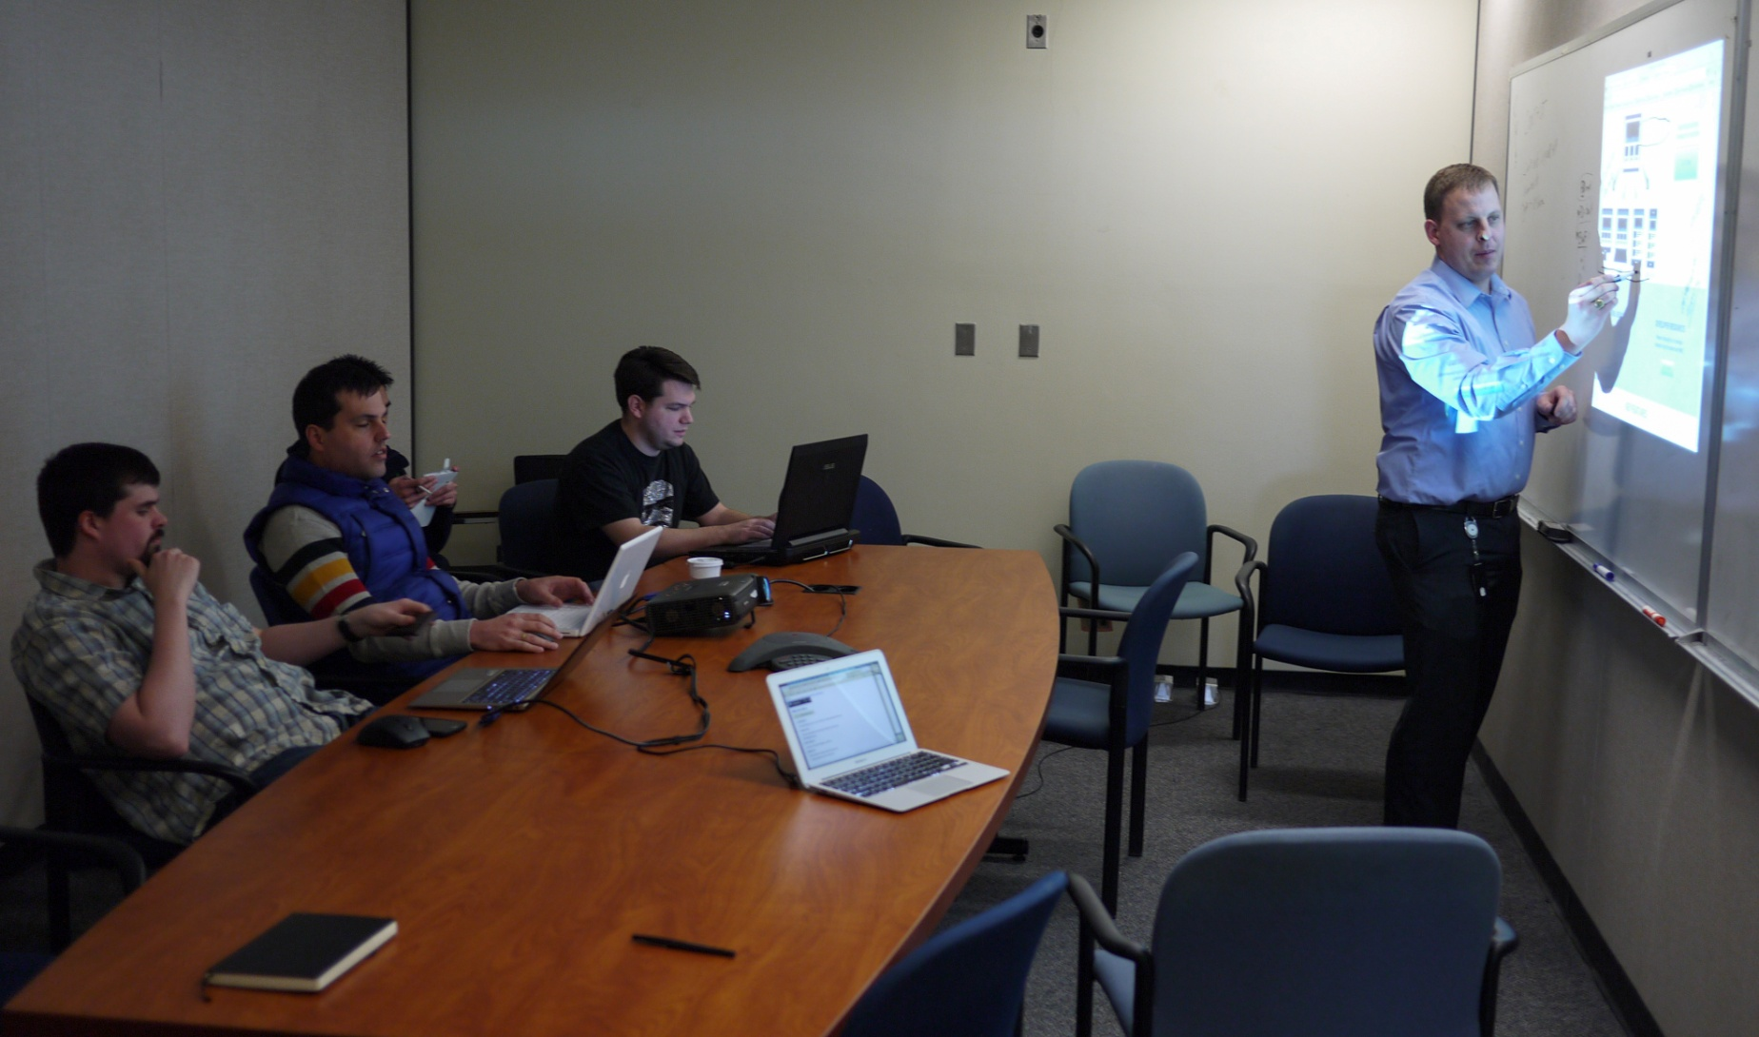
In the Thick of It

Slide 11
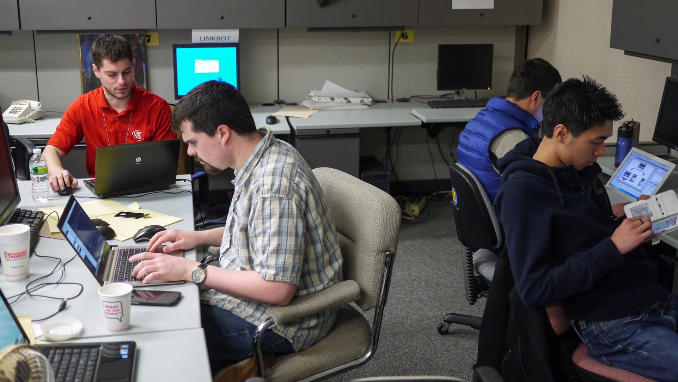
In the Thick of It

Slide 12
Keys to Success
Well-defined goal
Skilled team
Strict time limit

Slide 13
Room for Improvement
Workplace logistics
Software uncertainty

Slide 14
Ideal Projects
Cross-agency
Modernization

Slide 15
Ideal Projects
Create
Explore

Slide 16
Recipe for a Code Sprint
2-day to 1-week project
The right people
All other projects in maintenance mode

Slide 17
Sharp Focus
Good | Enhance an API
Better | Add features
Best | Add JSON output

Slide 18
Bring Your Own Devices
Laptops
Phones, tablets, etc

Slide 19
Prepare
Workplace logistics
Laptops, software
Setup the dev stack

Slide 20
Learn and Progress
Evaluate
Fine tune
Plan your next sprint

