Slide 1
Development Today
Distracted by multitasking
Loose deadlines
Focus is too broad

Slide 2
How to Improve
No distractions
One goal at a time
Short timeframe

Slide 3
Code Sprint
A small team dedicates a short period of time entirely to one goal.

Slide 4
S.W.A.T. Team
Skilled developers
Small group
Startup mentality

Slide 5
Why Now?
Connectedness
Consolidated services

Slide 6
Why Now?
GitHub

Slide 7
Successful Code Sprints
github.com/nys-its
Open Data
DMV Registration Renewal

Slide 8
Successful Code Sprints
github.com/nys-its
Responsive Web Design
Sites
Go Responsive
NYS Division of Tax Appeals
Framework
Excelsior

Slide 9
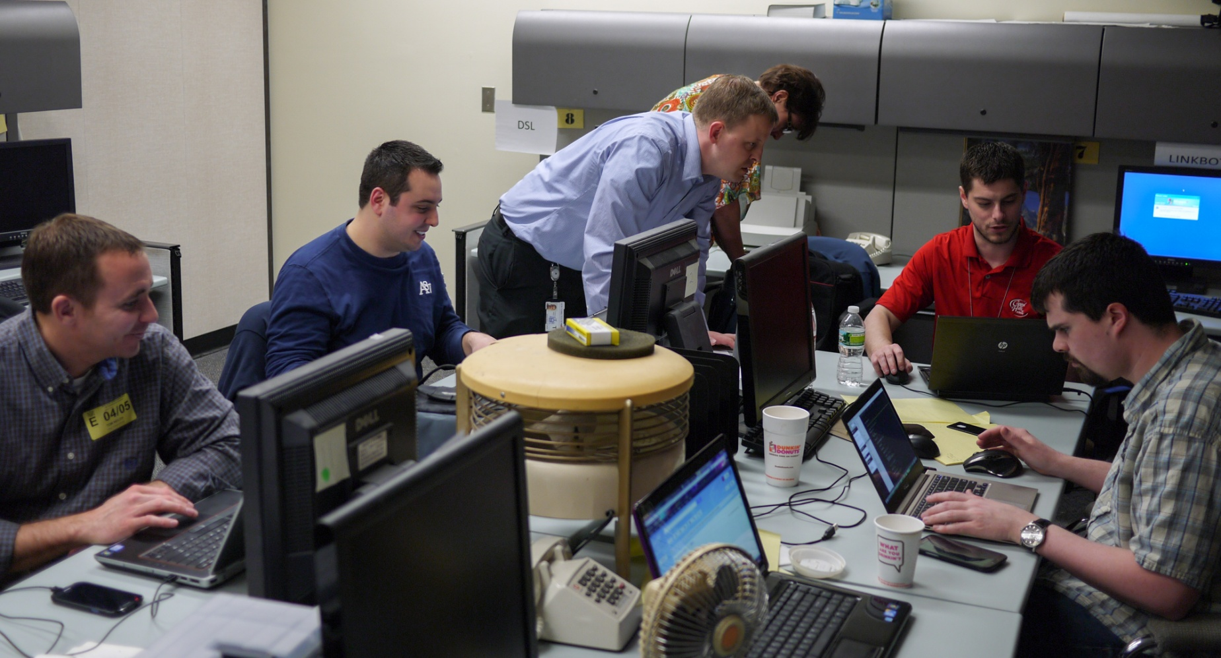
In the Thick of It

Slide 10
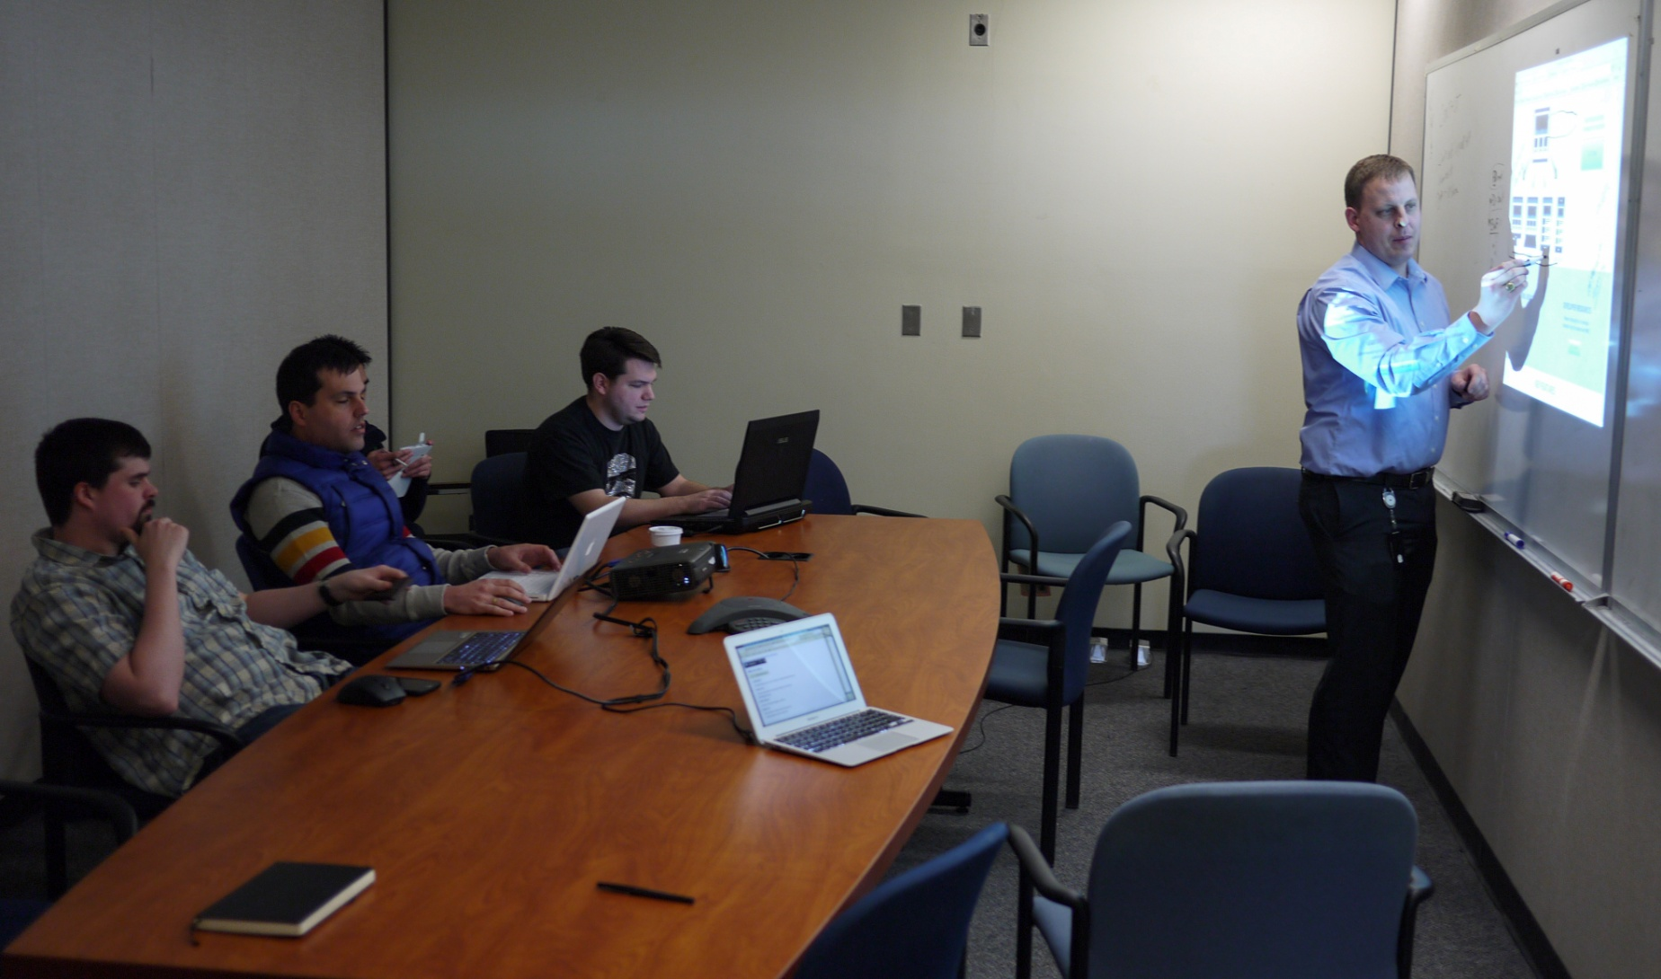
In the Thick of It

Slide 11
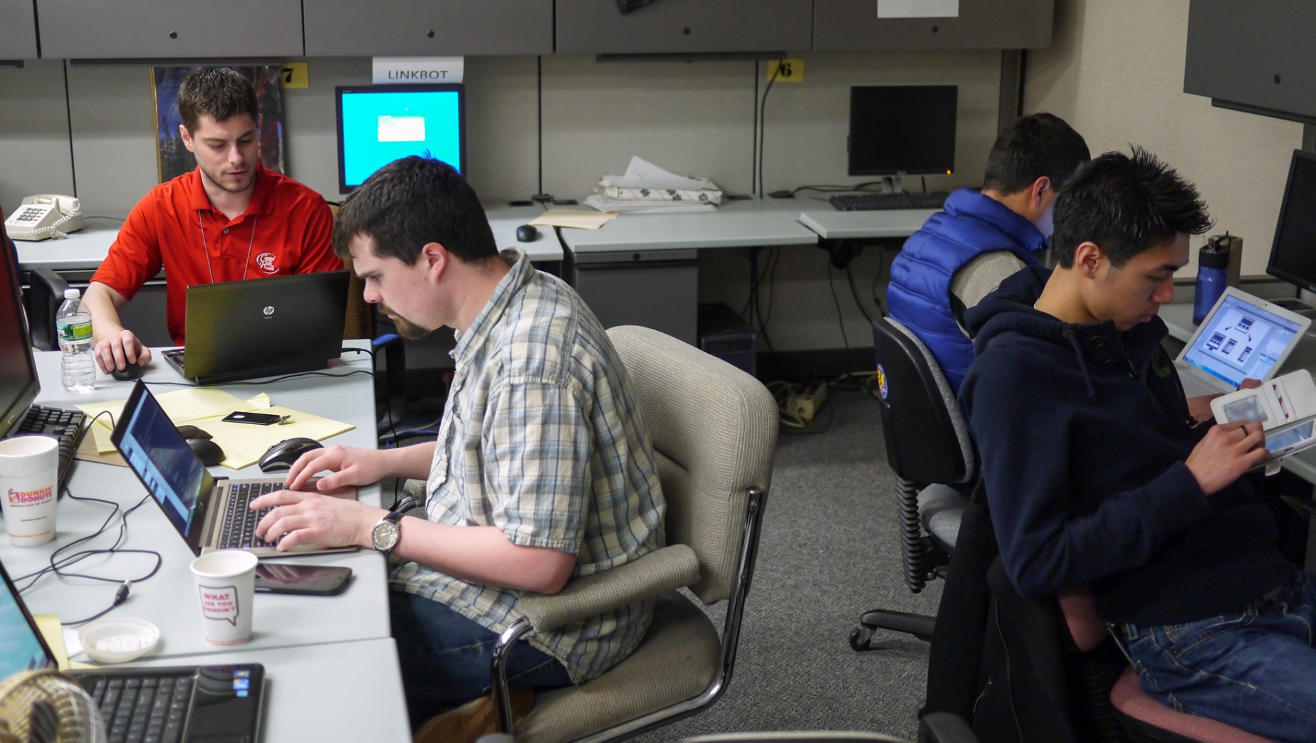
In the Thick of It

Slide 12
Keys to Success
Well-defined goal
Skilled team members
Strict time limit

Slide 13
Room for Improvement
Time wasted on workplace logistics
Uncertain development stack
Clarifying the goal

Slide 14
Where it Works Best
Cross-agency initiatives
Small pieces of a larger project
Exploration

Slide 15
Ideal Code Sprint Projects
Porting an application
Writing documentation
Enhancing a test suite

Slide 16
Recipe for a Code Sprint
Find a 2-day to 1-week project
Round up the right developers
Put other projects into maintenance mode

Slide 17
Sharp Focus
Good
“Beef up our API”
Better
“Add features to our existing API”
Best
“Add a JSON option to API endpoints”

Slide 18
Bring Your Own Devices
Laptops
Phones, tablets, etc

Slide 19
Prepare
Workplace logistics
Procure laptops and software, or BYOD
Setup the development stack

Slide 20
Learn and Progress
Evaluate successes and pitfalls
Fine tune the plan for your next sprint

