Slide 1
Development Today
Distracted by multitasking
Loose deadlines
Focus is too broad

Slide 2
Making Improvements
Small, dedicated team
One simple goal — no distractions
Short time frame
Startup mentality

Slide 3
Code Sprint, Defined
A small team dedicates a short period of time entirely to one goal.

Slide 4
Why Now?
Consolidation
Connectedness

Slide 5
Why Now?
GitHub

Slide 6
Successful Code Sprints
Open Data
DMV Registration Renewal
github.com/nys-its

Slide 7
Successful Code Sprints
Responsive Web Design
Sites
Go Responsive
NYS Division of Tax Appeals
Framework
Excelsior
github.com/nys-its

Slide 8
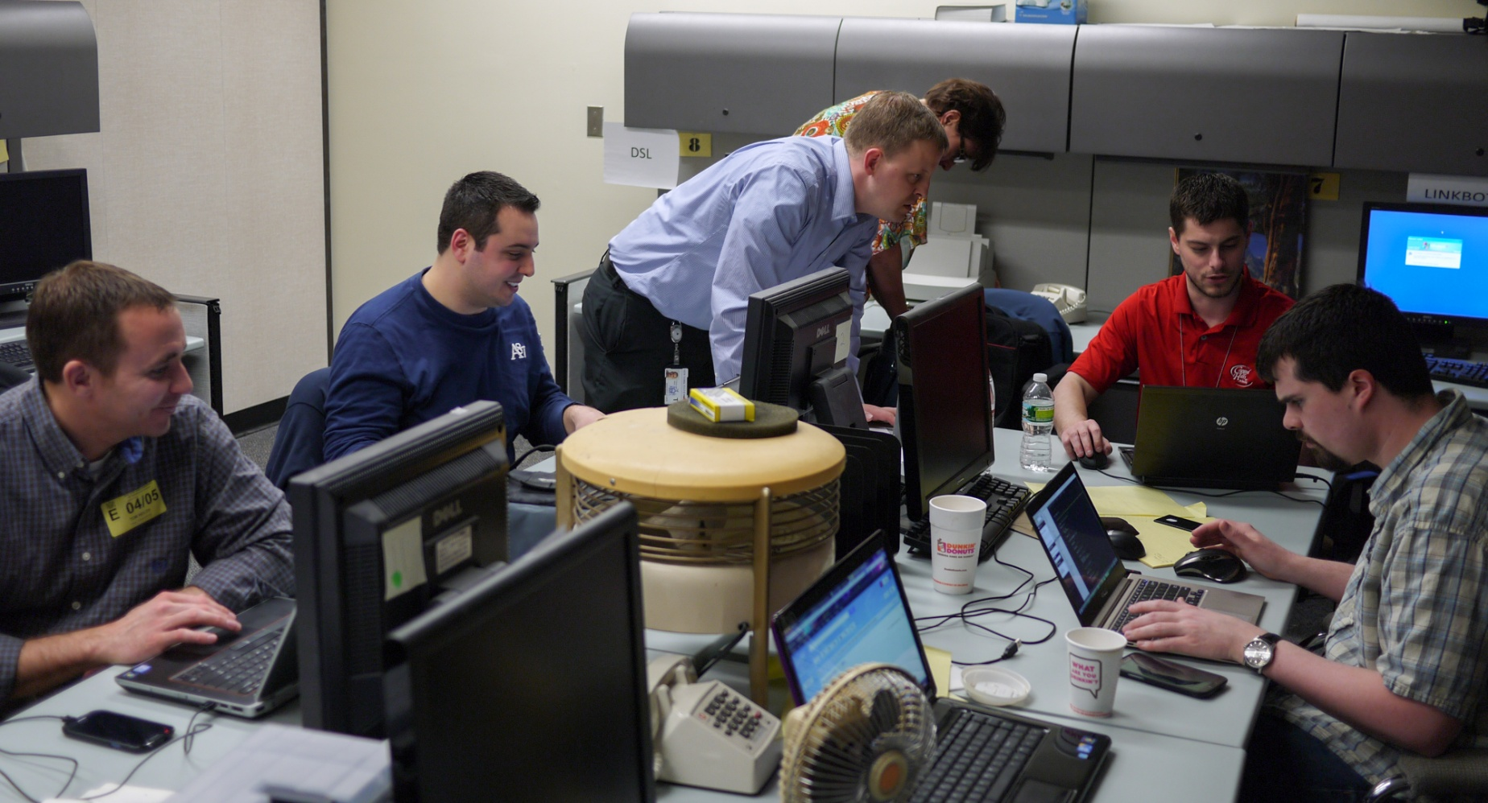
In the Thick of It

Slide 9
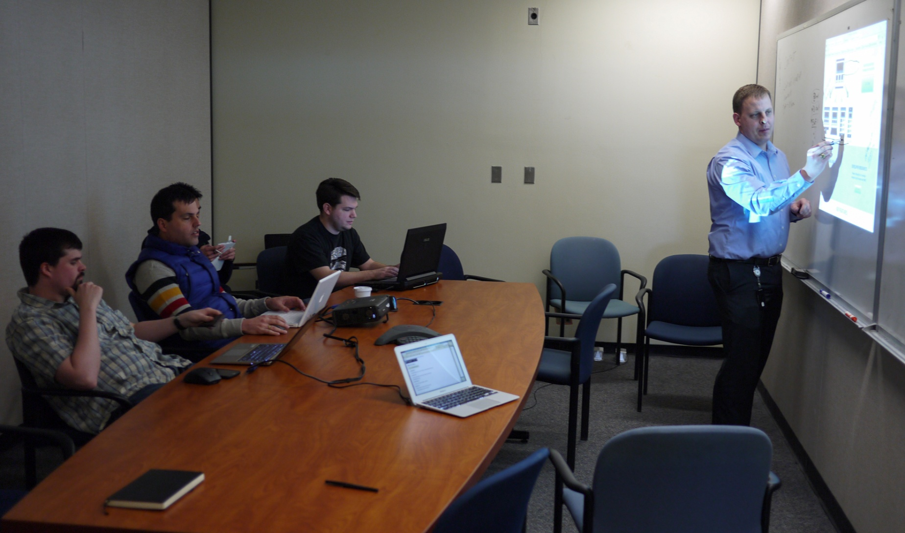
In the Thick of It

Slide 10
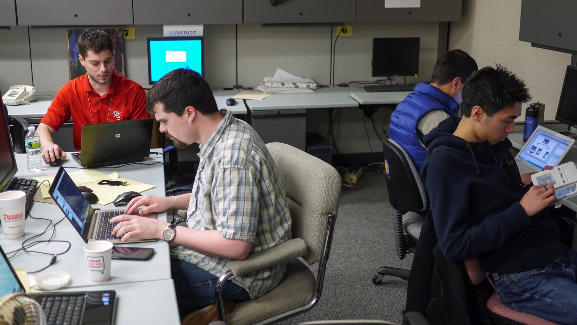
In the Thick of It

Slide 11
Keys to Success
Well-defined goal
Skilled team members
Strict time limit

Slide 12
Room for Improvement
Time wasted on workplace logistics
Questions about development stack
Clarifying the goal

Slide 13
It’s Real Work
It may be fun, but it's not playtime.

Slide 14
Where it Works Best
Small modules within a larger project
Exploration
Projects that never seem to end

Slide 15
Ideal Code Sprint Projects
Cross-agency initiatives
Switch from Subversion to Git
Write documentation
Enhance a test suite

Slide 16
Recipe for a Code Sprint
Find a 2-day to 2-week project
Round up the right developers
Put other projects into maintenance mode

Slide 17
Sharp Focus
Good
Beef up your API
Better
Add features to your existing API
Best
Add a JSON option to your API endpoints

Slide 18
Bring Your Own Devices
Laptops
Phones, tablets, etc

Slide 19
Preparation
Workplace logistics (parking, security passes, network access)
Procure laptops and software, or BYOD
Setup the development stack

Slide 20
Reflect
Evaluate successes and pitfalls
Fine tune the plan for your next sprint

