Slide 1
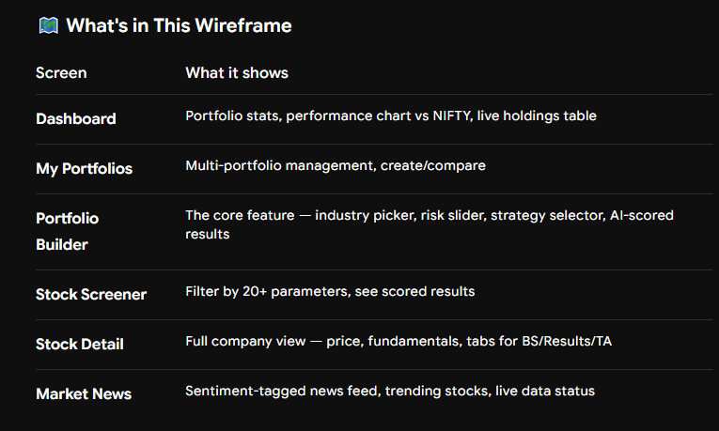

Slide 2
Step 1 (Done ✅) → Visual Wireframe + Architecture Plan
Step 2 (Next) → Backend: FastAPI setup + Data ingestion pipelines
Step 3 → Database schema design (PostgreSQL)
Step 4 → Portfolio scoring engine (Python/TA-Lib)
Step 5 → Frontend: React app with real components
Step 6 → Auth, user management (Supabase)
Step 7 → Deployment: Railway (backend) + Vercel (frontend)

