Slide 1
INVESTMENT ASSIGNMENT SUBMISSION
Name:Akshaykumar Arjun Patil

Slide 2
Abstract
Spark Funds wants to make investments in a few companies. The CEO of Spark Funds wants to understand the global trends in investments so that she can take the investment decisions effectively.
Business objective:
The objective is to identify the best sectors, countries, and a suitable investment type for making investments. The overall strategy is to invest where others are investing, implying that the 'best' sectors and countries are the ones 'where most investors are investing'.
Few of constraints in investing are as below:
5 to 15 million USD per round of investment
Company wants to invest in English countries only(This countries can be found out from Wikipedia)

Slide 3
Problem solving methodology:
Data Understanding
Data Cleaning-Finding Missing values & Unique values
Data Cleaning-Dropping Missing values & checking of data
Merging the two dataframes on sngle variable i.e. company_permalink which is common in both
Identifying top 3 English countries based on amount investment
Country analysis
Selection of funding type based on number of investments
Funding type Analysis based number of investments
Sector Analysis
Identifying top 3 sectors based on number of investments in each top 3 countries
Identifying top companies based on investment amount in each top 2 sectors
Plotting results

Slide 4
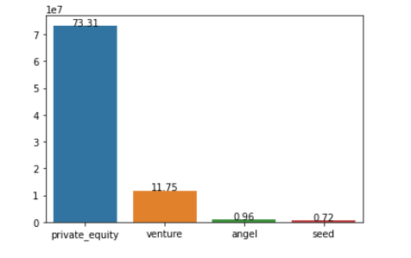
<Selection of Funding type>
First funding type that is most suitable is Venture based on constraints to invest between 5 to 15 million USD.

Slide 5
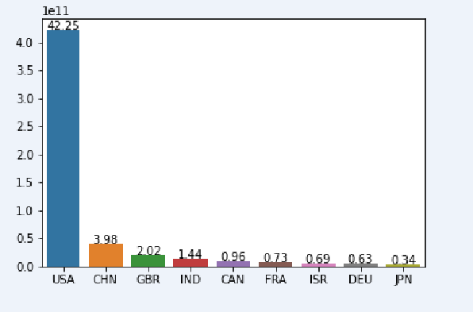
Country Analysis
The top 3 countries that are having highest investment are USA, GBR,IND

Slide 6
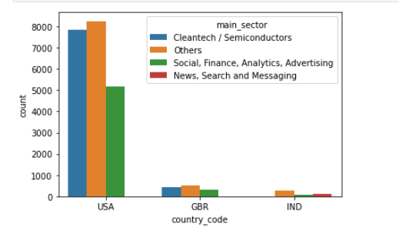
Sector Analysis:
Also sectors also analyzed in these top 3 countries.
The top 3 sectors in each countries are analyzed based on total number of investment in that main sector.

Slide 7
<Conclusions>
For spark Fund company , following investment sectors ,countries & funding type based on best strategy,constraints of company are suggested:
Funding type-Venture
Top 3 Countries USA,GBR,IND
In USA main sectors are
In GBR main sectors are
In IND main sectors are
Others
Cleantech / Semiconductors
Social, Finance, Analytics, Advertising
Others
Cleantech / Semiconductors
Social, Finance, Analytics, Advertising
Others
News, Search and Messaging
Social, Finance, Analytics, Advertising

