Slide 1
NLP PROJECT
Sentiment Analysis
Extracting Customer Insights from Product Reviews
Natural Language Processing | Machine Learning | Text Classification

Slide 2
Group Details :
Group number: 5
Team members :
1) Mohamed Kumail Abbas
2) H. Mohith
3) Shaima Samad
4) Janhawi Sharma
5) Abhishek Patil
6) Praveen Singh Thakur
Project Co-Ordinator: Nagesh Agrawal

Slide 3
BUSINESS OBJECTIVE
What are we solving?
Customer reviews on e-commerce platforms like Amazon contain rich, unstructured opinions about products. Reading thousands of reviews manually is not scalable. This project automates that process using NLP.
Extract customer sentiment from Amazon reviews of Samsung M12 using NLP techniques.
Identify recurring themes in feedback (camera, performance, battery, WiFi) to highlight strengths and weaknesses.
Provide actionable insights through deployment (Streamlit/Flask/RShiny) for product improvement and marketing strategies.

Slide 4
DATASET DETAILS
Dataset Overview
Rating Distribution
Source
E-commerce product reviews (Amazon-style)
5 Stars ★★★★★
419 (29.1%)
Total Reviews
1,440
4 Stars ★★★★
310 (21.5%)
Total Data Points
4,320
3 Stars ★★★
199 (13.8%)
Columns
title, rating, body
Missing Values
None — clean dataset
2 Stars ★★
126 (8.8%)
Rating Scale
1 star (worst) to 5 stars (best)
1 Star ★
386 (26.8%)
Average Review Length
333 characters
Rating Mean / Std Dev
3.17 / 1.58
Dataset is well-spread across all star ratings with no missing values. 5-star (Positive) and 1-star (Negative) reviews dominate, which is typical of real e-commerce data.

Slide 5
EXPLORATORY DATA ANALYSIS (EDA)
What the data looks like
Review Title
Rating
Sentiment (derived)
Key Observation
Horrible product
1
Negative
Disappointed with performance
Camera quality is not like 48MP
3
Neutral
Camera below expectations
Overall (launch day purchase)
4
Positive
Battery appreciated
A big no from me
1
Negative
WiFi & software issues
Put your money somewhere else
1
Negative
Faulty software, poor display
Key Findings from EDA
Dataset has 1,440 reviews with 3 columns (title, rating, body) — zero null values.
Star ratings were converted to sentiment labels: 4–5 → Positive (50.6%), 3 → Neutral (13.8%), 1–2 → Negative (35.6%).
Review lengths ranges from 9 to 2,536 characters with an average of 333 characters.
Title and body were combined into a single 'review' column for NLP processing.

Slide 6
SENTIMENT LABELING & TEXT PREPROCESSING
Sentiment Labeling
Text Preprocessing Pipeline
Rating 4 – 5
1
Lowercasing
729 (50.6%)
All text converted to lowercase for consistency
Positive
2
Remove Special Chars
Rating 3
Numbers, punctuation and symbols stripped out
199 (13.8%)
Neutral
Tokenization
3
Sentence split into individual word tokens
Rating 1 – 2
512 (35.6%)
Stop Words Removal
Negative
4
Common words (is, the, and…) removed using NLTK
5
Stemming
Words reduced to root form via Porter Stemmer
6
Lemmatization
Tokens mapped to base dictionary form via WordNet
After preprocessing: tokens rejoined into clean sentences ready for TF-IDF vectorization and model training.

Slide 7
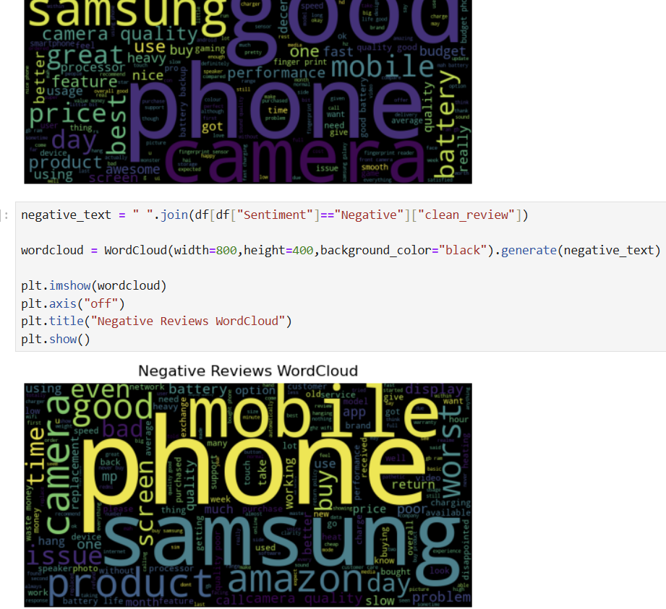
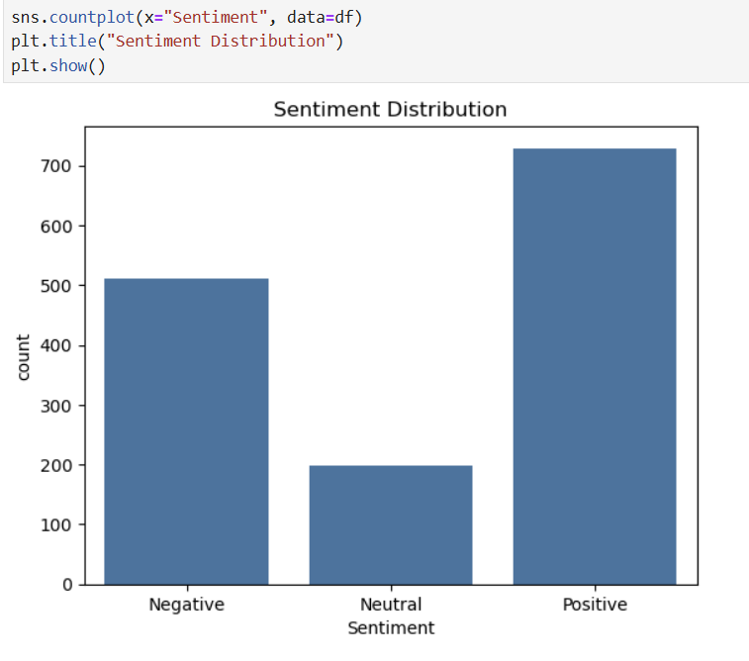
Sentiment distribution & Text preprocessing

Slide 8
FEATURE ENGINEERING & VECTORIZATION
TF-IDF Vectorization
Train–Test Split
Machine learning models cannot process raw text. Text vectorization converts words into numbers. TF-IDF (Term Frequency – Inverse Document Frequency) it assigns higher weights to words that are meaningful in a review but rare across the entire dataset.
• max_features = 5,000 top words selected
• Captures word importance per document
• Handles large vocabulary efficiently
Training Set 80% → 1,152 samples
Testing Set 20% → 288 samples
random_state = 42
Pipeline Flow
Raw Reviews
→
Clean Text
→
TF-IDF Matrix
→
Train/Test Split
→
ML Models
→
Predictions

Slide 9
MODEL BUILDING — 6 ALGORITHMS
Logistic Regression
Linear
Multinomial Naive Bayes
Probabilistic
Support Vector Machine
Linear SVC
Probabilistic classifier using sigmoid function. Supports multi-class via OvR. max_iter=200.
Bayesian classifier optimized for text counts. Fast and efficient for high-dimensional data.
Finds optimal hyperplane to separate classes. LinearSVC used for speed on large text datasets.
Random Forest
Ensemble
Gradient Boosting
Boosting
XGBoost
Boosting+
Ensemble of 100 decision trees. Handles non-linearity and is robust to overfitting.
Sequential tree ensemble minimizing loss iteratively. Strong performer on structured data.
Optimized gradient boosting with label encoding. Uses mlogloss for multiclass training.

Slide 10
MODEL EVALUATION
Evaluation Metrics Used
Accuracy Score
Measures the percentage of reviews correctly classified out of all predictions. Primary comparison metric across 6 models.
F1 Score (Weighted)
Balances Precision and Recall across all three classes. Especially useful because our classes are slightly imbalanced.
ROC Curve
Plotted for all 6 models across all 3 sentiment classes. Shows the tradeoff between True Positive Rate and False Positive Rate.
Results Summary
Model
Accuracy
F1 Score
Gradient Boosting
80.2%
69.6%
Best Acc
Logistic Regression
77.8%
72.0%
★ Selected
Support Vector Machine
76.7%
77.8%
Random Forest
74.0%
70.4%
Multinomial Naive Bayes
67.0%
61.0%

Slide 11
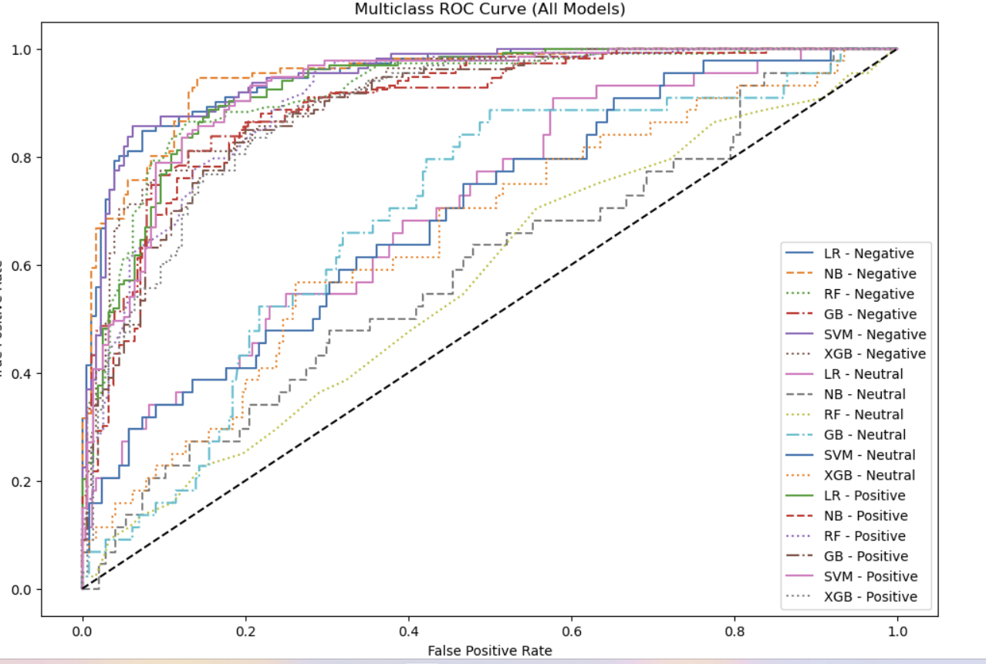
ROC CURVE

Slide 12
FINAL MODEL SELECTION
✓ Selected Model: Logistic Regression
Accuracy: 77.78% | F1 Score: 71.98% | Provides probability outputs | Deployment-ready
📊
🔍
⚡
🚀
Probability Outputs
Interpretability
Competitive Performance
Deployment Suitability
Logistic Regression provides confidence scores per class, enabling richer UX in deployment (e.g., 85% Positive).
Model coefficients are easily interpretable. Stakeholders can understand which words drive each sentiment class.
77.78% accuracy is competitive vs Gradient Boosting (80.2%) — a small gap justified by deployment advantages.
Works seamlessly with Streamlit & Flask. Pickled model + TF-IDF vectorizer can be loaded instantly for inference.

Slide 13
DEPLOYMENT
Deployment Plan
• Model saved via pickle (model.pkl) • TF-IDF vectorizer saved (tfidf.pkl) • Web app built with Streamlit • User inputs review → real-time prediction • Returns: Positive / Neutral / Negative • Displays confidence probability score
NLP Sentiment Analysis Project | Natural Language Processing | Machine Learning

Slide 14
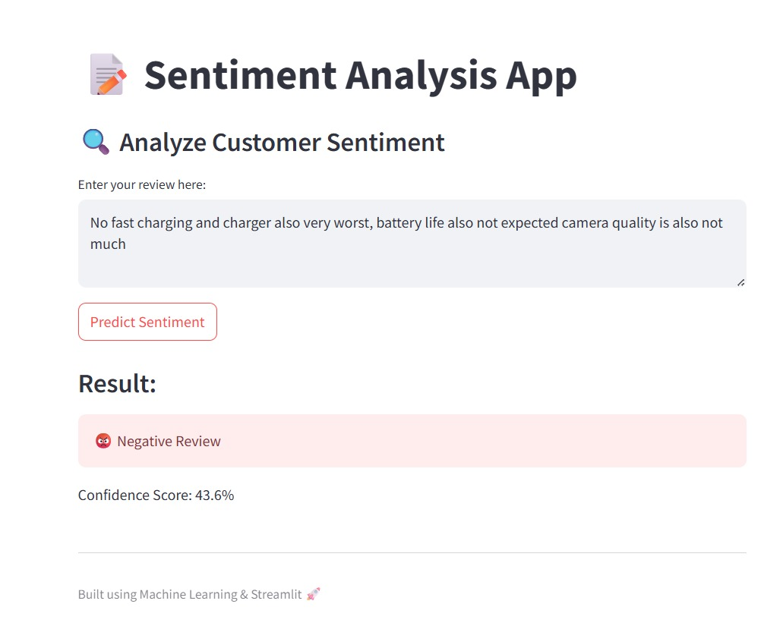
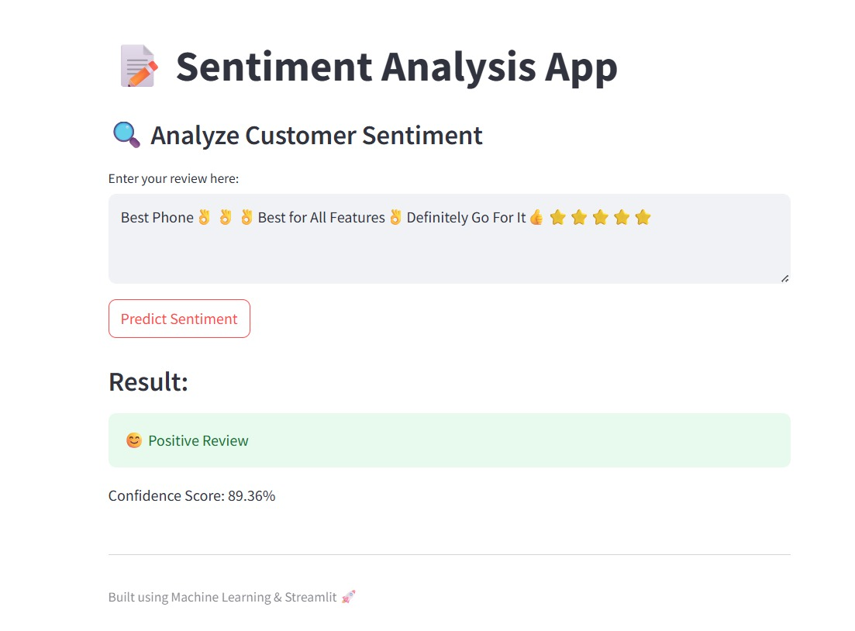
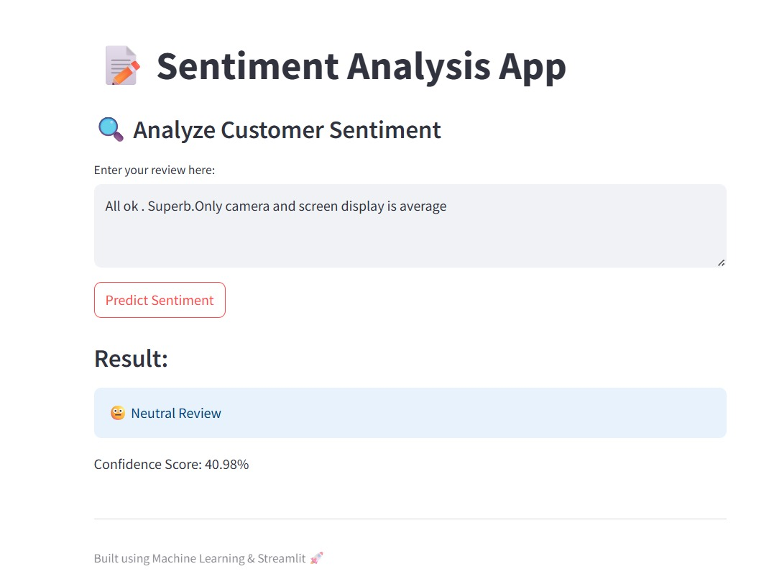
Deployment Output

Slide 15
Conclusion
NLP Sentiment Analysis of Customer Reviews
Collected 1,440 real product reviews and structured them into a clean 3-column dataset.
Performed EDA — understood rating distribution, review lengths, and sentiment imbalance.
Applied a full 6-step NLP preprocessing pipeline: lowercase → clean → tokenize → stopwords → stem → lemmatize.
Vectorized text using TF-IDF (5,000 features) and split data 80/20 for training and testing.
Trained 6 machine learning models and evaluated using Accuracy, F1 Score, and ROC curves.
Gradient Boosting achieved the highest accuracy (80.2%). Logistic Regression was selected for deployment.
Model and vectorizer saved as .pkl files and deployed as a real-time sentiment prediction web application.
NLP Sentiment Analysis | Machine Learning | Text Classification

Slide 16
THANK YOU
NLP Sentiment Analysis Project | Natural Language Processing | Machine Learning

