Slide 1
SQL

Slide 2
SQL is a database computer language designed for the retrieval and management of data in a relational databases like MySQL, MS Access, SQL Server, MS Access, Oracle, Sybase, Informix.
SQL stands for Structured Query Language. SQL was developed in the 1970s by IBM Computer Scientists.

Slide 3


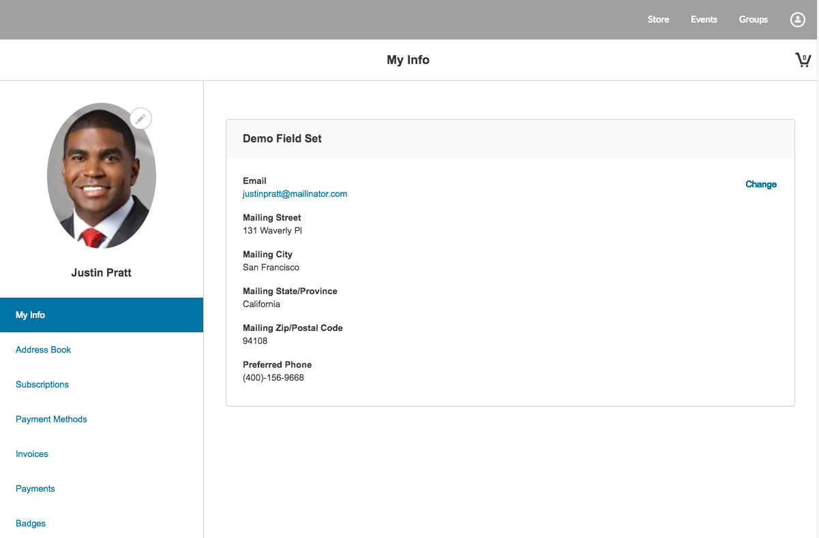

Slide 4
Applications of SQL
SQL is one of the most widely used Query Language over the databases. SQL provides following functionality to the database programmers:
Execute different database queries against a database.
Define the data in a database and manipulate that data.
Create data in a relational database management system.
Access data from the relational database management system.
Create and drop databases and tables.
Create and maintain database users.
Create view, stored procedure, functions in a database.
Set permissions on tables, procedures and views.

Slide 5
What is SQL?
SQL is a language to operate databases; it includes Database Creation, Database Deletion, Fetching Data Rows, Modifying & Deleting Data rows, etc.

Slide 6
CREATE DATABASE
The CREATE DATABASE statement is used to create a new SQL database.
Syntax
CREATE DATABASE databasename;

Slide 7
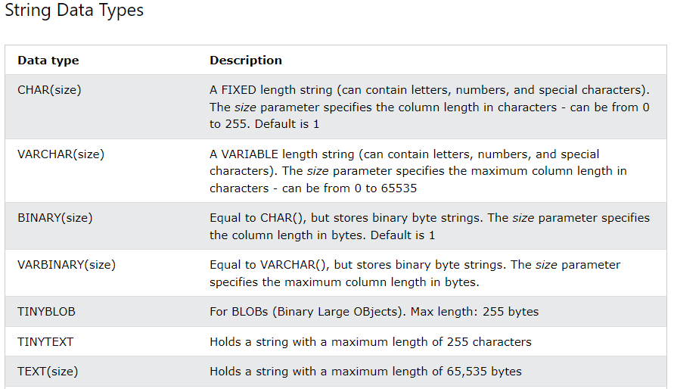

Slide 8

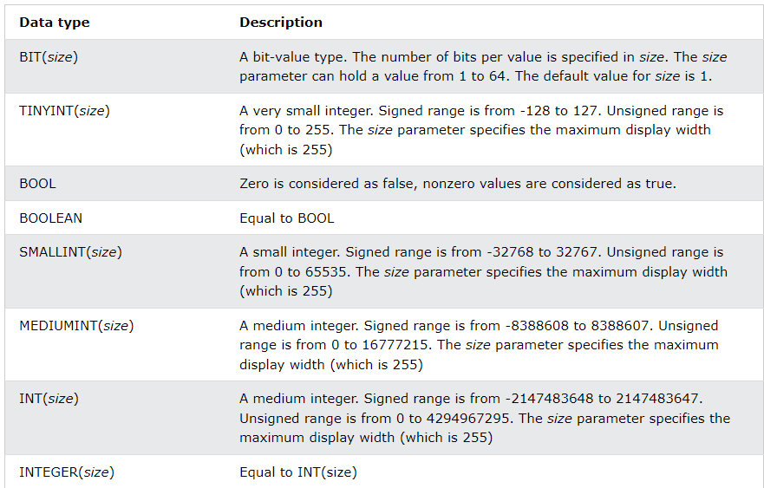

Slide 9
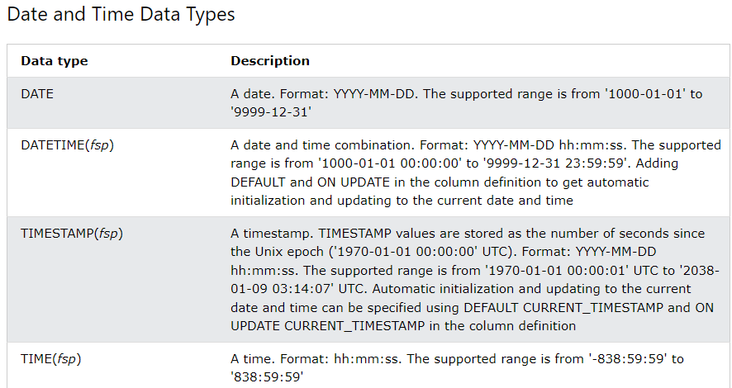

Slide 10
CREATE TABLE
The CREATE TABLE statement is used to create a new table in a database.
Syntax
CREATE TABLE table_name ( column1 datatype, column2 datatype, column3 datatype, .... );

Slide 11
INSERT INTO Statement
The INSERT INTO statement is used to insert new records in a table.
Syntax
It is possible to write the INSERT INTO statement in two ways:
1. Specify both the column names and the values to be inserted:
INSERT INTO table_name (column1, column2, column3, ...) VALUES (value1, value2, value3, ...);
2. If you are adding values for all the columns of the table, you do not need to specify the column names in the SQL query. However, make sure the order of the values is in the same order as the columns in the table. Here, the INSERT INTO syntax would be as follows:
INSERT INTO table_name VALUES (value1, value2, value3, ...);

Slide 12
ALTER TABLE
ADD Column
To add a column in a table, use the
syntax:
ALTER TABLE table_name ADD column_name datatype;

Slide 13
DROP TABLE
The DROP TABLE statement is used to drop an existing table in a database.
Syntax
DROP TABLE table_name;

Slide 14
DROP DATABASE
The DROP DATABASE statement is used to drop an existing SQL database.
Syntax
DROP DATABASE databasename;

Slide 15
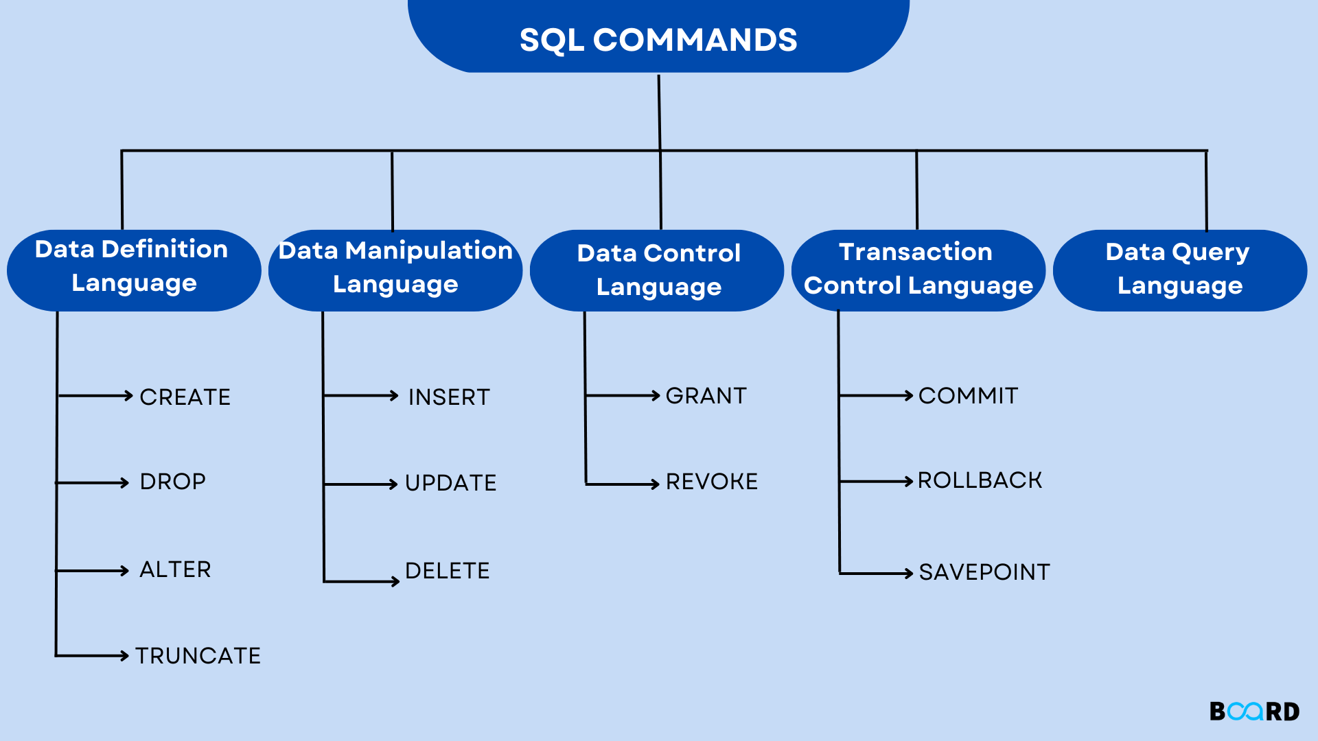
SELECT

Slide 16
SELECT -DQL
The SELECT statement is used to select data from a database.
The data returned is stored in a result table, called the result-set.
Syntax
SELECT column1, column2, ... FROM table_name;
Here, column1, column2, ... are the field names of the table you want to select data from. If you want to select all the fields available in the table, use the following syntax:
SELECT * FROM table_name;

Slide 17
SELECT DISTINCT
The SELECT DISTINCT statement is used to return only distinct (different) values.
Inside a table, a column often contains many duplicate values; and sometimes you only want to list the different (distinct) values.
Syntax
SELECT DISTINCT column1, column2, ... FROM table_name;
Also select count(distinct(column Name)) from table_name

Slide 18
WHERE Clause
The WHERE clause is used to filter records.
It is used to extract only those records that fulfill a specified condition.
Syntax
SELECT column1, column2, ... FROM table_name WHERE condition;

Slide 19
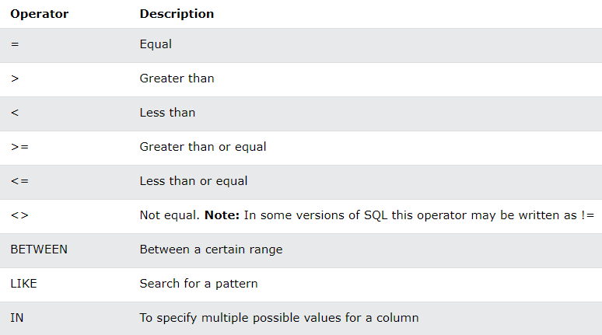

Slide 20
AND, OR and NOT Operators
The AND and OR operators are used to filter records based on more than one condition:
The AND operator displays a record if all the conditions separated by AND are TRUE.
The OR operator displays a record if any of the conditions separated by OR is TRUE.
The NOT operator displays a record if the condition(s) is NOT TRUE.
AND Syntax
SELECT column1, column2, ... FROM table_name WHERE condition1 AND condition2 AND condition3 ...;
OR Syntax
SELECT column1, column2, ... FROM table_name WHERE condition1 OR condition2 OR condition3 ...;
NOT Syntax
SELECT column1, column2, ... FROM table_name WHERE NOT condition;

Slide 21
ORDER BY Keyword
The ORDER BY keyword is used to sort the result-set in ascending or descending order.
The ORDER BY keyword sorts the records in ascending order by default. To sort the records in descending order, use the DESC keyword.
Syntax
SELECT column1, column2, ... FROM table_name ORDER BY column1, column2, ... ASC|DESC;

Slide 22
NULL Value?
A field with a NULL value is a field with no value.
If a field in a table is optional, it is possible to insert a new record or update a record without adding a value to this field. Then, the field will be saved with a NULL value.
Note: A NULL value is different from a zero value or a field that contains spaces. A field with a NULL value is one that has been left blank during record creation!
It is not possible to test for NULL values with comparison operators, such as =, <, or <>.
We will have to use the IS NULL and IS NOT NULL operators instead.
IS NULL Syntax
SELECT column_names FROM table_name WHERE column_name IS NULL;
IS NOT NULL Syntax
SELECT column_names FROM table_name WHERE column_name IS NOT NULL;

Slide 23
SQL LIMIT
SELECT * FROM Customers LIMIT 3;

Slide 24
MIN() and MAX() Functions
The MIN() function returns the smallest value of the selected column.
The MAX() function returns the largest value of the selected column.
MIN() Syntax
SELECT MIN(column name) FROM table_name WHERE condition;
MAX() Syntax
SELECT MAX(column name) FROM table_name WHERE condition;

Slide 25
COUNT(), AVG() and SUM() Functions
The COUNT() function returns the number of rows that matches a specified criterion.
Syntax
SELECT COUNT(column name) FROM table_name WHERE condition;
The AVG() function returns the average value of a numeric column.
Syntax
SELECT AVG(column name) FROM table_name WHERE condition;
The SUM() function returns the total sum of a numeric column.
Syntax
SELECT SUM(column name) FROM table_name WHERE condition;

Slide 26
IN Operator
The IN operator allows you to specify multiple values in a WHERE clause.
The IN operator is a shorthand for multiple OR conditions.
Syntax
SELECT column_name(s) FROM table_name WHERE column_name IN (value1, value2, ...);

Slide 27
The SQL LIKE Operator
The LIKE operator is used in a WHERE clause to search for a specified pattern in a column.
There are two wildcards often used in conjunction with the LIKE operator:
The percent sign (%) represents zero, one, or multiple characters
The underscore sign (_) represents one, single character
LIKE Syntax
SELECT column1, column2, ... FROM table_name WHERE columnN LIKE pattern;

Slide 28
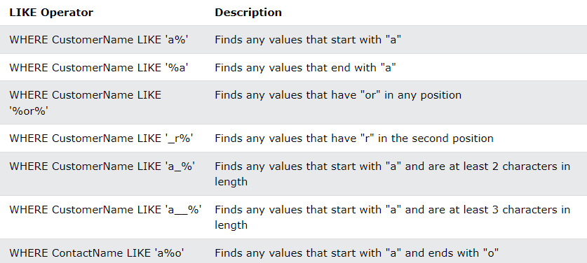

Slide 29
The SQL BETWEEN Operator
The BETWEEN operator selects values within a given range. The values can be numbers, text, or dates.
The BETWEEN operator is inclusive: begin and end values are included.
Syntax
SELECT column_name(s) FROM table_name WHERE column_name BETWEEN value1 AND value2;

Slide 30
SQL Aliases
SQL aliases are used to give a table, or a column in a table, a temporary name.
Aliases are often used to make column names more readable.
An alias only exists for the duration of that query.
An alias is created with the AS keyword.
Syntax
SELECT column_name AS alias_name FROM table_name;

Slide 31
Constraints
SQL constraints are used to specify rules for the data in a table.
Constraints are used to limit the type of data that can go into a table. This ensures the accuracy and reliability of the data in the table. If there is any violation between the constraint and the data action, the action is aborted.
Constraints can be column level or table level. Column level constraints apply to a column, and table level constraints apply to the whole table.
The following constraints are commonly used in SQL:
NOT NULL - Ensures that a column cannot have a NULL value
UNIQUE - Ensures that all values in a column are different
PRIMARY KEY - A combination of a NOT NULL and UNIQUE. Uniquely identifies each row in a table
FOREIGN KEY - Prevents actions that would destroy links between tables
CHECK - Ensures that the values in a column satisfies a specific condition
DEFAULT - Sets a default value for a column if no value is specified
CREATE INDEX - Used to create and retrieve data from the database very quickly

Slide 32
NOT NULL Constraint
By default, a column can hold NULL values.
The NOT NULL constraint enforces a column to NOT accept NULL values.
This enforces a field to always contain a value, which means that you cannot insert a new record, or update a record without adding a value to this field.

Slide 33
PRIMARY KEY Constraint
The PRIMARY KEY constraint uniquely identifies each record in a table.
Primary keys must contain UNIQUE values, and cannot contain NULL values.
A table can have only ONE primary key; and in the table, this primary key can consist of single or multiple columns (fields).

Slide 34
FOREIGN KEY Constraint
The FOREIGN KEY constraint is used to prevent actions that would destroy links between tables.
A FOREIGN KEY is a field (or collection of fields) in one table, that refers to the PRIMARY KEY in another table.
The table with the foreign key is called the child table, and the table with the primary key is called the referenced or parent table.

Slide 35
AUTO INCREMENT Field
Auto-increment allows a unique number to be generated automatically when a new record is inserted into a table.
Often this is the primary key field that we would like to be created automatically every time a new record is inserted.

Slide 36
CREATE INDEX Statement
The CREATE INDEX statement is used to create indexes in tables.
Indexes are used to retrieve data from the database more quickly than otherwise.
The users cannot see the indexes, they are just used to speed up searches/queries.

Slide 37
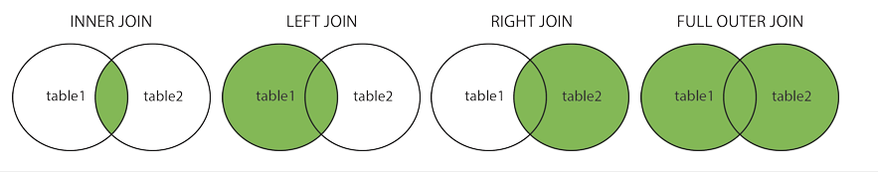
SQL JOINs
Here are the different types of the JOINs in SQL:
(INNER) JOIN: Returns records that have matching values in both tables
LEFT (OUTER) JOIN: Returns all records from the left table, and the matched records from the right table
RIGHT (OUTER) JOIN: Returns all records from the right table, and the matched records from the left table
FULL (OUTER) JOIN: Returns all records when there is a match in either left or right table

Slide 38
Self Join
A self join is a regular join, but the table is joined with itself.
UNION Operator
The UNION operator is used to combine the result-set of two or more SELECT statements.
Every SELECT statement within UNION must have the same number of columns
The columns must also have similar data types
The columns in every SELECT statement must also be in the same order

Slide 39
GROUP BY Statement
The GROUP BY statement groups rows that have the same values into summary rows, like "find the number of customers in each country".
The GROUP BY statement is often used with aggregate functions (COUNT(), MAX(), MIN(), SUM(), AVG()) to group the result-set by one or more columns.
Syntax
SELECT column_name(s) FROM table_name WHERE condition GROUP BY column_name(s) ORDER BY column_name(s);

Slide 40
HAVING Clause
The HAVING clause was added to SQL because the WHERE keyword cannot be used with aggregate functions.
Syntax
SELECT column_name(s) FROM table_name WHERE condition GROUP BY column_name(s) HAVING condition ORDER BY column_name(s);

