Slide 1
notejam
Migration to Cloud
Dipak Patil

Slide 2
Goal
Rehost notejam application in Azure cloud :
Must have
Application is highly available
Application sustain variable and peak load
Support Development team with multiple deployments without interruption
Support for backup/restore
Monitor the application and provide logs, metrics etc.
Deploy to DTAP with minimal efforts
Improvements
3 Tier application instead of monolithic
Application security
Costs of infrastructure

Slide 3
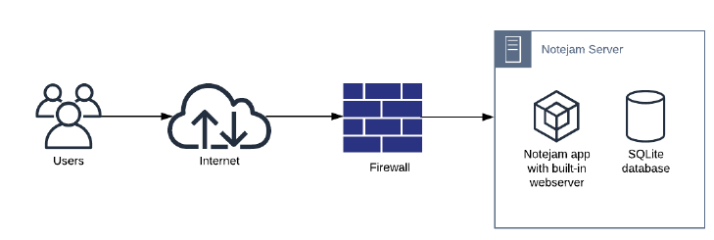
Current situation
Pain points
Self-managed infrastructure
Servers
Firewall
User management
Disaster recovery
Additional infrastructure of monitoring the application/firewall/server logs

Slide 4

Proposed - notejam solution design
Primary Region
Web Server
Database
User
Internet
Load Balancer + Firewall
Secondary Region
Web Server
Database

Slide 5
Technical Design
D/T/A/P
Load balanced routing
Authentication/ SSO
Diagnostics
notejam.com
Encrypted Traffic
Primary Region
Log Analytics
User
Frontdoor with WAF
Decrypt traffic
Inspect
Allow/Block request
Authentication/ SSO
Routing to secondary region
Fallback Region
Azure

Slide 6
Design Rationale -
Functional Requirement | Design Decision
High available infrastructure | Make use of multiple web application resources in different regions for high availability in case one of the Microsoft data center region goes donw. Configure failover mechanism for database server Use PaaS resoures, Microsoft guarantees 99.99% SLA
Scalable to handle peak loads | Set upscaling rules at web app to handle the peak and variable loads In case of under utilization of web application, create the scale-down rules to save the cost
Support for back up and restore | Use PaaS services which are fully managed resources by Microsoft with automatic scheduled backup Setup retention period of 3 years
Monitoring of infrastructure and application | Use Application Insights to actively monitor web application traffic, availability, logs Use Log Analytics workspace for resource telemtery, metrics and logs
Security | For application security, use Frontdoor service which is global service for multi-region web applications Use Frontdoor with WAF configuration, it helps to prevent attacks on internet facing web application Turn on the load balacing intelligent routign with maximum traffic to primary region Setup firewal rules on database server to allow traffic from web application endpoints only Set up network rule on web application to allow traffic from Frontdoor only thus disable <hostname>.azurewebsites.net host

Slide 7
Design Rationale -
Non-functional Requirement | Design Decision
Ease of deployment | Use Infrastructure As Code to provision resources across DTAP Use YAML pipelines in Azure DevOps to secure CI/CD way of working
Single-sign-on | Use Azure Active Directory for single sign-on Remove user management code from application and outsource it to AAD
Cost | Use AAD, Frontdoor, Log Analytics as shared services across multiple applications Wisely use the scaling rules to minimize application cost Use appropriate tags (e.g. Cost center, owner)on resource group to charge back the cost

Slide 8

Qustions..
This Photo by Unknown Author is licensed under CC BY

