Slide 1
notejam
Migration to Cloud
Dipak Patil

Slide 2
Goal
Rehost notejam application in Azure cloud :
Must have
Application is highly available
Application sustain variable and peak load
Support Development team with multiple deployments without interruption
Support for backup/restore
Monitor the application and provide logs, metrics etc.
Deploy to DTAP with minimal efforts
Improvements
3 Tier application instead of monolithic
Application security
Costs of infrastructure

Slide 3
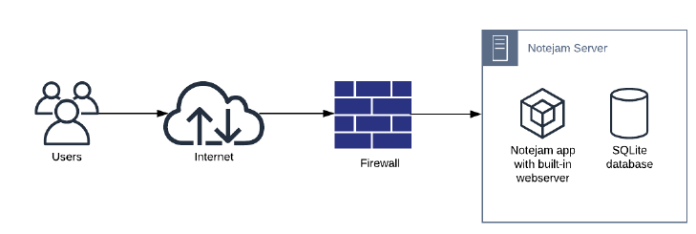
Current situation
Pain points
Self-managed infrastructure
Servers
Firewall
User management
Disaster recovery
Additional infrastructure of monitoring the application/firewall/server logs

Slide 4

Proposed - notejam solution design
Primary Region
Web Server
Database
User
Internet
Load Balancer + Firewall
Secondary Region
Web Server
Database

Slide 5
Technical Design
Diagnostics
notejam.com
Primary Region
Log Analytics
User
Frontdoor with WAF
Fallback Region
Azure

Slide 6
Design Rationale -
Functional Requirement | Design Decision
High available infrastructure
Scalable to handle peak loads
Support for back up and restore
Monitoring of infrastructure and application
Security

Slide 7
Design Rationale -
Non-functional Requirement | Design Decision
Ease of deployment
Single-sign-on
Cost

Slide 8

Qustions..
This Photo by Unknown Author is licensed under CC BY

