Slide 1
Natural Language Processing
P-184
Team 1
Aniket Patil
Dipali Patil
Kalyani Fulpagare
Rutuja Deshmukh
Shubham Nagpure
Vishal Sathe

Slide 2
BUSINESS PROBLEM
Deploy Model to Classify Mails into Abusive and Non-Abusive.
BUSINESS OBJECTIVE
Inappropriate emails would demotivates and spoil the positive environment that would lead to more attrition rate and low productivity and Inappropriate emails could be on form of bullying, racism, sexual favoritism and hate in the gender or culture, in today’s world so dominated by email no organization is immune to these hate emails.
The goal of the project is to identify such emails in the given day based on the above inappropriate content.

Slide 3
INTRODUCTION
Natural Language Processing (NLP) is field in Artificial Intelligence (AI) devoted to create computers that use natural language as input and/or output.
There are different types of NLP Algorithms but, the one we have used is ML- based System which uses Statistical Methods.
We had used NLTK package for Text Pre-Processing such as– Tokenization, Stemming, etc.

Slide 4
FLOW CHART
Dataset
Data Analysis and Labelling
Text Pre-Processing
Balancing Dataset
Splitting Data into Train and Test
Model Building
Deploying Model

Slide 5
(48076, 5)
23420
DATASET & Pre-Processing
The dataset contains around 20 lakh emails generated by employees of an organization.
Shape of dataset is 48076 rows and 5 columns.
Data-Type of Dataset is in Object.
There are no null values in the data.
There’s about 23420 duplicates in the data.

Slide 6
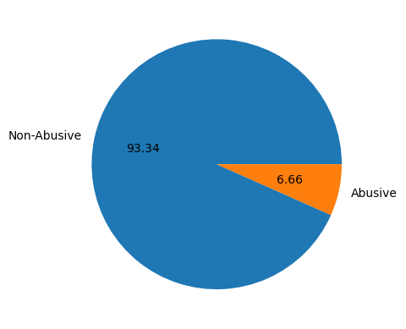
ABOUT DATASET
Dataset is too unbalanced.
93.34% of our dataset contains Non-Abusive E-mails.
Remaining 6.66% of our dataset contain Abusive E-mails.
We have balanced our dataset using Random Under Sampling Method.

Slide 7
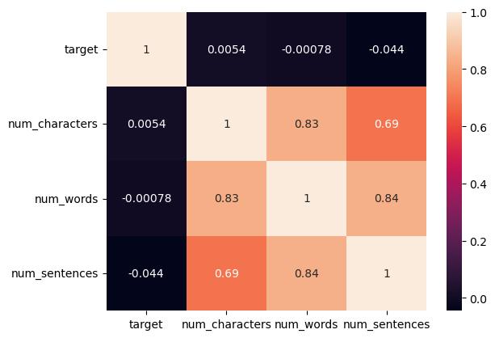
CORRELATION IN DATASET
Dataset contains strong correlation among them.
Num_Words and Num_Sentences have high correlation that is 0.84%.
Also, there’s high correlation between Num_Words and Num_Characters.

Slide 8
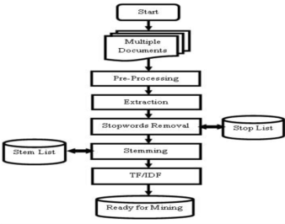
TEXT PRE-PROCESSING

Slide 9
MODEL BUILDING
Gaussian Naïve Bayes : Accuracy: 0.76 Precision: 0.98
Multi Nominal NB : Accuracy: 0.95 Precision: 0.96
Bernoulli Naïve Bayes : Accuracy: 0.81 Precision: 0.98
Support Vector Class. : Accuracy: 0.97 Precision: 0.97
Decision Tree : Accuracy: 0.95 Precision: 0.95
K-Nearest Neighbors : Accuracy: 0.95 Precision: 0.95
Random Forest : Accuracy: 0.97 Precision: 0.97
Logistic Regression : Accuracy: 0.97 Precision: 0.97

Slide 10
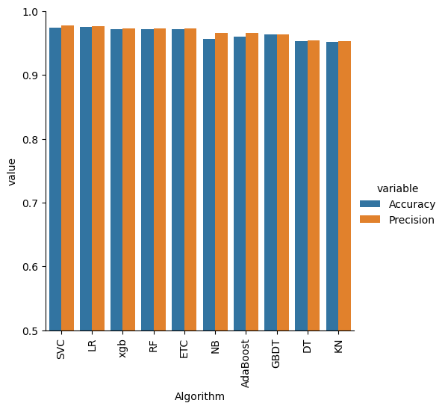
COMPARING MODELS WITH ACCURACY AND PRECISION

Slide 11
CONCLUSION
We can see Multi-Nominal NB and SVC have good Accuracy and Precision Score.
We will proceed to build model on Multi-Nominal NB because after re-training model Precision Score of it has increased.
As our Dataset is Un-balanced we will look for high Precision Score along with Accuracy.
Hence, we deployed Multi-Nominal NB Model using STREAMLIT.

Slide 12
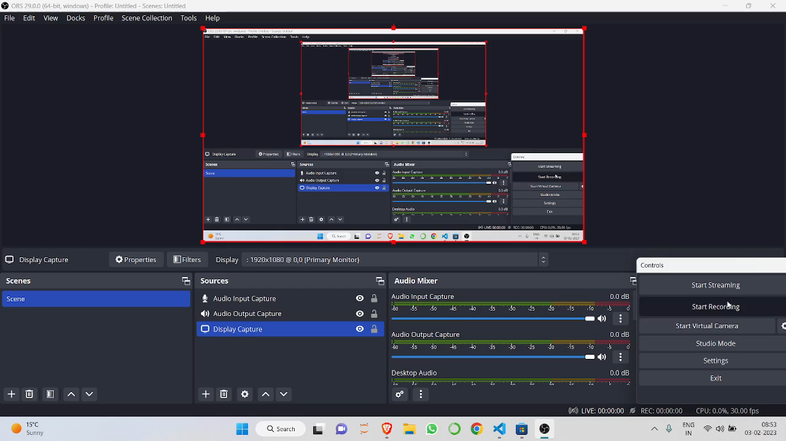
MODEL DEPLOYMENT

Slide 13
THANK YOU

