Slide 1

Analysis on Doctor’s Consultation Fee

Slide 2
About me
I am Patil Gopal, a recent graduate with a B.Tech degree in Electronics and Communication Engineering.
. I want to learn data science because it helps get important information from the raw data. It's like solving puzzles to make smart decisions and discover new things. I believe it's a powerful tool to make a positive impact and solve real-world problems.

Slide 3
Objective -
The main objective of the project is to analyse doctor’s based on their city, specialization, stories and experience

Slide 4
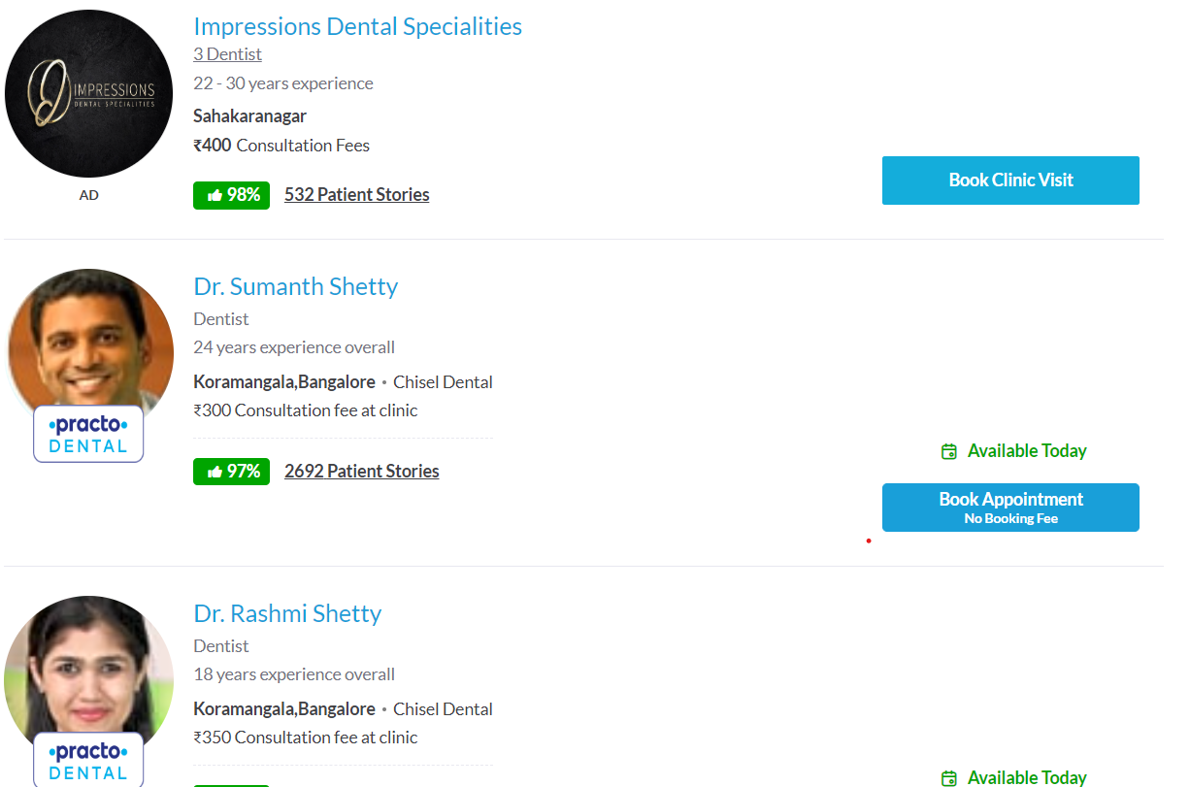
Web Scrapping -
For web scraping website used is Practo.
Practo Search is a patient focused, unbiased, independent medical website Patients can book confirmed appointments with doctors listed on Practo's website from this websites the information like doctor’s name, area, city, consultation fee, rating, experience and stories of the patients who has got treated by the doctors
the information was scraped by using python modules :
Numpy
Pandas
matplotlib
Seaborn
Regex , beautifulsoup & requests

Slide 5
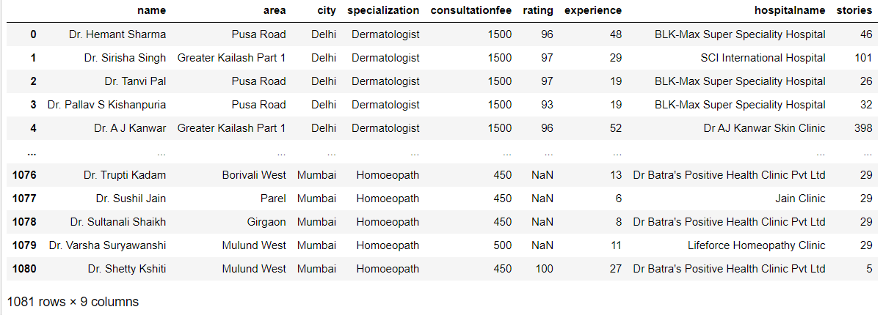
Summary of the Data -
The data frame consists of the 9 columns which includes both numerical and categorical data
The data consists of the categorical columns like area, city and stories
it also has numerical data columns like consultation fee, rating, experience and the stories

Slide 6
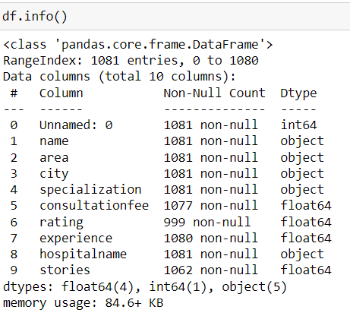
Exploratory Data Analysis:
Data cleaning & Manipulation–
After forming the data frame the null values are
present in the numerical columns consultation fee, rating,
experience and stories .

Slide 7
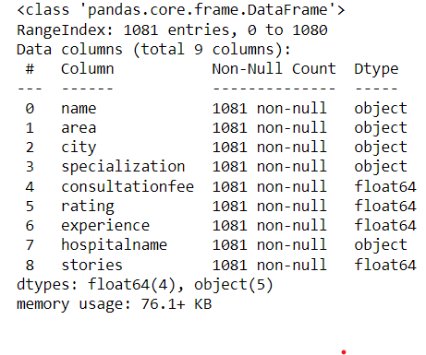
the null values consulation fee column has replaced by using group by of specialization because the consultation fee will be different for different specialization The null values in rating has filled with median of that column because the rating is Depends on his treatment it does not have relation with other columns also the Experience null values replaced with median of that column and the stories null values replaced by using group by of the experience column because the stories increases No of years of experience

Slide 8
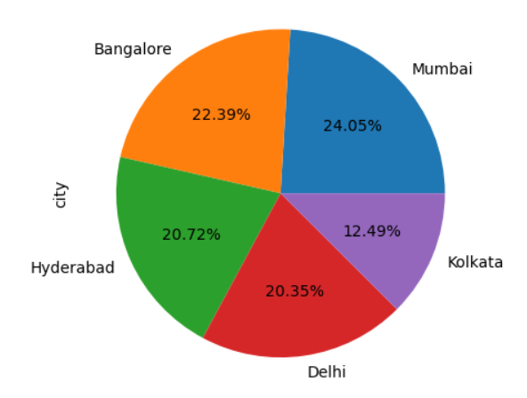
Uni-variate Analysis: analysis on city -
The pie plot shows that the highest percentage of doctors in Mumbai are high followed by bangalore, Hyderabad, delhi and least doctors are present in the Kolkata city are very less percentage when compared with other cities

Slide 9
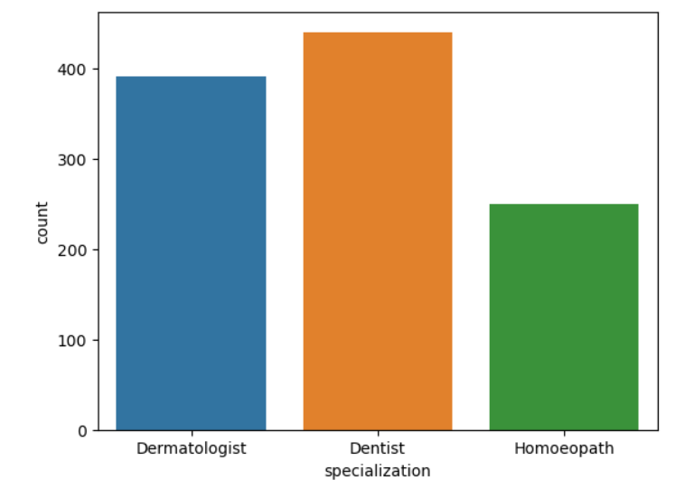
Analysis on specialization
The bar plot shows the doctors with specialization has dentist has more count when compared with the dermatologist and homoeopath

Slide 10
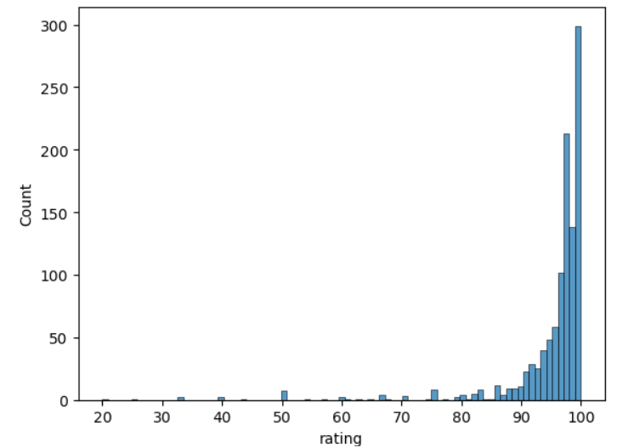
Analysis on ratings
the above histogram shows that most of the ratings are between 80 to 100

Slide 11
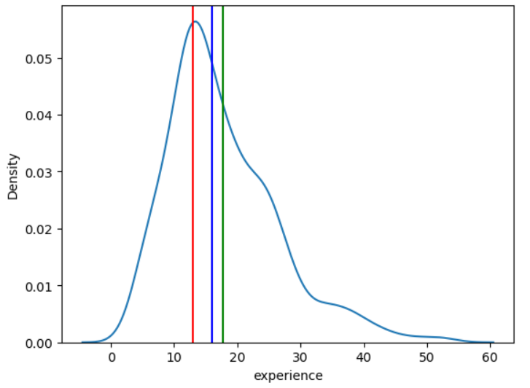
Analysis on experience - Kde plot shows that more experiences are between 5 and 20 years the kde plot is positively skewed as the mean(green line) is higher than the mode(redline)

Slide 12
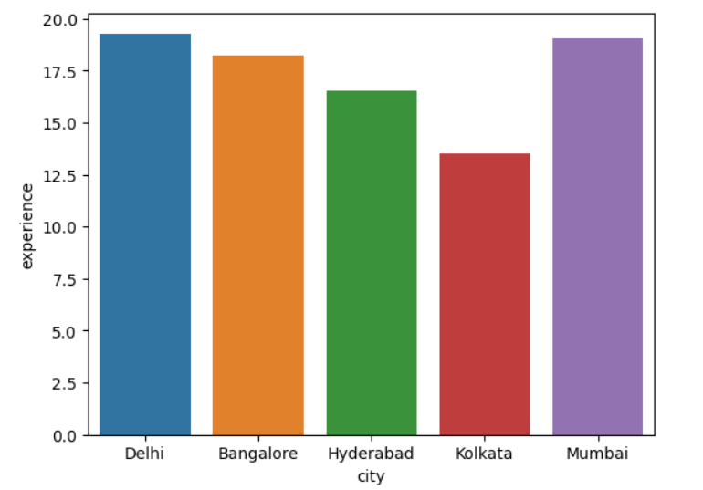
Bivariate Analysis -
Analysis on cities & experience -
Bar plot between city and experience shows that the less experienced doctors are from Kolkata compared to other cities

Slide 13
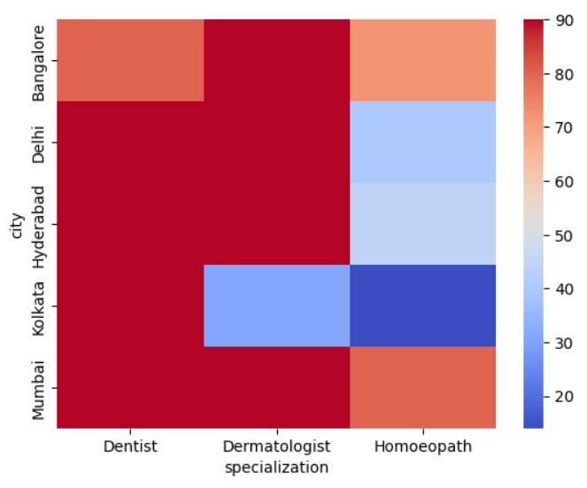
Analysis on specializations and cities- In Heat plot between specialization and city shows dentist, dermatologist are present in all the cities except dentist in bangalore and dermatologist in Kolkata homoeopath doctors are less I all the cities but they are low in Kolkata

Slide 14
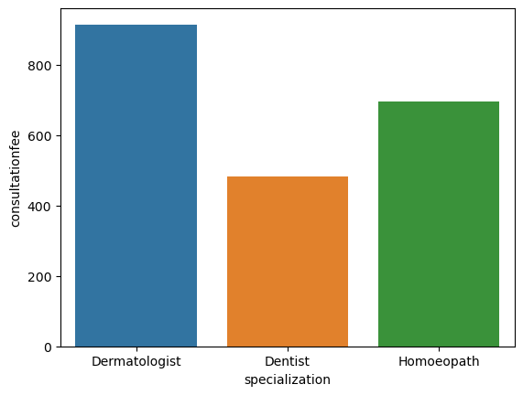
Analysis on specialization & consultation fee - Bar plot shows that dermatologist charges more consultation fee and dentists charges low.

Slide 15
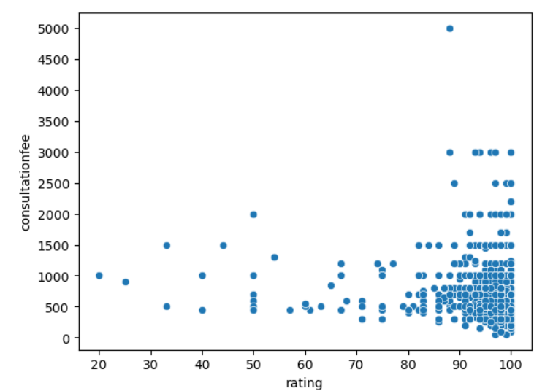
Analysis on rating and consultation fee- the scatterplot between rating and consultation fee it is clear that the most of high rated doctor’s consultation fee is below 1500

Slide 16
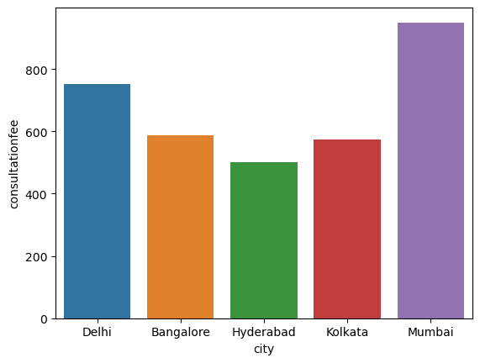
Analysis on cities and consultation fee- Above barplot shows Mumbai has the highest consultationfee.

Slide 17
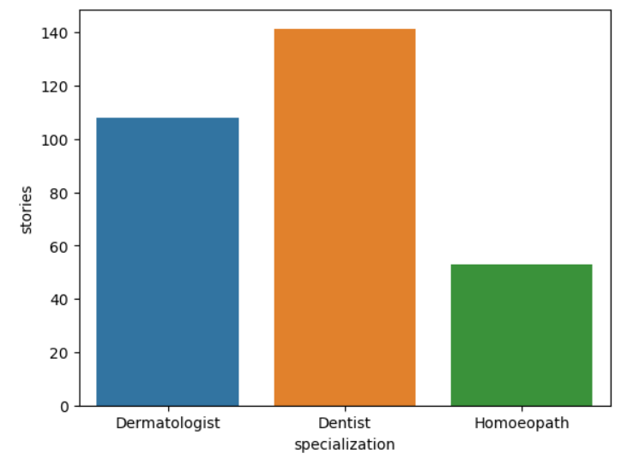
Analysis on specialization and stories- The barplot between specialization and stories shows that more no.of pateients are visiting dentist in comparsion with others.

Slide 18
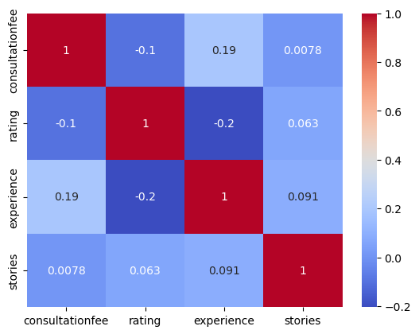
Multi-variate Analysis -
Analysis correlation between numerical columns
The heatmap shows the there is a weak negative correlation between rating and experience.

Slide 19
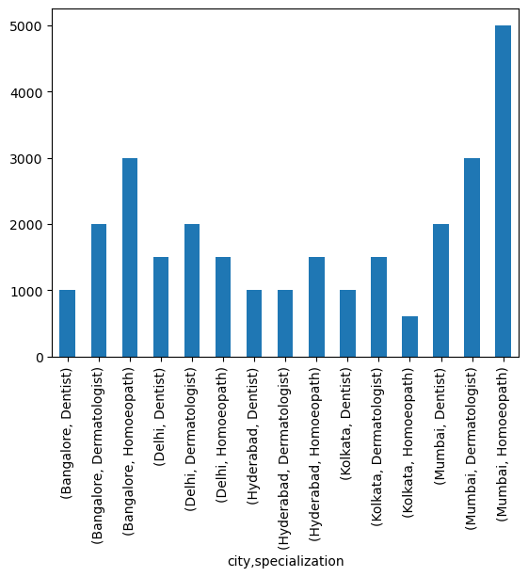
Analysis on city, specialization and consultation fee From the above bar plot it shows that homoeopath from Mumbai charges high consultation fee

Slide 20
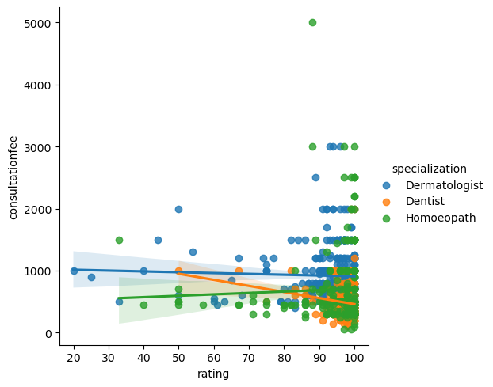
Analysis on rating ,specialization and consultation fee- Above plot shows that consultation fee decrease with increase in rating for dentist and increases for homoeopath and remains constants for dermatologist

Slide 21
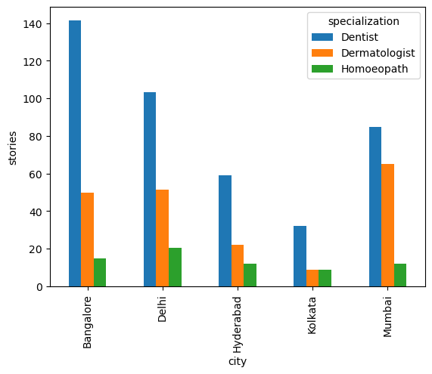
Analysis on cities, specializations and stories- The above plot shows that people visits dentists more than dermatologist and homeopath

Slide 22
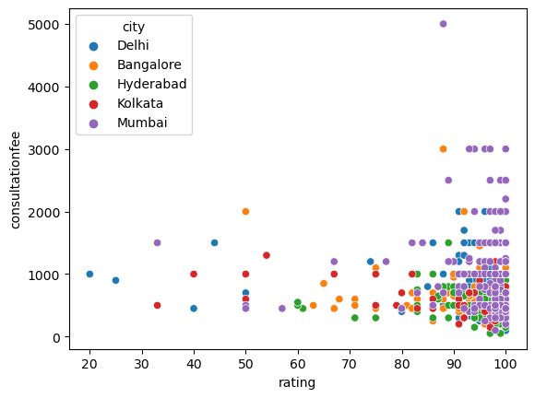
Analysis on rating ,consultation fee and city- Scatterplot shows that high rated doctors are from Mumbai.

Slide 23
Conclusion -
from this analysis can conclude that the doctors with high rating and all specialization are present Mumbai
Also that the experience does not effects the consultation fee
All the five cities consists of highest no of dentist
Dermatologist charges more consultation fee in all the cities
There are very less no of homoeopath doctors are present in all the cities it may be because less belief of people on homoeopath and there may be many other reasons like more healing time and no scientific evidences
but at some places like Mumbai homoeopathic doctors charges more it may be due to the less availability
Doctors from Mumbai city charges more consultation fee compared to other cities and doctors with good rating are also from Mumbai

Slide 24

THANK YOU

