Slide 1
Capstone Project Finance and Risk Analytics
Harsh PatiL

Slide 2
AGENDA
Business Case
Data Provided
Conclusion (Suggested Portfolio)
Data Insights
Returns & Risk
Sector Analysis
Correlation
Appendix
Steps followed
Summary of Metrics
Portfolio Returns

Slide 3
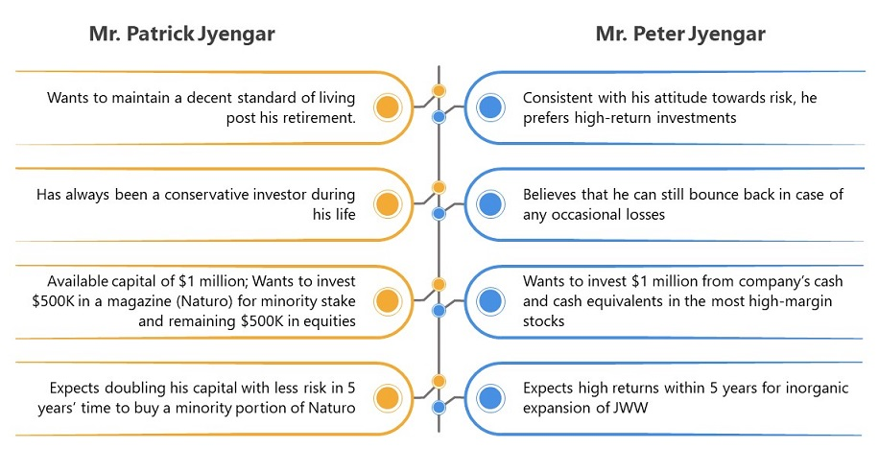
Business Case
Analyse a portfolio of stocks to provide consultation on investment management based on two clients’ requirements

Slide 4
Data Provided
Prices for 24 stocks of leading companies listed on New York Stock Exchange (NYSE)
The information for every stock ranges from 1st October 2010 to 30th September 2020
Sectors covered
Technology/IT
Travel/Aviation/Hospitality
Banking/Financial Services and Insurance
Pharmaceuticals/Healthcare/Life Sciences
S&P 500 index prices provided as benchmark for the same period
Steps followed have been provided as Appendix - I for reference
Assumption: Data for past 5 years is to be analysed and used to project next 5 years returns

Slide 5
Conclusion: Suggested Portfolio
 | Mr. Patrick Jyengar | Mr. Peter Jyengar
Invested amount | USD 500,000 | Invested Amount: USD 1,000,000
Expected Return | Double | High
Expected Risk | Low | No conditions
Suggested stocks & allocation | JNJ (Johnson & Johnson) – 25% RHHBY (Roche Holding AG) – 25% MRK (Merck and Co Inc) – 25% MSFT (Microsoft) – 25% | AMZN (Amazon) – 20% MSFT (Microsoft) – 20% AAPL (Apple) – 20% FB (Facebook) – 20% UNH (United Health Group Inc) – 20%
Expected return (after 5 yrs) * | 132% | 310%
Portfolio Risk (Annualized) | 22.85 | 29.65
Portfolio Value (after 5 yrs) * | USD 1,116,000 | USD 4,100,000
* Past 5 years returns are used to project next 5 years returns

Slide 6
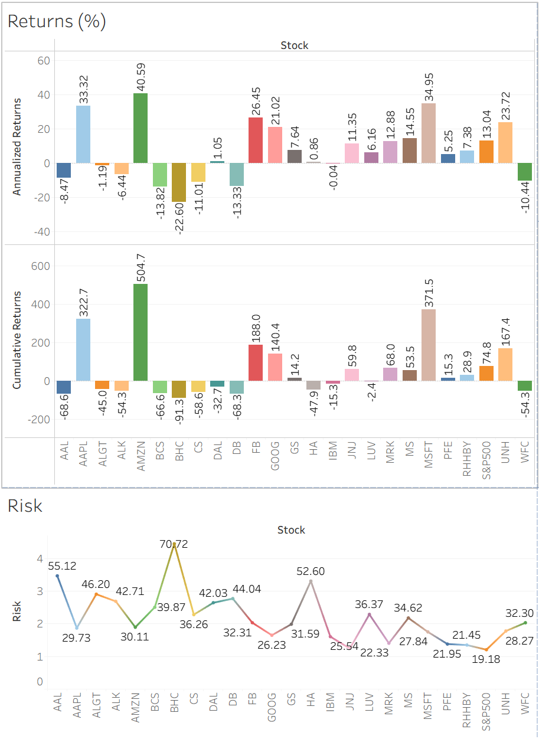
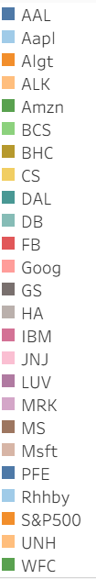
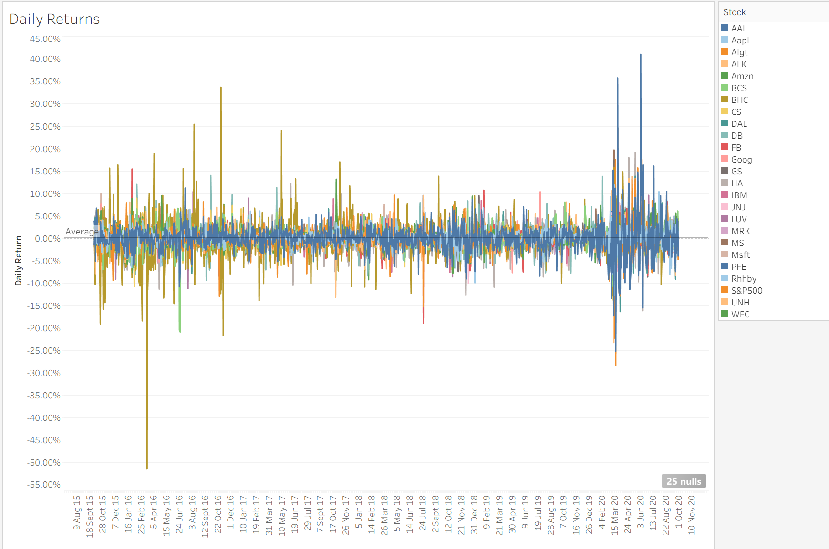
DATA Insights - RETURNS
12 stocks (+ S&P500) provided positive cumulative returns over this 5 year period
Recommended stocks have been selected from the above 12 stocks
AMZN, AAPL and MSFT are the top 3 performers in terms of both Annualized and Cumulative Returns

Slide 7
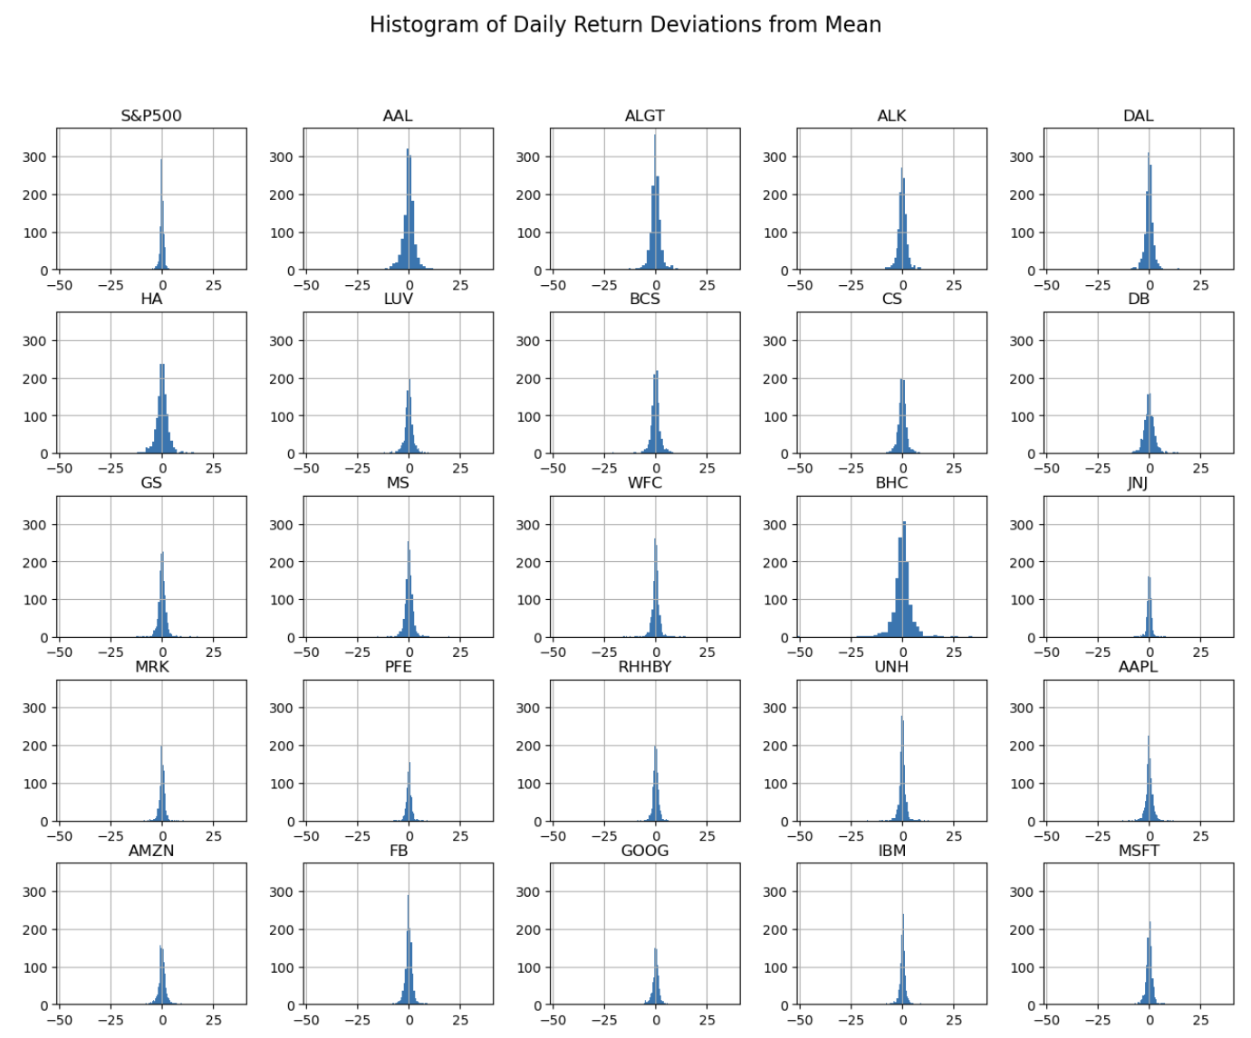
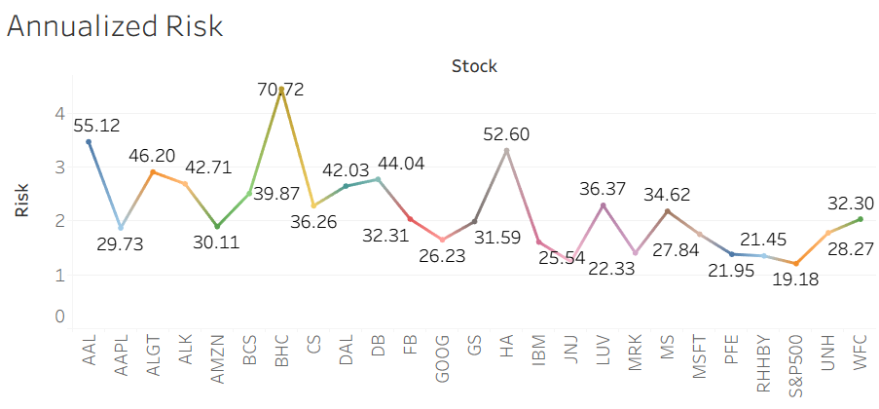
DATA Insights - RISK
The following stocks are the least risky:
JNJ
RHHBY
PFE
MRK
GOOG

Slide 8
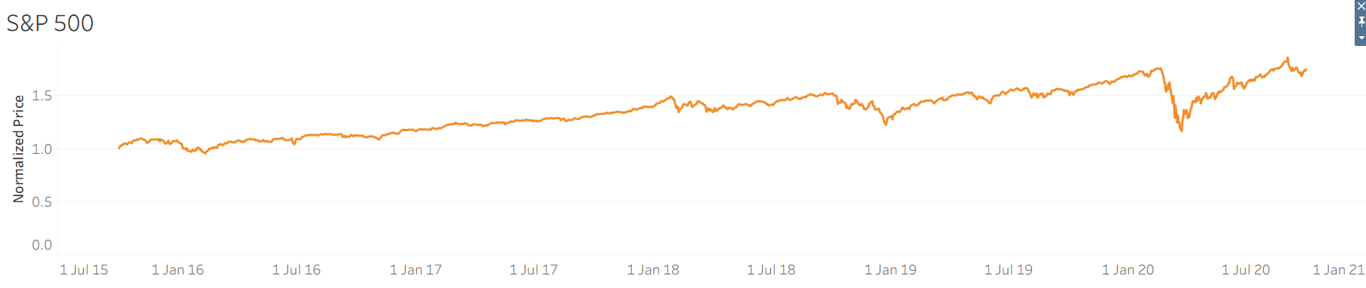
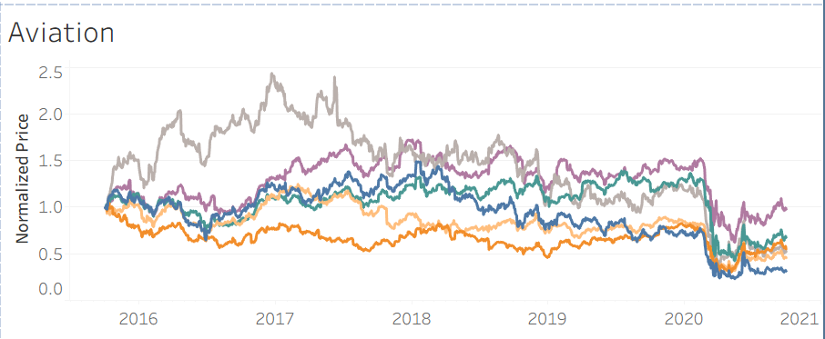
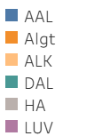
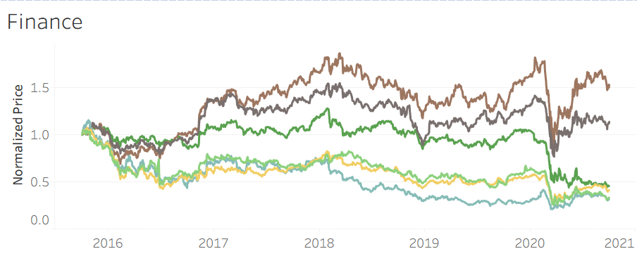
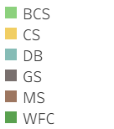
DATA INSIGHTS SECTOR ANALYSIS - I
Aviation
Aviation has a negative correlation to S&P 500
Returns have likely dipped because of Coronavirus pandemic since early 2020
There is some positive correlation between Delta and Allegiant and Delta and Southwest Airlines
Finance
Finance does not have a clear correlation to S&P 500 (though it is positive for some stocks)
Most stocks dipped in early 2020 but have been able to recover since then
Goldman Sachs and Morgan Stanley are highly correlated within the sector

Slide 9
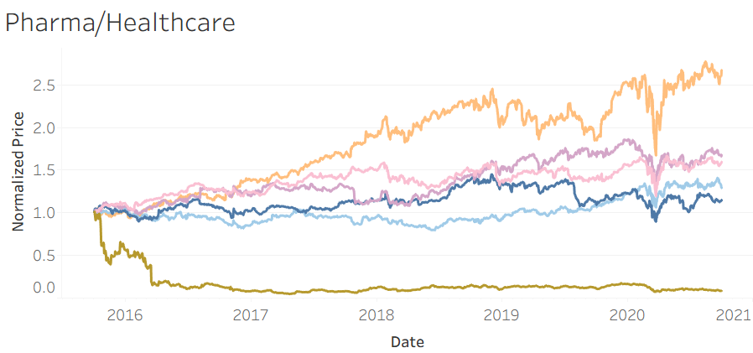
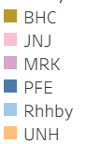
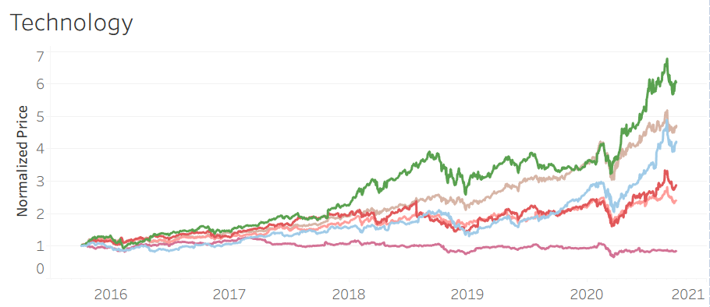
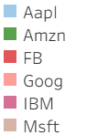
DATA INSIGHTS SECTOR ANALYSIS - II
Pharma / HealthCare
Pharma/Healthcare has a positive correlation to S&P 500
Pharma showed positive growth in 2020 during the Coronavirus pandemic
In general, Pharma stocks have the lowest risk, hence suggested for low risk investors
Technology
Technology has a positive correlation to S&P 500
Most stocks have outperformed the S&P 500 index
In terms of returns, technology is the strongest sector, hence suggested for investors looking for high returns

Slide 10
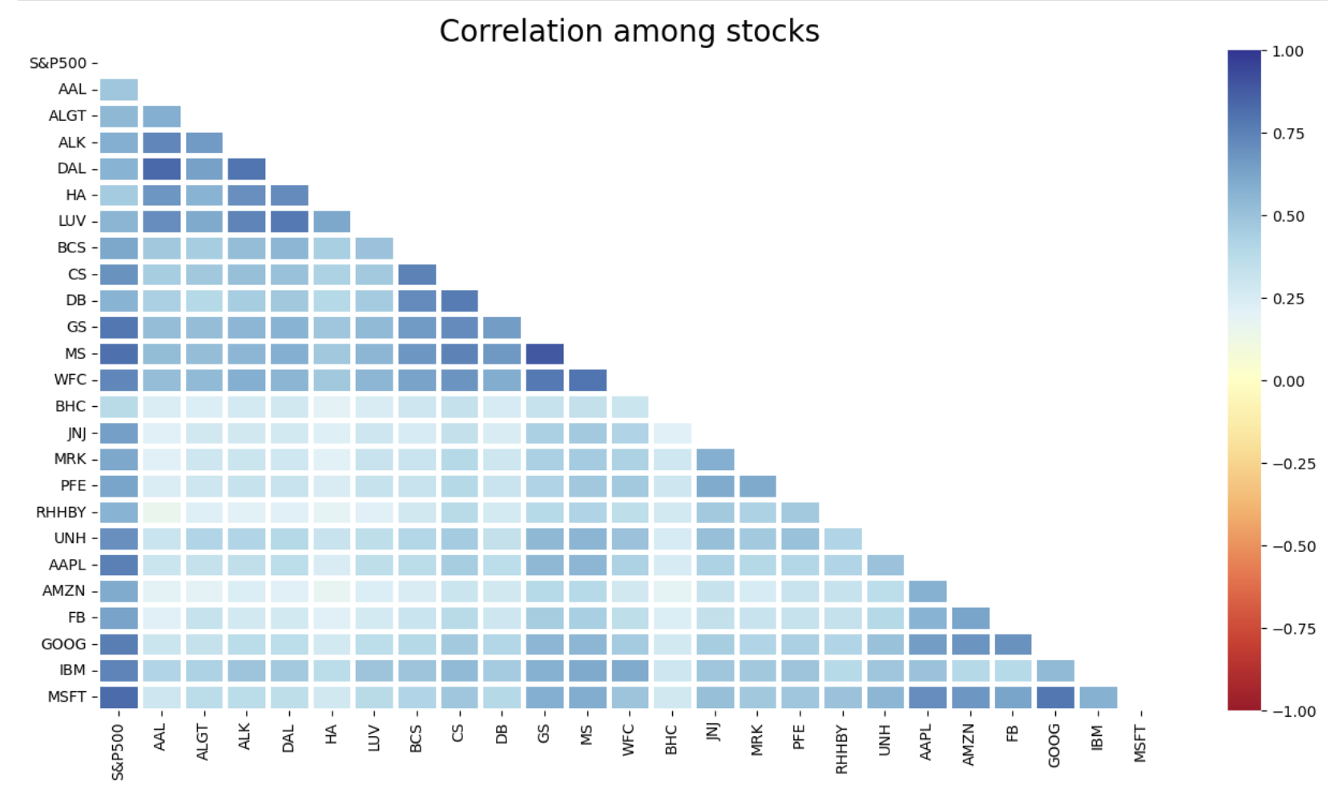
DATA INSIGHTS - Correlation

Slide 11
Appendix 1: Steps Followed
Reduced data to past 5 years
Merged individual datasets in one single dataset
Examined dataset for missing values and outliers
Performed required calculations: Daily returns, Dispersion from mean, Max/min prices, Risk/Volatility, Sharpe Ration, Correlation
Compared stocks against each other and within industry vs S&P 500
Identified the best stocks suited for the portfolios based on the requirements provided
Tools used: Jupyter Notebook, Tableau

Slide 12
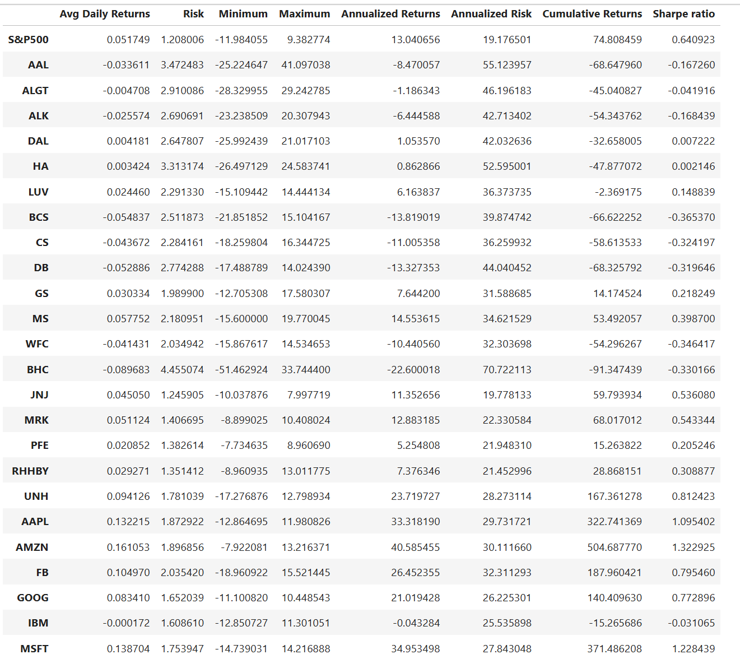
Appendix 2: Summary of METRICS

Slide 13
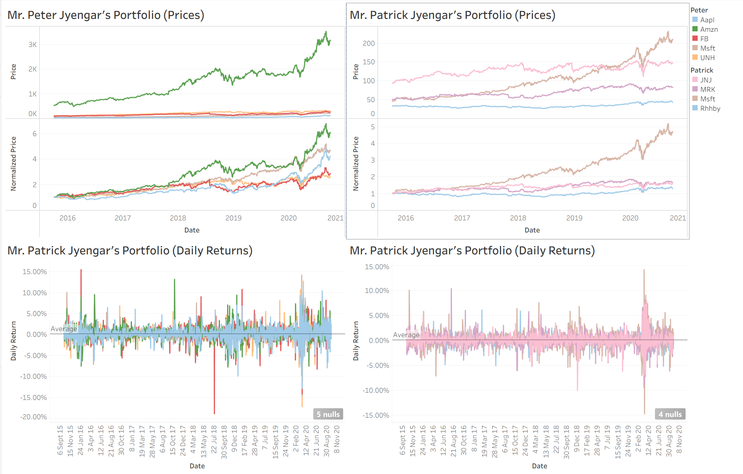
Appendix 3: PORTFOLIO RETURNS

