Slide 1
Data Visualization British Airways Customer Reviews Group Final Project
Ramvyasa Thavasiraj
Hrishikesh Anil Patil
Ranjay Bose
Nikhita Veluri

Slide 2
Content
Data Set
Visualizations used
Findings
Dashboard Demo

Slide 3

Data Set
The first dataset captures various feedback and ratings from travelers regarding their experiences with British Airways, covering aspects like seat comfort, staff service, food and beverages, entertainment, and overall value for money.
19 columns and 1325 rows.
The second dataset contains Country, Code, Continent and Region
4 columns and 252 rows.

Slide 4
Output of this Visualization
Identify Trends: Track customer satisfaction trends over time.
Comparative Analysis: Compare different service aspects like seat comfort and staff service.
Route Analysis: Focus on specific routes to pinpoint issues.
Customer Segmentation: Analyze feedback from different traveler types.
Verification Status: Assess feedback reliability between verified and non-verified trips.
Value for Money Analysis: Evaluate customer perceptions on service value.
Flight Specifics: Identify issues with flights or aircraft models.
Visualizing this data can provide insights for enhancing customer satisfaction and making informed business decisions.

Slide 5
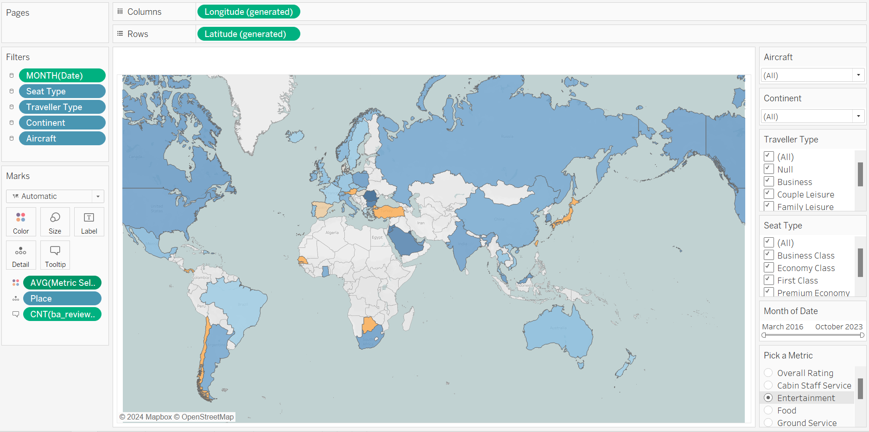
Worksheet 1 : Map and Filters

Slide 6
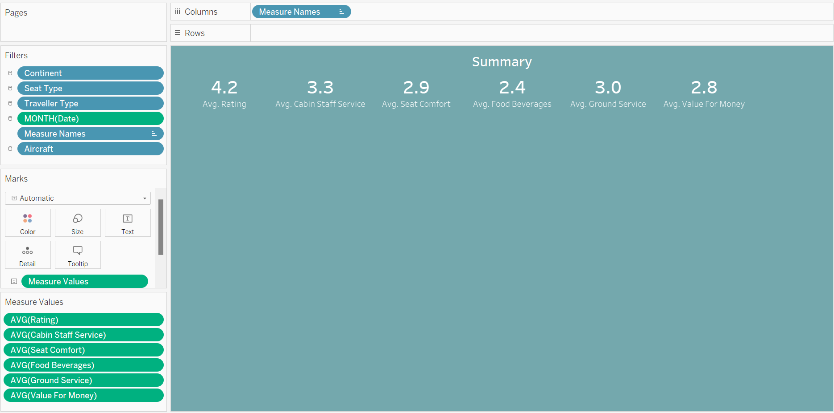
Worksheet 2 : Summary Data cards

Slide 7
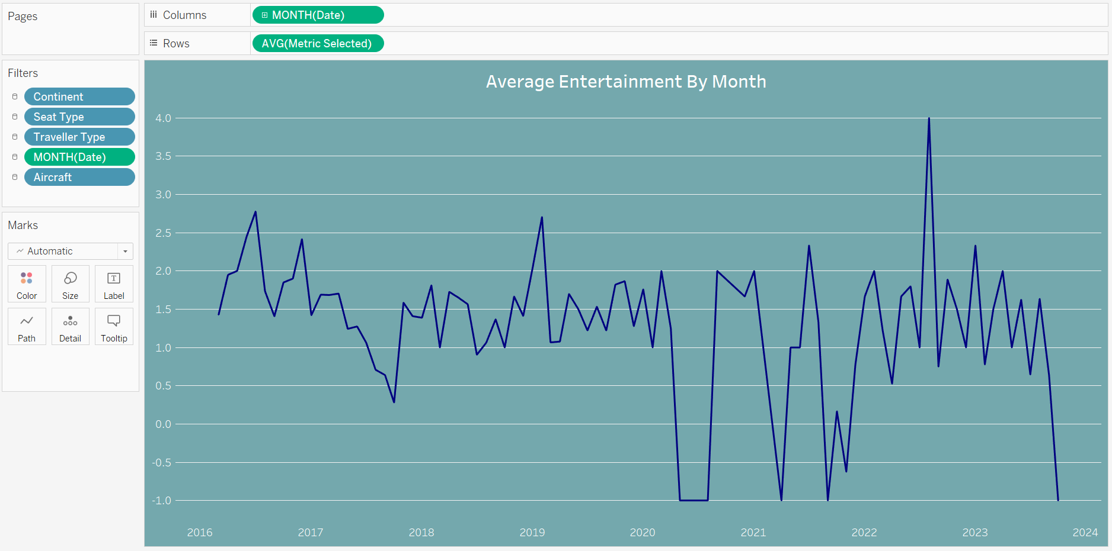
Worksheet 3 :Reviews vs Month

Slide 8
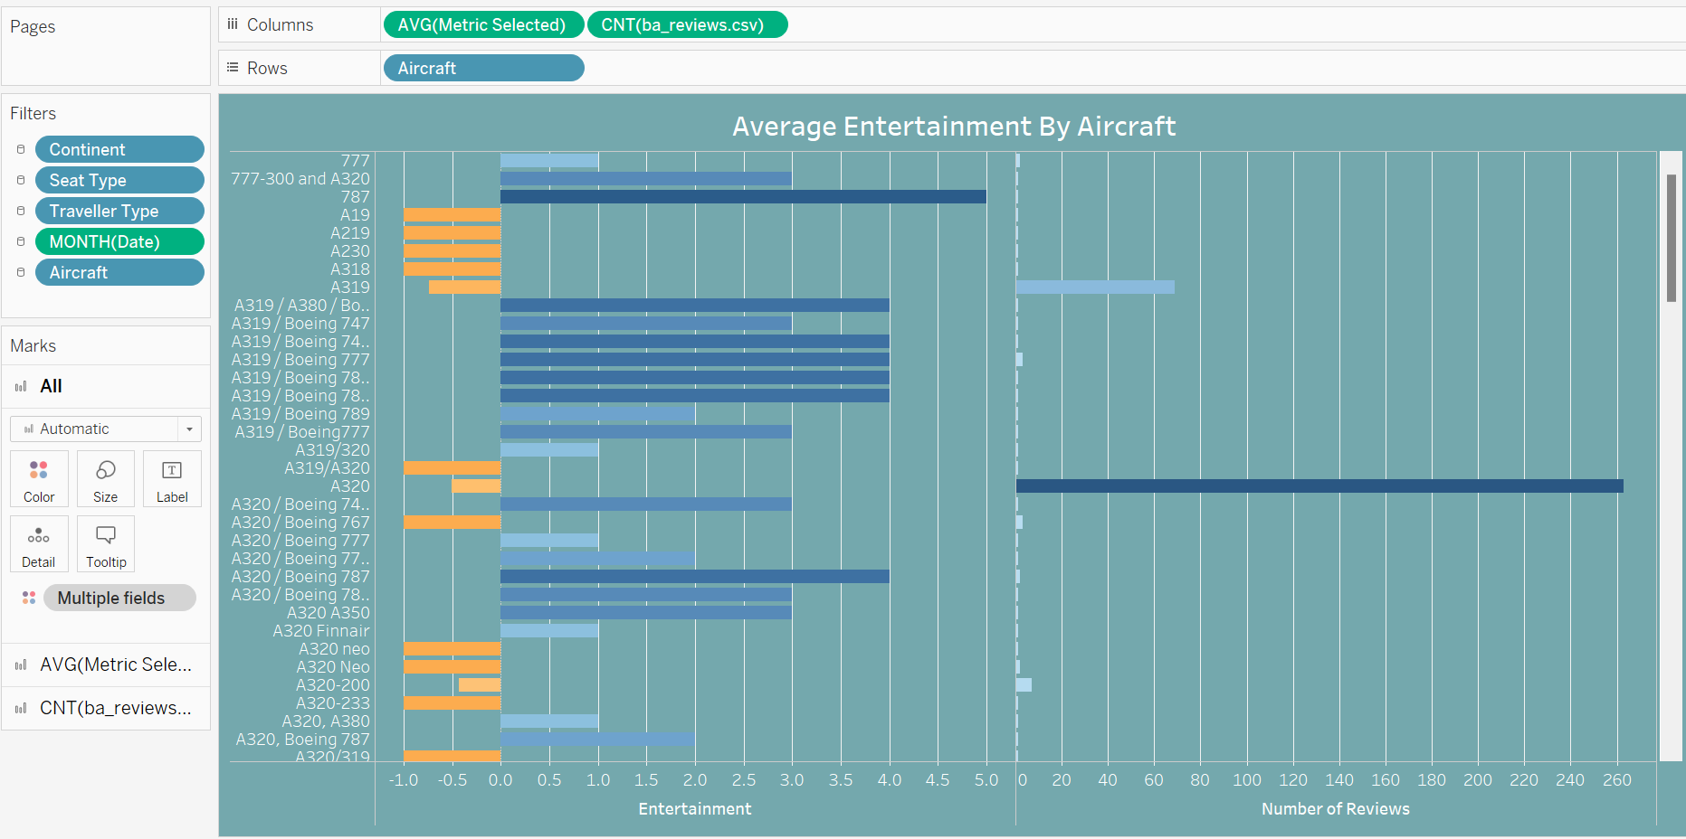
Worksheet 3 : Metric and Number of Reviews vs Aircraft model

Slide 9
Findings
The followings are few findings of many we can derive from this visualizations
A320 has a greater number of reviews with 283
United Kingdom has good rating and more reviews 4.2 and 837 reviews
Food reviews was low on June 2020 because of the impact of COVID
Value for money was highest during April 2021
Boeing 787 has very good revies compared to other aircraft types.

Slide 10
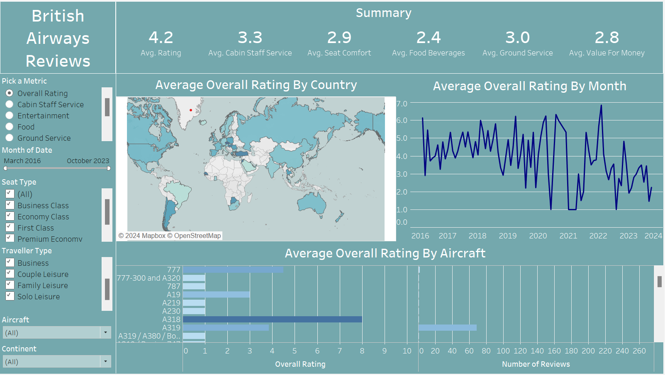
Dashboard Demo

Slide 11
Thank you

