Slide 1


MaidMatch - Connecting You with Reliable and Skilled Domestic Workers
Welcome to MaidMatch, the platform that connects individuals and businesses with domestic workers and maids. Our reliable and skilled service providers will help you with all your household needs.
tr
by temp rory

Slide 2

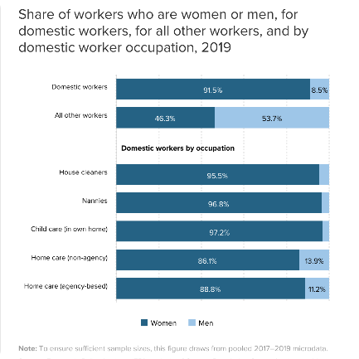

How MaidMatch Works
Step 1. Search
Step 2. Compare
Step 3. Book
Use our intuitive search engine to find a domestic worker or maid in your area. You can filter by skills, experience, availability, and more.
Compare different domestic workers and maids by looking at their experience, ratings, and customer reviews. Choose the right one for your needs.
Book your preferred domestic worker or maid with just a few clicks. You can customize the service, set the date and time, and pay securely online.

Slide 3
Benefits of Using MaidMatch
Save Time ⏰
Save Money 💰
No more endless searching and screening for the right domestic worker or maid. MaidMatch does all that for you.
MaidMatch's fees are reasonable and transparent. No hidden costs or unexpected expenses.
Peace of Mind 🧘‍♂️
Flexibility 🙌
MaidMatch's strict safety measures and background checks ensure that all domestic workers and maids are trustworthy and reliable.
MaidMatch offers a range of domestic services and customizable options to fit your unique needs and schedule.

Slide 4




Range of Domestic Services Available
House Cleaning
Child Care
Our domestic workers and maids will clean your apartment, house, or office until it shines. We offer one-time, regular, and deep cleaning options.
Our experienced and caring nannies will take care of your children when you are at work, running errands, or taking a well-deserved break.
Elder Care
Pet Care
Our compassionate and trained caregivers will provide personalized care and support for your elderly loved ones. From medication reminders to grooming assistance, we've got you covered.
Our animal-loving pet sitters and dog walkers will take care of your furry friends like they were their own. We offer feeding, walking, playing, and more.

Slide 5

Easy and Secure Payment and Booking Process
1
Step 1. Select Service
Choose the domestic service you'd like to book, and provide details about your location and schedule.
2
Step 2. Receive Quotes
We will send you quotes from several service providers that match your criteria. You can compare their prices, qualifications, and ratings.
3
Step 3. Confirm Booking
Once you've selected a provider, you can confirm the booking, customize the service, and pay securely through our platform. You can also communicate with the provider directly to clarify any details.

Slide 6
Safety Measures and Background Checks
At MaidMatch, we take your safety and trust seriously. That's why we employ a rigorous vetting process for all our domestic workers and maids. This includes:
Identity verification
Criminal record check
Reference check
Interview and skills assessment
We also provide liability insurance for all our service providers, so you can rest assured that you and your property are protected.

Slide 7

Testimonials and Success Stories
1
Life-Saving Service 💖
"I found MaidMatch when I was on a tight deadline and needed a reliable cleaner for my mother's house before she returned from the hospital. The maid they recommended was amazing, and the house looked spotless. Thank you, MaidMatch!"
2
A Better Way to Book 🙌
"I own a small guest house and was struggling to find a regular housekeeper who was available during peak season. MaidMatch made the process so easy - I got several quotes within hours and was able to book a fantastic cleaner right away. Highly recommend."
3
The Nanny of Our Dreams 🤗
"We were so nervous about finding a nanny for our triplets, but MaidMatch made it a breeze. We found a lovely nanny who exceeded our expectations - she's been with us for over a year now, and the kids adore her. Thank you, MaidMatch!"

