Slide 1

TV Product Analysis from Flipkart.com
Web Scraping and Data Analysis Project
By: Ketan Patil

Slide 2
Business Problem
Flipkart has lots of TVs for people to choose from.
Many TVs have almost the same features and prices.
This makes it confusing for buyers to pick the right one.
Sellers also don’t know how much to charge for their TVs.

Slide 3
Use Case
Understand what makes a phone popular.
Identify which features influence price and customer ratings.
Help buyers make smarter and more informed purchase decisions.
Assist sellers in pricing their products competitively and effectively.

Slide 4

Project Objectives
Collect TV data from Flipkart using web scraping.
To clean and organize the data for analysis.
To perform Exploratory Data Analysis (EDA) on features like price, rating, brand, screen size, etc.
To identify patterns and insights that help buyers and sellers make better decisions.
To visualize trends and relationships among features.

Slide 5
Web Scraping Details
Website Scraped: flipkart.com
Tools & Libraries Used: python, numpy, pandas, requests, BeautifulSoup, regex, matplotlib and seaborn.
Scrapping Process Followed : Collected Product Listings
a. Scraped 31 pages from Flipkart search results
b. Each page had around 20 to 24 TVs c. Collected over 700 TV listings
Extracted Attributes of Each TV :
Brand OS_Platform Resolution_type Inches Launch_Year Price Review_Count Rating

Slide 6
Summary of the Data
Total Records: 720 TVs listings scraped from 31 Flipkart pages.
Features Extracted: Brand, OS_Platform, Resolution_type, Inches, Launch_Year, Price, Review_Count, Rating.
Categorical Features:
Brand: TV company name (e.g., Samsung, Sony)
OS_Platform: Operating system used (e.g., Android, Tizen)
Resolution_type: Screen clarity (e.g., HD, Full HD, 4K)
Numerical Features:
Inches: Screen size
Launch_Year: Year the TV was released
Price: Cost of the TV
Review_Count: Number of customer reviews
Rating: Average customer rating

Slide 7
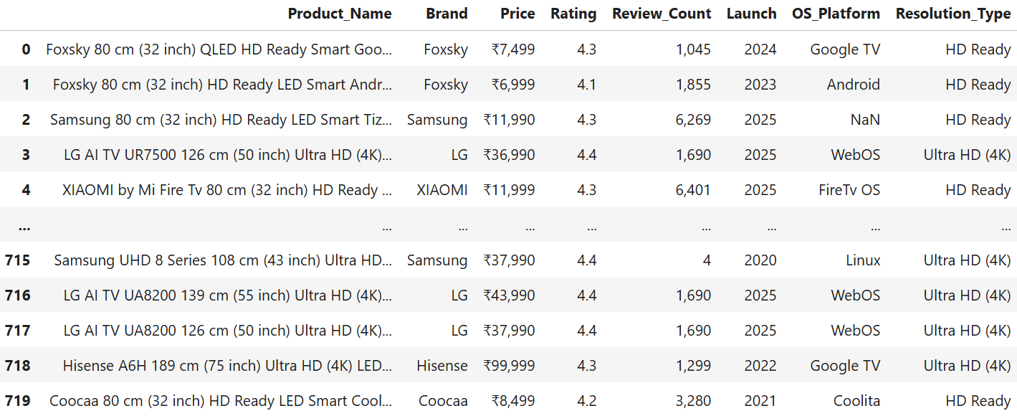
Data Frame After Scrapping The Website

Slide 8
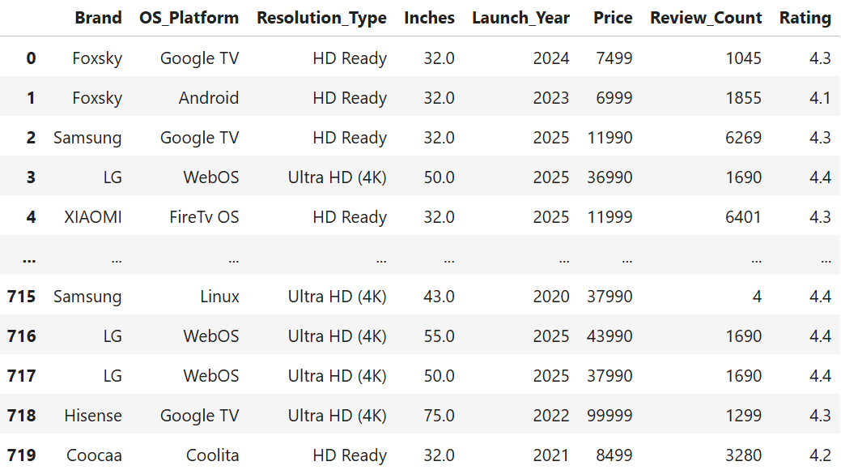
Data Frame After Cleaning The Data

Slide 9
Exploratory Data Analysis
Data Cleaning Steps :
Removed or filled missing information.
Removed symbols like ₹ and commas (e.g., “₹1,12,000”).
Fixed names written in different ways, (like "Ultra HD (4K)" - "Ultra HD 4K").
Converted price, rating, and reviews to numeric format.

Slide 10
Data Manipulation Steps:
Used regex to find and collect values like Brand, OS, Resolution, and Launch Year.
Made new columns for better analysis, like Launch Year and Screen Size.
Grouped TVs by Brand or OS Type.
Compared their average Price, Rating, and Review Count.

Slide 11
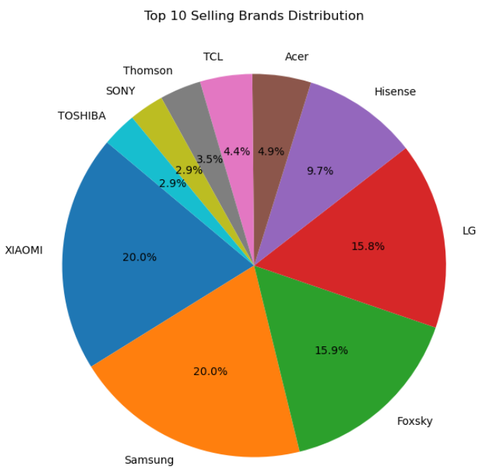
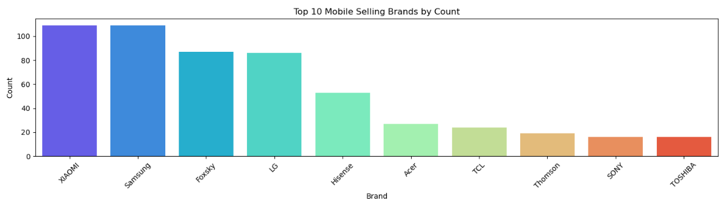
Univariate Analysis
Categorical Column – Brands:
Observation: Xiaomi and Samsung have the highest presence, each contributing 20.0% of the TV listings on Flipkart.

Slide 12
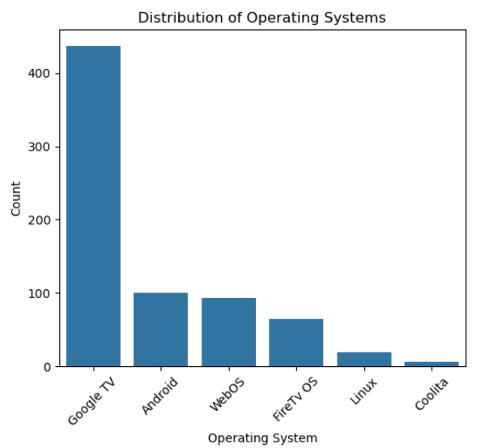
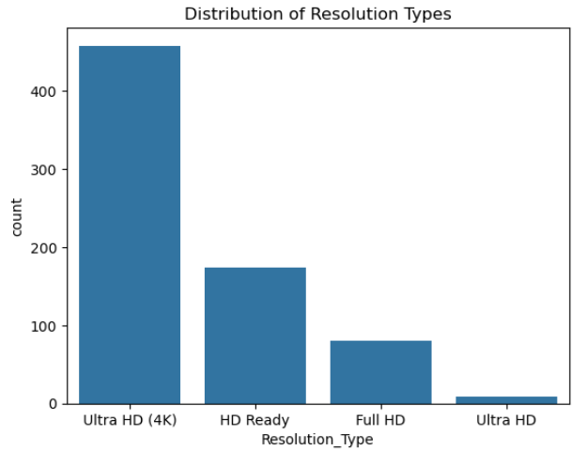
Categorical Column –
OS Platform Resolution Type
Observation: • Google TV is the most common OS, followed by Android and WebOS. • This means most smart TVs listed on Flipkart come with Google TV.
Observation: Most TVs offer Ultra HD (4K), showing a clear preference for better picture quality.

Slide 13
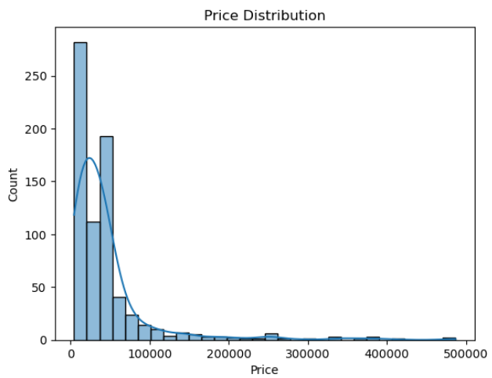
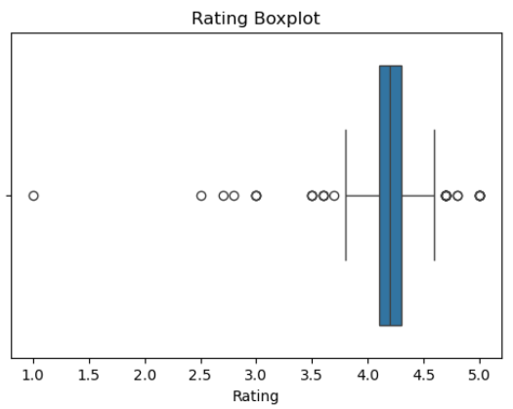
Numerical Column –
Price Rating
Observation:
Most TVs cost under ₹50,000.
₹10,000–₹20,000 is the most common range.
Very few TVs cost above ₹1,00,000.
Observation: •Cost TVs are rated between 4.0 and 4.5.
Very few TVs have ratings below 3.0.
A few TVs have very high or very low ratings.
TV ratings are mostly good on Flipkart.

Slide 14
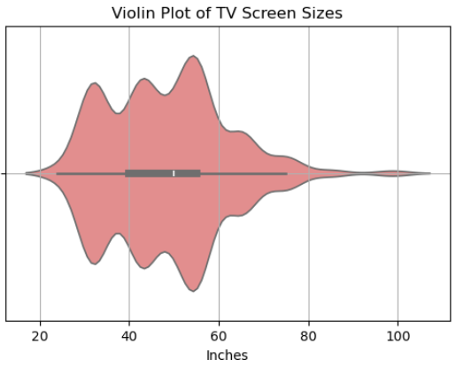
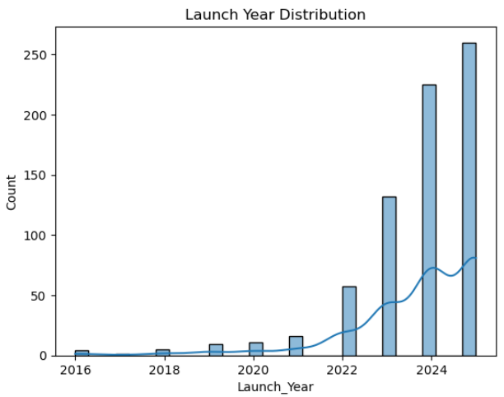
Screen Size (Inches) Launch Year
Observation:• Most TVs are between 32 to 55 inches.
43 inches is the most common size.
TVs above 65 inches are less common.
Mid-size TVs are the most popular among buyers.
Observation: • Most TVs were launched between 2021 and 2024.
2022 had the highest number of new TV releases.
Very few TVs were launched before 2020.

Slide 15
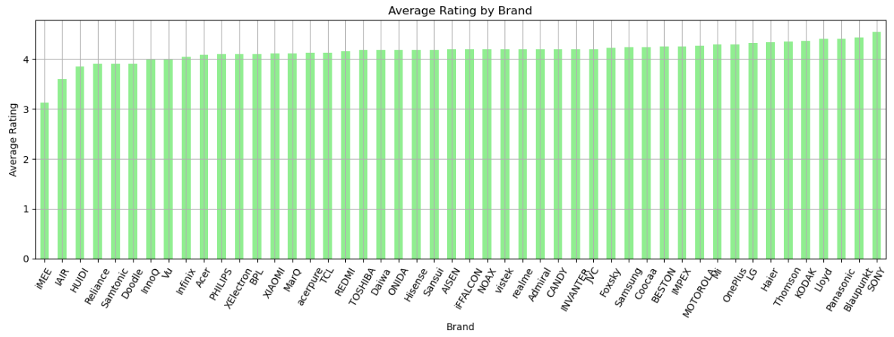
Bivariate Analysis
For Continuous and Categorical - Average Rating by Brand :
Most brands have ratings above 4.0, showing that customers are happy.
Kodak, Samsung, and Xiaomi have the highest average ratings.
A few brands have ratings below 4.0, but they are still acceptable.
Overall, ratings are consistent across most popular brands.

Slide 16
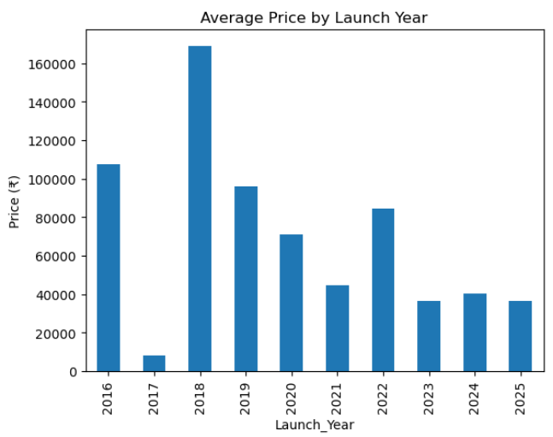
For Continuous and Categorical - Average Price by Launch Year :
Observation:
TVs launched in 2022–2024 have higher average prices.
TVs launched before 2020 are generally less expensive.
This shows that latest models cost more and may offer better features.
There is a visible rise in price trend over the years.

Slide 17
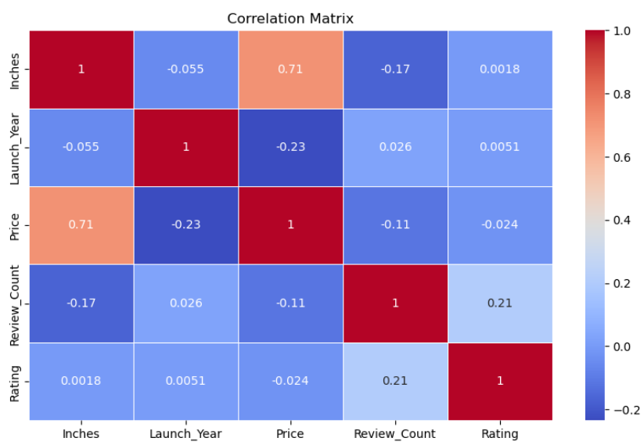
For Continuous and Continuous – Correlation plot
Observation:
Inches vs Price (0.71) • TVs with bigger screens usually cost more.
Launch Year vs Price (-0.23) • Newer TVs are more expensive; older ones are cheaper.
Review Count vs Rating (0.21) • TVs with more reviews may have slightly better ratings (weak connection).
Price vs Rating (-0.02) • Expensive TVs don’t necessarily get better ratings.
Inches vs Rating (0.0018) • Screen size has no effect on ratings.

Slide 18
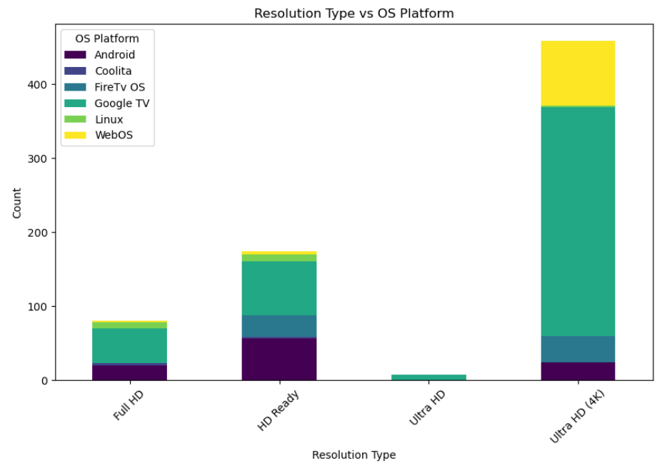
For Categorical and Categorical – Resolution Type vs OS Platform
Observation :
Google TV is used in all types, especially in 4K TVs.
Android TV is common in Full HD and 4K TVs.
WebOS is mostly seen in HD Ready and Full HD TVs.
HD Ready TVs have limited OS options, while 4K TVs have more choices.

Slide 19
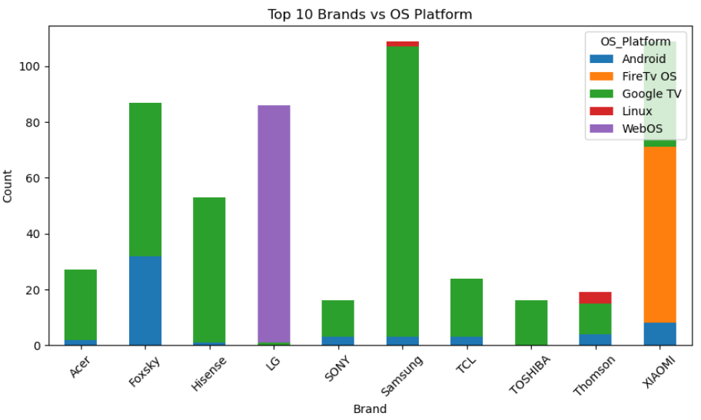
For Categorical and Categorical – Resolution Type vs OS Platform
Observation :
Samsung exclusively uses Tizen OS.
LG primarily uses WebOS.
Sony, Xiaomi, OnePlus, Realme, Thomson use Android OS.
Android OS is common among budget and mid-range brands.
Tizen and WebOS are used by premium brands.

Slide 20
Conclusion
Android and Google TV are the most preferred smart TV platforms.
resolution and larger screen sizes lead to higher prices.
Top-rated brands include Sony, LG, and OnePlus.
Most TVs are recent models from 2023 and 2024.
Customers look for good features at reasonable prices.

Slide 21
Experience & Challenges
Experience:
Learned how to collect data from websites using web scraping.
Used BeautifulSoup and regex to get TV details from Flipkart.
Improved my skills in data cleaning and analysis.
Learned how to find patterns using EDA (Exploratory Data Analysis).
Challenges:
Flipkart’s website structure kept changing.
Some product details were missing or incomplete.
It was hard to extract info like OS, year, and resolution from messy text.
Spent time cleaning and fixing raw data.

Slide 22

THANK YOU

