Slide 1
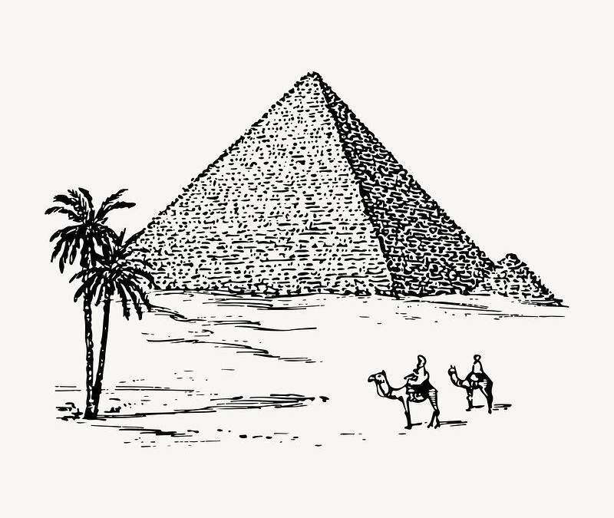
Cause Of Death

Slide 2
Cause Of Death
Content
In this Dataset, we have Historical Data of different cause of deaths for all ages around the World. The key features of this Dataset are: Meningitis, Alzheimer's Disease and Other Dementias, Parkinson's Disease, Nutritional Deficiencies, Malaria, Drowning, Interpersonal Violence, Maternal Disorders, HIV/AIDS, Drug Use Disorders, Tuberculosis, Cardiovascular Diseases, Lower Respiratory Infections, Neonatal Disorders, Alcohol Use Disorders, Self-harm, Exposure to Forces of Nature, Diarrheal Diseases, Environmental Heat and Cold Exposure, Neoplasms, Conflict and Terrorism, Diabetes Mellitus, Chronic Kidney Disease, Poisonings, Protein-Energy Malnutrition, Road Injuries, Chronic Respiratory Diseases, Cirrhosis and Other Chronic Liver Diseases, Digestive Diseases, Fire, Heat, and Hot Substances, Acute Hepatitis.
Problem Statement
This contains the problem statement and business goal
Prepared By : Kundan Patil

Slide 3
Index
Exploratory Data Analysis
Storytelling
Major Highlights
Conclusion

Slide 4
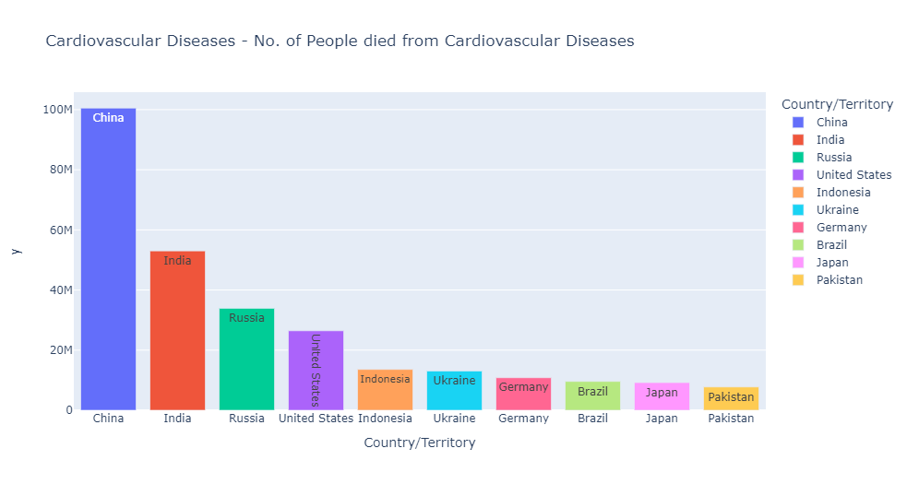
World wide death due Cardiovascular Diseases

Slide 5
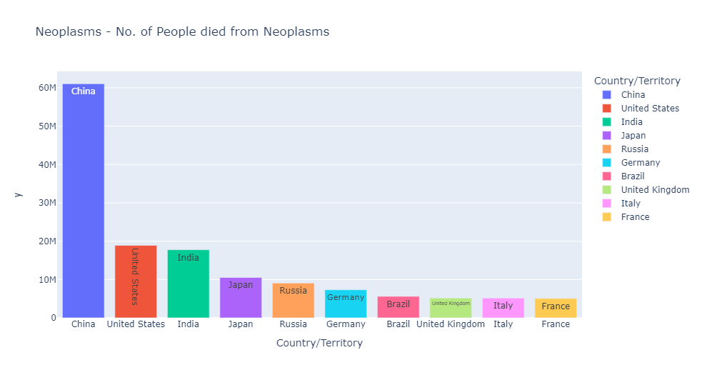
World wide death due neoplasm

Slide 6
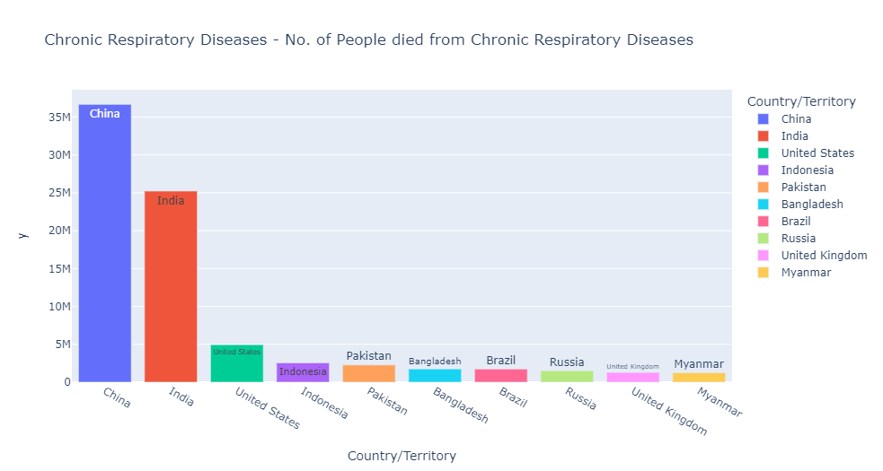
World wide death due to Chronic Diseases

Slide 7
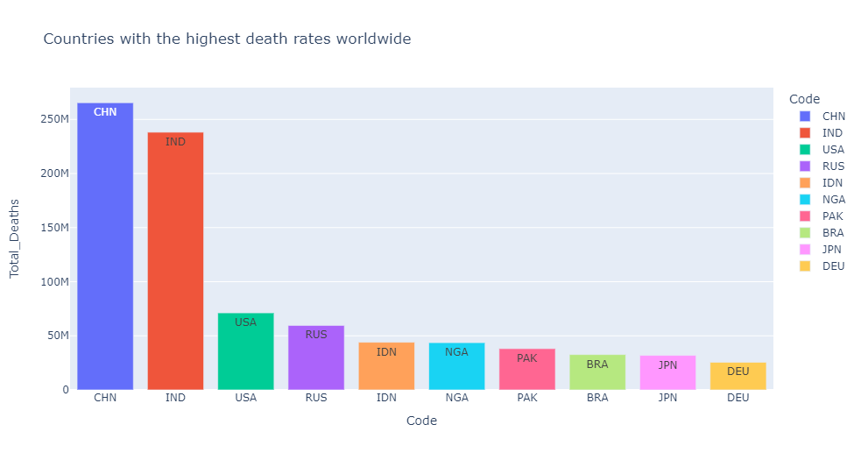
Countries with the highest death rates worldwide

Slide 8
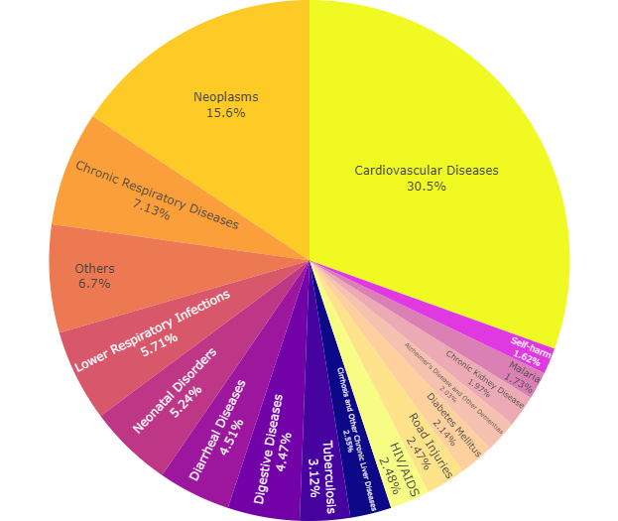
Biggest deadliest diseases in the world

Slide 9
Conclusions:-
CHINA , INDIA & USA has highest death rates due to
Cardiovascular, Neoplasms ,and Respiratory are The top global causes of death.
Thank you….✒️

