Slide 1

Basic Details of the Team and Problem Statement
Ministry/Organization Name/Student Innovation: Ministry of Education
PS Code: 1430
Problem Statement Title: Lowest Cost Board – A Seamless Teaching Experience.
Team Name: Hustlers
Team Leader Name: P Sai Kumar
Institute Code (AISHE): C - 26929
Institute Name: Sree Vidyanikethan Engineering College
Theme Name: Smart Education

Slide 2
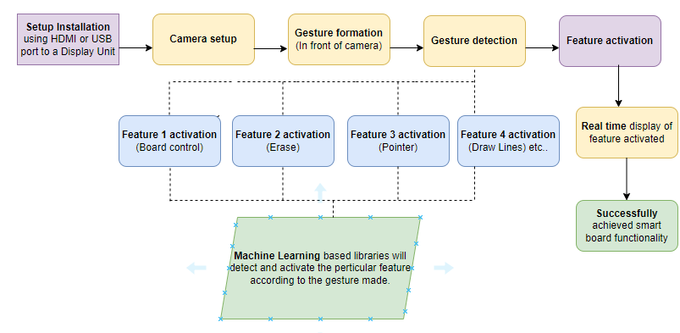





Idea/Approach Details
Describe your idea/Solution/Prototype here:
Current Issue: Smart boards in the market are expensive, making them unaffordable for small-scale schools and colleges.
Reason for High Cost: The high manufacturing cost for current smart board is primarily attributed to the expensive smart touch-based screens.
Proposed Solution: Utilize machine learning and artificial intelligence to eliminate the need for expensive interactive boards.
Innovative Approach: Implement a camera sensor to detect gestures made by hand, triggering features like next slide, previous slide, pointer function, write on slide, erase on slide, zoom in, and zoom out through the ML model.
Functionality: The camera sensor, powered by the ML model, will detect gestures and enable interactive learning, making it accessible and cost-effective for all educational institutions.
Describe your Technology stack here:
Raspberry Pi
Python
OpenCV
MediaPipe
Numpy

Slide 3
Idea/Approach Details
Describe your Use Cases here
Describe your Dependencies / Show stopper here
Cost-Efficiency: Our solution aims to replace costly smart boards priced between 25k to 50k rupees, offering a remarkable reduction to approximately 1k to 2k rupees, representing a staggering 75 to 90 percent cost reduction.
Accessibility for Disabled Individuals: This innovative system empowers people with disabilities, enabling them to use the interactive board from any corner of the room, promoting inclusivity and equal access to education.
Enhanced Mobility: The portable and pocket friendly nature of our technology ensures flexibility in classroom layouts, allowing educators to adapt and create dynamic learning environments effortlessly.
User-Friendly Interface: With intuitive gesture recognition, our system provides a seamless user experience, making it easy for both teachers and students to interact with educational content effectively.
Low Maintenance & Scalability: Our system demands minimal maintenance, guaranteeing uninterrupted learning. Additionally, it seamlessly scales to diverse educational contexts, accommodating different classroom sizes and teaching methods.
Supports Multilingual Education: The system's adaptability to different languages facilitates multilingual education, catering to diverse student populations and enhancing language learning experiences.
Dependencies :
CvZone Python Library.
External Display unit.
Slow stoppers :
The sole working of the model depends on quality of camera.
Area coverage also depends on quality of camera.

Slide 4
Team Member Details
Team Leader Name: P Sai Kumar
Branch : B Tech Stream : ECE Year : IV
Team Member 1 Name: S Mahesh
Branch : B Tech Stream : ECE Year : IV
Team Member 2 Name: P Gangothri
Branch : B Tech Stream : ECE Year : IV
Team Member 3 Name: Kuruba Dinesh Babu
Branch : B Tech Stream : IT Year : IV
Team Member 4 Name: Shaik Jameer Basha
Branch : B Tech Stream : ECE Year : IV
Team Mentor 1 Name: Dr N Padmaja
Category: Academic Expertise: Innovation Domain Experience (in years): 22

Slide 5
Working Model (Prototype)

Slide 6
Important Pointers
Please ensure below pointers are met while
Kindly keep the maximum slides limit to 4 pages
All the topics should be utilized for description of your idea
Try to avoid paragraphs and post your idea in points
Keep your explanation precisely and easy to understand
Idea should be unique and novel. If it has a business potential more weightage will be given.
Apart from this PPT abstract of your idea will be asked separately while submitting
You need to save the file in PDF and upload the same on portal. No PPT, Word Doc or any other format will be supported
You can delete this slide (Important Pointers) when you upload the details of your idea on SIH portal.

