Slide 1
Prometheus and Grafana Monitoring

Slide 2
Agenda
What is Prometheus?
Prometheus Architecture
What is Grafana?
Installation
Demo

Slide 3
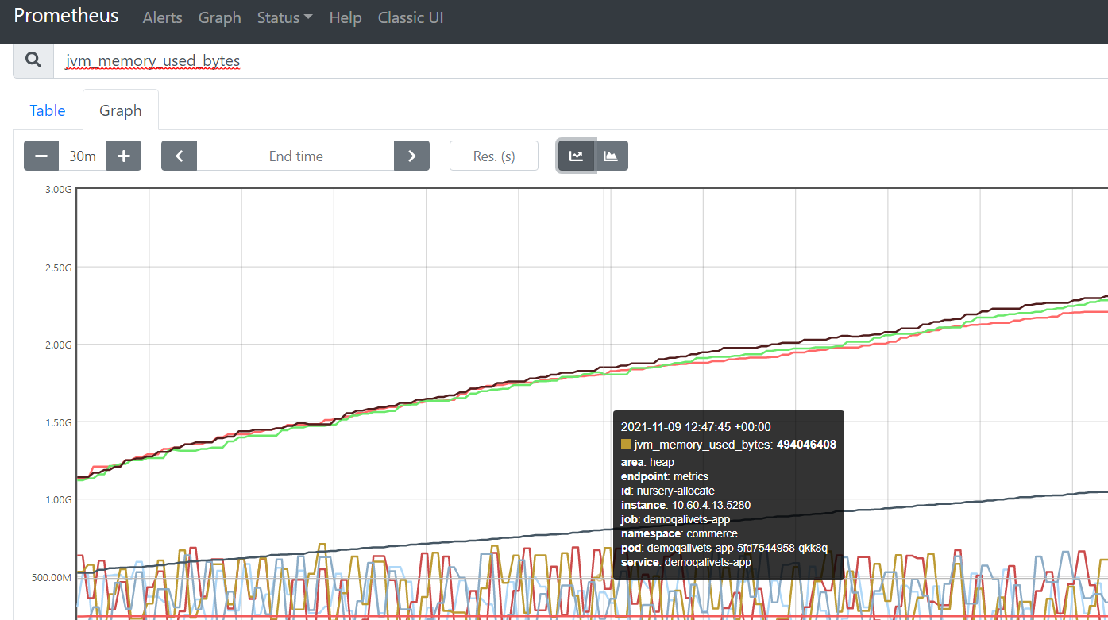


What is Prometheus?
Prometheus is open-source metrics-based monitoring toolkit.
Prometheus provides its own query language PromQL (Prometheus Query Language) that lets users select and aggregate data.

Slide 4
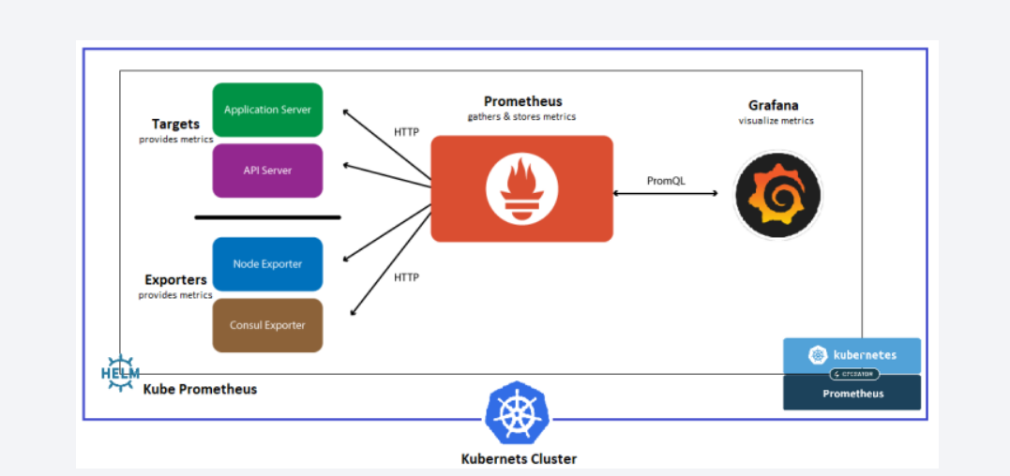
Prometheus Architecture

Slide 5
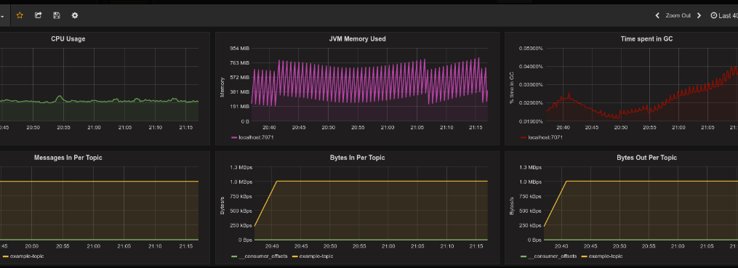
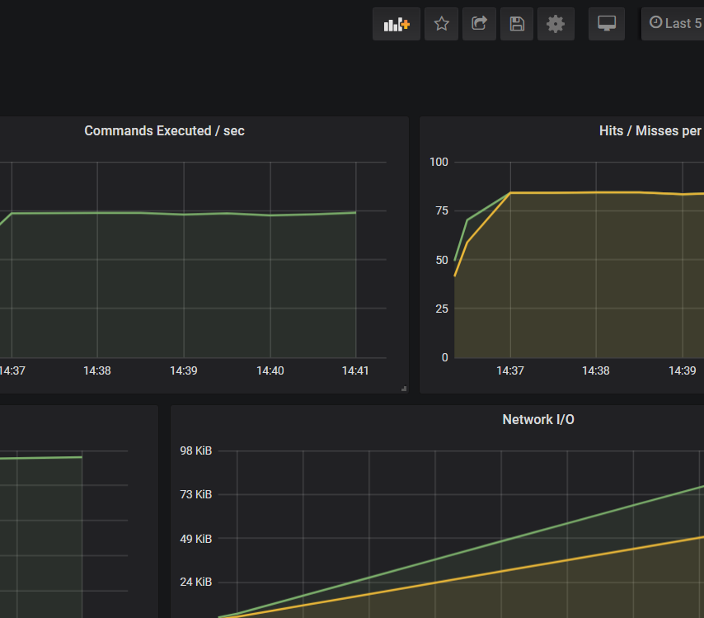
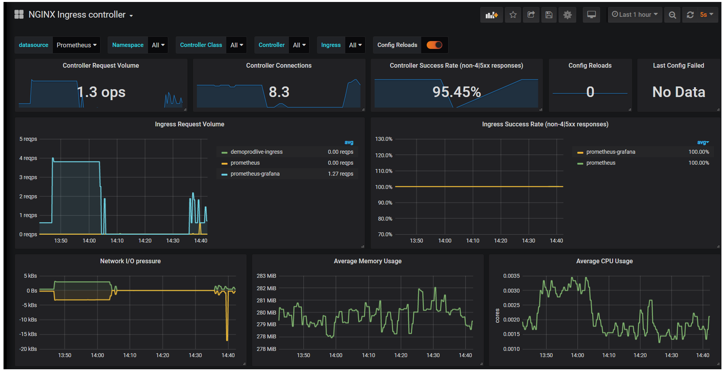

What is Grafana?
Grafana is an open-source analytics and interactive visualization web application.
Grafana possesses a huge variety of visualization options to help you view and understand your data easily. These options are split into “panels” which are then used to build the grafana dashboard

Slide 6

Installation
Prometheus can be installed using Prometheus operator in Kubernetes cluster
To install prometheus operator in commerce kube-prometheus-stack is recommended option.
(https://github.com/HCL-TECH-SOFTWARE/hcl-commerce-performance/blob/main/Grafana/Kube-prometheus-stack-step-by-step.md)
Enable the metrics in commerce helm charts
(https://github.com/HCL-TECH-SOFTWARE/hcl-commerce-performance/blob/main/Grafana/PrometheusGrafanaInstall.md#hcl-commerce---metrics-enablement)
Access Prometheus and grafana console (https://github.com/HCL-TECH-SOFTWARE/hcl-commerce-performance/blob/main/Grafana/Kube-prometheus-stack-step-by-step.md#accessing-the-prometheus-and-grafana-consoles)

Slide 7

Demo
Github prometheus & grafana installation Page
Github location for Commerce Grafana dashboards
Prometheus Console
Grafana Console
How to import and customize grafana dashboards

