Slide 1

Project Title -Healthcare Analytics for Doctor Visits
Student Name - Saisha Yogesh Patil
College Name – Sanjivani College Of Engineering,Kopargaon
AICTE STU ID : STU6a6c2a0b419001785473547

Slide 2

PROBLEM STATEMENT
Context: Healthcare organizations often struggle to efficiently allocate resources and predict patient volume due to unanalyzed healthcare utilization patterns.
Core Issue: Understanding how patient demographics, illness levels, income, and insurance status directly impact the frequency of doctor visits.
Objective: Perform Exploratory Data Analysis (EDA) on 5,190 patient records to identify key drivers behind doctor visits and provide actionable insights for healthcare management.

Slide 3
Project Description
Overview: A comprehensive data visualization and EDA project designed to analyze patient health profiles and physician visit frequencies.
Dataset Scope: Analyzed 5,190 patient records across 13 numerical and categorical variables, including age, gender, income, illness scores, health status, and insurance coverage.
Key Analytical Phases:
Data Cleaning & Preprocessing: Handled missing values, duplicates, and converted binary string attributes (yes/no, male/female) to numeric formats.
Univariate Analysis: Evaluated isolated distributions for demographic and health factors (age, income, visit frequency, illness ratings).
Bivariate & Multivariate Analysis: Identified complex relationships, such as doctor visit trends across age/gender segments, health status levels, and chronic condition presence.
Correlation & Insights: Evaluated linear relationships using correlation matrices and heatmaps to highlight key indicators of frequent doctor visits.

Slide 4

WHO ARE THE END USERS?
Healthcare Administrators & Hospital Managers: To optimize staffing, resource allocation, and appointment scheduling based on patient visit trends.
Health Insurance Providers: To evaluate how private insurance and government aid programs influence patient care utilization.
Public Health Policy Makers: To understand demographic barriers (age, income, chronic conditions) affecting healthcare access and targeted community interventions.
Data Analysts & Researchers: As a baseline framework for predictive modeling of healthcare utilization.

Slide 5

Technology Used
Programming Language: Python
Data Manipulation & Preprocessing: Pandas, NumPy
Data Visualization: Seaborn, Matplotlib
Development Environment: Google Colab / Jupyter Notebook

Slide 6
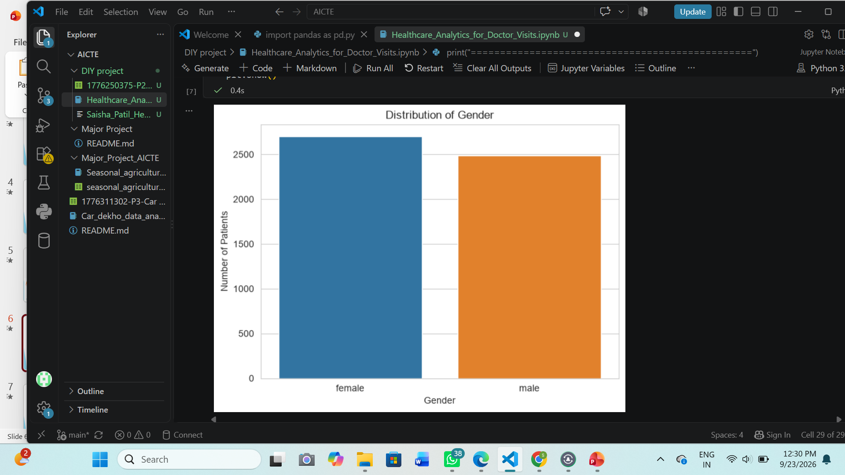
RESULTS
[Add screen shots of your code ]
Demo Link
https://github.com/patilsaisha1404-dot/AICTE_VOIS_Fortech_Internship/tree/main/DIY_PROJECT

Slide 7
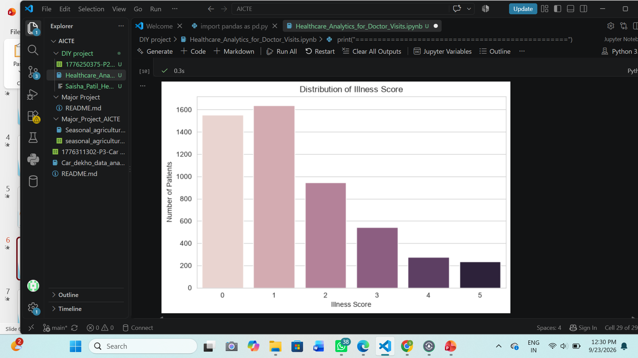
RESULTS
https://github.com/patilsaisha1404-dot/AICTE_VOIS_Fortech_Internship/tree/main/DIY_PROJECT

Slide 8
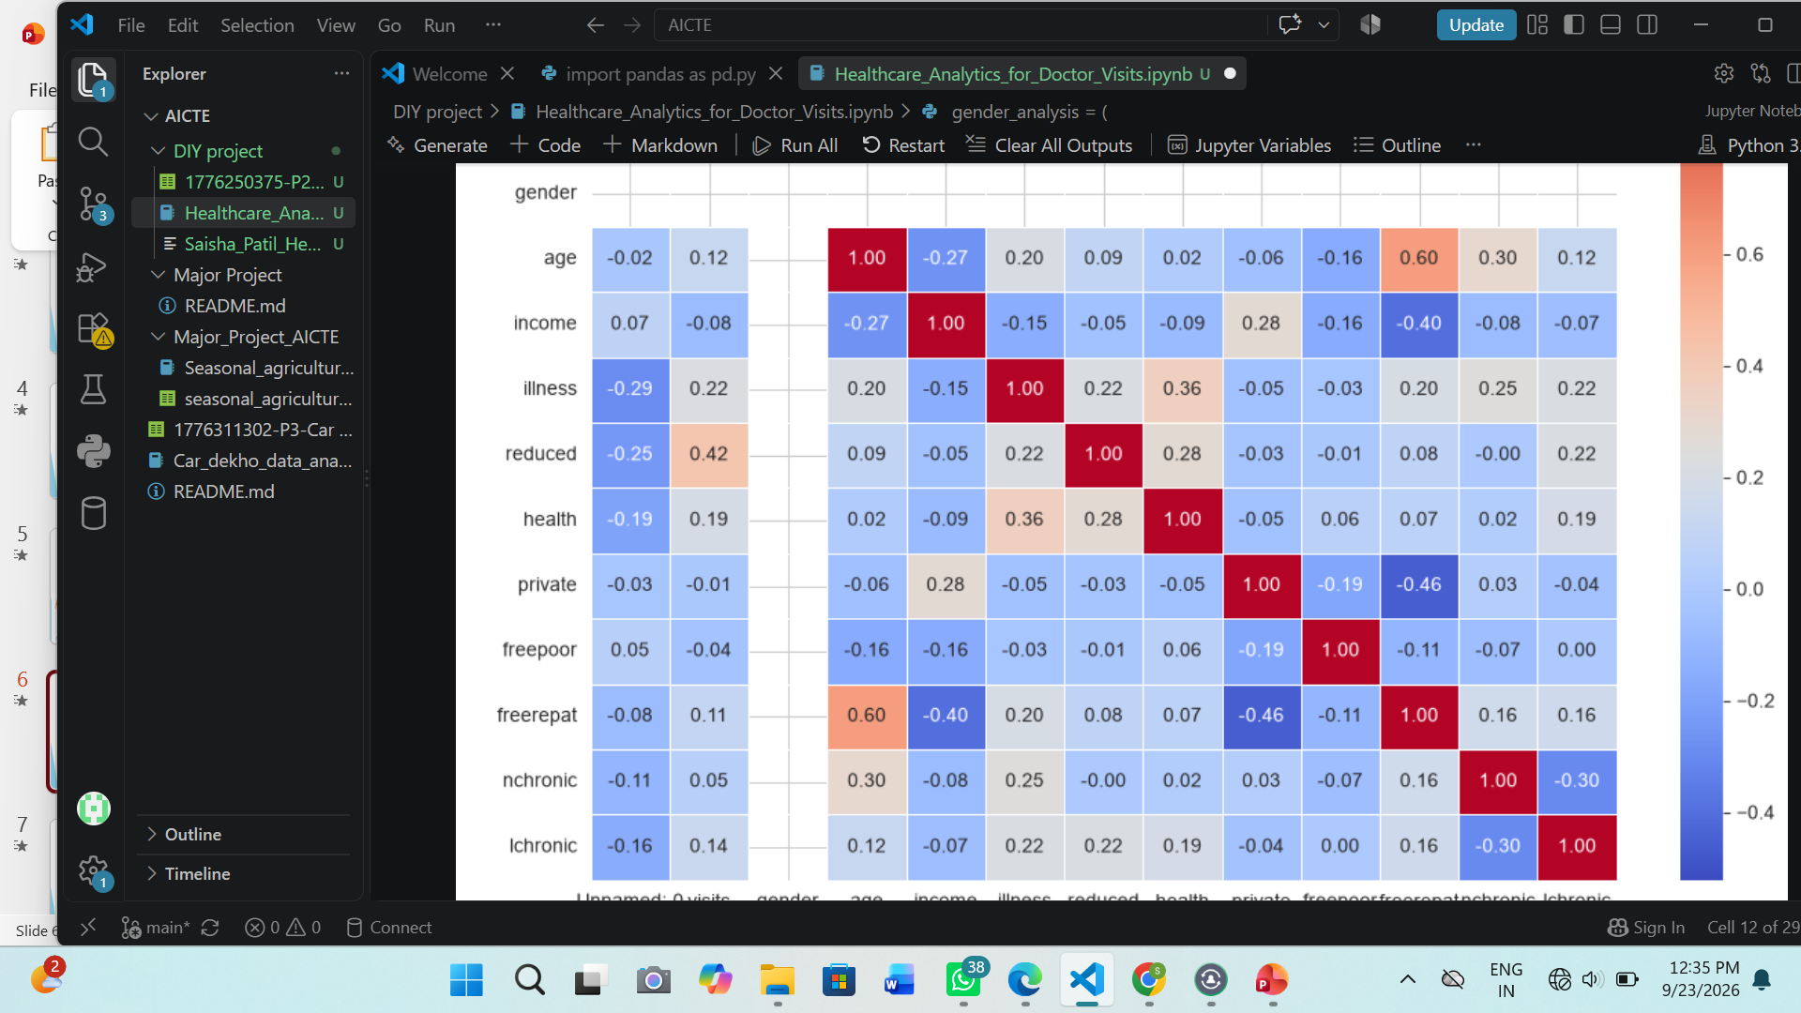
RESULTS
https://github.com/patilsaisha1404-dot/AICTE_VOIS_Fortech_Internship/tree/main/DIY_PROJECT

Slide 9
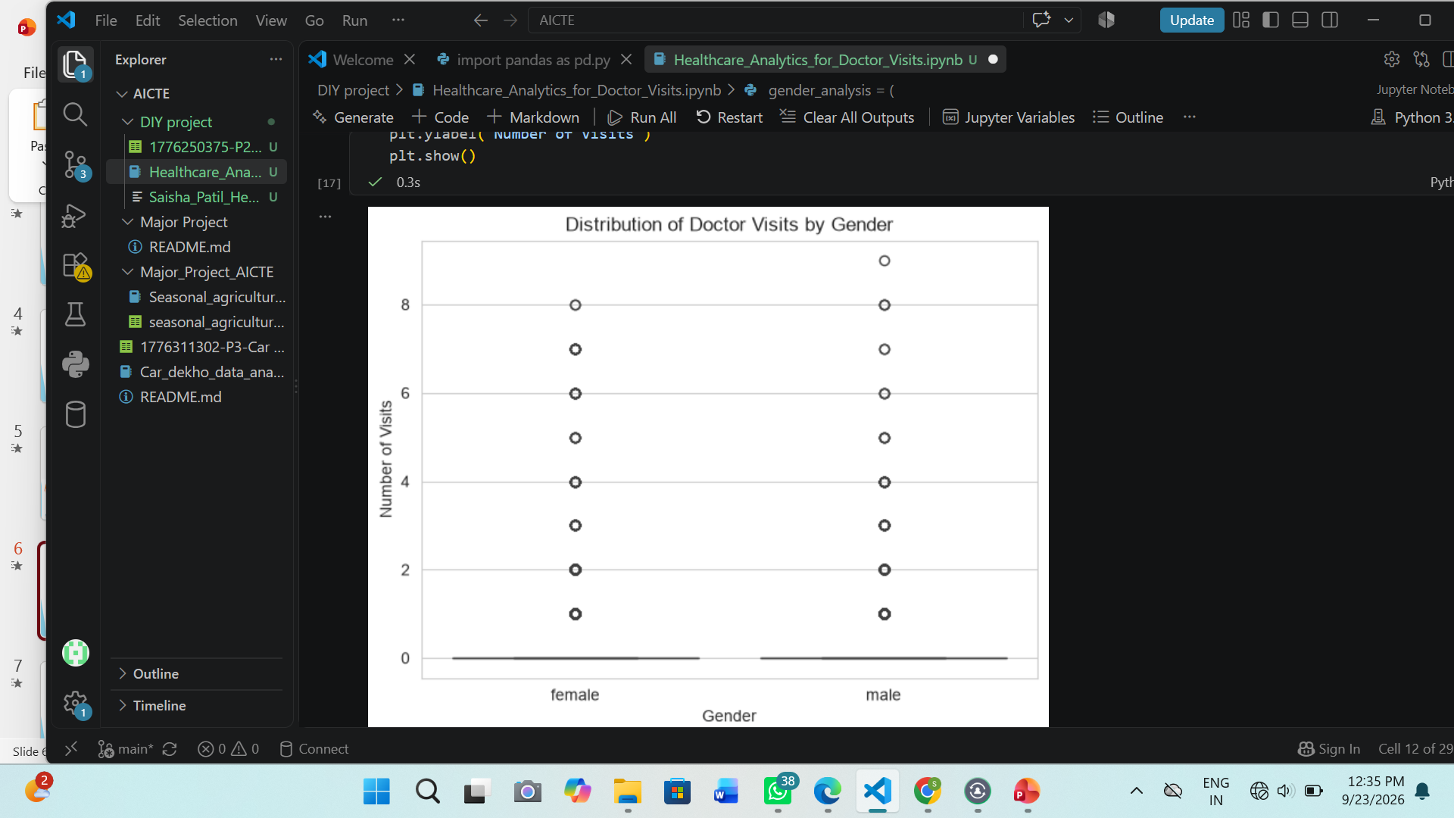
RESULTS
https://github.com/patilsaisha1404-dot/AICTE_VOIS_Fortech_Internship/tree/main/DIY_PROJECT

Slide 10
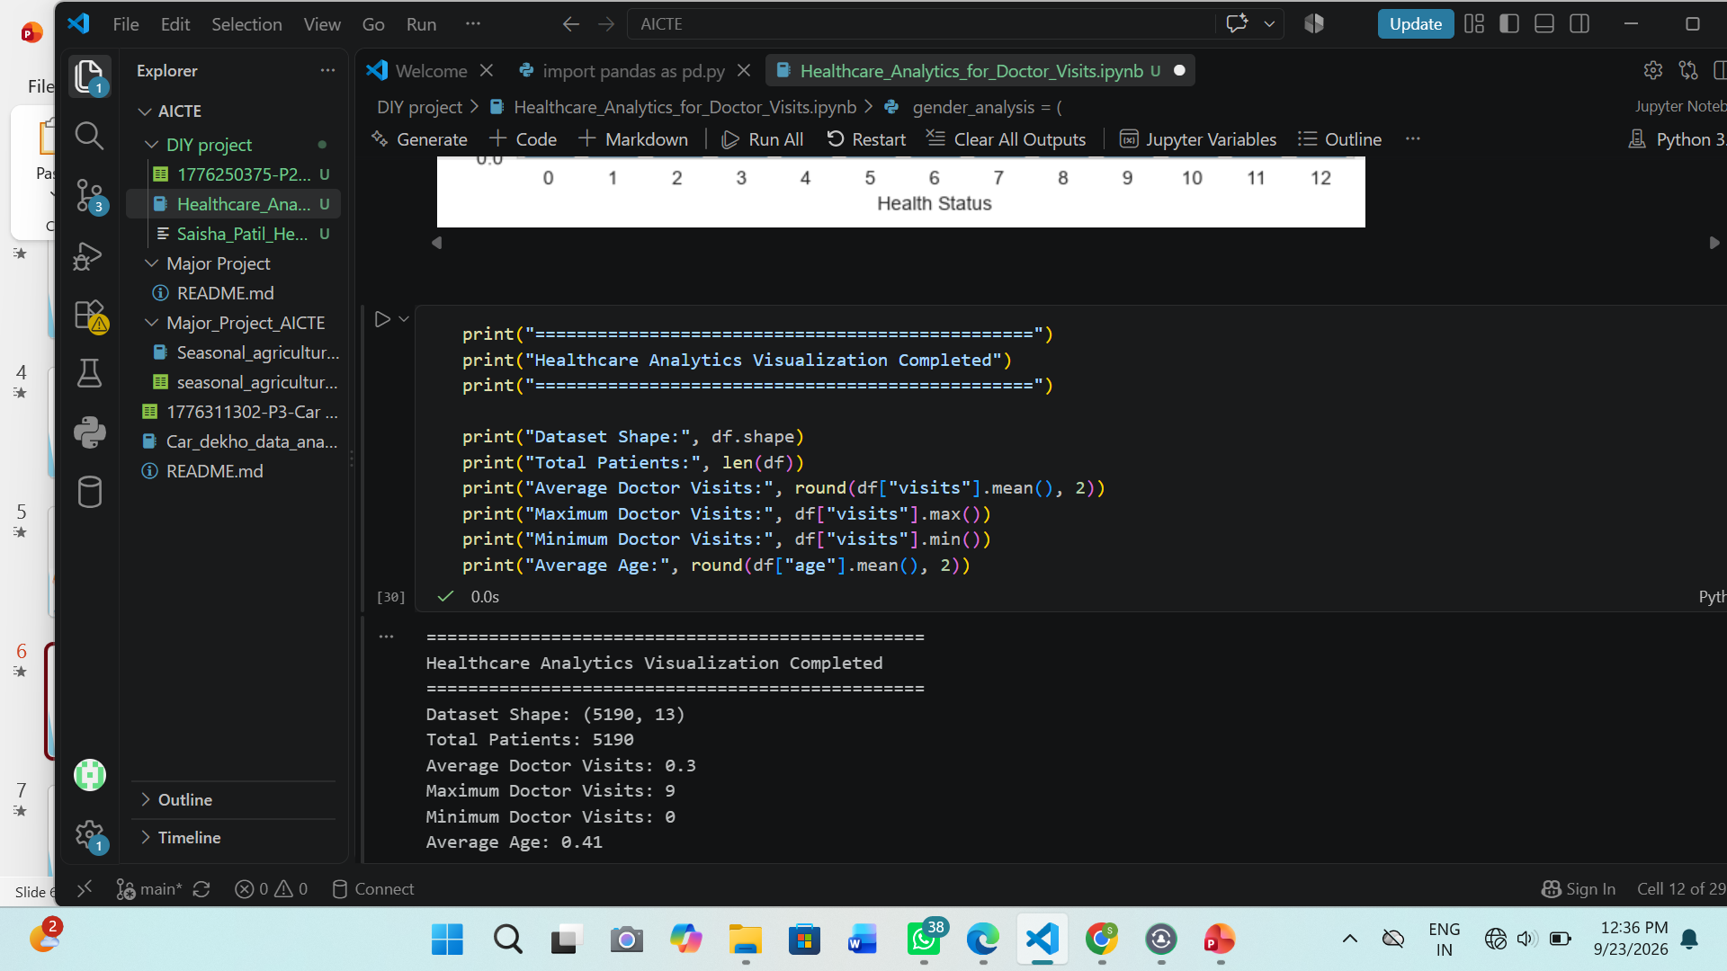
RESULTS
https://github.com/patilsaisha1404-dot/AICTE_VOIS_Fortech_Internship/tree/main/DIY_PROJECT

Slide 11
Thank you
.
.

