Slide 1


Coffee Shop Management System

Slide 2


Introduction
The Coffee Shop Management System will help the owner to extract valuable insights from the data like order summary, customer order details, top product sale wise, etc. using SQL queries. It will make their task quick and simple, saving the time for focusing on making improvements or enhancements required in increasing the profitability of the business.

Slide 3
Table of contents
ER Diagram
Tables
Sub-Queries
Joins
Views

Slide 4
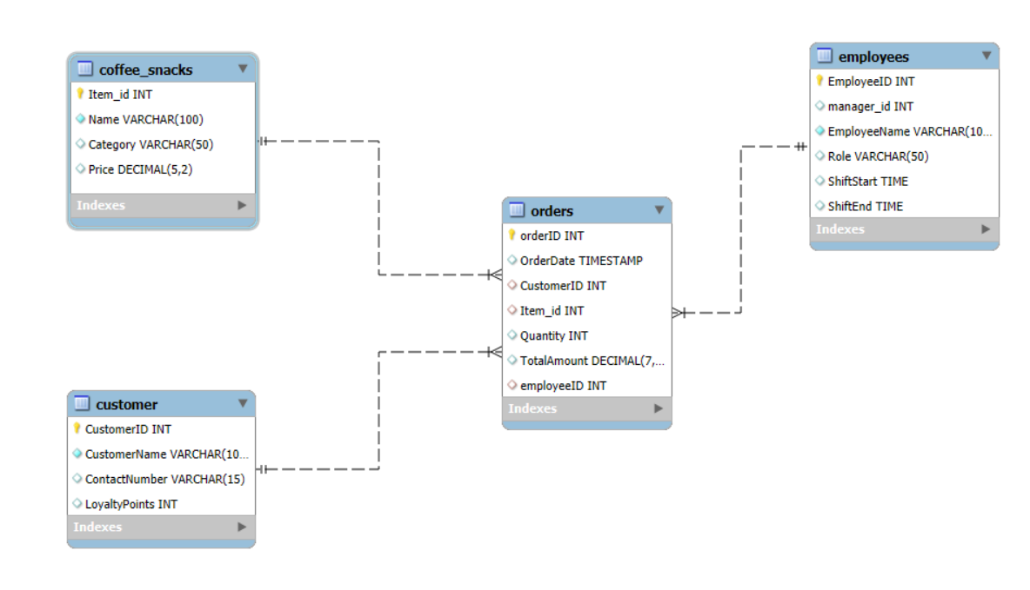
ER Diagram

Slide 5
Tables

Slide 6
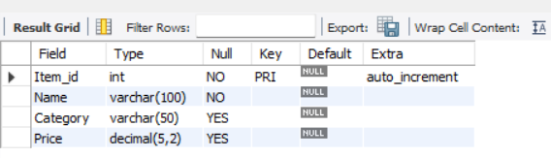
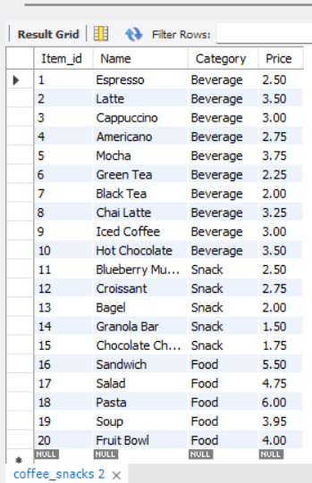
Coffee_snacks table
The table shows the list of coffees and snacks served, their id and price.
Description desc coffee_snacks;
Contents select * from coffee_snacks;

Slide 7
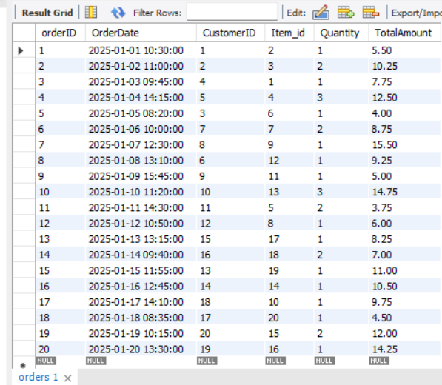
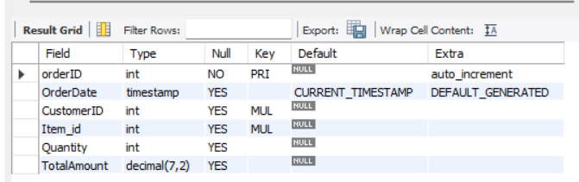
Orders table
The table shows details of orders placed like orderId, quantity and total amount.
Description desc orders;
Contents select * from orders;

Slide 8
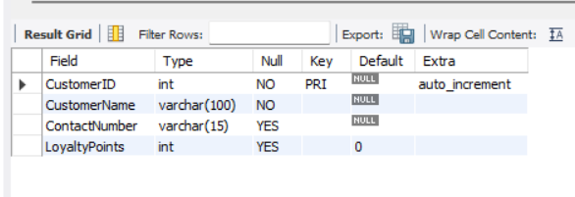
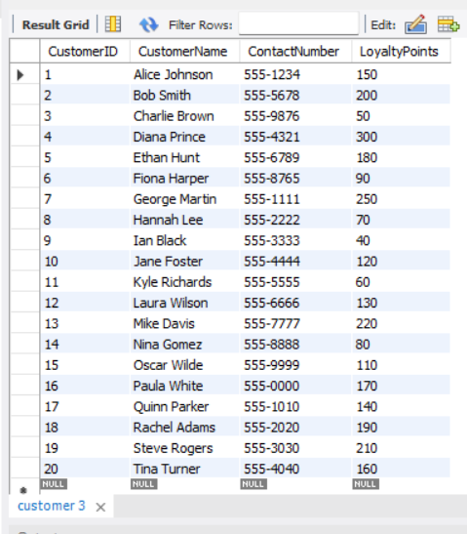
Customer table
The table shows details of customers like customerId, name and loyalty points.
Description desc customer;
Contents select * from customer;

Slide 9
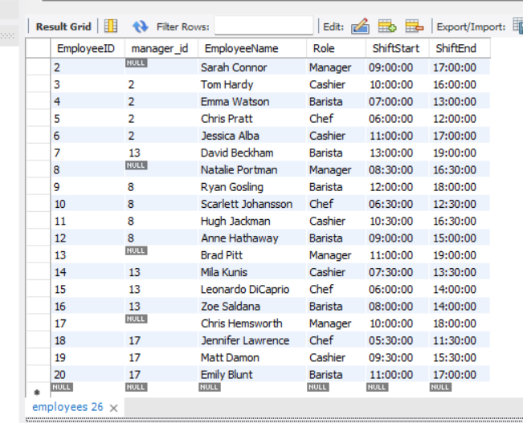
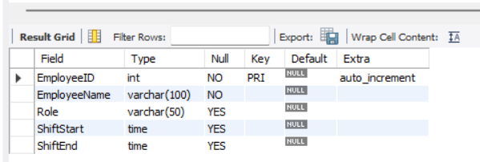
Employees table
The table shows details of employees like id, name, role and shift details.
Description desc employees;
Contents select * from employees;

Slide 10
Sub-Queries

Slide 11
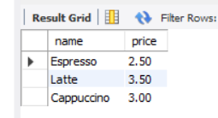
Display top 3 selling items with their price.
Syntax:
select name, price from coffee_snacks
where item_id in
(select item_id from orders group by item_id
order by sum(quantity))
limit 3;

Slide 12
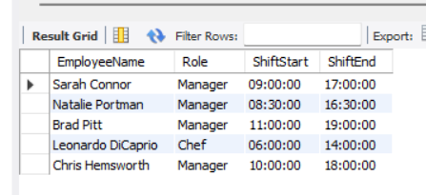
Display the names of the employees who worked more than the average shift time.
Syntax:
select EmployeeName, Role, ShiftStart, ShiftEnd
from Employees
where timediff(ShiftEnd, ShiftStart) >
(select avg(timediff(ShiftEnd, ShiftStart))
from Employees);

Slide 13
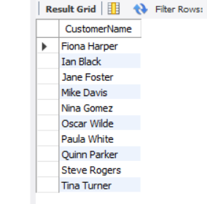
Display the names of the customers who didn’t order from beverage category.
Syntax:
select CustomerName from Customer
where CustomerID not in
(select distinct CustomerID from orders WHERE Item_ID in (select Item_ID from coffee_snacks where Category = 'Beverage'));

Slide 14
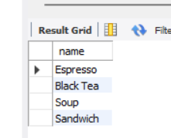
Display the names of the items ordered by customers with more than 200 Loyalty Points.
Syntax:
select name from coffee_snacks
where item_id in
(select item_id from orders
where CustomerID in
(select CustomerID from customer
where LoyaltyPoints > 200
)
);

Slide 15
Joins

Slide 16
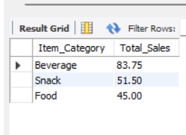
Display total sales for each category.
Syntax:
select cs.Category as Item_Category, sum(o.TotalAmount) as Total_Sales from orders o join coffee_snacks cs
on o.Item_id = cs.Item_id
group by cs.Category;

Slide 17
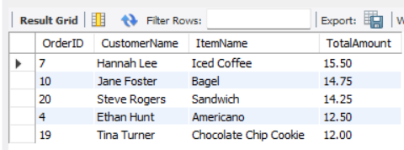
Display top 5 highest spending customers with their orders and total amount spent.
Syntax:
select Orders.OrderID,
Customer.CustomerName, coffee_Snacks.Name as ItemName,
Orders.TotalAmount
from Orders INNER JOIN Customer
on Orders.CustomerID = Customer.CustomerID
INNER JOIN Coffee_Snacks
on Orders.Item_id = Coffee_Snacks.Item_id
where Customer.CustomerID in
(selectTopCustomers.CustomerID from (select CustomerID from Orders group by CustomerID
order by sum(TotalAmount) desc
limit 5)
as TopCustomers);

Slide 18
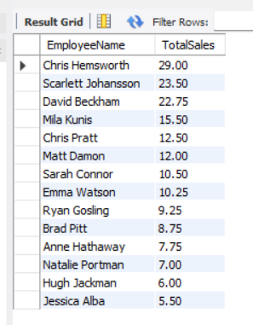
Display total sales handled by each employee.
Syntax:
select Employees.EmployeeName, sum(Orders.TotalAmount) as TotalSales
from
Orders INNER JOIN Employees
on Orders.employeeID = Employees.EmployeeID
Group by Employees.EmployeeName
order by TotalSales desc;

Slide 19
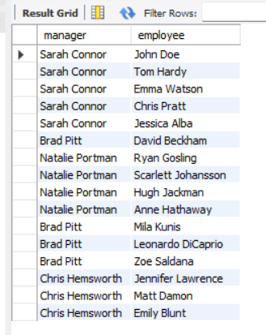
Display employee hierarchy.
Self Join
Syntax:
select e1.EmployeeName as manager,
e2.EmployeeName as employee
from Employees e1 JOIN Employees e2
ON e1.employeeid = e2.manager_ID;

Slide 20
Views

Slide 21
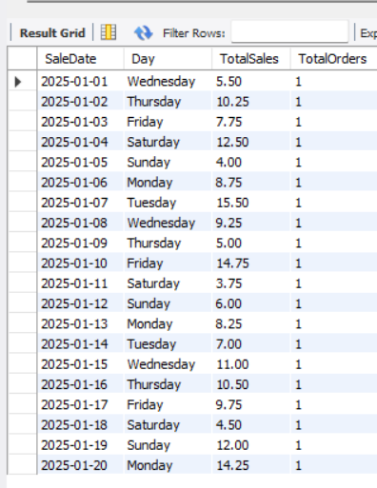
Daily Sales Report.
Syntax:
create view DailySales as
select
DATE(OrderDate) as SaleDate, DAYNAME(OrderDate) as Day, SUM(TotalAmount) as TotalSales, COUNT(OrderID) as TotalOrders
from Orders
group by SaleDate, Day
order by SaleDate;

Slide 22
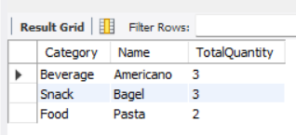
Items sold with highest quantities in each category.
Syntax:
create view CategoryMaxQty as
with CategoryTotals as
(select cs.category,cs.name,max(o.quantity) as totalquantity from coffee_snacks cs left join orders o on cs.item_id = o.item_id group by cs.name,cs.category order by totalquantity desc),
MaxTotals as
(select cs.category,max(o.quantity) as totalquantity from coffee_snacks cs left join orders o on cs.item_id = o.item_id group by category)
select ct.Category, ct.Name, ct.TotalQuantity
from CategoryTotals ct JOIN MaxTotals mct
on ct.Category = mct.Category AND ct.TotalQuantity = mct.totalQuantity;
select * from CategoryMaxQty;

