Slide 1
Seaborn is an amazing visualization library for statistical graphics plotting in Python. It provides beautiful default styles and color palettes to make statistical plots more attractive. It is built on top matplotlib library and is also closely integrated with the data structures from pandas
Seaborn vs. Matplotlib
a main differences between Matplotlib and Seaborn is their focus. Matplotlib is a low-level plotting library that provides wide range of tools for creating highly customizable visualizations. It is a highly flexible library, allowing users to create almost any type of plot they can imagine. This flexibility comes at the cost of a steeper learning curve and more verbose code.
Seaborn, on the other hand, is a high-level interface for creating statistical graphics. It is built on top of Matplotlib and provides a simpler, more intuitive interface for creating common statistical plots. Seaborn is designed to work with Pandas dataframes, making it easy to create visualizations with minimal code. It also offers a range of built-in statistical functions, allowing users to easily perform complex statistical analyses with their visualizations.
Another key difference between Matplotlib and Seaborn is their default styles and color palettes. Matplotlib provides a limited set of default styles and color palettes, requiring users to customize their plots manually to achieve a desired look. Seaborn, on the other hand, offers a range of default styles and color palettes that are optimized for different types of data and visualizations. This makes it easy for users to create visually appealing plots with minimal customization.

Slide 2
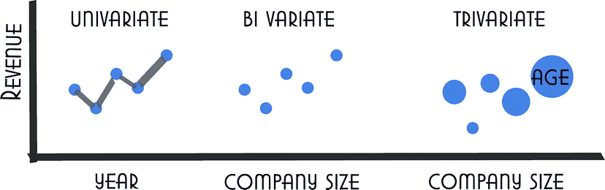
Seaborn Plot types
Univariate – x only (contains only one axis of information)
Bivariate – x and y (contains two axis of information)
Trivariate – x, y, z (contains three axis of information)

Slide 3
Type Of Different Plot Using Seaborn
Scatter Plot. A scatter plot is used to visualize the relationship between two variables. Seaborn's scatterplot() function provides a simple way to create scatter plots.
Line Plot. A line plot is used to visualize the trend of a variable over time. Seaborn's lineplot() function provides a simple way to create line plots.
Histogram. A histogram is used to visualize the distribution of a variable. Seaborn's histplot() function provides a simple way to create histograms.
Box Plot. A box plot is used to visualize the distribution of a variable. Seaborn's boxplot() function provides a simple way to create box plots.
Violin Plot. A violin plot is similar to a box plot, but provides a more detailed view of the distribution of the data. Seaborn's violinplot() function provides a simple way to create violin plots.
Heatmap. A heatmap is used to visualize the correlation between different variables. Seaborn's heatmap() function provides a simple way to create heatmaps.
Pairplot. A pairplot is used to visualize the relationship between multiple variables. Seaborn's pairplot() function provides a simple way to create pairplots.

Slide 4
Seaborn scatter plots
Scatter plots are used to visualize the relationship between two continuous variables. Each point on the plot represents a single data point, and the position of the point on the x and y-axis represents the values of the two variables.

Slide 5
import seaborn as sns
import matplotlib.pyplot as plt
tips = sns.load_dataset("tips")
sns.scatterplot(x="total_bill", y="tip", hue="sex", size="size", sizes=(50, 200), data=tips)
plt.xlabel("Total Bill")
plt.ylabel("Tip")
plt.title("Relationship between Total Bill and Tip")
plt.show()

Slide 6
Seaborn line plots
Line plots are used to visualize trends in data over time or other continuous variables.
In a line plot, each data point is connected by a line, creating a smooth curve.
In Seaborn, line plots can be created using the lineplot() function.
import seaborn as sns
import matplotlib.pyplot as plt
fmri = sns.load_dataset("fmri")
sns.lineplot(x="timepoint", y="signal", hue="event", style="region", markers=True, dashes=False, data=fmri)
plt.xlabel("Timepoint")
plt.ylabel("Signal Intensity")
plt.title("Changes in Signal Intensity over Time")
plt.show()

Slide 7
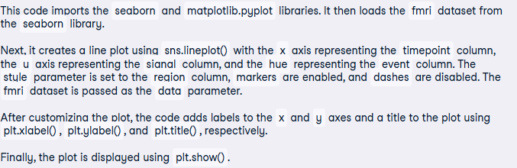

Slide 8
Seaborn bar plots
Bar plots are used to visualize the relationship between a categorical variable and
a continuous variable. In a bar plot, each bar represents the mean or median (or any aggregation)
of the continuous variable for each category.
In Seaborn, bar plots can be created using the barplot() function.
import seaborn as sns
import matplotlib.pyplot as plt
titanic = sns.load_dataset("titanic")
sns.barplot(x="class", y="fare", hue="sex", ci=None, palette="muted", data=titanic)
plt.xlabel("Class")
plt.ylabel("Fare")
plt.title("Average Fare by Class and Gender on the Titanic")
plt.show()

Slide 9
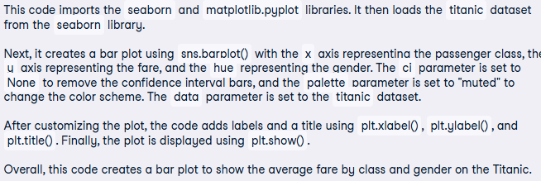

Slide 10
Seaborn histograms
Histograms visualize the distribution of a continuous variable. In a histogram, the data is divided into
bins and the height of each bin represents the frequency or count of data points within that bin.
In Seaborn, histograms can be created using the histplot() function.
import seaborn as sns
import matplotlib.pyplot as plt
iris = sns.load_dataset("iris")
sns.histplot(data=iris, x="petal_length", bins=20, kde=True, color="green")
plt.xlabel("Petal Length (cm)")
plt.ylabel("Frequency")
plt.title("Distribution of Petal Lengths in Iris Flowers")
plt.show()

Slide 11
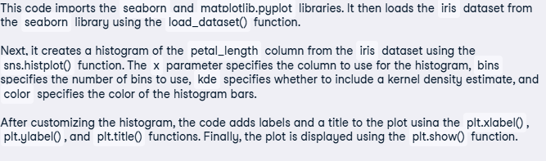

Slide 12
Seaborn density plots
Density plots, also known as kernel density plots, are a type of data visualization that display the distribution of a continuous variable.
They are similar to histograms, but instead of representing the data as bars, density plots use a smooth curve to estimate the density of the data.
In Seaborn, density plots can be created using the kdeplot() function.
import seaborn as sns
import matplotlib.pyplot as plt
tips = sns.load_dataset("tips")
sns.kdeplot(data=tips, x="total_bill", hue="time", fill=True, alpha=0.6, linewidth=1.5)
plt.title("Density Plot of Total Bill by Meal Time")
plt.xlabel("Total Bill ($)")
plt.ylabel("Density")
plt.show()

Slide 13
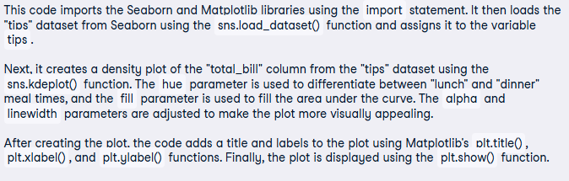

Slide 14
Seaborn box plots
Box plots are a type of visualization that shows the distribution of a dataset. They are commonly used to compare the distribution of one or more variables across different categories.
import seaborn as sns
tips = sns.load_dataset("tips")
sns.boxplot(x="day", y="total_bill", data=tips)

Slide 15
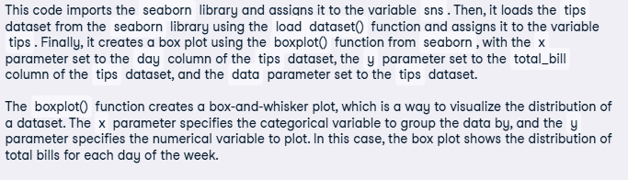

Slide 16
Seaborn violin plots
A violin plot is a type of data visualization that combines aspects of both box plots and density plots. It displays a density estimate of the data, usually smoothed by a kernel density estimator, along with the interquartile range (IQR) and median in a box plot-like form.
The width of the violin represents the density estimate, with wider parts indicating higher density, and the IQR and median are shown as a white dot and line within the violin.
import seaborn as sns
iris = sns.load_dataset("iris")
sns.violinplot(x="species", y="petal_length", data=iris)
plt.show()

Slide 17
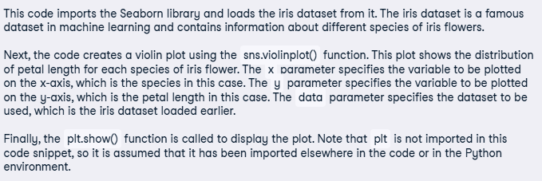

Slide 18
Seaborn heatmaps
A heatmap is a graphical representation of data that uses colors to depict the value of a variable in a two-dimensional space. Heatmaps are commonly used to visualize the correlation between different variables in a dataset.
import seaborn as sns
import matplotlib.pyplot as plt
tips = sns.load_dataset('tips')
corr = tips.corr()
sns.heatmap(corr)
plt.show()

Slide 19
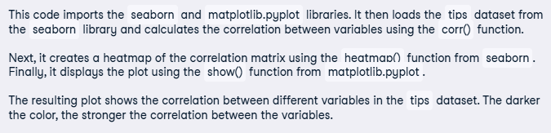

Slide 20
Seaborn pair plots
Pair plots are a type of visualization in which multiple pairwise scatter plots are displayed in a matrix format. Each scatter plot shows the relationship between two variables, while the diagonal plots show the distribution of the individual variables.
import seaborn as sns
iris = sns.load_dataset("iris")
sns.pairplot(data=iris)
plt.show()

Slide 21
