Slide 1
Project 4 b: Sayali Sanjay Patil
Exploratory Data Analysis of Large-Scale Industry Performance Dataset Using Univariate, Bivariate, and Multivariate Statistical Techniques

Slide 2
Project Overview
• Dataset contains 15,000 company records and 12 original columns.
• Objective: explore company performance patterns and build a regression model to predict annual revenue.
• Target variable: annual_revenue_million.
• Workflow: data checks → EDA → feature engineering → model training → evaluation → sample prediction.
• Five regression algorithms were compared using MAE, RMSE and R².
2

Slide 3
Dataset at a Glance
Item | Notebook result
Records | 15,000 rows
Original columns | 12
Missing values | 0 across all columns
Duplicate rows | 0
Industry groups | Finance, Technology, Retail, Manufacturing, Healthcare
Countries | India, Germany, Canada, USA
Regions | Asia, Europe, North America
The dataset remained at 15,000 × 12 after duplicate checking.
3

Slide 4
Variables & Feature Engineering
• Numeric inputs: employee count, profit margin, founded year, customer count and market rating.
• Categorical inputs: industry, country and region.
• Date was converted to datetime using day-first parsing.
• Derived features: created_year, created_month, created_quarter and company_age.
• Excluded id, company_name and the raw created_date from model inputs.
• Split: 12,000 training records (80%) and 3,000 testing records (20%); random_state = 42.
4

Slide 5
Descriptive Statistics
Variable | Mean | Minimum | Maximum
Employee count | 2,606.86 | 100 | 5,099
Annual revenue (million) | 549.73 | 50.16 | 1,049.96
Profit margin (%) | 25.01 | 5.00 | 45.00
Founded year | 2004.37 | 1990 | 2019
Customer count | 50,449.25 | 500 | 100,495
Market rating | 2.51 | 0.0 | 5.0
Revenue averages about 549.73 million in the dataset; units follow the source column name.
5

Slide 6
Categorical Distribution
Category | Group | Records
Industry | Finance | 3,000
Industry | Technology | 3,000
Industry | Retail | 3,000
Industry | Manufacturing | 3,000
Industry | Healthcare | 3,000
Country | India / Germany / Canada / USA | 3,750 each
Region | North America | 7,500
Region | Asia / Europe | 3,750 each
6

Slide 7
Data Quality & EDA
• No missing values were reported in the original columns.
• No duplicate rows were found; the row count stayed at 15,000.
• IQR-based checks reported zero outliers for the six numeric variables examined.
• Histograms/boxplots, category counts, correlation heatmap and scatterplots were generated.
• Employee count vs revenue, customer count vs revenue and industry vs revenue were explored.
• Skewness values were close to zero for the six numeric variables, indicating near-symmetric distributions in this generated dataset.
7

Slide 8
Regression Models Compared
Model | MAE | RMSE | R²
Linear Regression | 248.278 | 287.337 | -0.0012
Random Forest | 248.727 | 287.981 | -0.0057
Gradient Boosting | 249.231 | 288.886 | -0.0121
Extra Trees | 250.440 | 290.741 | -0.0251
Decision Tree | 254.220 | 297.177 | -0.0710
8

Slide 9
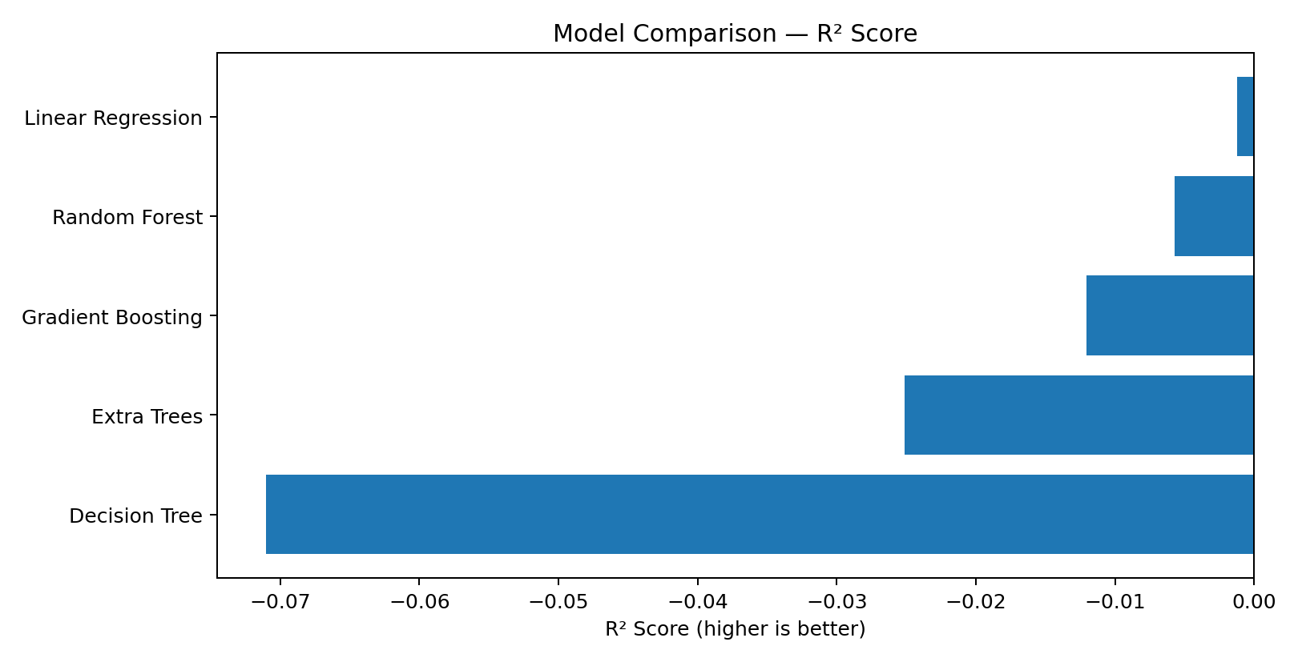
Model Comparison: R²
A negative R² means the model performs slightly worse than a simple baseline that predicts the test-set mean.
9

Slide 10
Best Model & Test Predictions
Linear Regression
• Predictions are clustered near roughly 550 million.
• The actual test revenues vary much more widely.
• This suggests the current features/model do not explain revenue differences well.
Metric | Value
MAE | 248.278
RMSE | 287.337
R² | -0.001235
Train / test records | 12,000 / 3,000
10

Slide 11
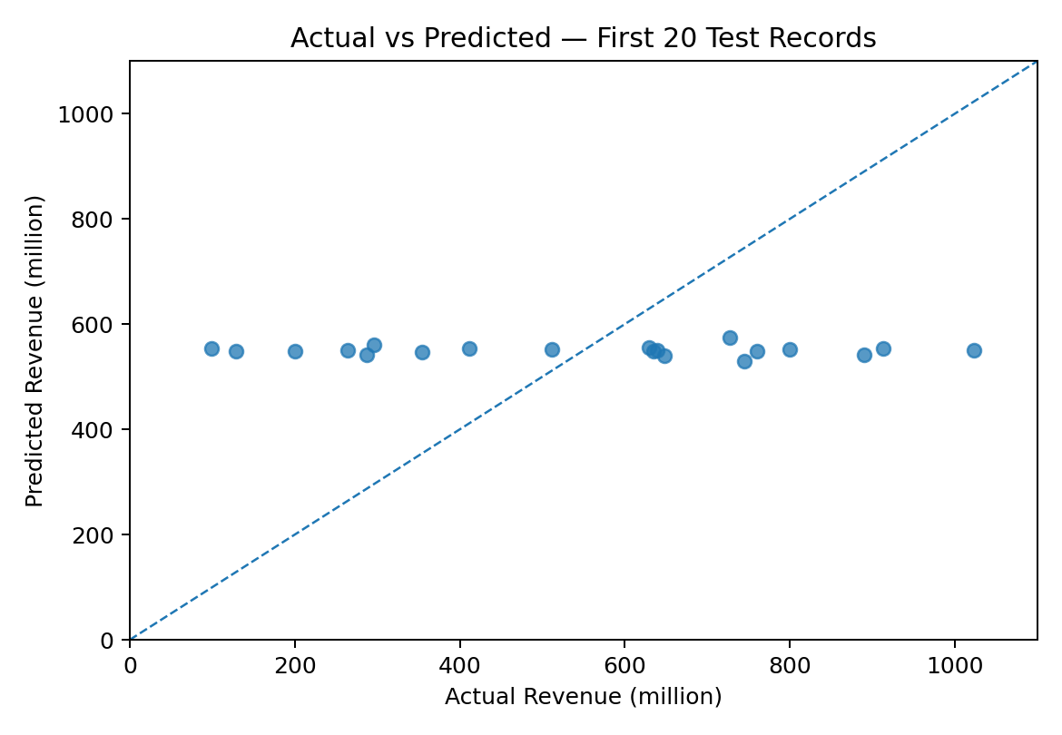
Actual vs Predicted Revenue
• Predictions stay close to the average.
• High and low actual revenues are not tracked closely.
• Use this chart as a visual diagnostic, not evidence of a reliable production model.
11

Slide 12
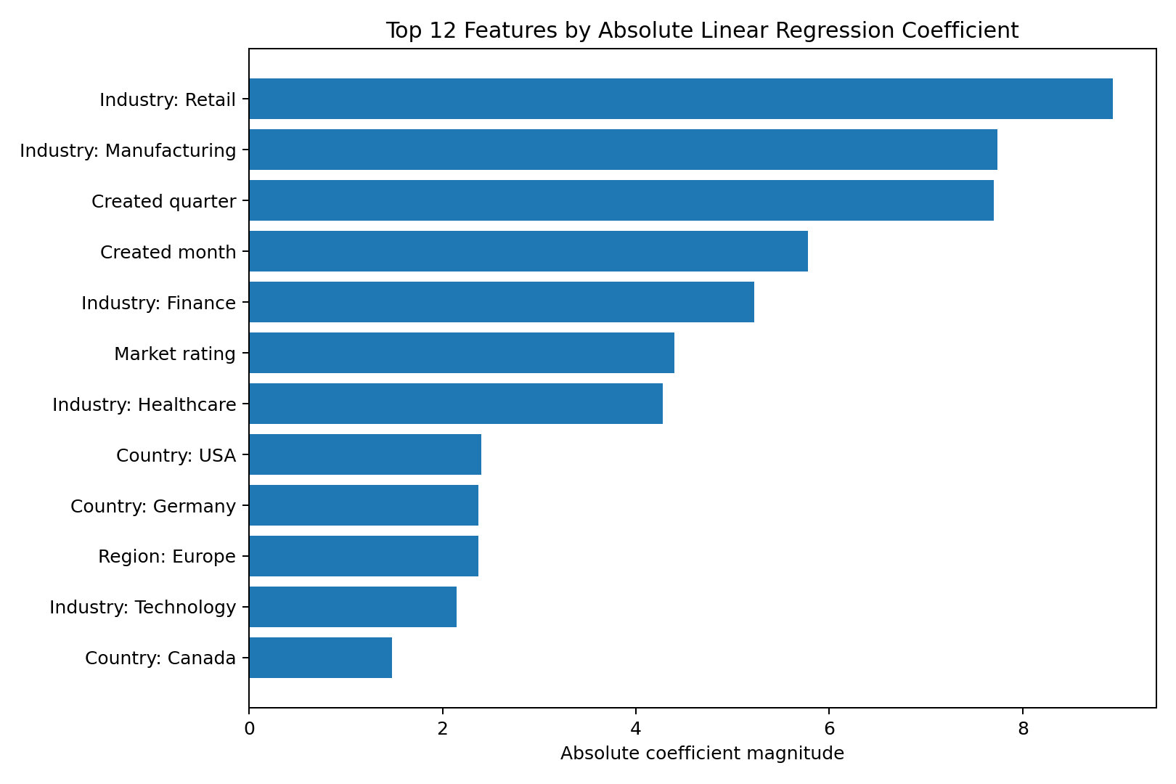
Feature Interpretation
• Retail industry: +8.93
• Manufacturing industry: −7.74
• Created quarter: +7.70
• Created month: −5.78
• Market rating: +4.40
• These are coefficient magnitudes/signs, not causal effects. Numeric scaling and one-hot encoding affect interpretation.
12

Slide 13
New Company Prediction
Predicted annual revenue
552.91 million
Input example shown in code
• Industry: Technology
• Country: India
• Employee count: 3,500
• Profit margin: 35.5%
• The prediction is an illustrative model output; current model accuracy is weak, so it should not be used for business decisions.
13

Slide 14
Conclusion & Key Takeaways
• The dataset was clean on missing values and duplicate checks.
• The EDA covered numeric distributions, category counts, outlier checks and relationships between selected variables.
• Linear Regression had the best R² among the five tested models, but R² ≈ −0.001 indicates very weak predictive value.
• The sample prediction of 552.91 million should be treated as exploratory only.
• Next steps: validate feature/target relationships, test stronger signal features, use cross-validation, compare against a mean baseline and investigate whether the dataset contains meaningful revenue patterns.
14

Slide 15
THANK YOU
Industry Performance Dataset — EDA & Machine Learning

