Slide 1
Business Problem
Microsoft want to get into movie making business like other big companies Amazon and Apple. They want to create movie studio and start creating movies which are most popular and people. My task is to analyze the data to recommend types of movies Microsoft can produce best movies which will result in highest popularity
Goals and Objectives
The goal of the data analysis is to study the database related to movies and recommend Microsoft to help their decision with making movies. My main objective of this analysis is to come up with three recommendations,
Study different titles of the movies and find out most popular movie title to follow
Study highest rating movies and recommend different characteristics for high rated movies
Study trends and patterns for highest grossing film

Slide 2
Methodology
The analysis of the data involve using the following database files:
imdb.title.basics
imdb.title.ratings
bom.movie_gross
The following steps are followed for detailed analysis of the files,
Import relevant libraries & modules
Read in the data
Clean the data
Check for null values
Impute or drop null values
Check for duplicate values
Delete repeated data
Join different tables where necessary

Slide 3
Detailed Methodology
Data Analysis for Recommendation 1
Conduct data analysis of various movie titles
Make visualizations
Summarize findings
Data Analysis for Recommendation 2
Conduct data analysis of movie ratings
Make visualizations
Summarize findings
Data Analysis for Recommendation 3
Conduct data analysis of movie gross for various movies
Make visualizations
Summarize findings
Conclusion & Recommendations
Conclude findings
Offer recommendations

Slide 4
Python Libraries & Modules Used
Various python libraries used in the analysis are:
Pandas: a data analysis library we will use for its data structures and operations for manipulating numerical tables.
Numpy: an essential library for scientific computing in python
Matplotlib: a plotting library useful for making the graphs and visualizations we need.
Seaborn: a data visualization library based on matplotlib to make graphs more visually appealing.

Slide 5
Movie Data Used
The data provided comes from various sources but three main data used in the analysis is taken from the zipped data folder
Box Office Mojo
IMDB for titles
IMDB for ratings

Slide 6
Clean Data
I have used several methods to clean multiple dataframes,
info() and .head() method to view the structural shape of the dataframes including their structure and datatypes, as well as look into the dataframes themselves. Furthermore I have used this information to make informed decisions about how to manage missing and duplicated data.
value.sum() method to know if a dataframe had any missing or duplicated values.
dropna() and .drop_duplicates() to delete missing and duplicated values from the dataframes.
fillna() method in conjunction with the .median() method to fill the missing values with the median value of a particular column of a dataframe.
merge() method to join dataframes with useful data on identical columns
replace() methods to alter the values within columns.

Slide 7
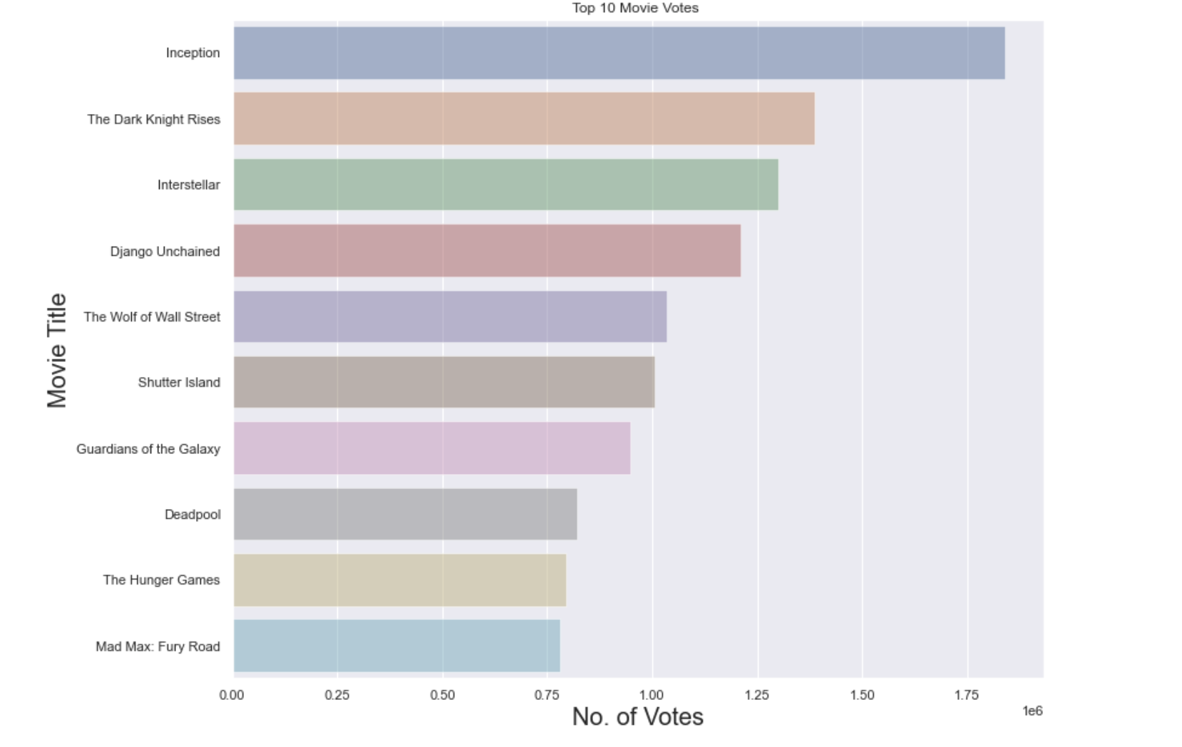
Q1: Study different titles of the movies and find out most popular movie titles to follow?
The analysis of top 10 movies based upon the highest number of votes reveal that Action and adventure films (Figure below) are most popular genre of movies. Based on the data generated and the bar charts the Microsoft has to focus on Action and Adventure movies.

Slide 8
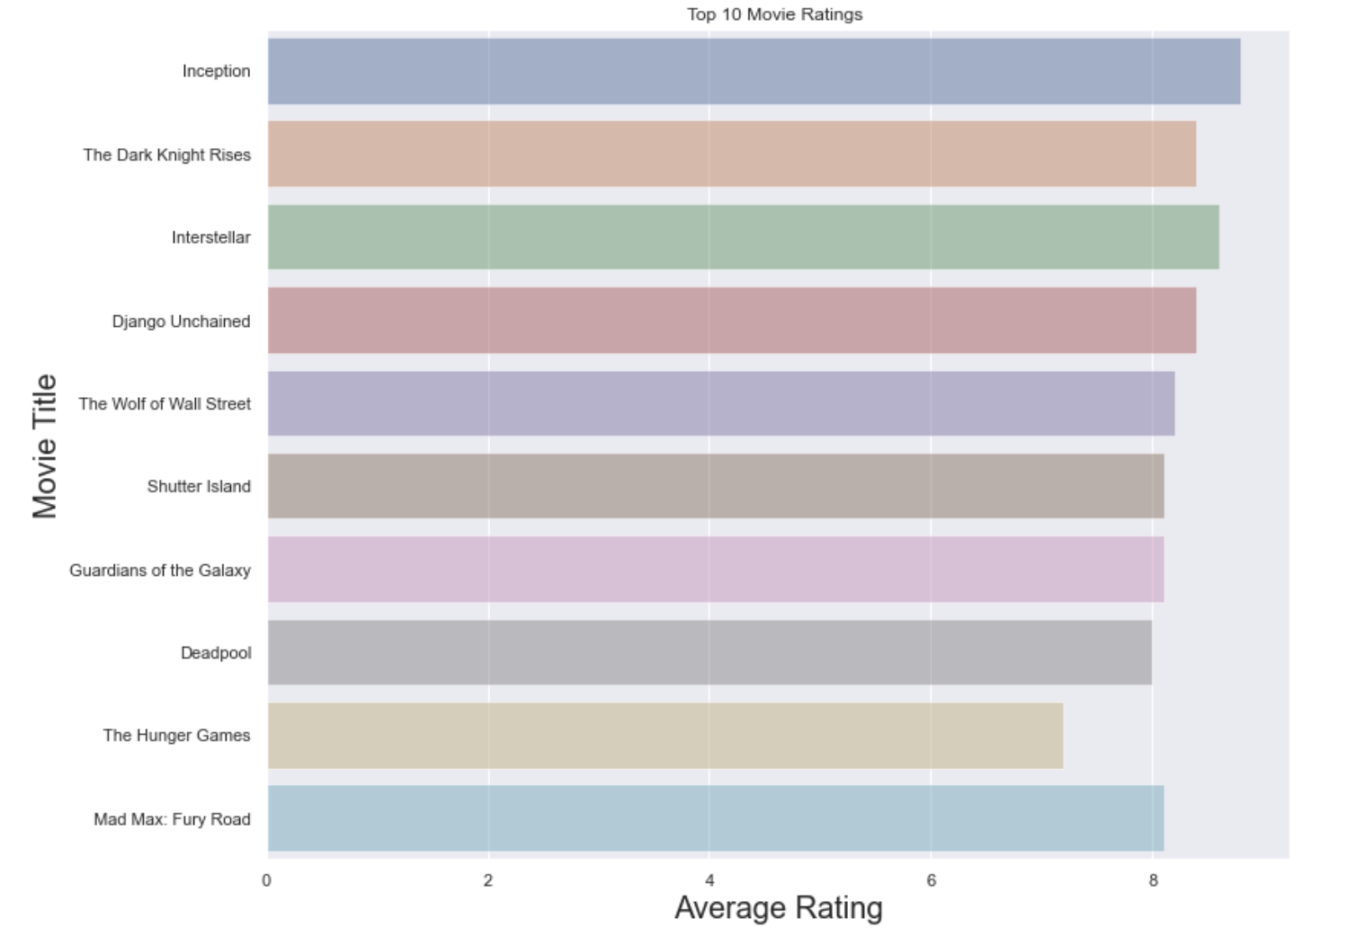
Q2: Study highest rating movies and recommend different characteristics for high rated movies?
The analysis of top 10 movies based upon the highest rating of movies reveal that Action and adventure films (Figure below) are most popular genre of movies. Similar to Q1 based on the data generated and the bar charts the Microsoft has to focus on Action and Adventure movies.

Slide 9
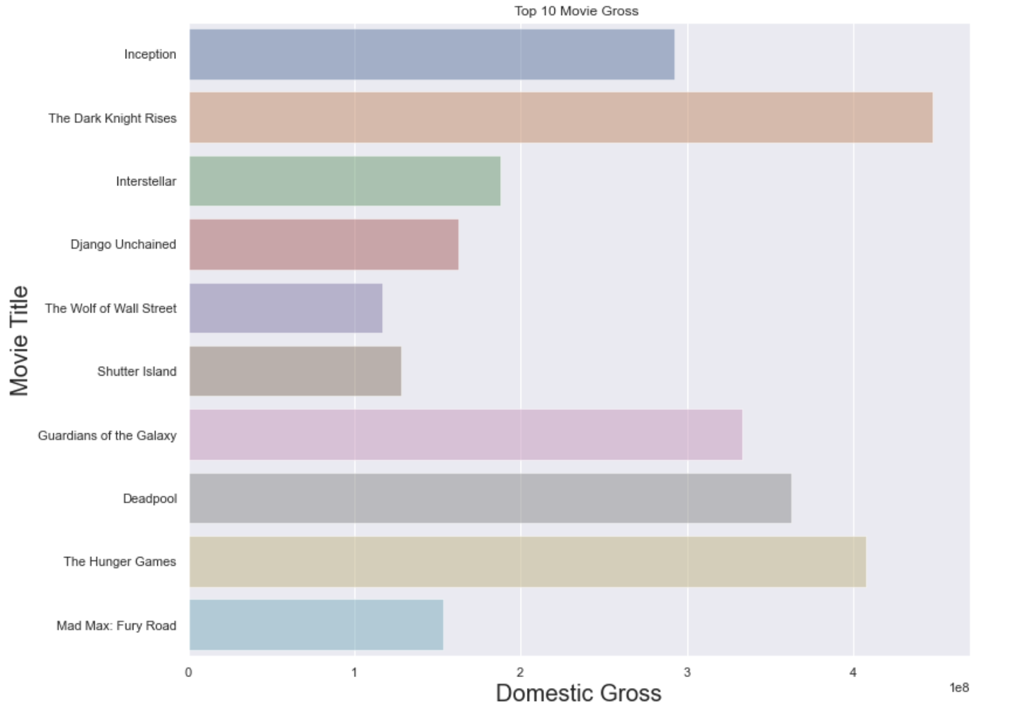
Q3: Study trends and patterns for highest grossing film?
The analysis of top 10 movies based upon the highest gross of movies reveal that Action and adventure films (Figure below) are most popular genre of movies. Similar to Q1 and Q2 based on the data generated and the bar charts the Microsoft has to focus on Action and Adventure movies.

