Slide 1

Grade 1 : Truth and Lies

Slide 2
What do you think is correct?
(Click on the right ones)
Telling someone what exactly happened
Hiding a part of the story
Blaming someone for something you did
Hiding actions that you know are wrong
Notes:
Context Slide

Slide 3
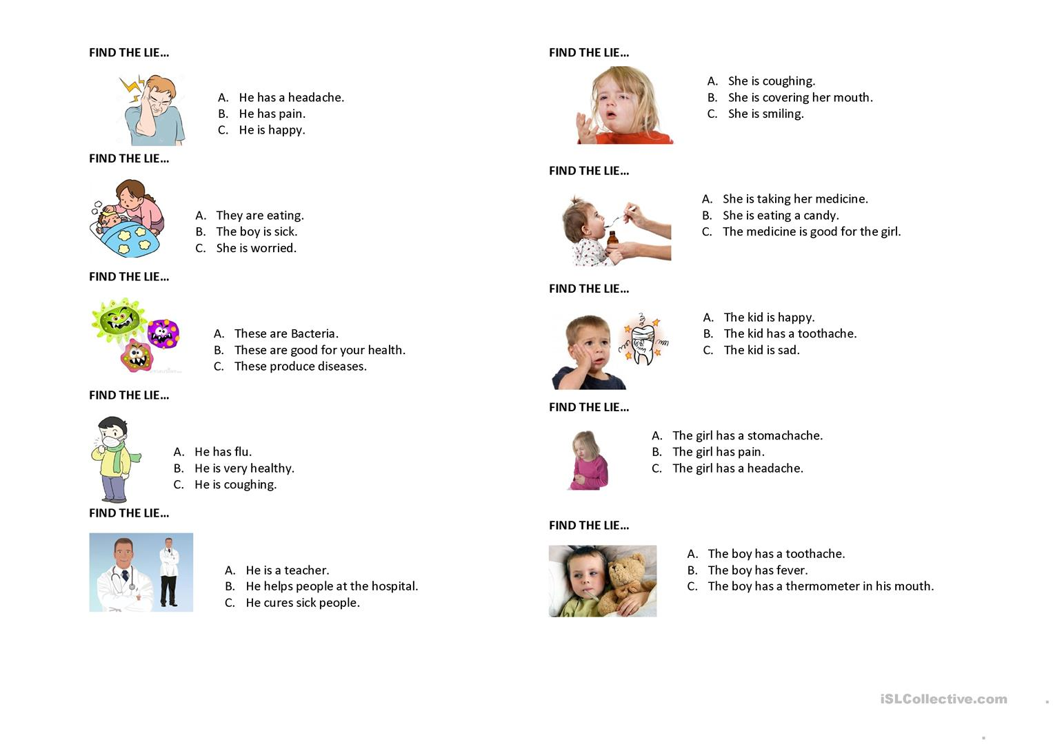
Notes:
Context slide - Recreate

Slide 4

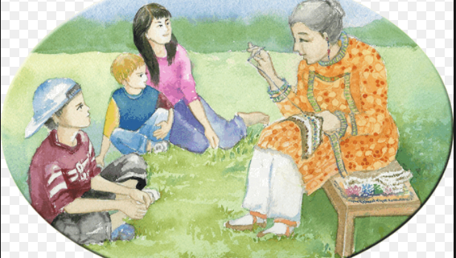
Truth and Lies
An afternoon with grandmother
It is summer vacation time
Every afternoon Keisha and her friends enjoy listening to grandmother’s stories
‘Grandmother, which story will you tell us today?’, Raghav asked
‘Today I will tell you about, “The boy who cried wolf”. Come sit near me.’
Notes:
Recreate image

Slide 5
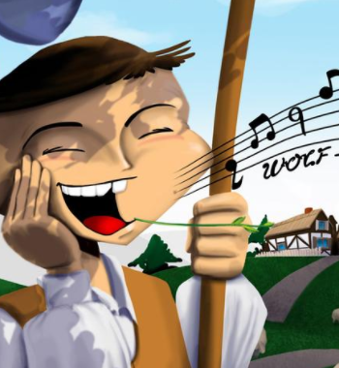
Truth and Lies
An afternoon with grandmother
‘A shepherd boy was with his sheep in the jungle
He was bored so decided to have some fun
He shouted loudly, “Wolf! Wolf! Help!”
Farmers from nearby left their work and rushed to help the boy and his sheep.
Notes:
Recreate image

Slide 6
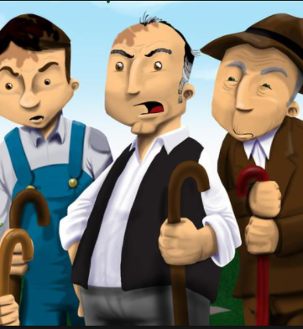
Truth and Lies
An afternoon with grandmother
When they came near him, they saw no sign of a wolf
“Wasn’t it you who cried for help?”, they asked the boy
He laughed and said, “I was having fun. There is no wolf. Go away.”
The farmers got angry and went away.
Notes:
Recreate image

Slide 7
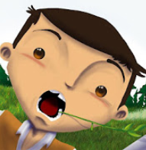
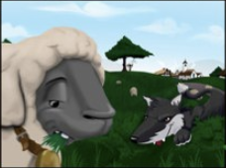
Truth and Lies
An afternoon with grandmother
A few days later, he was again with his sheep around the same spot. This time, a wolf really came
He was very scared
His sheep were in danger
He climbed up a tree and shouted for help
But no one came.
Notes:
Recreate image

Slide 8
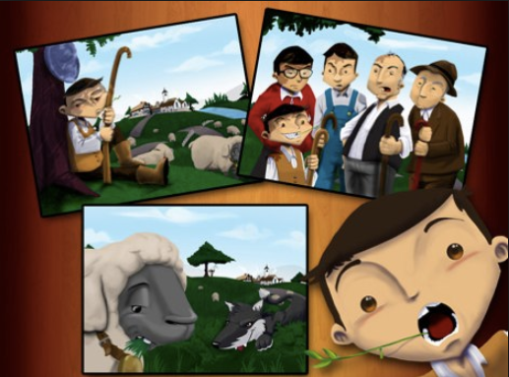
Truth and Lies
The boy who cried wolf
Everybody thought that the boy was playing a trick
The wolf killed many of the boy’s sheep
The boy went home sorry and sad’
Grandmother took a sip of water, as she finished telling the children the story
Notes:
Recreate image

Slide 9
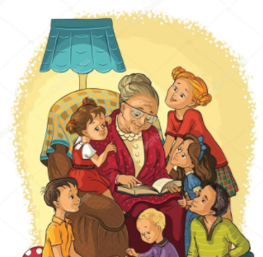
Truth and Lies
An afternoon with grandmother
‘Grand mother, why did the farmers not come when the boy shouted for help the second time. He was telling the truth?’, asked Rekha
‘He was telling the truth but, he had lied the first time. If you lie once, nobody will believe you again’, grandmother answered
Notes:
Recreate image

Slide 10
Truth and Lies
An afternoon with grandmother
Rekha’s eyes lit up and she said, ‘So, grandmother to tell the truth is to tell what really happened and to tell lies is to make up or hide things.’
The children shouted together, ‘One more story, grandmother, please’.
Notes:
Add image of a girl speaking out in the group of children with the grandmother

Slide 11
What is honesty?
Only doing or saying things that are truthful
telling the truth
not hiding the truth
Only doing things that are right
not stealing

Slide 12
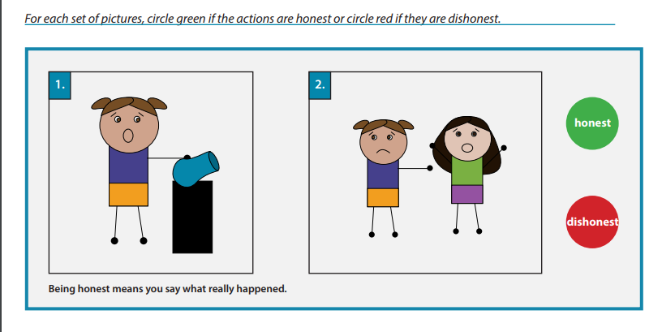
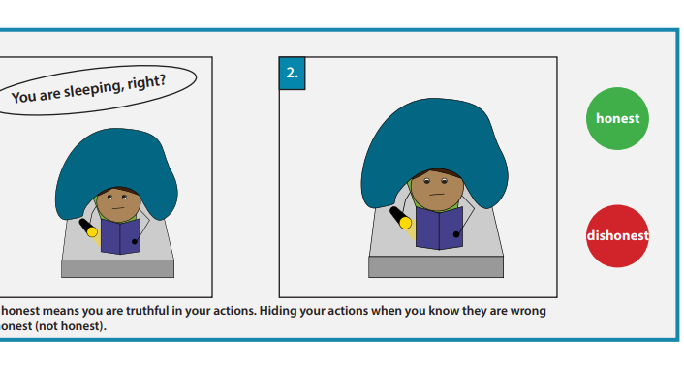
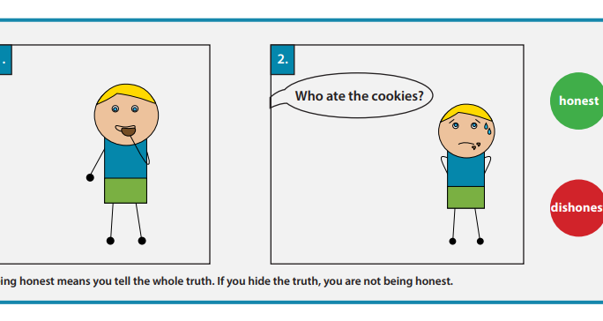
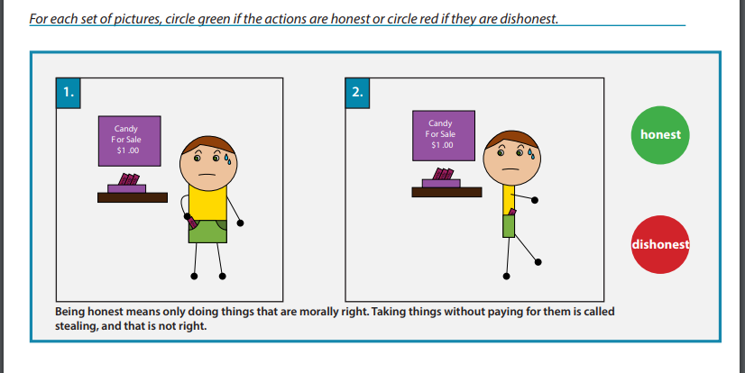
Notes:
Activity 1 - Re create images and Make clickable options ‘Truth’ and ‘Lies’

Slide 13
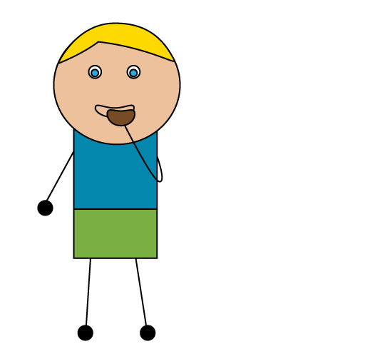
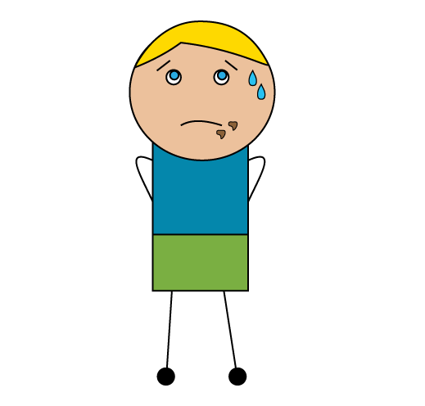
1
2
Who ate the cookies?
Notes:
To tell the truth is to say that you ate the cookies
and to tell lies is to say that you did not eat the cookies

Slide 14
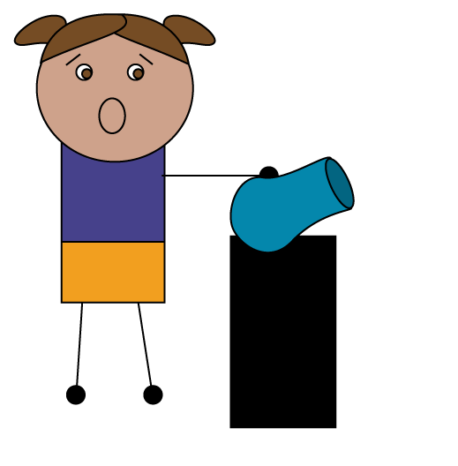
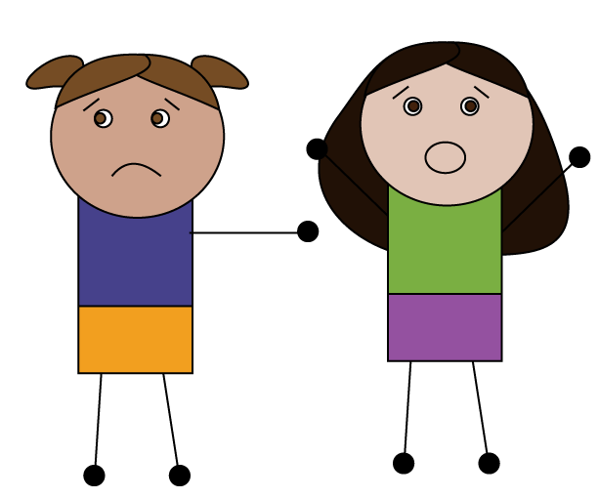
Is this honest?
1
2
Notes:
1)Image of a child breaking a vase
2)Pointing at another child
To tell the truth is to tell what really happened and to tell lies is to make up things

Slide 15
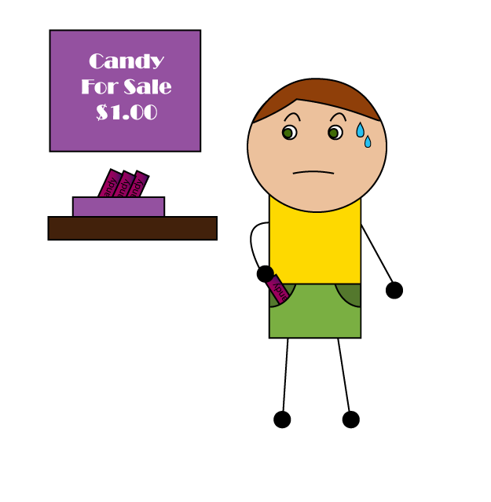
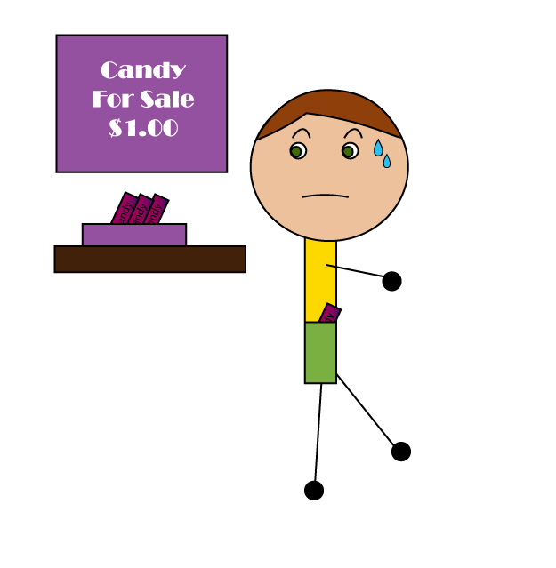
Is this honest?
1
2
Notes:
Taking a chocolate from the store without paying for it is stealing – a form of lying, not being truthful

Slide 16
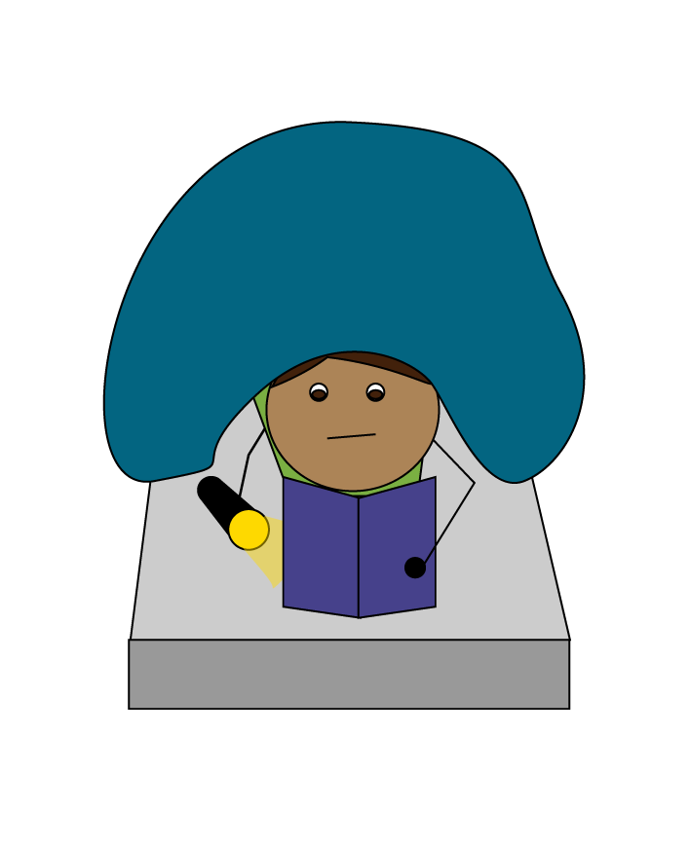
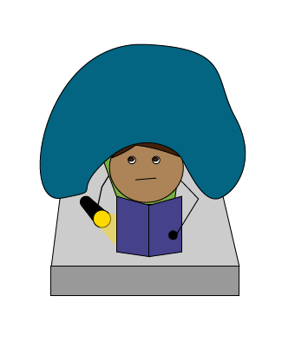
Is this honest?
1
2
You are sleeping, right?
Notes:
Hiding what you are doing when you know it is wrong is also a form of lying, not being truthful

Slide 17
Activity 2: I can be honest by
Draw a picture of a way that you can show honesty.
Write a sentence about it :
------------------------------------------------------------------------------------------
Notes:
Activity 2
Needs to change!

Slide 18
CYU
________ means telling the truth.
Respect
Cleanliness
Honesty
2. Hiding part of truth is called a _____.
Lie
Pie
Tie
3. Which other word also means ‘Being Honest’?
Care
Respect
Truth

Slide 19
Truth and Lies
Summary
Telling the truth is when we tell ‘what really happened’
Telling lies is when we ‘make up or hide things’
If we tell lies once, nobody will believe us again.

