Slide 1
OpenCart Automation Testing
Presented by - Sulkshana Patil
Under Guidance of Mrs. Vaishali Sonawane Mam

Slide 2
Introduction
This project is based on automation testing of the OpenCart demo website.
Tools used: Selenium WebDriver with Cucumber (BDD).
Aim: To automate common workflows in OpenCart such as Registration, Login, Checkout, and Address Management.

Slide 3
Overview
What is OpenCart?
OpenCart is an online shopping platform used by businesses worldwide.
Main features automated in this project include:
- User Registration and Forgot Password
- Login
- Product Search
- Sort
- Add to Cart
- Update Quantity in Cart
- Remove from Cart
- Checkout
- Address Management (Add/Update)
- Order History
- Transactions/Payments

Slide 4
Modules
Module 1: Registration Page
- Checked Registration functionalities by filling of user details
Module 2: Login Page
- Validating login with multiple credentials
Module 3: Product Search
- Automated product search via search bar (e.g., “iPhone”)
Module 4: Sort Functionality
- Validation that sorting displays correct order

Slide 5
Modules
Module 5: Add to Cart
- Adding selected product to cart
- Ensures cart is updated with correct product
Module 6: Update Quantity in Cart
- Viewing cart and modifying item quantities
- Updating cart and validating updated total
Module 7: Remove from Cart
- Removing product(s) from cart
- Validating that cart reflects removal
Module 8: Checkout
- Simulated checkout flow after cart update

Slide 6
Modules
Module 9: Transactions/Payments
- Automated navigation to “Transactions” in My Account
- Validation of payments/transactions records
Module 3: Address Update
- Automated shipping address update with parameterized data

Slide 7
DEFECTS
Search function when we search for right product its shows product not found
Registration page accepts invalid values for email and username fields.

Slide 8
Defect identifier :- D_001
Ø Defect summary :- When searching for Cameras, the application shows “Product not found” even though products exist in the category.
Ø Test Id :- TC_1
Ø Test case name :- TC_Search
Ø Module name :- Product Search
Ø Reproducible :-
Ø Severity :- High
Ø Priority :- High
Ø Raised by :- Sulkshana Patil
Ø Assigned to :-
Ø Date of assignment :- 9/9/2025
Ø Status :- OPEN
Ø Snap shots :-
Ø Fixed by :- developer
Ø Date of fixing :-

Slide 9
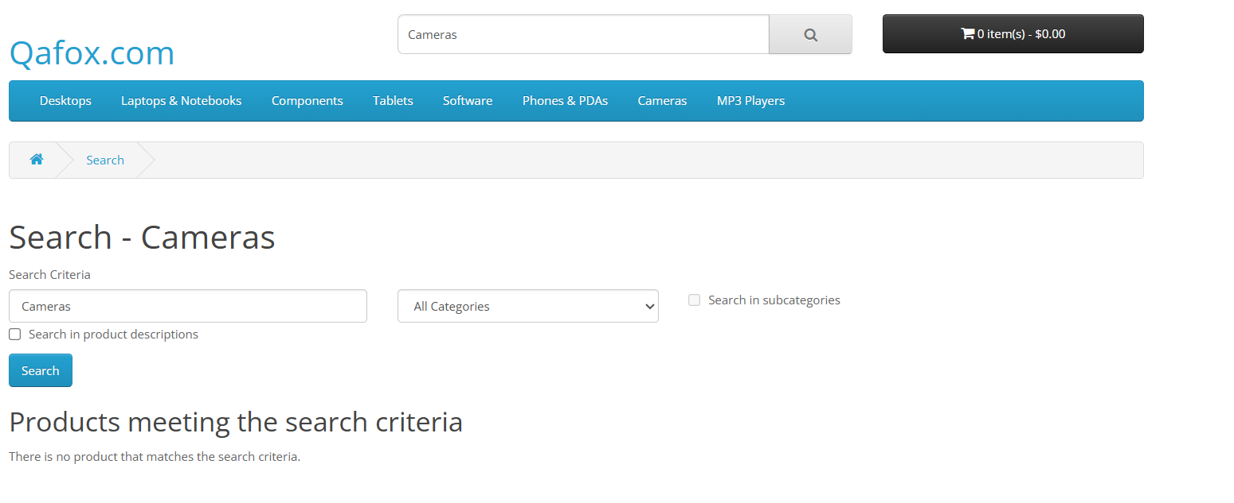

Slide 10
Defect identifier :- D_002
Ø Defect summary :- Registration page accepts invalid values for email and username fields
Ø Test Id :- TC_2
Ø Test case name :- TC_Search
Ø Module name :- Registration Page
Ø Reproducible :-
Ø Severity :- Medium
Ø Priority :- Medium
Ø Raised by :- Sulkshana Patil
Ø Assigned to :-
Ø Date of assignment :- 9/9/2025
Ø Status :- OPEN
Ø Snap shots :-
Ø Fixed by :- developer
Ø Date of fixing :-

Slide 11
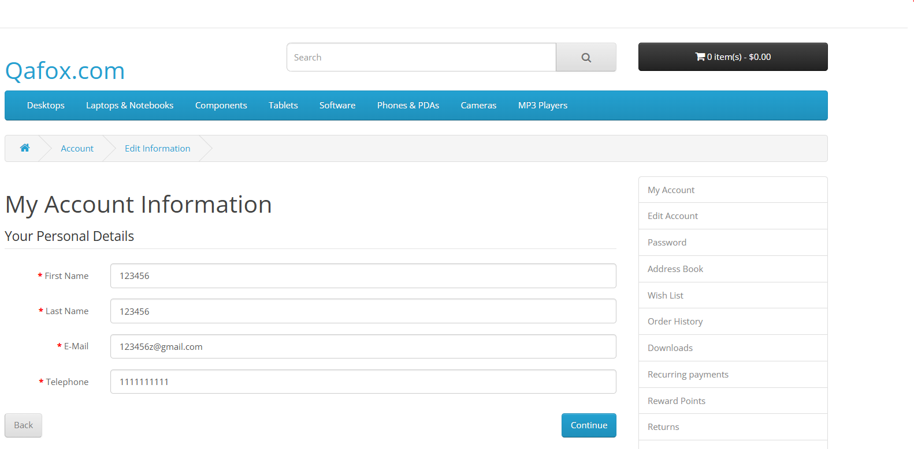

Slide 12
Challenges
- Handling synchronization in dynamic pages
- Avoiding CAPTCHA during login
- Managing test data via feature files
- Debugging element locators for complex forms

Slide 13
Experience
- Learned Selenium with Cucumber (BDD)
- Gained experience with Page Object Model (POM)
- Understood the importance of parameterization in automation
- Improved debugging and reporting skills

Slide 14
Thank You !!!

