Slide 1
eBay Project
presented by- Sulkshana Patil
Under Guidance of Mrs. Vaishali Sonawane Mam

Slide 2
Introduction
This project focuses on automation testing of the eBay website using Selenium WebDriver with TestNG.
The aim was to automate commonly used features of eBay like login, search, add to cart, shop by category, and profile management.

Slide 3
Overview
What is Ebay?
eBay is one of the largest online shopping platforms where people can buy and sell products worldwide
In this project, we automated some of the main features of eBay using Selenium with TestNG, such as:
Login
profile
Update
Product search
Add To Cart
Shop by category
all categories Automation

Slide 4
Modules
Module 1 : Login Page
Checked functionalities of email, password, and sign-in process.
Module 2 : Search Button
Automated search for multiple products like Watch, Phone, Laptop, Lipstick
Module 3 : Add to Cart
Verified that selected products are correctly added to the cart
Notes:
Module 1: Signn in page
Checked all the functionalities on Sign in page which included personal info as email
address, password
Module 2: Women page
Checked all the functionalities on Women page which included item details, Quantity, Filters,compare button,Add to cart button,product info,grid,list button
Module 3: Tshirt page
Checked all the functionalities on T-Shirt page which included item details, Quantity, Filters,compare button,Add to cart button,product info,grid,list button
Module 4: All Buttons and Drop Down Arrow :
team checked if all the buttons and drop down arrows of different fields are functioning properly or not

Slide 5
Module 4 : All Categories
Ensured dropdown options function properly
Module 5 : UserName and Address Update
Automated updating of personal information like address and username.
Module 6 : Language Change
Check that change the language is supported or not
Module 7 : shop by category
Ensured that product are also available on shop by category
Module 8 : Product Description
check that product description are also available by right click

Slide 6
Defects
While running a testcase at certain point some fields are not working as it is expected which is nothing but a defect, so the my team have created a Defect report on those defects.

Slide 7
Defect identifier :- TC_001
Ø Defect summary :- Address fields accepts numbers (e.g, 1234) instead of only alphabets
Ø Test Id :- TC_01
Ø Test case name :- TC_address_city_field_validation
Ø Module name :- Profile Update
Ø Reproducible :-
Ø Severity :- Medium
Ø Priority :- Medium
Ø Raised by :- Team lead
Ø Assigned to :- developer Team lead
Ø Date of assignment :-
Ø Status :- pending
Ø Snap shots :-
Ø Fixed by :- developer
Ø Date of fixing :-

Slide 8


Slide 9
Defect identifier :- TC_002
Ø Defect summary :- Sort by “Lowest Price” mixes products instead of showing strictly ascending order
Ø Test Id :- TC_02
Ø Test case name :- TC_sort_by_lowest_price
Ø Module name :- Filters
Ø Reproducible :-
Ø Severity :- Medium
Ø Priority :- Medium
Ø Raised by :- Team lead
Ø Assigned to :- developer Team lead
Ø Date of assignment :-
Ø Status :- pending
Ø Snap shots :-
Ø Fixed by :- developer
Ø Date of fixing :-

Slide 10
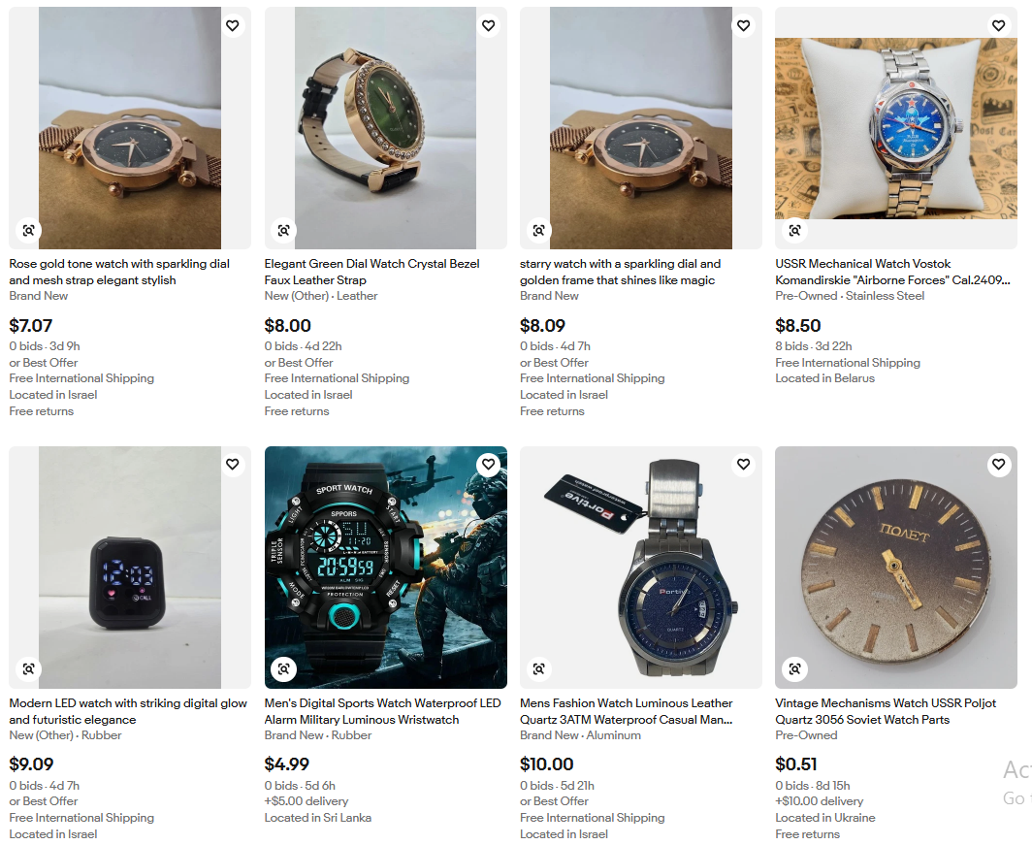

Slide 11
Challenges
Handling Module like add to cart
Synchronization issues (replaced Thread.sleep() with Waits)
Avoiding CAPTCHA during login

Slide 12
Experience
Learned Selenium with TestNG
Learned the importance of Page Object Model in reducing code
Writing test cases and executing them gave practical knowledge of automation

Slide 13
Thank You!!!
Vaishali Mam For Guiding Us through out the Project.

