Slide 1
Explicit VS Implicit intents
BY: Brijesh Patel

Slide 2
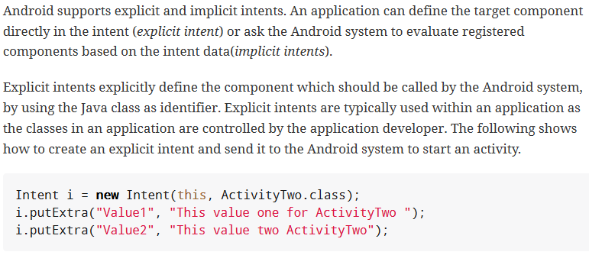
Explicit Intent

Slide 3
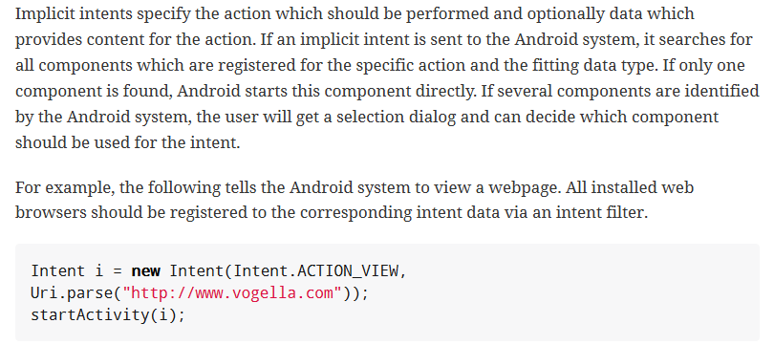
Implicit Intent

