Slide 1
Activities and Intent
By : Brijesh Patel

Slide 2
Activity
An activity represents a single screen with a user interface.
For example, an email application might have one activity that shows a list of new emails, another activity to compose an email, and one for reading emails.
If an application has more than one activity, then one of them should be marked as the activity that is presented when the application is launched.

Slide 3
An activity is implemented as a subclass of Activity class as follows:
public class MainActivity extends Activity
{
//
}

Slide 4
Activity Life Cycle
The activity class has the following method callbacks to help you manage the app:
onCreate()
onStart()
onResume()
onPause()
onStop()
onRestart()
onDestroy()

Slide 5
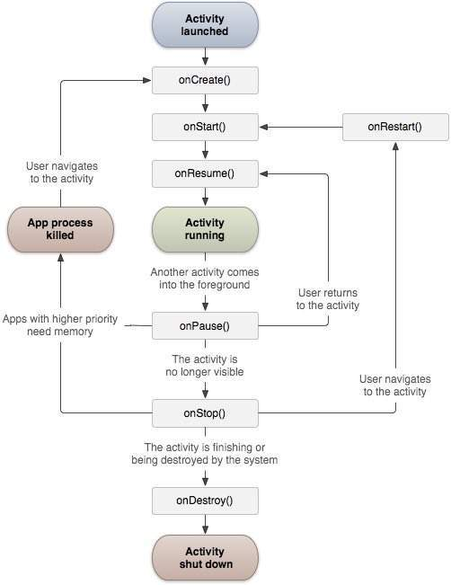

Slide 6
Sr.No | Callback & Description
1 | onCreate() This is the first callback and called when the activity is first created.
2 | onStart() This callback is called when the activity becomes visible to the user.
3 | onResume() This is called when the user starts interacting with the application.
4 | onPause() The paused activity does not receive user input and cannot execute any code and called when the current activity is being paused and the previous activity is being resumed.
5 | onStop() This callback is called when the activity is no longer visible.
6 | onDestroy() This callback is called before the activity is destroyed by the system.
7 | onRestart() This callback is called when the activity restarts after stopping it.

Slide 7
import android.os.Bundle;
import android.app.Activity;
import android.util.Log;
public class MainActivity extends Activity
{
String msg = "Android : ";
/** Called when the activity is first created. */
@Override
public void onCreate(Bundle savedInstanceState)
{
super.onCreate(savedInstanceState);
setContentView(R.layout.activity_main);
Log.d(msg, "The onCreate() event");
}
/** Called when the activity is about to become visible. */
@Override
protected void onStart()
{
super.onStart();
Log.d(msg, "The onStart() event");
}

Slide 8
/** Called when the activity has become visible. */
@Override
protected void onResume() {
super.onResume();
Log.d(msg, "The onResume() event");
}
/** Called when another activity is taking focus. */
@Override
protected void onPause() {
super.onPause();
Log.d(msg, "The onPause() event");
}
/** Called when the activity is no longer visible. */
@Override
protected void onStop() {
super.onStop();
Log.d(msg, "The onStop() event");
}
/** Called just before the activity is destroyed. */
@Override
public void onDestroy() {
super.onDestroy();
Log.d(msg, "The onDestroy() event");
}
}

Slide 9
Activity Intent
An Android Intent is an abstract description of an operation to be performed.
It can be used with startActivity to launch an Activity, broadcastIntent to send it to any interested BroadcastReceiver components,
and startService(Intent) or bindService(Intent, ServiceConnection, int) to communicate with a background Service.

Slide 10
Activity Navigation
Intent in=new Intent(MainActivity.this, second_main.class);
startActivity(in);

Slide 11
activity_main.xml
<?xml version="1.0" encoding="utf-8"?>
<RelativeLayout
<TextView android:text=“First Activity" android:layout_width="wrap_content" android:layout_height="wrap_content" android:id="@+id/textview" android:textSize="35dp" android:layout_alignParentTop="true" android:layout_centerHorizontal="true" />
<Button
android:layout_width="wrap_content"
android:layout_height="wrap_content"
android:text=“Go to Second Activity"
android:id="@+id/button" />
</RelativeLayout>

Slide 12
MainActivity.java
public class MainActivity extends Activity {
Button b1;
@Override
protected void onCreate(Bundle savedInstanceState) {
super.onCreate(savedInstanceState);
setContentView(R.layout.activity_main);
b1 = (Button) findViewById(R.id.button);
b1.setOnClickListener(new View.OnClickListener() {
@Override
public void onClick(View v) {
Intent in=new Intent(MainActivity.this,second_main.class);
startActivity(in);
}
});
}
}

Slide 13
activity_main_activity2.xml.
<?xml version="1.0" encoding="utf-8"?>
<RelativeLayout
<TextView android:text=“Second Activity" android:layout_width="wrap_content" android:layout_height="wrap_content" android:id="@+id/textview" android:textSize="35dp" android:layout_alignParentTop="true" android:layout_centerHorizontal="true" />
</RelativeLayout>

Slide 14
second_main .java
public class second_main extends Activity {
@Override
protected void onCreate(Bundle savedInstanceState)
{
super.onCreate(savedInstanceState);
setContentView(R.layout.activity_main_activity2);
}
}

Slide 15
<?xml version="1.0" encoding="utf-8"?>
<manifest xmlns:android="http://schemas.android.com/apk/res/android"
package="com.example.comp.myapplication" >
<application
android:allowBackup="true"
android:icon="@mipmap/ic_launcher"
android:label="@string/app_name"
android:theme="@style/AppTheme" >
<activity
android:name=".MainActivity"
android:label="@string/app_name" >
<intent-filter>
<action android:name="android.intent.action.MAIN" />
<category android:name="android.intent.category.LAUNCHER" />
</intent-filter>
</activity>
<activity android:name=".second_main"></activity>
</application>
</manifest>

