Slide 1
Notification
By: Brijesh Patel

Slide 2
A notification is a message you can display to the user outside of your application's normal UI. When you tell the system to issue a notification, it first appears as an icon in the notification area.
To see the details of the notification, the user opens the notification drawer. Both the notification area and the notification drawer are system-controlled areas that the user can view at any time.

Slide 3
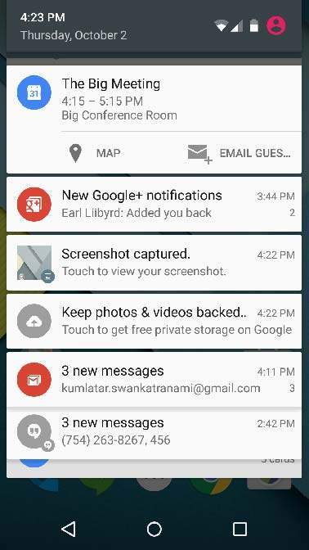

Slide 4
Create and Send Notifications
Create Notification Builder
Setting Notification Properties
Attach Actions
Issue the notification

Slide 5
Step 1 - Create Notification Builder
NotificationCompat.Builder mBuilder
= new NotificationCompat.Builder(this)

Slide 6
Step 2 Setting Notification Properties
A small icon, set by setSmallIcon()
A title, set by setContentTitle()
Detail text, set by setContentText()
mBuilder.setSmallIcon(R.drawable.notification_icon);
mBuilder.setContentTitle("Notification Alert, Click Me!");
mBuilder.setContentText("Hi, This is Android Notification Detail!");

Slide 7
Step 3 Attach Actions
This is an optional part and required if you want to attach an action with the notification.
An action allows users to go directly from the notification to an Activity in your application, where they can look at one or more events or do further work.
The action is defined by a PendingIntent containing an Intent that starts an Activity in your application.

Slide 8
Step 4 - Issue the notification
NotificationManager mNotificationManager = (NotificationManager) getSystemService(Context.NOTIFICATION_SERVICE);
mNotificationManager.notify(notificationID, mBuilder.build());

