Slide 1
Abduction
Notes:
At this point, you’ve seen two ways to reason: deduction and induction. Deduction is the application of logic—it works with true or false statements. Induction is reasoning with probability.

Slide 2
Contents
Definition of abduction
An abductive learning method
Recommended reading

Slide 3
Abduction
Abduction, or inference to the ‘best’ explanation, is a method of reasoning in which one chooses the hypothesis that would, if true, best explain the relevant evidence.
Abductive reasoning starts from a set of accepted facts and infers to their most likely, or best, explanations.
The term abduction is also sometimes used to just mean the generation of hypotheses to explain observations or conclusions, but the former definition is more common both in philosophy and computing.

Slide 4
Abduction
Abduction is the operation of adopting an explanatory hypothesis that would account for all the facts or some of them.
Illustrations:
  There is smoke in the East building.
  Fire causes smoke.
  Hypothesize that there is a fire in the East building.
Which are some other potential explanations?

Slide 5
Continued..
University campus is wet.
Raining causes the streets to be wet.
Hypothesize that it was raining on the University campus

Slide 6
Definition
D is a collection of data (facts, observations, givens),
H explains D (would, if true, explain D),
No other hypothesis explains D as well as H does.
Therefore, H is probably correct.
Abstract illustrations:
If B is true and A → B
then hypothesize A.
If A=A1 & A2 & ... & An and A2 & ...& An is true
then hypothesize A1.

Slide 7
Discussion
Which are the basic operations in abductive learning?
  generation of explanatory hypotheses;
  selection of the "best" hypothesis;
  (testing the best hypothesis).

Slide 8
Overall structure of the abductive learning method
Let D be a collection of data
Find all the hypotheses that (preferably causally) explain D
Find the hypothesis H that explains D better than other hypotheses
Assert that H is true

Slide 9
How to choose the “best” explanation?
Consider this: B is true and A → B and C → B
What should we hypothesize?
  prefer to backtrace causal rules (A causes B);
  prefer to backtrace the rule that has the highest number of true left-hand side literals;
  prefer to backtrace the rule that has the highest number of known instances;
  prefer the simplest hypothesis, etc.

Slide 10
An illustration of the abductive learning problem
Given
• A surprising observation that is not explained by the background knowledge
KILL(John, John) ; John committed suicide
Background knowledge
∀x, ∀y, BUY(x, y) → POSSESS(x, y)
∀x, ∀y, HATE(x, y) & POSSESS(x, z) & WEAPON(z) → KILL(x, y)
∀x, GUN(x) → WEAPON(x)
∀x, DEPRESSED(x) → HATE(x, x) ...
DEPRESSED(John), AGE(John, 45), BUY(John, obj1), ...
Learning goal
Find an assumption which is consistent with the background knowledge and represents the best explanation of the new observation.
Determine
The “best” assumption satisfying the learning goal: GUN(obj1)

Slide 11
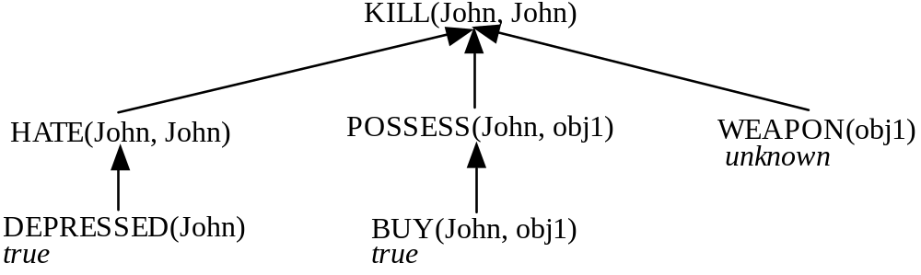
An illustration of the abductive learning method
Build partial explanations of the observation:
If one assumes that "WEAPON(obj1)" is true
Then "KILL(John, John)" is explained.
Therefore, a possible assumption is "WEAPON(obj1)".

Slide 12
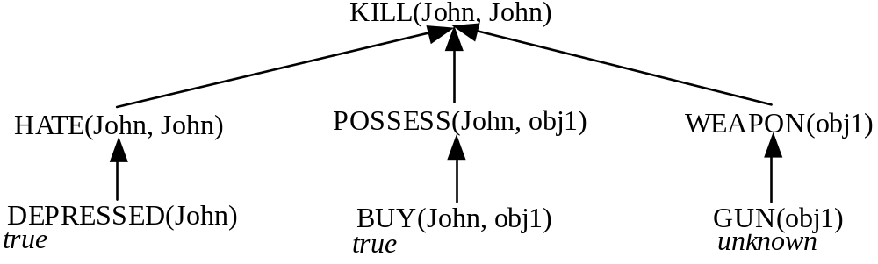
An illustration of the abductive learning method
Another partial proof tree:
If one assumes that "GUN(obj1)" is true
Then "KILL(John, John)" is also explained.
Therefore, another possible assumption is "GUN(obj1)".
What hypothesis to adopt?
the most specific one?
the most general one?

Slide 13
Applications
Applications in artificial intelligence include:
  fault diagnosis
  belief revision
  automated planning
The most direct application of abduction is that of automatically detecting faults in systems: given a theory relating faults with their effects and a set of observed effects, abduction can be used to derive sets of faults that are likely to be the cause of the problem.

Slide 14
Applications
Abduction can also be used to model automated planning.
Given a logical theory relating action occurrences with their effects (for example, a formula of the event calculus), the problem of finding a plan for reaching a state can be modeled as the problem of abducting a sequence of literals implying that the final state is the goal state.

Slide 15
Applications
Belief revision, the process of adapting beliefs in view of new information, is another field in which abduction has been applied.
The main problem of belief revision is that the new information may be inconsistent with the corpus of beliefs, while the result of the incorporation cannot be inconsistent.
This process can be done by the use of abduction: once an explanation for the observation has been found, integrating it does not generate inconsistency. This use of abduction is not straightforward, as adding propositional formulae to other propositional formulae can only make inconsistencies worse. Instead, abduction is done at the level of the ordering of preference of the possible worlds.

Slide 16
Applications
In the philosophy of science, abduction has been the key inference method to support scientific realism, and much of the debate about scientific realism is focused on whether abduction is an acceptable method of inference.

