Slide 1
Introduction to TSQL

Slide 2
Core Concepts
Database Objects
Database objects are entities that hold data and its metadata. In other words, an object is a data structure used to store or reference data.
Some of the object types contained in a schema are Databases, Tables, Views, Stored procedures, Indexes, Sequences, Constraints, Triggers, and Functions.
To get a complete list of objects in your schema -
Connect to the SQL Server
In the Query editor, execute the following command
SELECT DISTINCT type_desc FROM sys.all_objects;

Slide 3
What is a Database Schema
A schema is a collection of database objects. Schema is a collection of logical structures of data.
Database schema describes the structure of the data and how the data is related to each other.
Schema is also referred to as a named space of database objects. Each user owns a single schema. You can use the T-SQL commands to create and manipulate the objects in the schema.

Slide 4
SQL Types
SQL statements are generally categorized into different types based on the tasks each statement can perform.

Slide 5
SQL Type | Commands | Description
Data Definition Language (DDL) | CREATE ALTER DROP TRUNCATE | Statements that define the data and data structure (schema objects).
Data Manipulation Language (DML) | INSERT UPDATE DELETE | Statements that manipulate the data.
Data Control Language (DCL) | GRANT REVOKE | Statements to limit the access on the data.
Transact Control Language (TCL) | COMMIT ROLLBACK SAVEPOINT | Statements to control the transactions in a session.
Data Query Language (DQL) | SELECT | Statements used to view the data.

Slide 6
MSSQL Constraints
SQL constraints are the rules to restrict the type of data entered into the database. The constraints ensure data integrity and adhere to the business rules.
MSSQL has the following constraints:
NOT NULL: The column value cannot be null.
UNIQUE constraint: Enforce unique value on a column(s) that is not a primary key.
PRIMARY KEY (PK) constraint: Column key that uniquely identifies each row in the table.
FOREIGN KEY (FK) constraint: Column key that references a primary key in another table.
CHECK constraint: Enforce a check on the value that can be entered in the table

Slide 7
CANDIDATE KEY
A candidate key is one or more set of attributes(columns) that can uniquely identify a row in a table.
For example, the Account number or email_id column is a Single Candidate key. However, you need a combination of first name and the last name to uniquely identify a row. Such a set of columns are called Composite Candidate key

Slide 8
PRIMARY KEY (PK)
A primary key (PK) is a candidate key that uniquely identifies a row. The Entity1 Integrity constraints on a primary key are:
A PK cannot be null.
A PK has to be unique.
FOREIGN KEY (FK)
A foreign key is a candidate key that refers to a primary key in another table. The values in a column declared as an FK can have duplicate or null values.
FK has a Referential Integrity enforced, which enforces the rule that every value in the FK column must be present in the PK column.
CHECK
The value in a column with a check constraint can only be entered when the check T-SQL constraint evaluates to true.

Slide 9
Transact-SQL Data Types
Data type category | Data type
Exact numerics | bigint, numeric, bit, smallint, decimal, smallmoney, int, tinyint, money
Approximate numerics | float, real
Date and time | date, datetimeoffset, datetime2, smalldatetime, datetime, time
Character strings | char, varchar, text
Unicode character strings | nchar, nvarchar, ntext
Binary strings | binary, varbinary, image
Other data types | cursor, rowversion, hierarchyid, uniqueidentifier, sql_variant, table

Slide 10
Create a database using T SQL
Syntax
CREATE DATABASE database_name;
Open SSMS and connect to the Database Engine.
Click New Query from the top ribbon bar.
In the Query editor, enter the following command and then press Execute.
CREATE DATABASE HASURA;
GO
GO is not a T-SQL statement. It is a command that indicates the end of a batch of T-SQL statements to Server utilities.

Slide 11
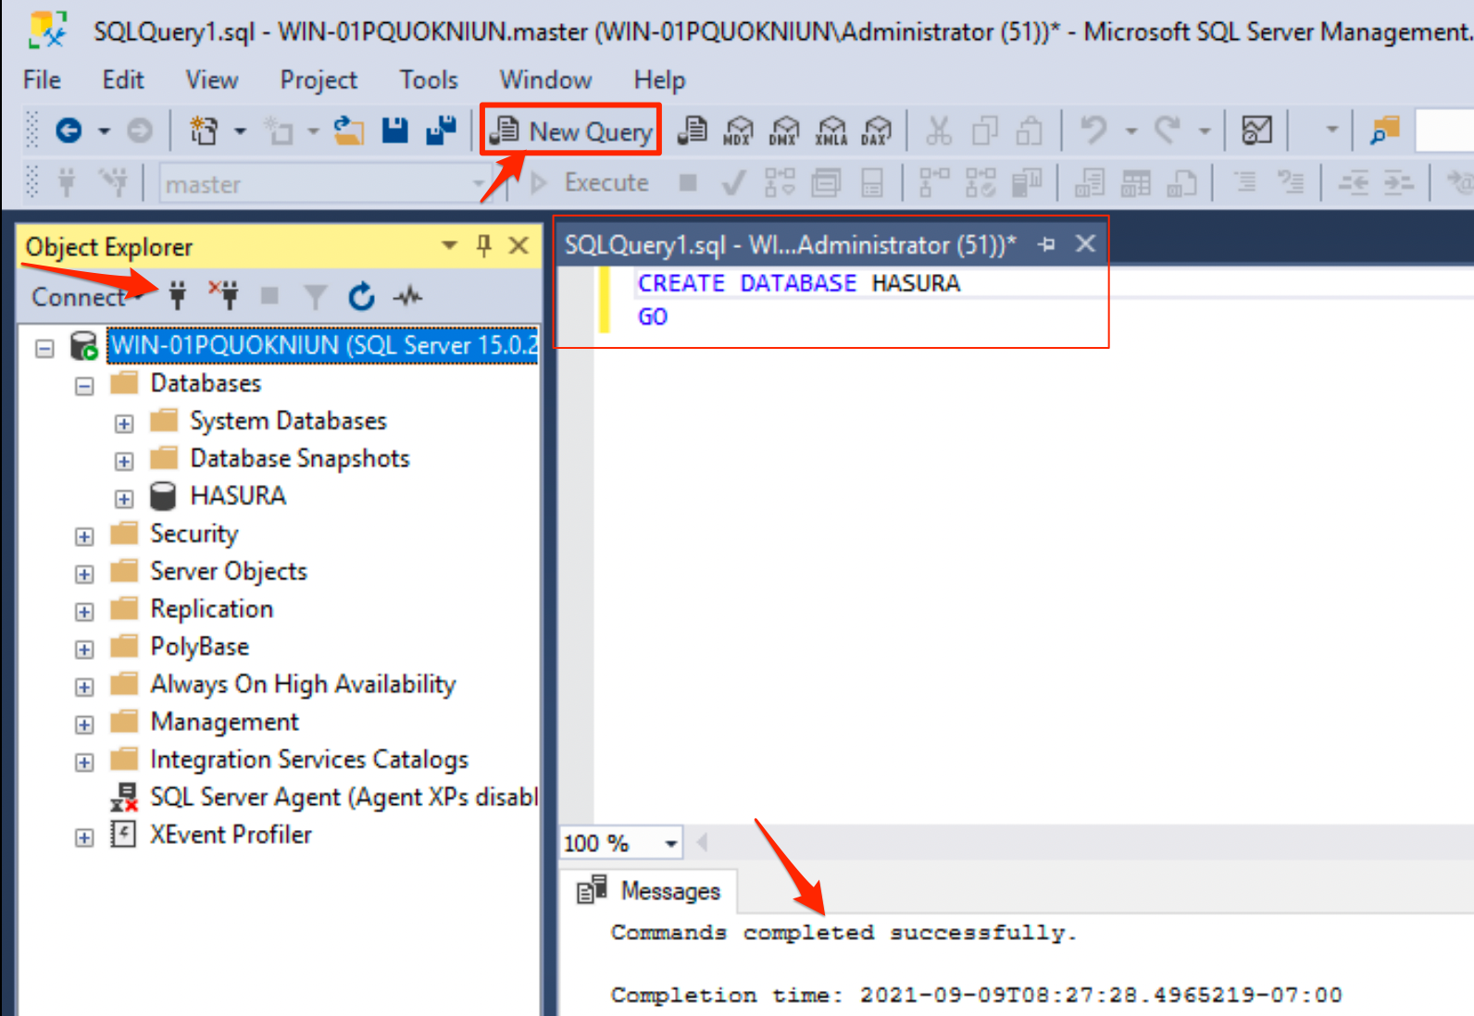

Slide 12
Expand Databases in the Object Explorer on the left, the database HASURA is displayed.
Note: If the new database is not displayed automatically, click the Refresh icon in the Object Explorer

Slide 13
Drop a Database
To drop a database from a schema or from an instance of SQL Server, run the following command:
DROP DATABASE database_name;
When you drop a database, the database is removed from the SQL Server instance.
You cannot remove System databases.
To drop multiple databases, you can provide a comma-separated list of database names.

Slide 14
CREATE table
CREATE is a T-SQL DDL command.
Syntax
CREATE TABLE <table_name> (
<column_name> data_type constraints
...
)
where,
table_name: Name of the table to be created
column_name: Column(attribute) name
data_type: SQL data type
constraints: MSSQL constraints to enforce data integrity

Slide 15
Example
USE HASURA; /*Connect to the database*/
CREATE TABLE EMPLOYEE (
EMP_ID INT PRIMARY KEY,
EMP_NAME VARCHAR(40) NOT NULL,
DEPT_ID INT
)
GO
In the Object Explorer window, refresh and view the employee table created under the Hasura database.

Slide 16
INSERT data into the table
Syntax
INSERT INTO <table_name> VALUES (
);
Insert single row
USE HASURA;
INSERT INTO EMPLOYEE VALUES (
1,'DB2',100
);
GO

Slide 17
Insert multiple rows
INSERT INTO EMPLOYEE(emp_id, dept_id, emp_name)
VALUES
(2, 101, 'MYSQL'),
(6, 110, 'MSSQL'),
(4, 101, 'ORACLE');
GO

Slide 18
DROP table
The DROP command (DDL) removes the data table and the table's structure from the database.
Syntax
DROP TABLE [IF EXISTS] <table_name>;
GO
IF EXISTS: First checks if the table exists, and if it does, drop the table.
Without this keyword if the table does not exist, an error is thrown: Cannot drop the table 'EMPLOYEE', because it does not exist or you do not have permission.

Slide 19
Example
USE HASURA;
DROP TABLE IF EXISTS EMPLOYEE;
GO
TRUNCATE table
The TRUNCATE is a DDL T-SQL command. This command is used to delete the data in a table, but the structure of the table remains.
Example
USE HASURA
TRUNCATE TABLE EMPLOYEE;
GO

Slide 20
SELECT T SQL statements
Syntax
SELECT [Arguments]
FROM <table_name>
WHERE <search_condition>
GROUP BY <group_by_expression>
HAVING <search_condition>
ORDER BY <order_expression> [ASC|DESC]

Slide 21
The Arguments may be any of the following:
ALL: The result set returns all the rows and columns and may include duplicate values. 'ALL' is the default.
DISTINCT: Returns unique rows.
column_list: A single column name or a list of comma-separated column names.
*: The result set returns all columns and rows from a table/view, as specified in the 'FROM' clause.

Slide 22
Tob restore database follow these steps
Use the sample database given and move the .bak file to your SQL Server backup location.
Move the .bak file to your SQL Server backup location. This location varies depending on your installation location, instance name, and version of SQL Server. For example, the default location for a default instance of SQL Server 2022 (16.x) is:
Open SSMS and connect to your SQL Server instance.
Right-click Databases in Object Explorer > Restore Database... to launch the Restore Database wizard.

Slide 23
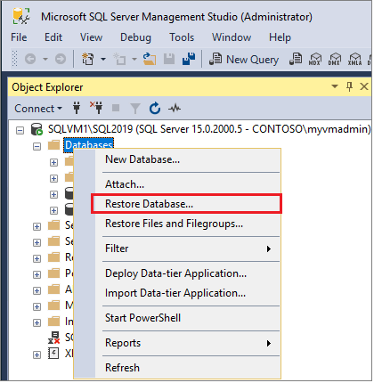

Slide 24
Select Device and then select the ellipses (...) to choose a device.
Select Add and then choose the .bak file you recently moved to the backup location. If you moved your file to this location but you're not able to see it in the wizard, SQL Server or the user signed into SQL Server doesn't have permission to this file in this folder.
Select OK to confirm your database backup selection and close the Select backup devices window.
Check the Files tab to confirm the Restore as location and file names match your intended location and file names in the Restore Database wizard.
Select OK to restore your database.

Slide 25
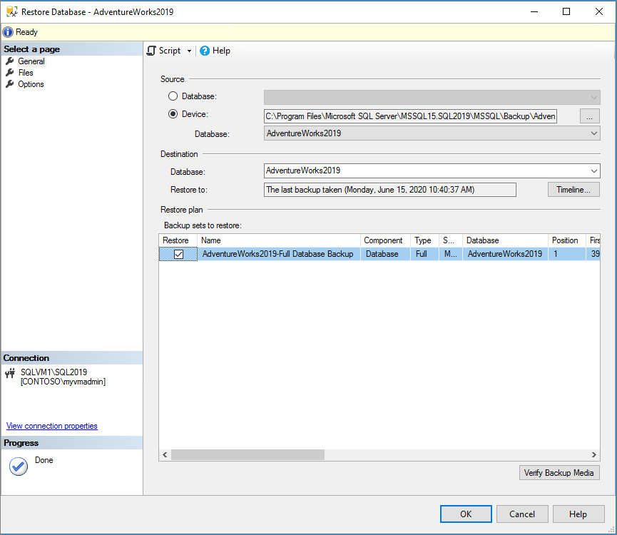

Slide 26
Restore to SQL Server
Next, you can use the .bak file to restore the sample database into your SQL Server.
Before you begin
In the Object Explorer, click to expand AdventureWorks2019 > Tables.
Select HumanResources.Employee and then click New Query from the top ribbon bar. where,
HumanResources is the schema name.
Employee is a table in the above schema.
Run the below statement to use the 'AdventureWorks2019' sample database.
USE AdventureWorks2019;
GO

Slide 27
Select to retrieve all rows and columns
SELECT * FROM HumanResources.Employee;
Get the count of all rows in a table
SELECT COUNT(*) FROM HumanResources.Employee;
Select certain columns
SELECT NationalIDNumber, JobTitle FROM HumanResources.Employee;
Select columns and print an alias column name
-First column is renamed as 'SSN'
SELECT NationalIDNumber AS 'SSN', HireDate
FROM HumanResources.Employee;
Derived column
A derived column is based on the calculation results on another column(s).
SELECT ( VacationHours + SickLeaveHours ) AS 'TOTAL LEAVES' FROM HumanResources.Employee

Slide 28
Select distinct rows
DISTINCT keyword removes any duplicate row(s).
SELECT DISTINCT JobTitle FROM HumanResources.Employee;
Limit the rows with the WHERE clause
Equal to = operator
--List all the employees with a specific job title
SELECT * FROM HumanResources.Employee
WHERE JobTitle='Application Specialist';
LIKE
The LIKE clause retrieves only the rows that match the search pattern (regular expression).
-Search with a regular expression - 'Assistant' anywhere in the text
SELECT DISTINCT JobTitle FROM HumanResources.Employee
WHERE JobTitle LIKE '%Assistant%';

Slide 29
--Job Title that begins with 'Assistant' followed by any text
SELECT DISTINCT JobTitle FROM HumanResources.Employee
WHERE JobTitle LIKE 'Assistant%';
--Job Title that ends with 'Assistant'
SELECT DISTINCT JobTitle FROM HumanResources.Employee
WHERE JobTitle LIKE '%Assistant';
--Job Title that begins with 'Human' and ends with 'Assistant'
SELECT DISTINCT JobTitle FROM HumanResources.Employee
WHERE JobTitle LIKE 'Human%Assistant';
NOT LIKE
- Retrieve all the roles, where 'Job Title' is not like the given string.
SELECT DISTINCT JobTitle FROM HumanResources.Employee
WHERE JobTitle NOT LIKE '%Supervisor%';

Slide 30
LOGICAL AND
-Select the rows where both the `Where` conditions are true
SELECT * FROM HumanResources.Employee
WHERE OrganizationLevel=2 AND JobTitle LIKE '%Assistant%‘;
LOGICAL OR
--Show the rows where any one of the conditions is true
SELECT * FROM HumanResources.Employee
WHERE OrganizationLevel=2 OR JobTitle LIKE '%Assistant%';
IN
SELECT * FROM HumanResources.Employee
WHERE OrganizationLevel IN (1,3);
BETWEEN
-Rows with OrganizationLevel that include 2,3, AND 4.
SELECT DISTINCT OrganizationLevel FROM HumanResources.Employee
WHERE OrganizationLevel BETWEEN 2 and 4;

Slide 31
NOT
-Rows with OrganizationLevel that do not include 2,3, AND 4.
SELECT DISTINCT OrganizationLevel FROM HumanResources.Employee
WHERE OrganizationLevel NOT BETWEEN 2 and 4;
Group BY
The GROUP BY clause is used to categorize the result set based on a single or multiple columns.
The clause can be applied only on the column(s) that are listed in the SELECT query
All non-aggregate columns listed in the SELECT query must be included in the GROUP BY clause. Or, the column on which you apply the GROUP BY clause must be a non-aggregate column.
-Get the count of employees in each department.
SELECT COUNT(NationalIDNumber) AS 'Count of employees', JobTitle
FROM HumanResources.Employee
GROUP BY JobTitle;

Slide 32
HAVING
Is used along with the GROUP BY clause to limit the result set obtained by the Group by clause. It specifies a search condition on the Groups.
-List the department that has more than 25 employees
SELECT COUNT(NationalIDNumber) AS 'Count of employees', JobTitle
FROM HumanResources.Employee
GROUP BY JobTitle
HAVING COUNT(NationalIDNumber) > 20;

Slide 33
ORDER BY
The result set can be sorted by any column's value in ascending (ASC) or descending (DESC) order. By default, the rows are sorted in ascending order. To change the order in descending order run the following statement:
-Rows ordered in descending order of BusinessEntityID
SELECT * FROM HumanResources.Employee
ORDER BY BusinessEntityID DESC;
SELECT INTO
Use the SELECT INTO statement to create another (backup) table from an existing table.
USE AdventureWorks2019;
GO
SELECT *
INTO PRODUCTION.PRODUCT_BACKUP
FROM PRODUCTION.PRODUCT;

