Slide 1
EMF-based (de-)serialization of FHIR documents
Joerg Kiegeland
Keith Duddy

Slide 2
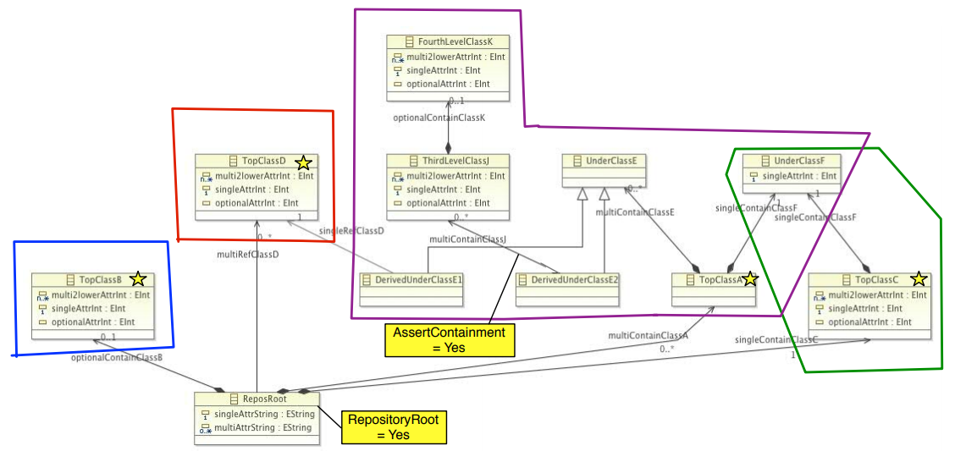
Idea: Serialize “containment” trees
There are no non-containment references in the FHIR model

Slide 3
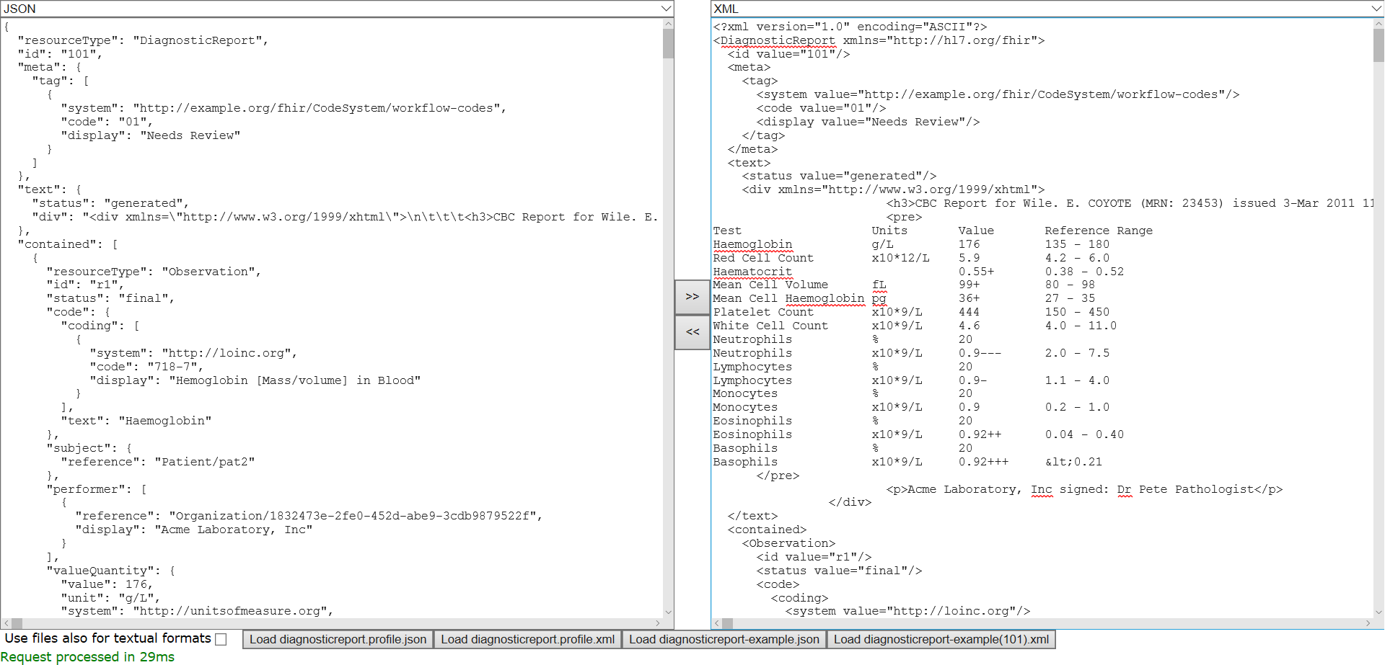
Spring-Boot based prototype

Slide 4
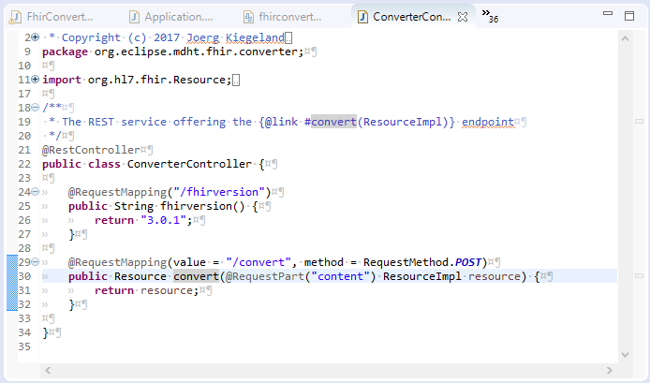
The Spring REST controller

Slide 5
RaaS (Repository as a Service) approach
Annotate generated Java code with JAXB annotations
JAXB annotations are part of Java JDK, so no additional dependencies
Install wizard from update site
  https://raw.githubusercontent.com/patins1/raas4emf/master/plugins/org.eclipse.jqvt.updatesite

Slide 6
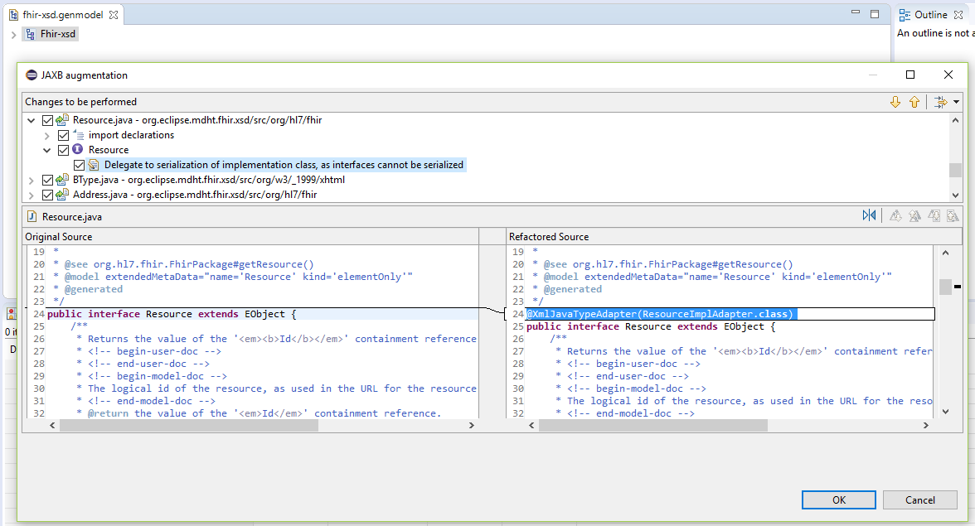
RaaS Generator wizard

Slide 7
Further customization
Use Jackson Mixins to provide further customizations
We identified two Mixins for FHIR

Slide 8
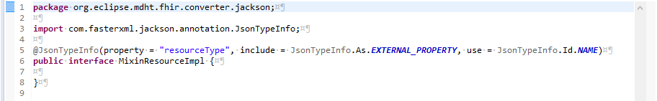
Mixin 1
Add resourceType attribute that is not part of the XML schema

Slide 9
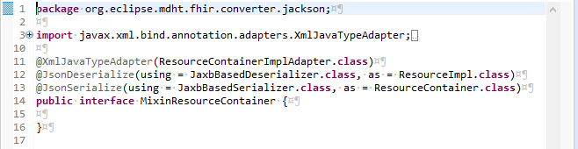
Mixin 2
Flatten ResourceContainer in JSON format but not in XML format by using custom Jackson serializer

Slide 10
Advantages of RaaS approach
New FHIR versions can be integrated in less than 10 minutes just by code generation
A wide range of Jackson formats are successfully tested
Performance is similar to HAPI library

Slide 11
How we tested correctness
We downloaded examples-json.zip
Every JSON file was converted
  original.json => raas.json => hapi_1.json
  original.json => hapi_2.json
Assuming that the HAPI library is functional correct, comparing files hapi_1.json and hapi_2.json showed what our (de)serialization raas.json changed in the document

Slide 12
Known functional issues
“date” type has formatting problems
Problems with some property namings, like “class” and “_code”
patient-example-b.json has a parsing error in the included base64 encoded photo, but all other example json files could be read and converted
Comments are not preserved

Slide 13
Performance results
For all JSON files in examples-json.zip (114MB)
  RaaS took 32 seconds
  HAPI took 30 seconds
For all XML files in examples.zip (73MB)
  RaaS took 16 seconds
  HAPI took 18 seconds

Slide 14
Supported formats
JSON
XML
YAML – “YAML Ain't Markup Language”
Java Properties
BSON – MongoDB
CBOR - Concise Binary Object Representation
Smile -binary serialization of generic JSON data model
Amazon Ion
Protobuf, CSV, AVRO, msgpack need further investigation (they have not a fixed schema)

Slide 15
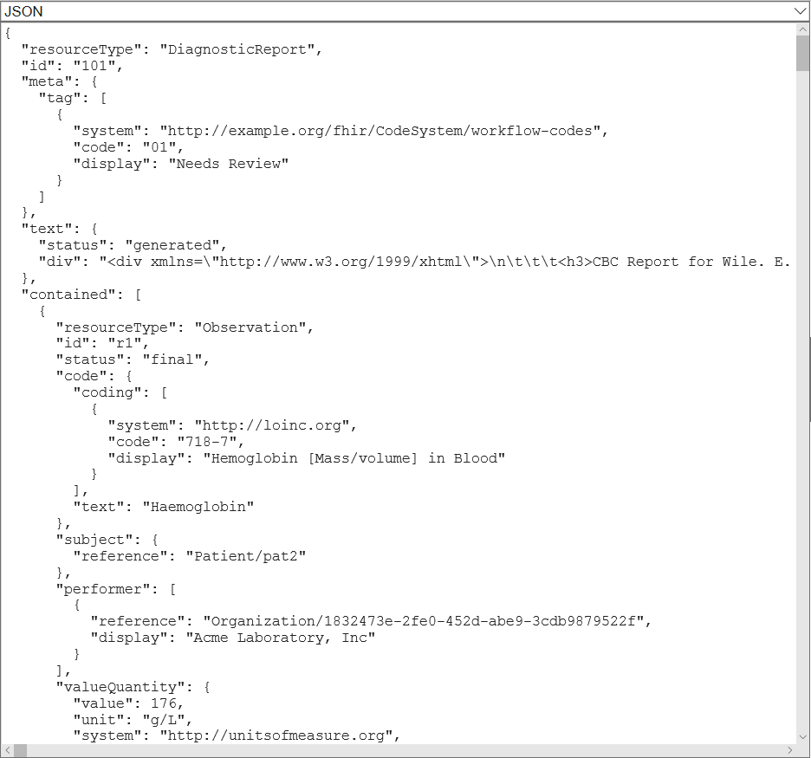
Screenshot: JSON DiagnosticReport

Slide 16
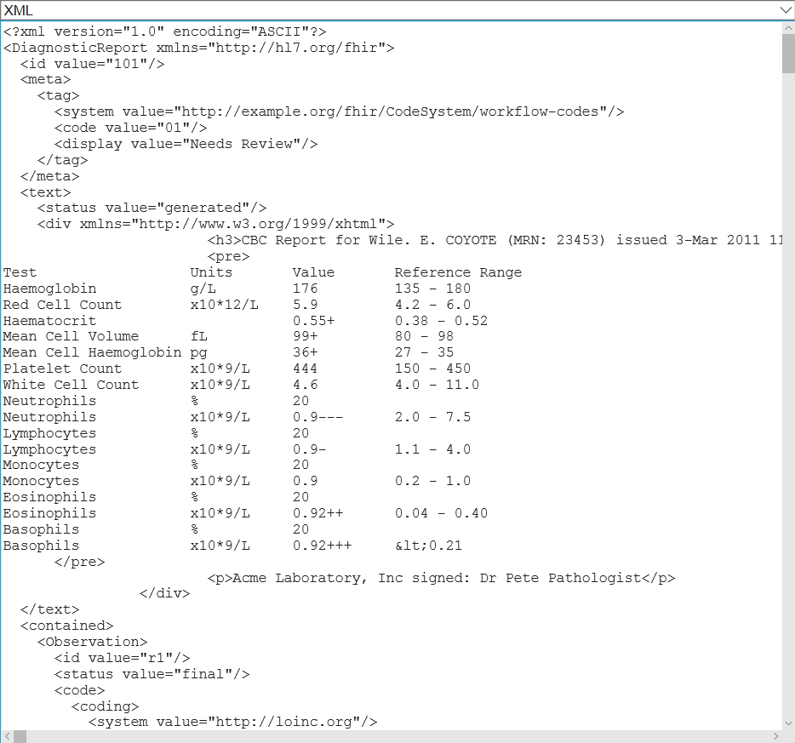
Screenshot: XML

Slide 17
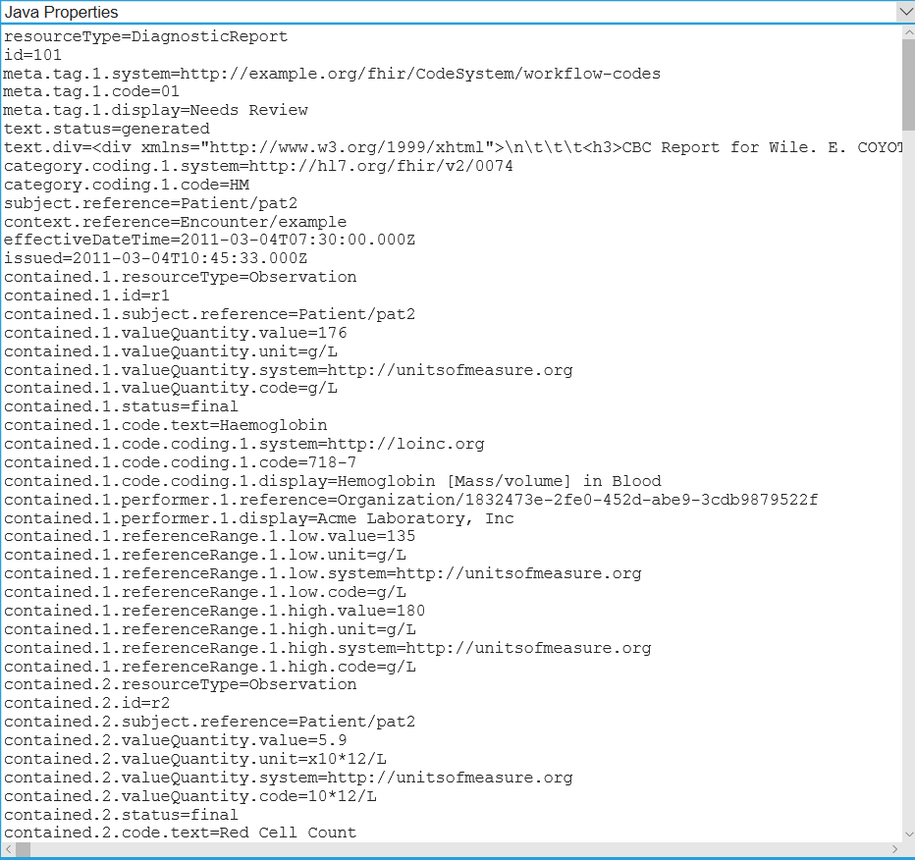
Screenshot: Java Properties

Slide 18
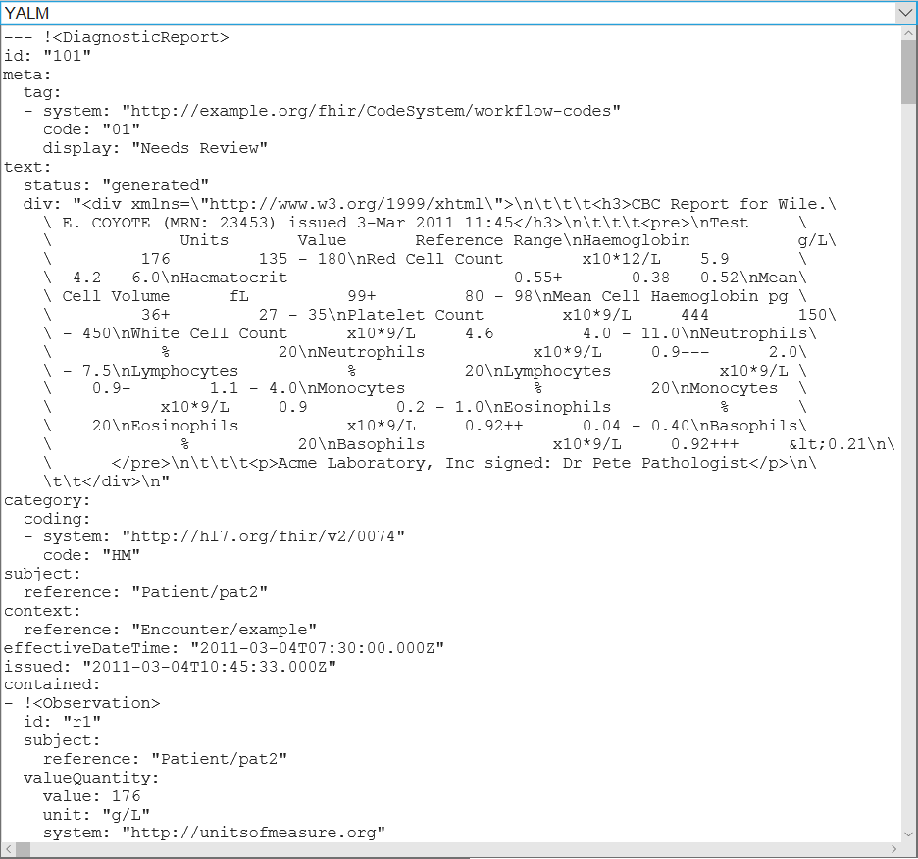
Screenshot: YAML

Slide 19
Open Source
This prototype is EPL licensed and (soon) official part of MDHT
The prototype has 1140 Java lines of code and 383 HTML5 lines of code
  90% of this code can be applied to any EMF metamodel, so refactoring would be useful!

