Slide 1
Webservices using EMF: overview of existing approaches

Slide 2
Developing Web Services with EMF SDOs for complex XML schema
http://www.ibm.com/developerworks/webservices/library/ws-emfsdo/
The „trick“ is that both the SOAPElement and the EMF object have the same XML representation. This fact is used to convert them into each other.
WSDL
XSD
references
input
GenModel with SDO defaults applied
generates
input
instance of
WSDL2Java
javax.xml.soap.
SOAPElement
EMF types
instead of JAXB
Client
generates
save/load
generates
parameter/result
usage
invokes
load/save
Skeleton
(implementation)
Business
logic
SEI
(interface)
implemented by
XML document

Slide 3
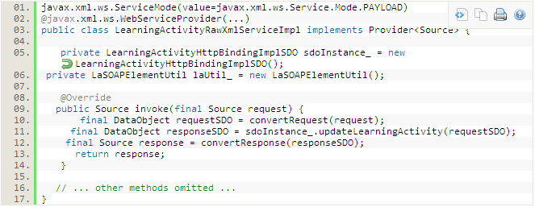
Creating JAX-WS Web Service Using Service Data Objects (SDO) Instead of JAXB-bound POJOs
http://java.dzone.com/articles/creating-jax-ws-webservice
Similar „trick“ as on previous slide but using javax.xml.ws.Provider<Source> to access the plain XML of the data objects.
  The XML (javax.xml.transform.Source) is converted to a SDO object.
  The business logic is executed.
  The SDO result is converted back to XML.

Slide 4
RaaS version 1
When manually converting an EMF instance to a org.jdom.Element, i.e. to an XML document, is the XML document really an instance of the XSD?
WSDL
XSD
references
GenModel
generates
generates
generates
instance of?
RaaS wizard
org.jdom.
Element
EMF
types
instead of JAXB
convert
Client
generates
generates
parameter/result
usage
invokes
Skeleton
(implementation)
Business
logic
SEI
(interface)
implemented by

Slide 5
RaaS version 2
An EMF instance is an instance of the XSD (when serialized as XML) since the XSD is created from the SEI which uses the EMF types as parameter/return types.
No conversion is required at all, only trivial glue code is executed in XmlAdapters for converting from an EMF interface to an EMF implementation (just a cast) or to a „Ref“ structure (copying the ID attribute).
WSDL
XSD
generates
references
GenModel
Java2WSDL
generates
generates
instance of
input
RaaS wizard
EMF
types
annotate with JAXB
Client
generates
generates
parameter/result
usage
invokes
Skeleton
(implementation)
Business
logic
SEI
(interface)
implemented by

Slide 6
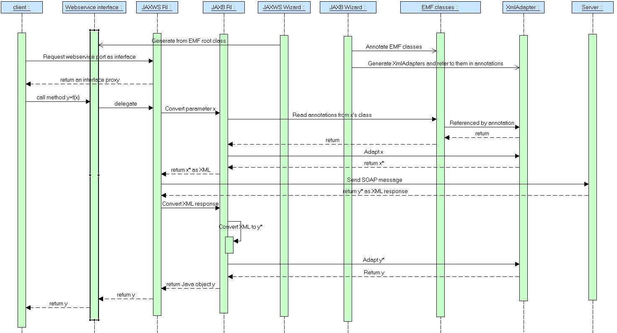
RaaS version 2: client invocation

Slide 7
Comparison
 | SDO | RaaS version 1 | RaaS version 2
Consistency of serialized XML with XSD ensured by | WSDL2Java, XSD2Ecore | RaaS | Java2WSDL
Effort to use approach | Patching generated skeleton code | No effort since wizard | No effort since wizard
Can client also use EMF types instead of generated stubs? | Yes, with same effort as for the server side | Not tried | Yes, with no glue code
Supports a list of instances as parameter / return value | No | Yes | Yes
Support for external EMF references | No | Yes, using „Refs“ | Yes, using „Refs“, resp. EMF proxies in the EMF tech. space
Can use custom SEI | Yes | No (only „CRUD“ SEIs) | Yes (only using the JAXB wizard)

