Slide 1
React & Redux

Slide 2
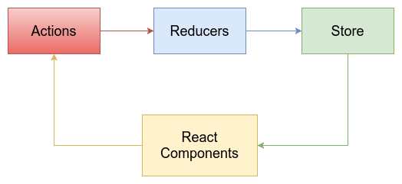
Redux data flow

Slide 3
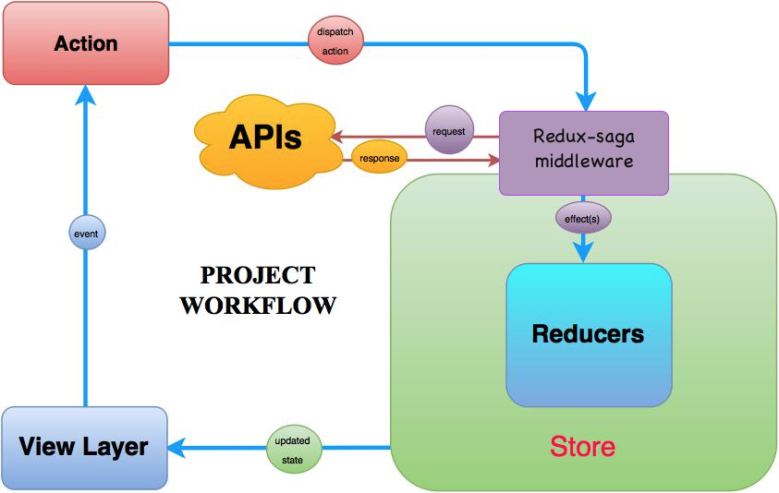
Redux Saga Flow

Slide 4
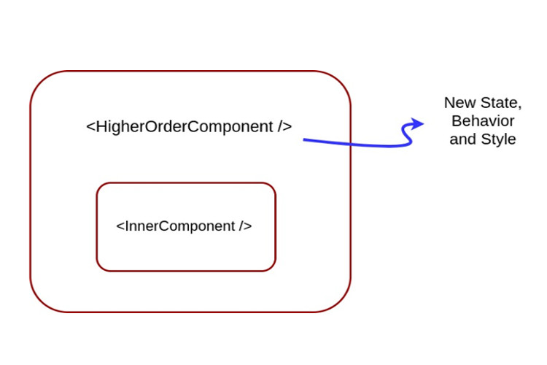
Hight order component

