Slide 1


Sacred Heart Degree
College

Slide 2
Name – Pavnesh Singh
Program - B.C.A. 2nd yr.
Roll No – 49
Submitted To :- Mr. Pankaj Sir

Slide 3
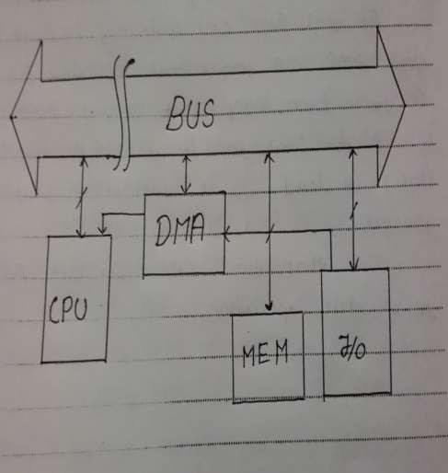
Direct Memory Access
Operation:-
CPU call DMA for operation
It will allow the device to access memory directly.

Slide 4
Types of data transfer mode
Programmed I/O
Interrupt driven I/O
DMA (Direct Memory Access)
]

Slide 5
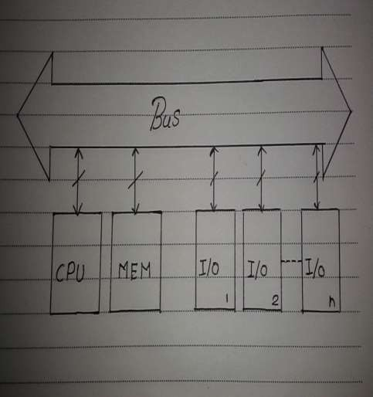
Programmed I/O
Operation:-
Address the Device.
Check its status.
IF ready
perform operation else
check another device

Slide 6
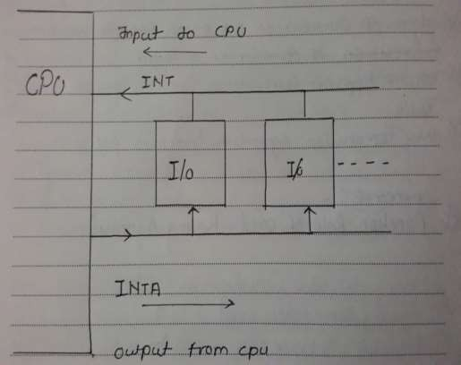
Interrupt driven I/O
Operation:-
Device interrupt’s CPU
CPU acknowledge the I/O device.
CPU perform operation

Slide 7
Need of DMA
DMA, or Direct Memory Access, is a sub controller that can access memory in sequential order without intervention from the processor. DMA is used to moving around large amounts of data in the computer without taking time away from the processor.
The first major uses of DMA included drive controllers and sound cards.

Slide 8
Basic operation’s of DMA
DMA provide direct access to memory.
For fast operation DMA work as a bus master.
Direct Memory Access is a method of transferring data between peripherals and memory without using the CPU.

Slide 9
DMA Data Transfer
It is data transfer technique directly between memory and I/O without CPU intervention.
Under the supervision of extra hardware called DMA controller .
Fastest type of data transfer technique among this parallel group.

Slide 10
Types DMA based data transfer techniques
Byte /cycle stealing mode.
Burst /demand mode.
Continuous / block mode.

Slide 11
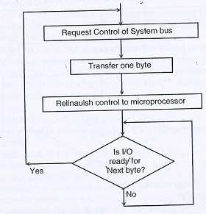
Byte /cycle stealing mode.

Slide 12
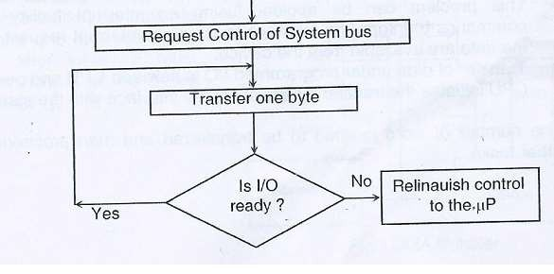
Burst /demand mode.

Slide 13
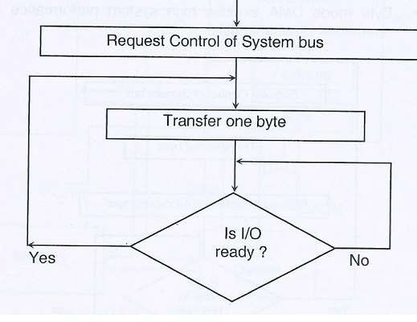
Continuous / block mode.

Slide 14


