Slide 1

Factors of Production

Slide 2

Definition of Factors of Production
Factors of production are
resources for production

Slide 3
Classification of Factors of Production
Factors of Production
Natural
Resources
Human
Resources
Man-Made
Resources
Labour
and
Entrepreneurship
Land
Capital

Slide 4

LAND
Natural Resources:
LAND

Slide 5

LAND
Definition:
Resources provided by nature are called land.

Slide 6
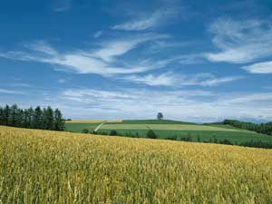


LAND
Characteristics:
A Gift of nature
Limited in Supply
Land is immovable

Slide 7

Capital
Man-Made Resources:
Capital

Slide 8
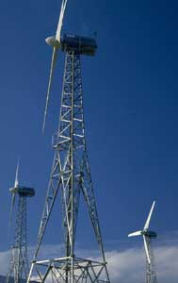
Capital
Definition:
All resources that are made by men to assist production are capital.

Slide 9

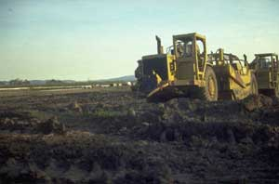

Capital
Characteristics:
Man-made Resources
Increase in Productivity

Slide 10

Labour
Human Resources:
Labour

Slide 11
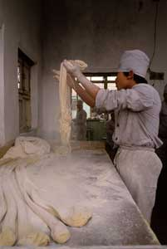
Labour
Definition:
Labour refers to human efforts, both mental and physical that are involved in the production process.

Slide 12
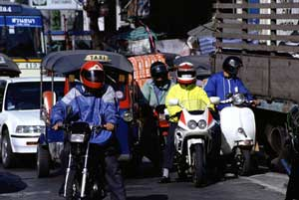
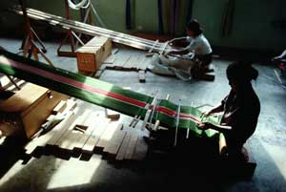
Labour
Characteristics:
Human Resources
Rest and Leisure
Improvement in Productivity

Slide 13

Labour Supply
Labour Supply
Definition:
The supply of labour is measured by the total working hours of the workers involved in production.

Slide 14
Labour Supply
Factors affecting Labour Supply:
Size of the population
The size of working population
The number of working hours

Slide 15
Labour Productivity
Labour Productivity
Definition:
Average labour productivity measures the output per worker per unit of time.

Slide 16
Labour Productivity
Factors affecting Labour Productivity:
Education and Training
Rewards and Benefits
Working environment
Health of workers
Mechanization
Division of labour
Management

Slide 17

Entrepreneurship
Human Resources:
Entrepreneurship

Slide 18

Entrepreneurship
Definition:
Entrepreneurship refers to human efforts which organize all resources, make decisions and bear risks.

Slide 19
Entrepreneurship
Characteristics:
Management and Organization
Major Decision-Making
Risk Bearing

Slide 20
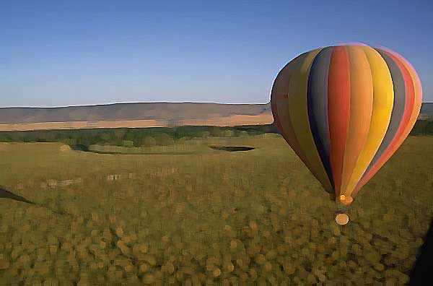
Mobility of Resources
Type of Mobility of Labour:
Occupational Mobility
Geographical Mobility

Slide 21
Mobility of Resources
Factors affecting the Occupational Mobility of Labour:
Monetary Rewards
Non-Monetary Rewards
Skills of Workers
Restrictions of Trade Unions and Professional Associations
Age of workers

Slide 22
Mobility of Resources
Factors affecting the Geographical Mobility of Labour:
Transportation
Political Factors
Economics Conditions of the Home Country
Economics Conditions of Other Countries
Social Factors

Slide 23
End

