Slide 1
Zomato Restaurants Analysis
Overview of restaurant data across cities and cuisines

Slide 2
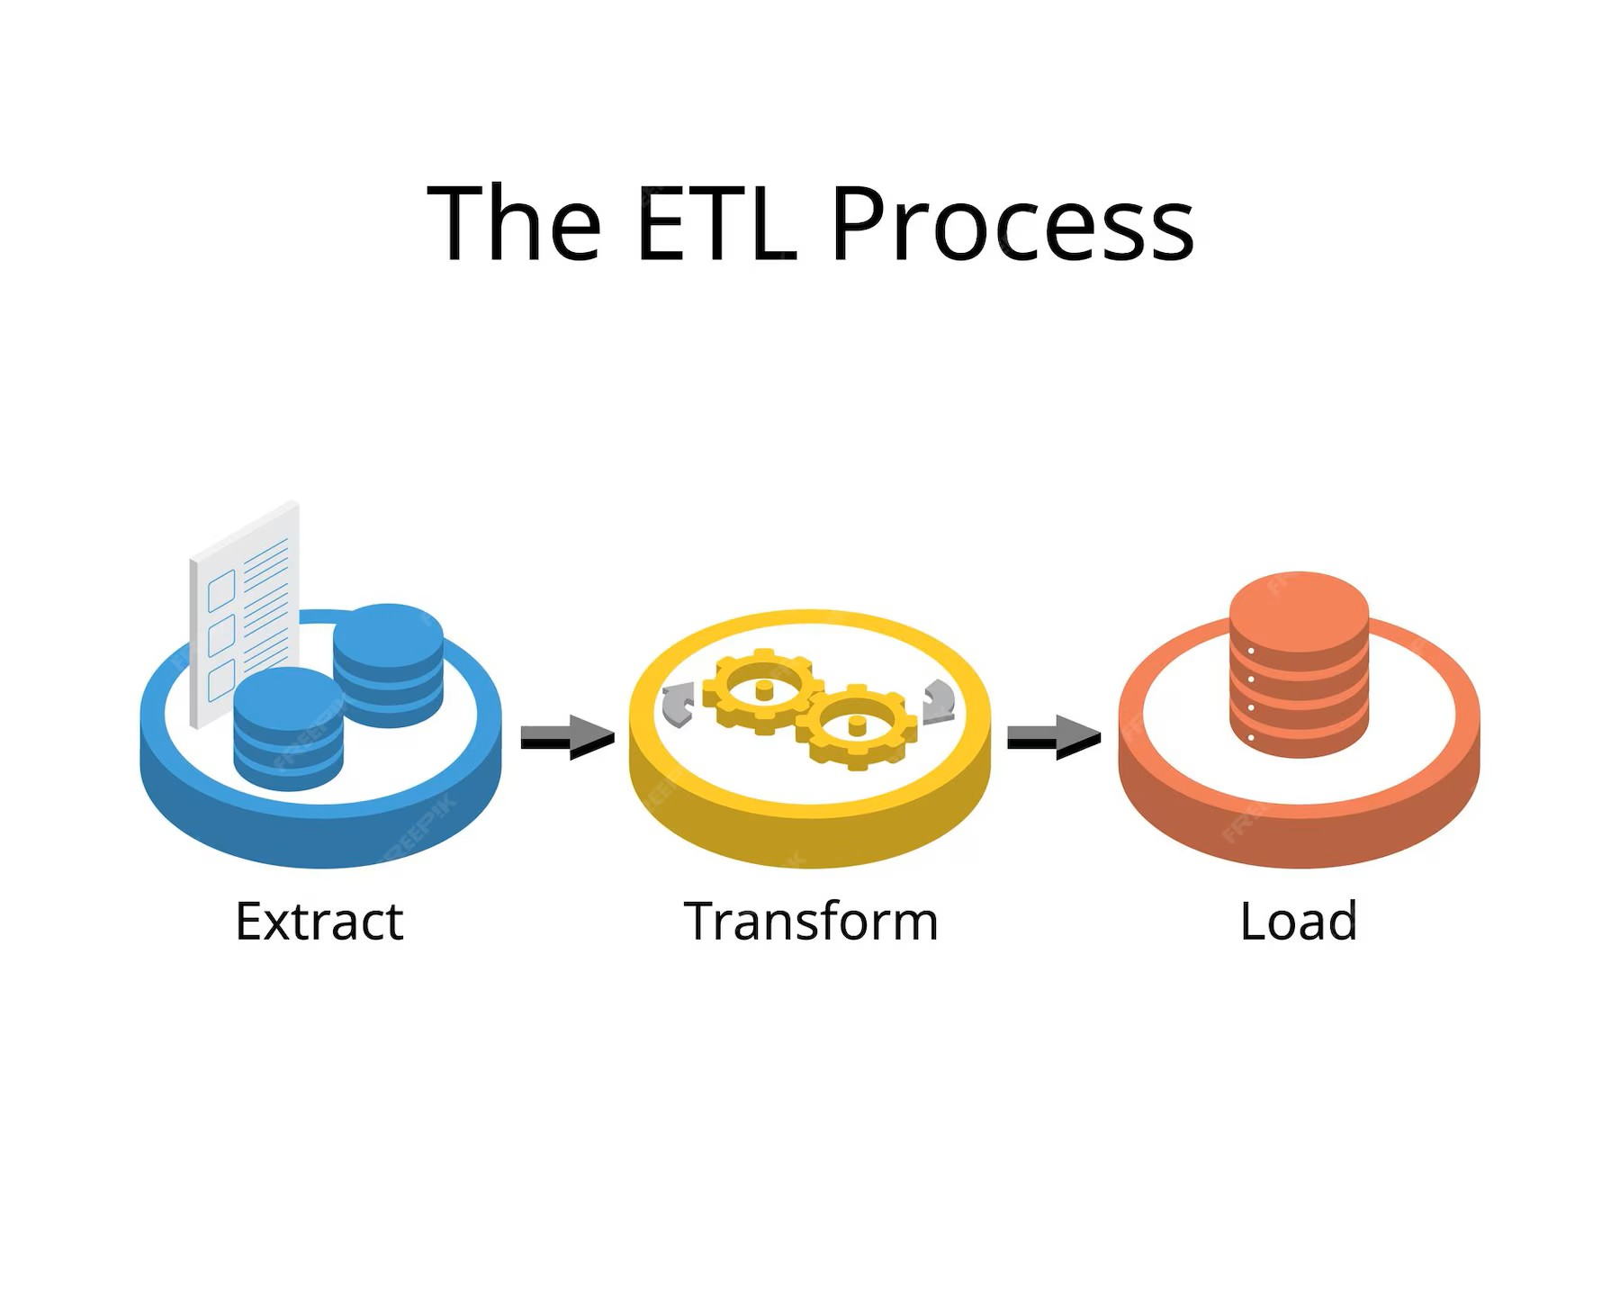

Slide 3
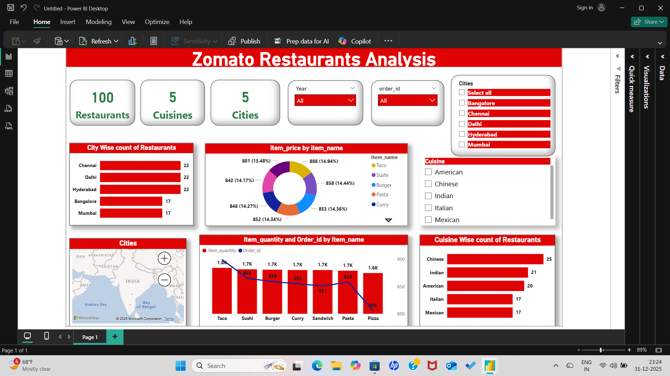

Slide 4
Dashboard Summary
Total Restaurants: 100
Cuisines Covered: 5 (American, Chinese, Indian, Italian, Mexican)
Cities Analyzed: Bangalore, Chennai, Delhi, Hyderabad, Mumbai
Filters: Year, Order ID, City, Cuisine

Slide 5
City-Wise Restaurant Count
Restaurants

Slide 6
Cuisine-Wise Restaurant Count
Restaurants

Slide 7
Item Price Distribution
Item Price

Slide 8
Item Quantity and Order Analysis
Orders

Slide 9
Geographic Distribution
Map of India showing Bangalore, Chennai, Delhi, Hyderabad, Mumbai

Slide 10
Insights & Observations
Chinese cuisine leads in restaurant count
Pizza has the highest item price
Taco tops in both quantity and order count
Chennai, Delhi, and Hyderabad have equal restaurant representation
Balanced distribution across cuisines and cities

