Slide 1

TOPIC : SMART ATTENDANCE TRACKER
PRESENTED BY :
CH.VENKATA TEJA -25MVCSMR0021
P.MADHUSUDAN REDDY-25MVCSMR0066
K.HANSIKA-25MVCSMR0047
K.SAI MADHUHASINI-25MVCSMR0044

Slide 2
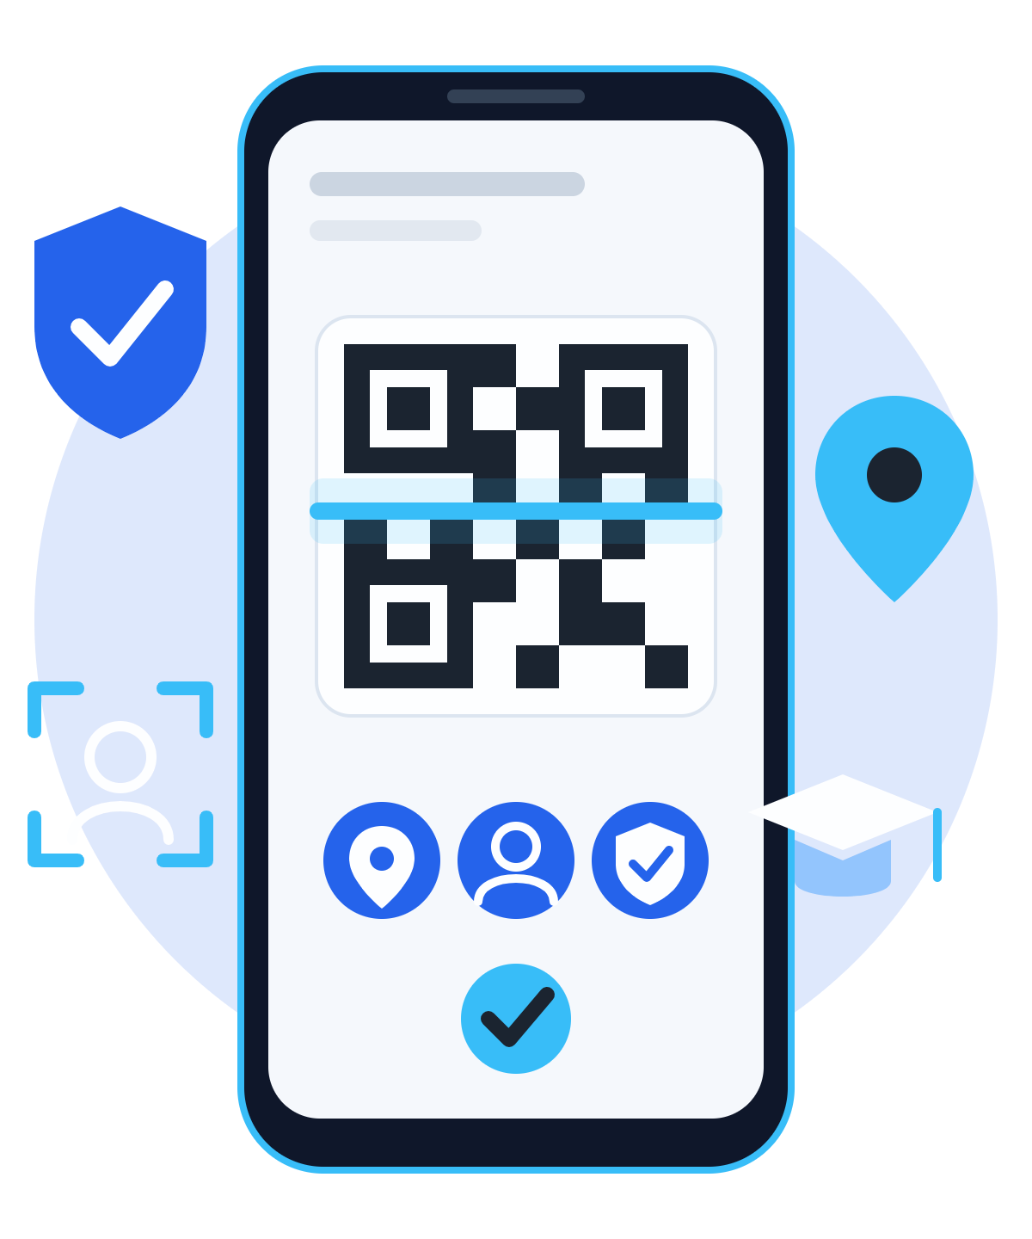
Smart Attendance System
EDTECH · HACKATHON PROJECT
using MERN Stack
A secure QR-based attendance system with multi-layer verification to eliminate proxy attendance.
M
MongoDB
E
Express
R
React
N
Node.js
TEAM MEMBERS
PROBLEM DOMAIN
Chetala Venkata Teja
Patlolla Madhusudan Reddy
Khandare Hansika
Kathi Sai Madhuhasini
Education Technology (EdTech)
Notes:
Welcome. Introduce the project: a secure QR-based attendance system with multi-layer verification that eliminates proxy attendance. Mention the team and the EdTech problem domain.

Slide 3






The Challenge
THE PROBLEM
Manual roll call wastes class time
Proxy attendance by friends
KEY CHALLENGE · OUR ANSWER
Prevent QR sharing
Expiring one-time token
Verify the real student
QR photos shared outside class
Fake GPS apps spoof location
Live selfie face check
Secure authentication
JWT login + email OTP
Attendance records get manipulated
No attendance analytics
Fast attendance marking
Done in under 3 seconds
Why it matters
Accurate attendance
Time saving
Increased transparency
Better student monitoring
Smart Attendance System · Secure QR Verification
02 / 07
Notes:
Manual attendance wastes time and basic QR attendance is easy to cheat: QR photos get shared, GPS can be faked, friends can mark proxy attendance. The right panel pairs each key challenge with how our system answers it.

Slide 4

Our Innovation
WHAT IS NEW
Identity
1
JWT authentication · Email OTP · Role-based access (Admin, Faculty, Student)
2
QR token
Dynamic QR per class · 30-second expiry · One-time token
CORE IDEA
Secure multi-layer attendance verification instead of relying only on QR scanning.
3
Location
GPS location verification
4
Device
Device fingerprinting
5
Person
WHY IT IS DIFFERENT
Live selfie face verification
Traditional QR attendance can be cheated. Every extra layer makes sure only genuine students can mark attendance.
Verified attendance
Analytics dashboard updated for faculty
Smart Attendance System · Secure QR Verification
03 / 07
Notes:
Our innovation is five verification layers instead of just a QR scan: identity, a short-lived one-time QR token, GPS location, device fingerprint and a live selfie. Only a student who passes every layer is marked present, and faculty see it instantly in the analytics dashboard.

Slide 5














System Workflow
HOW IT WORKS
Highlighted steps are security checks
1
2
3
4
5
6
Faculty Login
Generate Secure QR
QR Sent to Students
Student Login
Scan QR
GPS Verification
7
8
9
10
11
12
Device Verification
Face Verification
QR Expiry Check
JWT Authentication
Stored in MongoDB
Dashboard Updated
Faculty
Login
Generate QR
Monitor Attendance
Download Reports
Student
Login
Verify Email
Scan QR
Selfie Verification
Attendance Success
Smart Attendance System · Secure QR Verification
04 / 07
Notes:
Twelve steps from faculty login to the updated dashboard. The highlighted steps (GPS, device, face, QR expiry, JWT) are the security checks that block proxy attendance. The two lanes at the bottom show the faculty and student journeys.

Slide 6





Technology & Algorithms
UNDER THE HOOD
TECH STACK
ALGORITHMS · TIME COMPLEXITY
Frontend
React.js
HTML
CSS
JavaScript
Algorithm | Complexity
QR Token Generation | O(1)
JWT Authentication | O(1)
Face Verification | O(n)
Device Fingerprinting | O(1)
GPS Validation | O(1)
Attendance Report Generation | O(n)
Bootstrap
Backend
Node.js
Express.js
Database
MongoDB
Authentication
JWT
bcrypt
Cloud
MongoDB Atlas
Render
WHY THESE TECHNOLOGIES
Fast full-stack development
Flexible attendance records
Secure JWT authentication
bcrypt-protected passwords
Responsive React UI
Smart Attendance System · Secure QR Verification
05 / 07
Notes:
MERN stack end to end: React front end, Node and Express back end, MongoDB for flexible attendance records, JWT plus bcrypt for security, and MongoDB Atlas with Render for cloud hosting. The table lists each core algorithm with its time complexity; face verification and report generation scale with n.

Slide 7
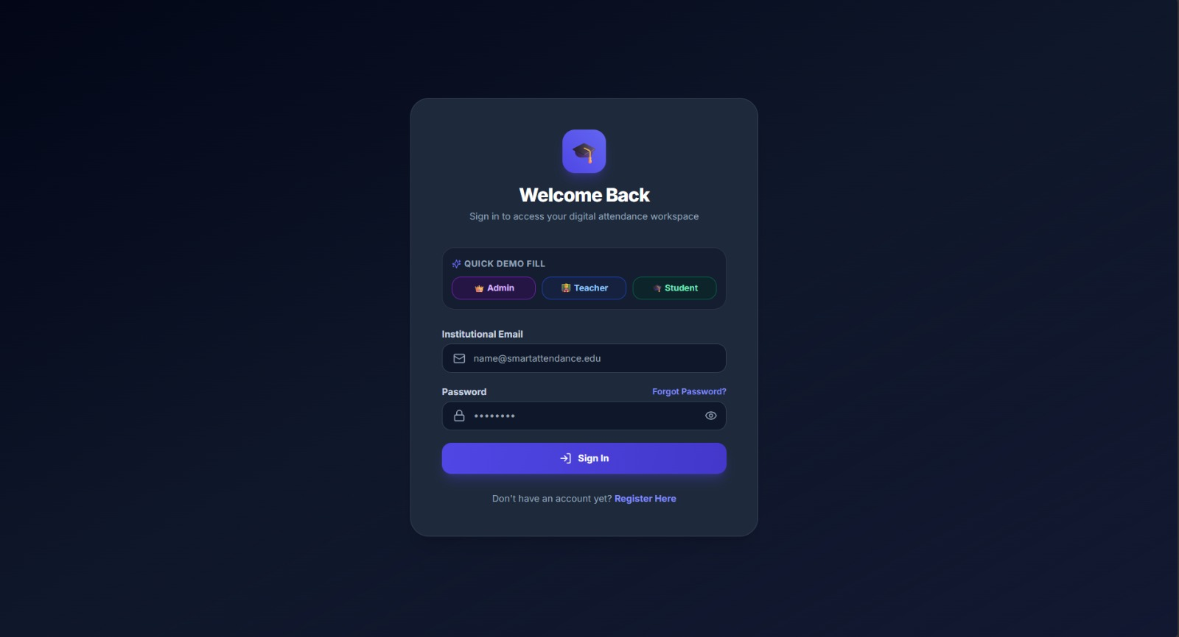

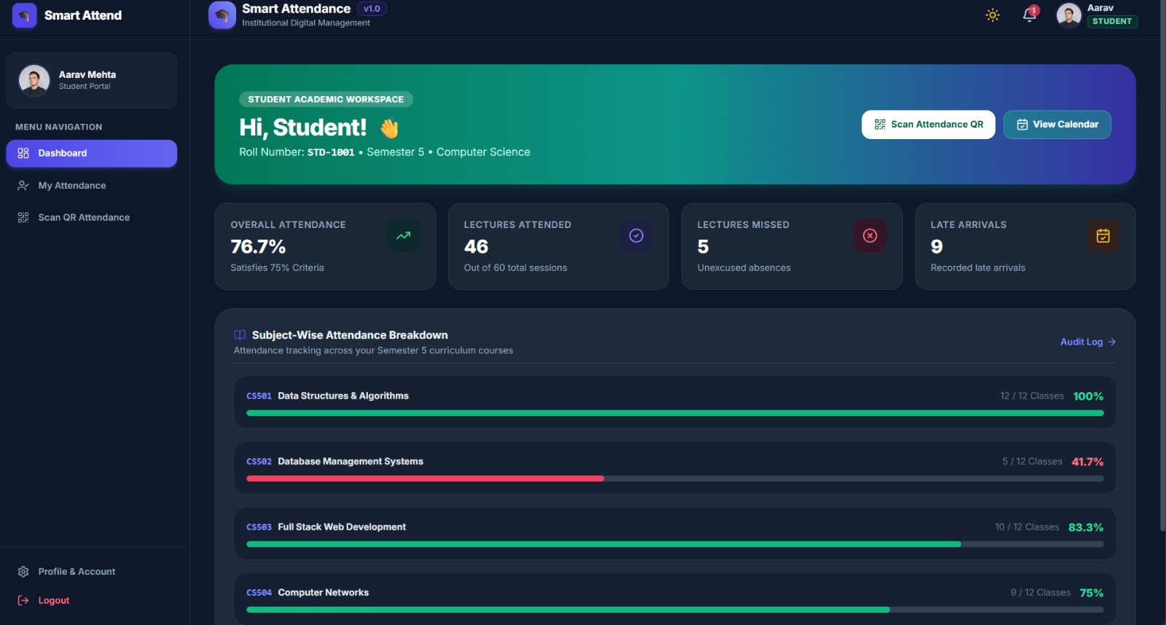
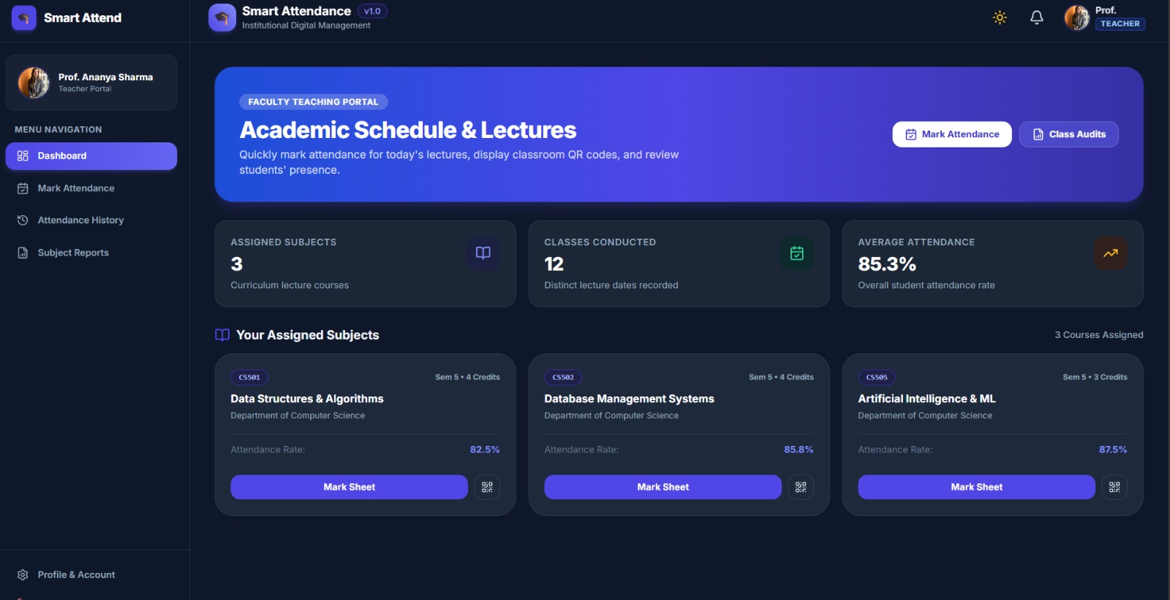
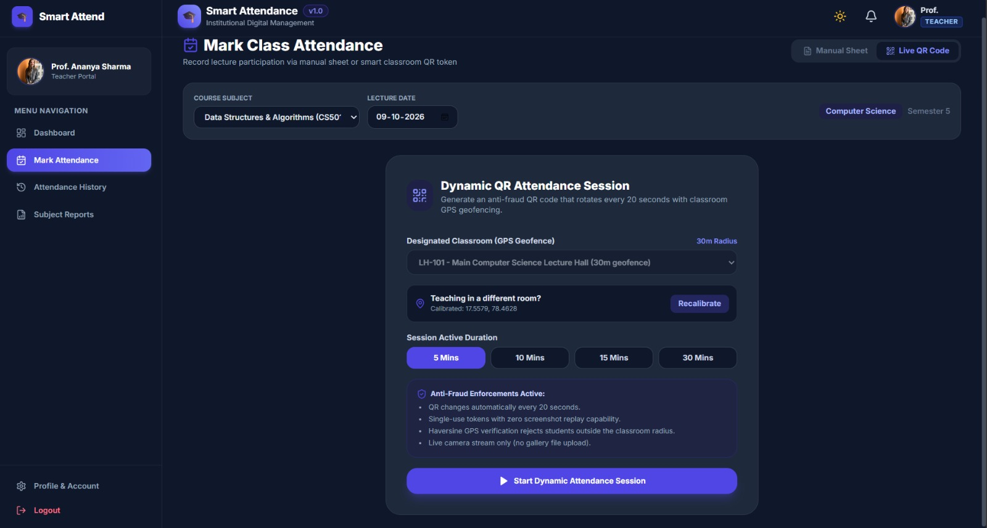

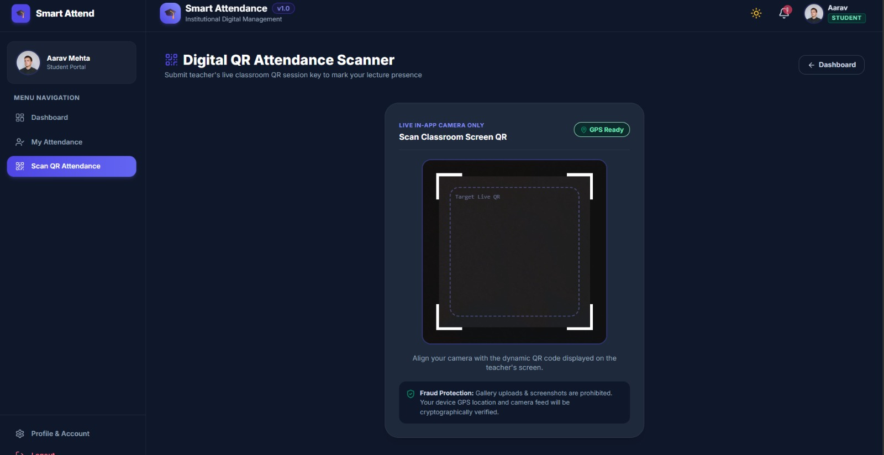
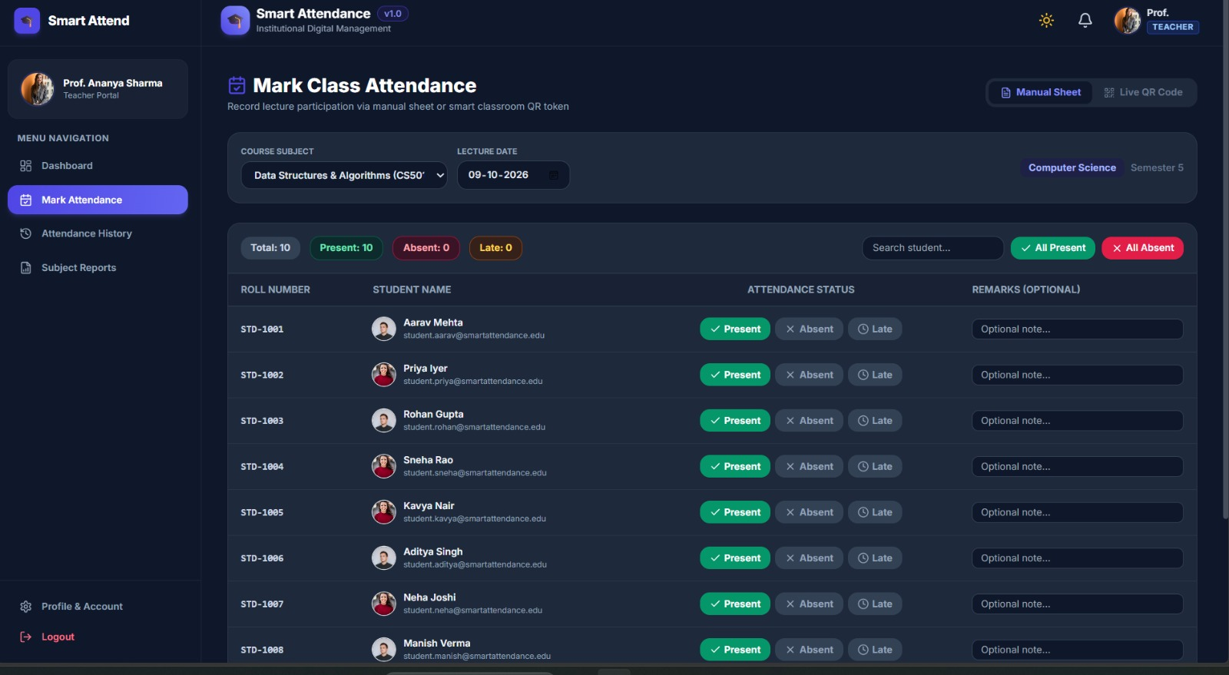
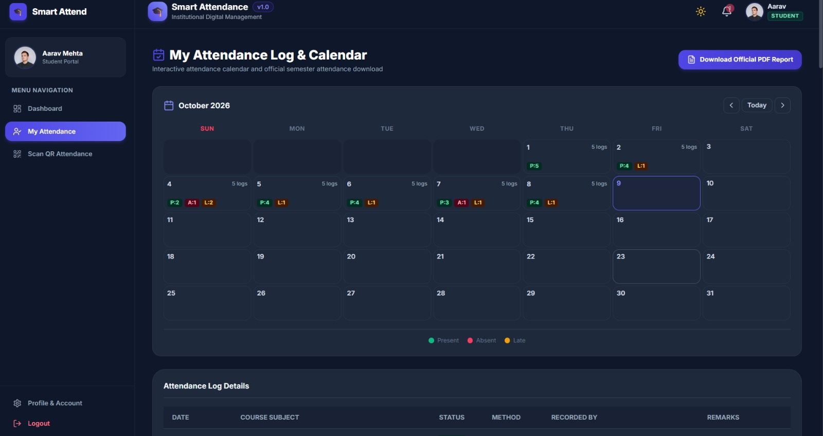

Demo & Impact
SEE IT WORKING
Live screens from the running app
PERFORMANCE
< 3 s
Login Page
Student Dashboard
Faculty Dashboard
QR Generation
to mark attendance
SAMPLE OUTPUT
Prevents proxy attendance
Secure authentication
Real-time updates
Attendance Marked Successfully
QR Scanner
Manual Sheet
Attendance Log
Saves teacher time
Paperless attendance
Accurate records
Secure verification
Easy report generation
Smart Attendance System · Secure QR Verification
06 / 07
Notes:
These tiles are illustrative placeholders for the seven screens: login, student dashboard, faculty dashboard, QR generation, QR scanner, attendance success and attendance report. Replace each with a real screenshot of the running app before presenting. Highlight the under-3-seconds marking time and the benefits along the bottom.

Slide 8






Future Vision
WHAT IS NEXT
CURRENT ACHIEVEMENT
FUTURE IMPROVEMENTS
SCALABILITY
Functional MERN app
AI Face Recognition
Fingerprint Authentication
Schools
Secure QR attendance
Colleges
NFC Attendance
BLE Beacon Verification
JWT authentication
Universities
Attendance dashboard
Parent Notifications
Mobile App
Corporate Offices
MongoDB integration
AI Attendance Prediction
Offline Attendance Sync
Training Institutes
THANK YOU
CONTACT
"Making attendance smarter, faster, and more secure with modern technology."
[your-email@example.com]
Questions & Answers
github.com/[username]/[repo]
Smart Attendance System · Secure QR Verification
07 / 07
Notes:
We already have a working MERN application with secure QR attendance, JWT authentication, a dashboard and MongoDB storage. Next: AI face recognition, fingerprint, NFC and BLE beacons, parent notifications, a mobile app, AI attendance prediction and offline sync. It scales to schools, colleges, universities, offices and training institutes. Close with the takeaway, then open for questions. Add your real contact details and GitHub link.

