Slide 1

Exploratory Data Analysis
(AMCAT Dataset)

Slide 2
About me
I am Patlolla Samhitha , I have completed my masters in the stream of data science though I have done masters on data science I am not perfect in coding skills . so, I have joined innomatics to improve my skills and knowledge in coding.
Feel free to reach out! You can do so by following the below links:
https://www.linkedin.com/in/patlollasamhtha/
https://github.com/patlolla-samhitha

Slide 3
OBJECTIVE OF THE PROBLEM
This exploratory data analysis of “AMCAT DATASET” focuses on understanding various factors that might influence the level of salaries indicated in the dataset. We consider education and experience, gender, specialization, and job roles and observe how they are related in order to understand a factor that influences higher or lower levels of salaries. The critical steps which indicate the analysis involved creating a mental image of the data, establishing trends and patterns, testing many hypotheses post observations to finally build insightful results which could be used as guidelines for any decision making process that could further calibrate salary prediction models.

Slide 4
SUMMARY OF THE DATASET
There are 38 columns in total that are used to find the individual impacts on salary.
Out of 38 columns, there are 29 numerical columns and 9 categorical columns.
With 3998 Datapoints that make our analysis to the optimal insights with all the necessary information.

Slide 5
DATA CHECKS TO PERFORM
Check missing values, duplicated values and various different columns.
Check the datatypes and also look at the unique number of columns.
Check statistics of data set
Check various categories present in the different categorical column.
Drop unnecessary columns

Slide 6
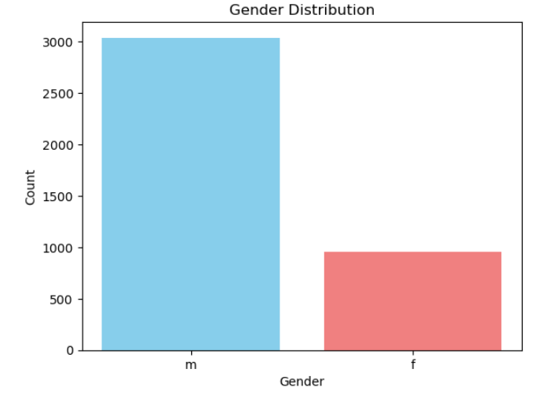
What target variable ‘Gender’ tells us?
It indicates that there are 3 times more males are employed than females .

Slide 7
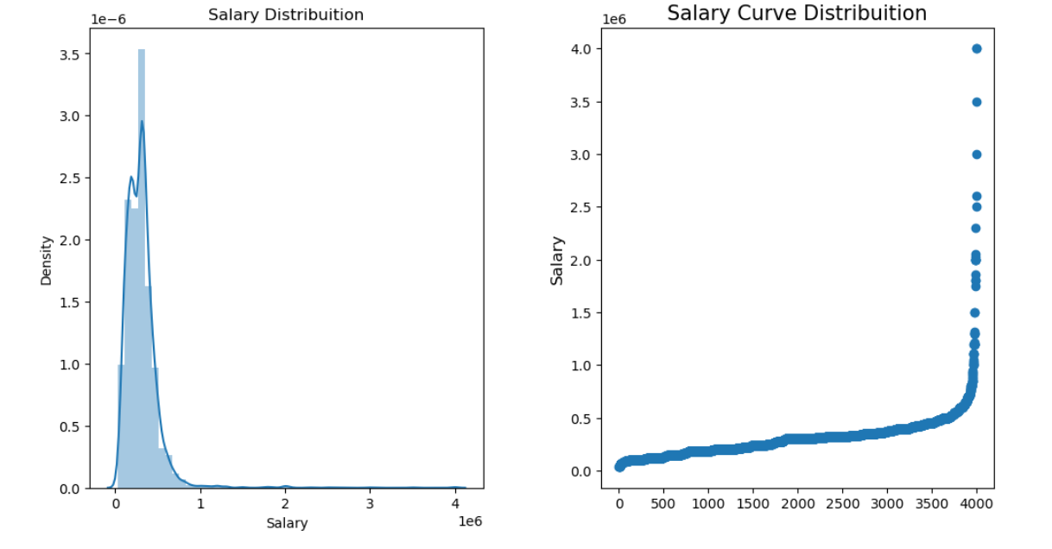
Most of the graduates having salaries under 10 lakhs.
Long tail of distribution is on right hand side which shows that distribution is right skewed or positively skewed.

Slide 8
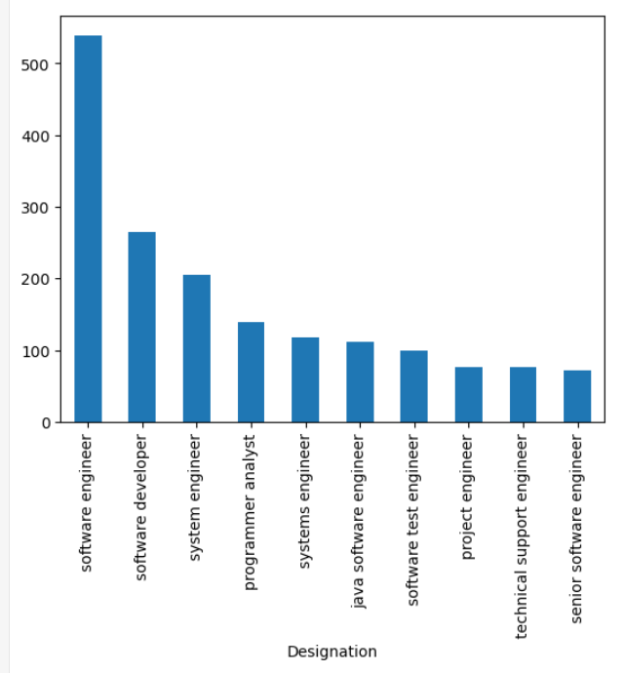
TOP 10 Distribution for Designation
More peoples are software Developer
less peoples are senior software engineer

Slide 9
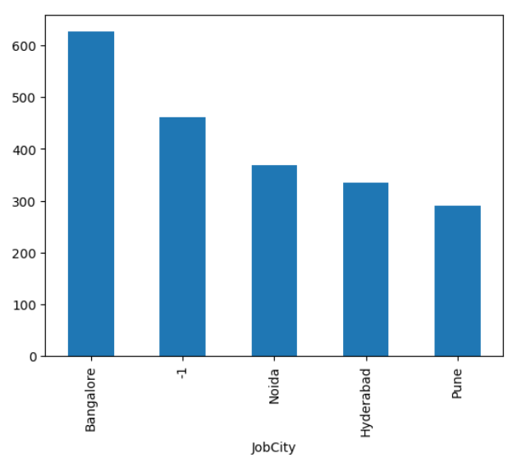
By comparing cities Bangalore has more number of jobs

Slide 10
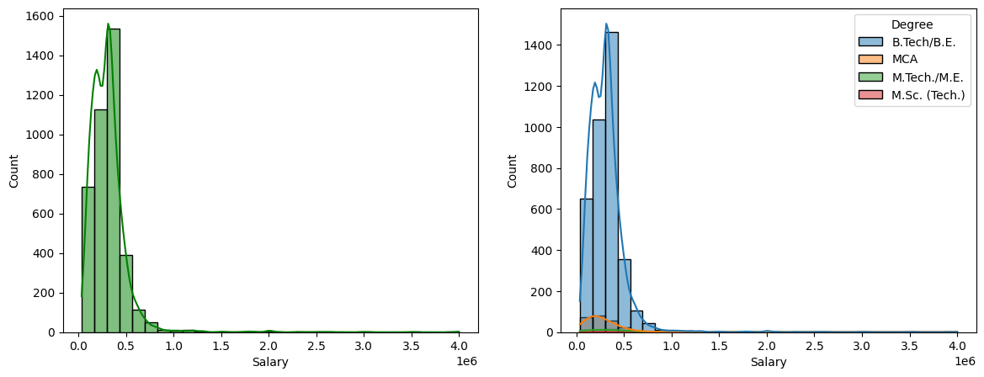
hhahh
B.Tech students has a higher salary other Degree persons.

Slide 11
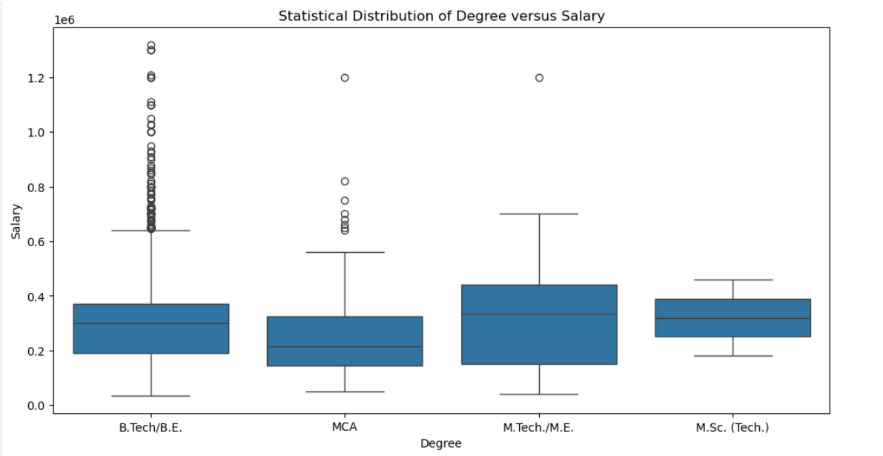

Slide 12
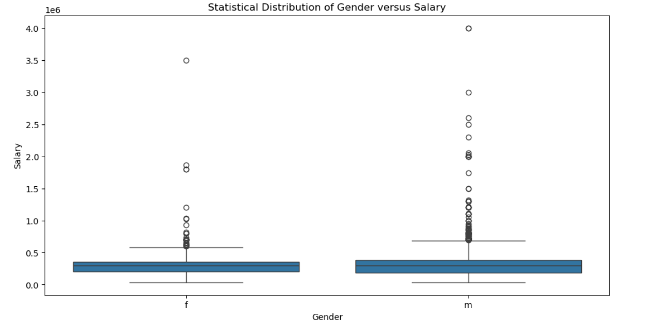
The Average salary for man and woman are looking almost same.There are outliers in salary column.

Slide 13
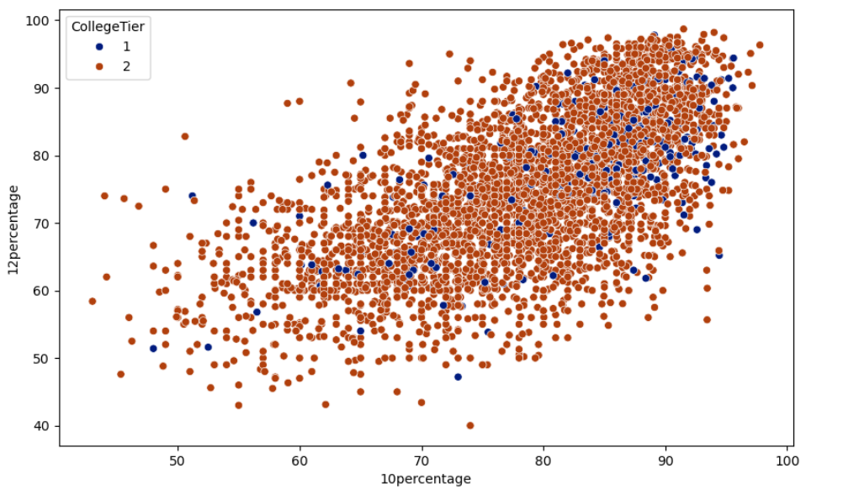
Analysis of 10th and 12th percentage by college tier
According to correlation plot and scatterplot, we can see that 10th and 12th are positively correlated

Slide 14
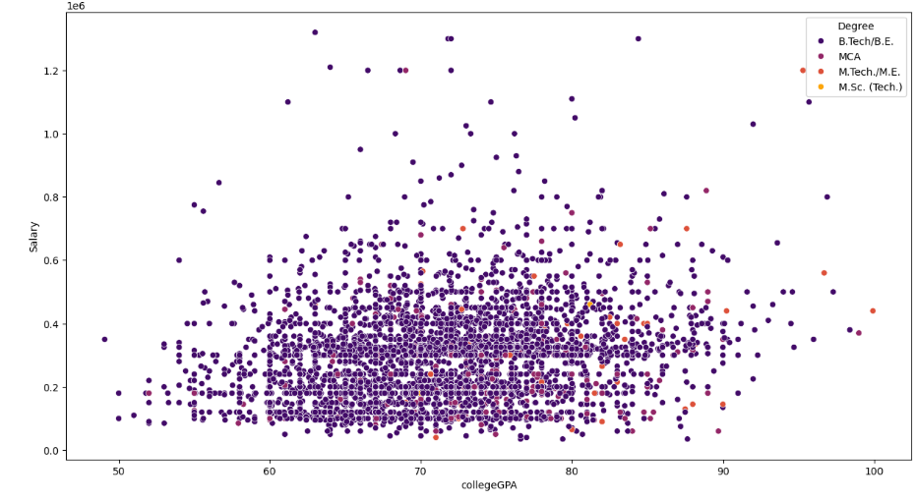
Average salary is highest for BE/B.tech graduates as compared to any other degree graduates.

Slide 15
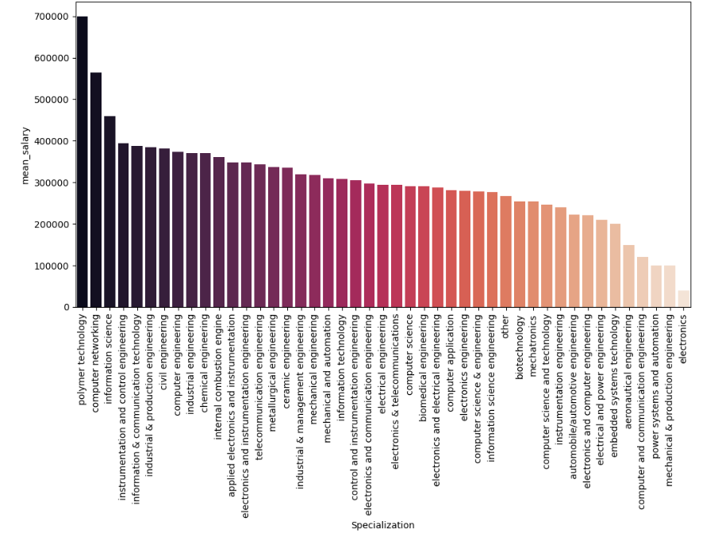
Analysis of Salary and Specialization
Polymer technology, Computer networking and informative science having highest mean salary.

Slide 16
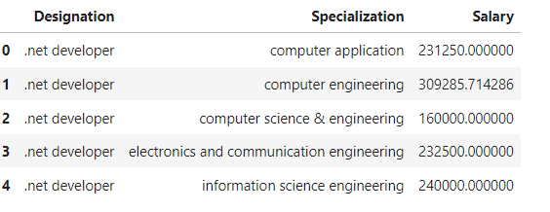
Research Question 1: Determine whether fresh graduates earn 2.5-3 lakhs annually as stated in the article.
The average salary of fresh graduates are not between given range

Slide 17
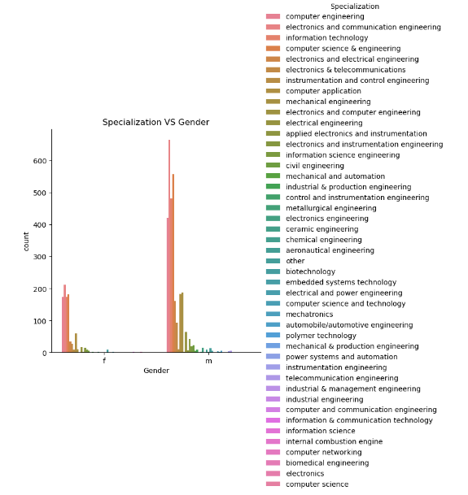
Research Question 2: Determine if gender influences the choice of specialization.
The graph shows that most specializations have a higher number of male graduates than female graduates.
There are a few specializations with a higher number of female graduates, but they are outnumbered by those with more male graduates.
The highest number of graduates is in Computer Science and Engineering, followed by Electronics and Communication Engineering.

Slide 18
Conclusion
The analysis of the AMCAT dataset provides insightful conclusions regarding salary trends, specialization, and skill sets of fresh graduates in different roles. Here are some key takeaway:
Polymer technology, Computer networking and informative science having highest mean salary.
There are a few specializations with a higher number of female graduates, but they are outnumbered by those with more male graduates
The highest number of graduates is in Computer Science and Engineering, followed by Electronics and Communication Engineering.

Slide 19

THANK YOU

