Slide 1


SelfHealOS
AI-Based Operating System Fault Detection and Recovery System
PBL-2
LITERATURE REVIEW
CRITICAL ANALYSIS
GAP ANALYSIS
Research Team
Project Scope
2510030269 | Snigdha
2510030331 | Sriya Aditi
2510030164 | Deekshith
2510030156 | Sai Charan
SelfHealOS proposes a unified, lightweight, OS-native pipeline that integrates real-time monitoring, ML-based fault classification, automated recovery, and post-recovery verification — a capability gap confirmed across the 2024–2026 literature.
No existing system unifies all four pipeline stages at the OS level.
Notes:
1

Slide 2


Why Intelligent OS Fault Detection Becomes Necessary
Fault Origins
Stage 1
OS faults originate from CPU overload, memory pressure, disk and resource exhaustion, and abnormal process behaviour — often compounding silently before system degradation becomes visible.
Real-Time Monitoring
Stage 2
Self-Healing Requirements
Intelligent Fault Detection
A self-healing OS demands four continuous capabilities: real-time monitoring, intelligent fault detection, automated recovery execution, and post-recovery verification to confirm system stability.
Stage 3
Automated Recovery
Traditional Monitoring Gap
Stage 4
Conventional monitoring tools detect symptoms but cannot intelligently classify fault type, determine severity, or autonomously initiate the correct recovery action.
Post-Recovery Verification
Motivation for SelfHealOS
No existing lightweight, OS-level system unifies these four stages into a single pipeline — creating a clear and addressable research gap.
Notes:
2

Slide 3


How Existing Work Was Evaluated
Evaluation Dimensions
Research Scope
1
Approach & Data Source
Period
What data or signals does the method rely on — logs, metrics, process state?
Recent peer-reviewed research from 2024–2026
2
ML Technique
Approach
Which learning paradigm is applied — supervised, self-supervised, transformer-based?
Comparative and critical analysis — not descriptive summary
3
Detection & Recovery Capability
Lens
Does the system detect only, recover only, or attempt to integrate both stages?
Strengths, limitations, and integration gaps across detection and recovery stages
4
Limitation & Gap
What integration, scope, or deployment constraint limits real-world OS applicability?
Notes:
3

Slide 4





Existing Research Approaches: Five Domains
Log-Based Anomaly Detection
Deep Learning / Transformers
Process & Resource Monitoring
System event log analysis and sequential pattern recognition to identify deviations from normal OS behaviour.
Complex pattern learning from sequential log and metric data using neural architectures including LSTMs and transformer models.
CPU, memory, disk, and process-level metrics used as real-time fault signals at the OS resource layer.
OS / System Fault Detection
Automated Remediation & Self-Healing
Operating system-level anomaly identification targeting kernel events, system calls, and scheduler state anomalies.
Autonomous recovery action execution including process restart, resource reallocation, and service restoration workflows.
Notes:
4

Slide 5
Literature Matrix: 10 Papers, 2024–2026
Study | Year | Approach / Technique | Main Contribution | Key Limitation
WDLog | 2024 | Wide & Deep Learning | Robust log anomaly detection | Log-dependent; no recovery capability
OneLog | 2024 | End-to-End Learning | Unified log anomaly pipeline | Detection only; no system recovery
LogSD | 2024 | Self-Supervised Learning | Frequency-based anomaly masking | Limited to log analysis scope
Log Parsing Impact | 2024 | Deep Learning + Parsing | Parsing quality affects detection accuracy | Significant preprocessing overhead
LogETA | 2024 | Time-Aware Cross-System | Multi-system anomaly detection | Temporal complexity; no recovery stage
Anomaly Detection in Logs | 2024 | Deep Learning | Effective event pattern recognition | Requires labeled training data
Distributed System Logs | 2025 | LSTM + Process State | Distributed system anomaly detection | Limited to detection phase only
Unified Framework (Transformers) | 2025 | Collaborative Transformers | Point & collective anomaly detection | OS-level recovery not addressed
Cloud-Based AI Systems | 2025 | Intelligent Fault Detection | Autonomous self-healing capability | Cloud-specific; not OS-focused
CROSS | 2026 | Cloud-Native Remediation | Automated recovery actions | Cloud infrastructure; limited OS integration
Notes:
5

Slide 6


What Existing Technologies Solve — and Where They Stop
Capabilities Demonstrated Across Literature
Critical Observation
Log-Based ML
Existing approaches demonstrate strong capabilities within individual pipeline stages. Very few provide a complete OS-level pipeline that combines:
Detects abnormal system events with high accuracy using pattern recognition on structured and unstructured log streams.
  Real-time resource monitoring
  ML-based fault classification
  Automated recovery
  Post-recovery verification
Deep Learning / Transformers
Learns complex anomaly patterns from sequential data windows, including point and collective anomalies.
Process-State Monitoring
The integration gap — not the individual technique — is the core research problem.
Enriches fault signals with process-level context and attributable resource causation beyond raw log entries.
Resource Monitoring
Identifies CPU, RAM, and disk abnormalities in real-time, enabling early warning before critical failure.
Automated Remediation
Performs autonomous recovery actions — demonstrated primarily in cloud environments.
Notes:
6

Slide 7
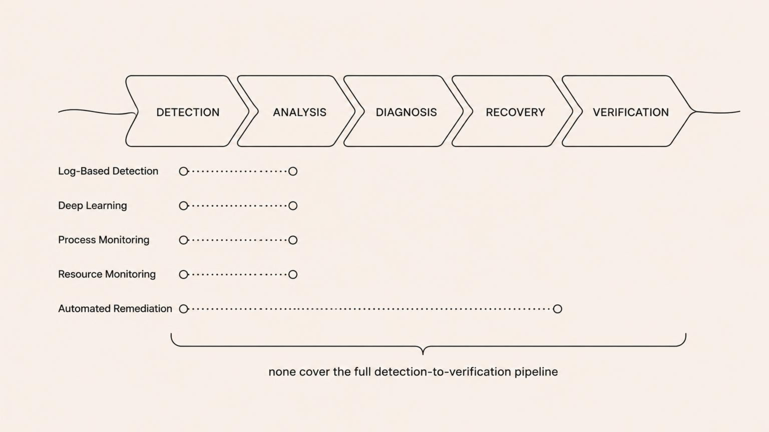
Strengths & Limitations by Approach
Approach | Strength | Limitation
Log-Based Detection | Detects abnormal system events with high precision across diverse log formats | Dependent on log availability and quality; fails when logs are absent or malformed
Deep Learning | Learns complex, non-linear anomaly patterns without manual feature engineering | Requires substantial labeled or domain-specific training data to generalise reliably
Process Monitoring | Provides granular process-level fault context and resource attribution | Typically scoped to detection; lacks system-wide automated recovery integration
Resource Monitoring | Delivers real-time, low-latency visibility into CPU, RAM, and disk health | Threshold-based rules alone miss complex or multi-dimensional fault conditions
Automated Remediation | Enables self-healing by autonomously executing recovery actions without human input | Recovery decisions are often rule-based and lack adaptive or verification mechanisms
Notes:
7

Slide 8



Identified Research & Project Gap
Missing Integration
Where the Gap Manifests
Existing studies predominantly address individual pipeline stages in isolation. The academic literature lacks a system that integrates all five of the following within a single, lightweight, OS-native pipeline:
Detection ↔ Recovery Disconnect
Log-based and transformer-based detection methods stop at anomaly identification; recovery is left to separate, often manual, processes.
01
Real-time OS resource monitoring
Cloud vs. OS Scope Mismatch
02
Self-healing capabilities that do exist (CROSS, Cloud-Based AI Systems) are designed for cloud infrastructure — not applicable to general-purpose operating systems.
ML-based fault classification
03
Automated recovery action selection
No Verification Stage
No reviewed paper includes post-recovery verification to confirm system return to a stable baseline — a critical reliability gap.
04
Post-recovery state verification
05
Recovery logging for future learning
Notes:
8

Slide 9
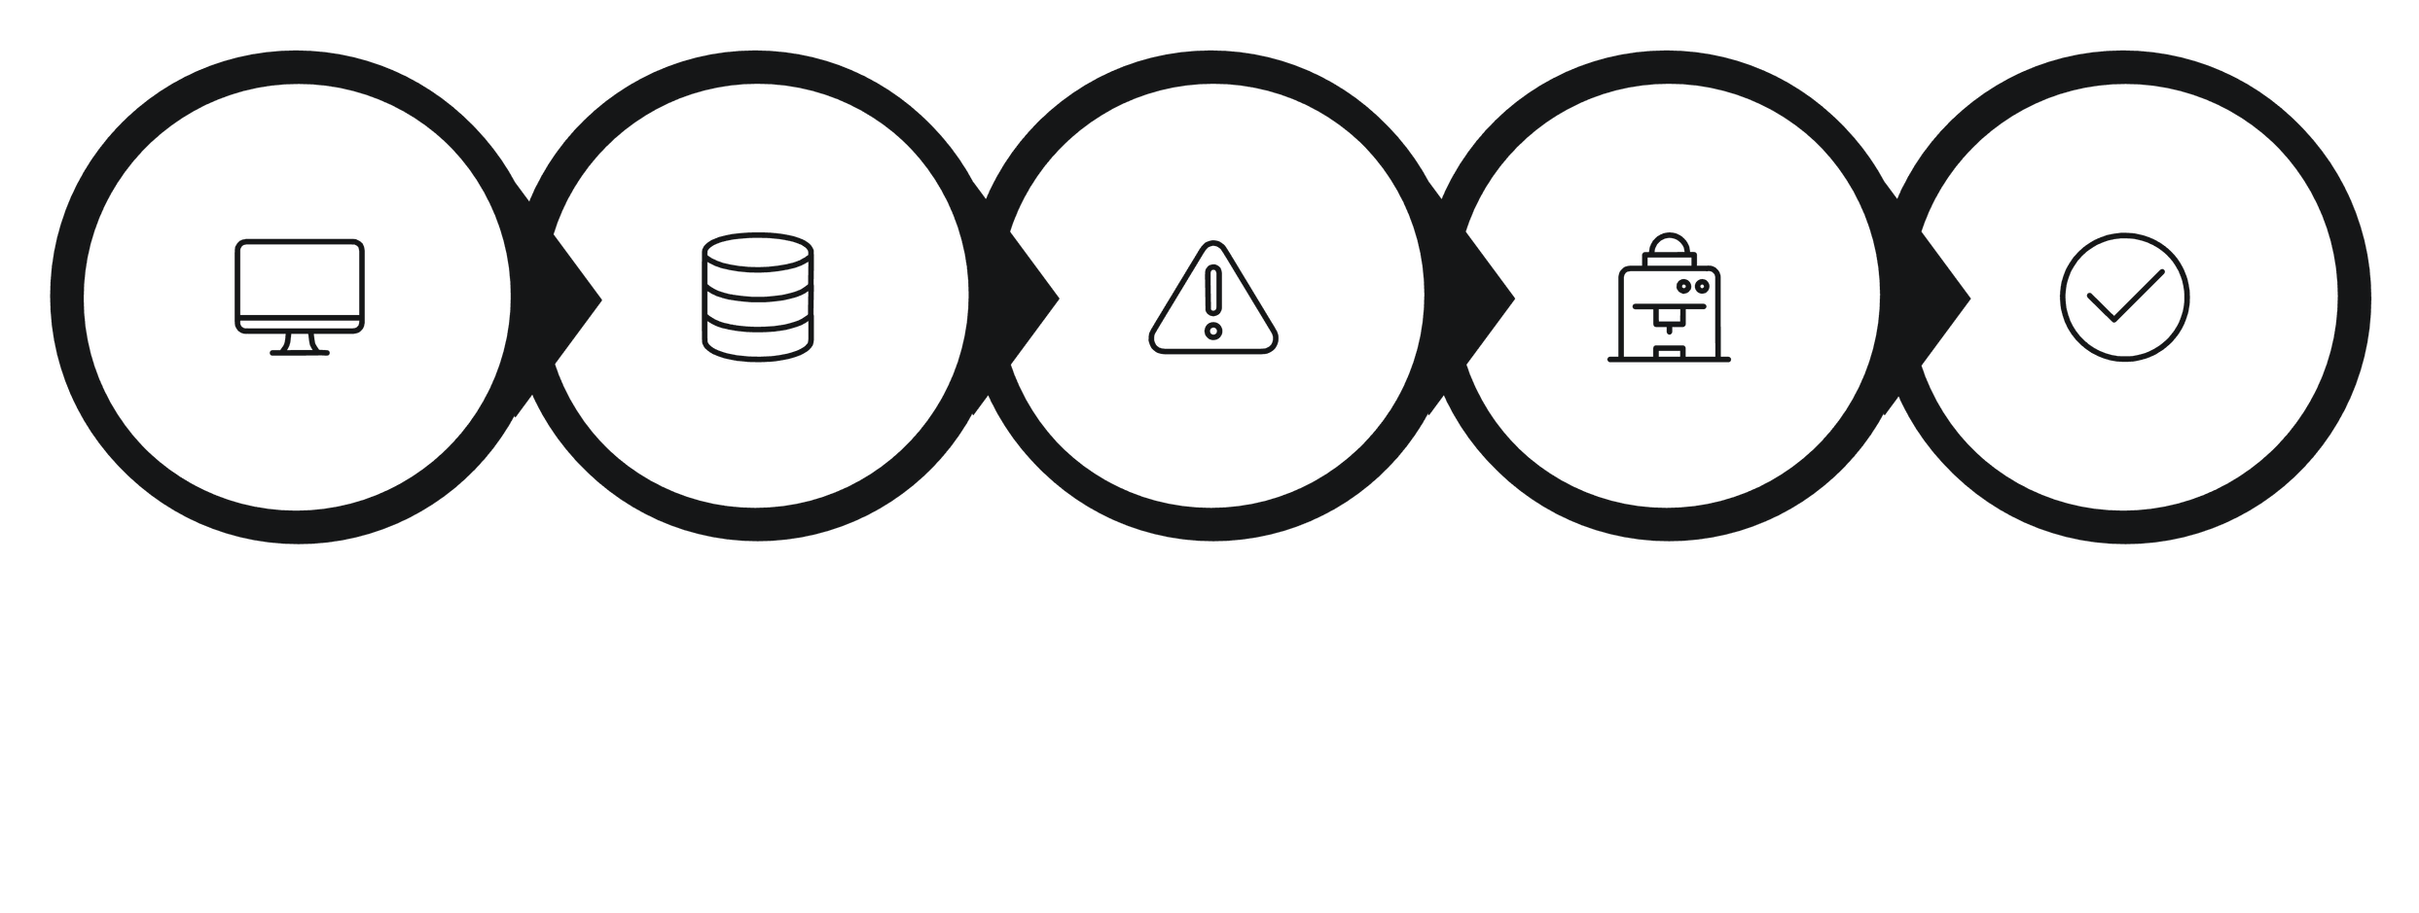
SelfHealOS System Architecture
The SelfHealOS pipeline is structured as eight sequential stages, each with a distinct responsibility — from continuous observation through to auditable recovery logging.
Monitor
Data
Detect
Classify
Confirm
System Monitor
Data Collection
Continuously observes system health and runtime behavior.
Captures OS metrics and process signals for analysis.
Fault Detection
ML Classification
Identifies anomalies and raises a fault event.
Assigns the fault to a recovery-relevant class.
Fault Confirmation
Recovery Engine
Validates the fault before any corrective action is taken.
Selects and executes the appropriate self-healing action.
Verification
Recovery Log
Confirms the system has returned to a stable state.
Stores the event for auditing and future learning.
Notes:
9

Slide 10


SelfHealOS: Monitored Parameters & Fault Classes
Monitored Parameters
Fault Classification Classes
System-Level
CPU Overload
Memory Pressure
  CPU usage
  RAM usage
  Disk usage
Sustained high CPU utilisation triggering classification
RAM saturation or resource starvation events
1
Abnormal Process Behaviour
Process-Level
Rogue or misbehaving process behaviour detected
2
  Process CPU usage
  Process RAM usage
The Recovery Engine selects the appropriate action for each fault class, verifies the system has returned to a stable state, and then logs the event to the recovery dataset for future learning.
Notes:
10

Slide 11
Literature → Gap → Proposed System
What the Literature Establishes
What SelfHealOS Contributes
•Robust ML techniques for log anomaly detection exist and mature
•Deep learning and transformers generalise well to sequential fault patterns
•Automated remediation is feasible — demonstrated in cloud contexts
•Process and resource monitoring provide actionable OS-level signals
  Earlier Fault Detection
Continuous OS-level resource monitoring identifies faults before cascading failure.
  Intelligent Classification
ML-based multi-class fault classification replaces static threshold rules.
  Automated Recovery
Fault-class-specific recovery actions executed without manual intervention.
  Verified & Logged Recovery
Post-recovery verification confirms stability; events logged for future learning.

Slide 12
THANK YOU!

