Slide 1
Comparing Hydrogen and Jet-A for an N+3 Turbofan with Water Recirculation using Gradient-Based Optimization
Peter Atma
MDO Lab University of Michigan
AIAA Aviation, June 14, 2023
Copyright © by Peter Atma, University of Michigan. Published by the American Institute of Aeronautics and Astronautics, Inc., with permission.

Slide 2
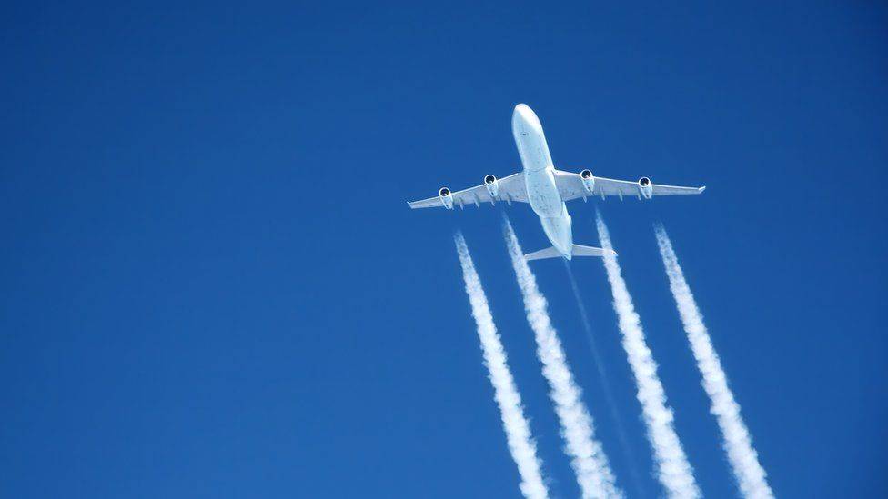
Motivation
Due to climate change, alternative aviation fuels are actively being researched
Hydrogen presents itself as the most viable alternative to kerosene-based fuels for long-haul flights
Notes:
Picture Credit: https://www.bbc.com/news/science-environment-63165607

Slide 3
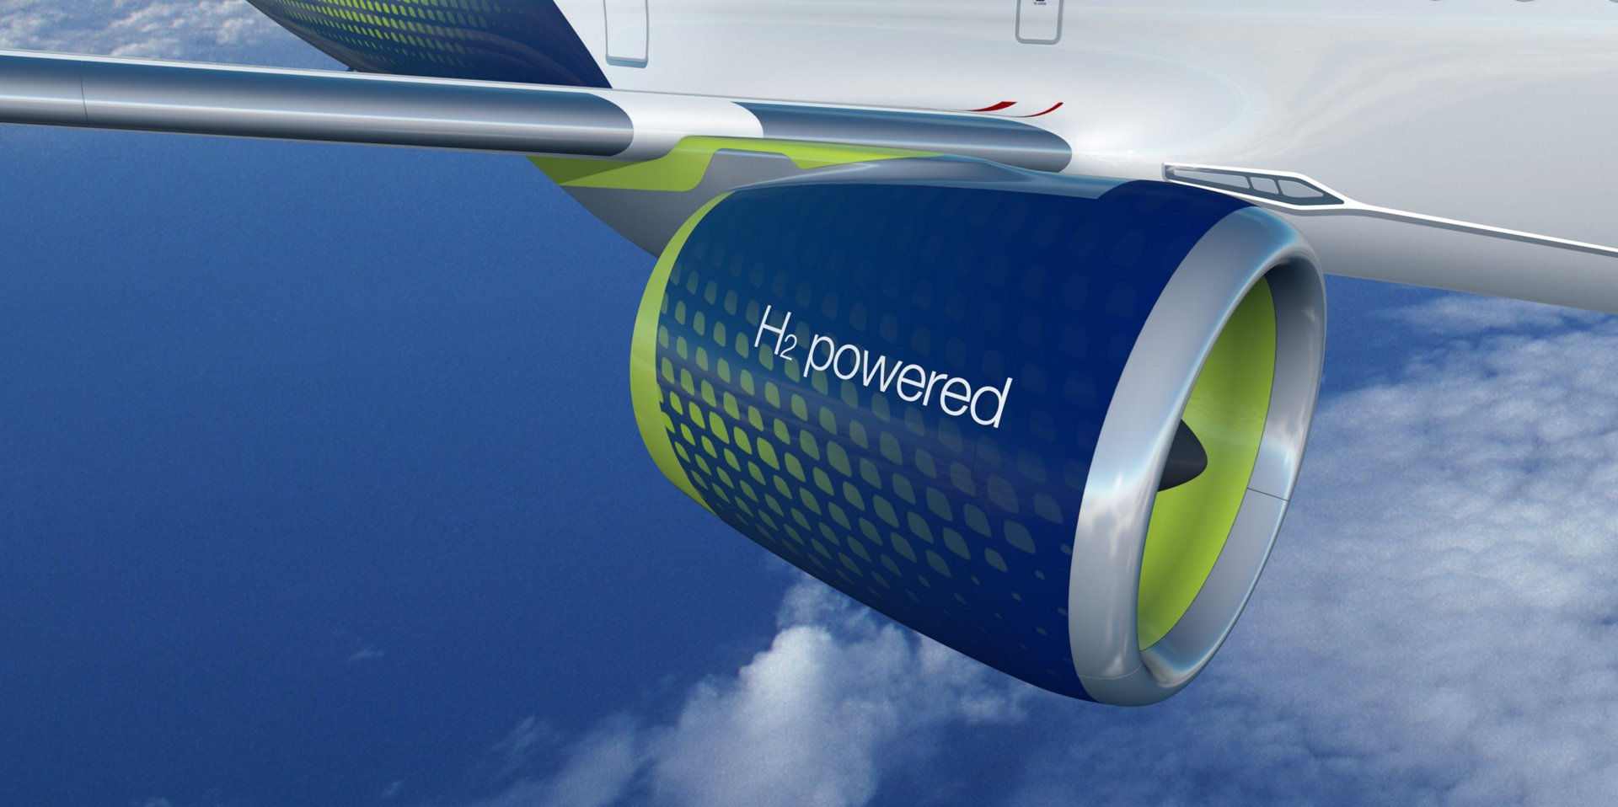
Motivation
Modern turbofan engines can run off hydrogen with limited modifications
Hydrogen eliminates carbon emissions with water being the main by-product of combustion
Notes:
Picture Credit: https://wernerantweiler.ca/blog.php?item=2021-05-20

Slide 4
Motivation
Hydrogen-powered engines present a few technological obstacles to being a replacement for Jet-A fuel
Hydrogen tanks need to be stronger and more insulated to keep hydrogen in liquid form, potentially increasing weight
Using water recirculation can potentially offset these negative effects by increasing efficiency and thrust

Slide 5
Presentation Roadmap
Computational Tools
Water Recovery Model
Propulsion Model
Optimization Problem
Results
Condenser Design Space Sweep
Summary

Slide 6
Computational Tools
Computational Tools
Water Recovery Model
Propulsion Model
Optimization Problem
Results
Condenser Design Space Sweep
Summary

Slide 7

OpenMDAO
OpenMDAO is an open-source platform for multidisciplinary design analysis written in Python
Primarily supporting gradient-based optimization, it allows users to explore large design spaces with complex models

Slide 8
pyCycle
pyCycle is a zero-dimensional engine cycle modeling tool written on top of the OpenMDAO framework
It uses modular components and a chemical equilibrium analysis (CEA) solver to converge engine designs to determine performance

Slide 9

pyOptSparse and SNOPT
The pyOptSparse framework provides a Python interface for nonlinear constrained optimizers
We use SNOPT, a gradient-based sequential quadratic programming (SQP) algorithm for large-scale constrained problems

Slide 10
Computational Tools
Computational Tools
Water Recovery Model
Propulsion Model
Optimization Problem
Results
Condenser Design Space Sweep
Summary

Slide 11
Water Recovery Model
An injector component was created in pyCycle
Injects a water flow rate and uses CEA to find the new equilibrium componsition

Slide 12
Water Recovery Model
Similarly, an extractor component was created in pyCycle
Uses CEA to find the molar fraction of water and extracts a given mass fraction

Slide 13
Water Recovery Model
The injector and extractor create a feedback loop that creates a mis-match between mass flow rates
We use a nonlinear Newton solver to satisfy conservation of mass

Slide 14
Computational Tools
Computational Tools
Water Recovery Model
Propulsion Model
Optimization Problem
Results
Condenser Design Space Sweep
Summary

Slide 15
Propulsion Model
We use the NASA advanced technology N+3 Ultra-High Bypass (UHB) Ratio engine that could be available in the 2030—2040 timeframe

Slide 16
Propulsion Model
We use a Multipoint implementation of the engine allows us to consider several operating conditions in the design
We can size the engine at the “design point” and the pass flow paths and map scalars to operate at other points

Slide 17
Propulsion Model
The water recovery feedback loop was implemented in the N+3 engine
Inputs are thermodynamic variables, water fraction, and design targets and outputs are net thrust and fuel burn

Slide 18
Computational Tools
Computational Tools
Water Recovery Model
Propulsion Model
Optimization Problem
Results
Condenser Design Space Sweep
Summary

Slide 19
Optimization Problem
The optimization problem was set up to converge the MDA group at each optimization iteration
The design point was TOC and the objective function was fuel burn at CRZ

Slide 20
Optimization Problem
The optimization was run for both Jet-A and H2 fuels
Each fuel was run with and without water recovery

Slide 21
Computational Tools
Computational Tools
Water Recovery Model
Propulsion Model
Optimization Problem
Results
Condenser Design Space Sweep
Summary

Slide 22
Results
The optimization converged for all four permutations
The optimizations took between 36-48 minutes and 20-30 major SNOPT iterations on a laptop

Slide 23
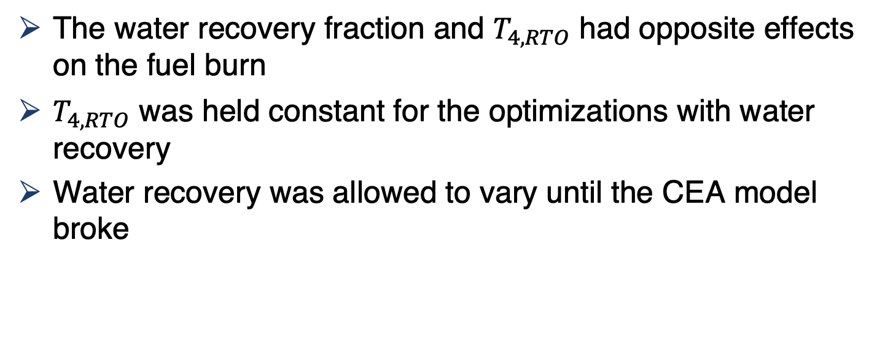
Results
The water recovery fraction and $T_{4,RTO}$ had opposite effects on the fuel burn
$T_{4,RTO}$ was held constant for the optimizations with water recovery
Water recovery was allowed to vary until the CEA model broke

Slide 24
Results
Optimized Values

Slide 25
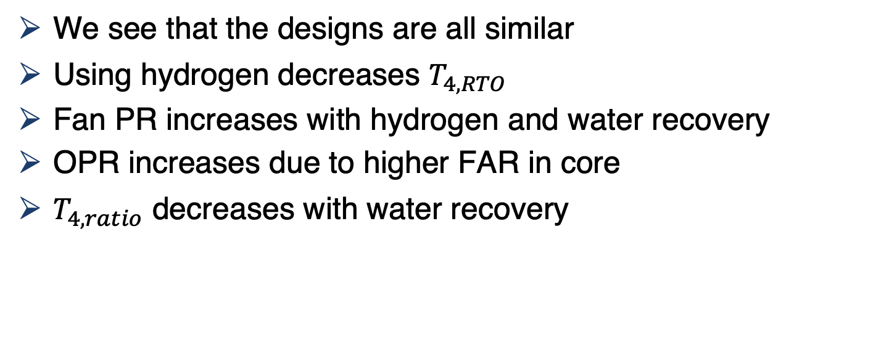
Results
We see that the designs are all similar
Using hydrogen decreases $T_{4,RTO}$
Fan PR increases with hydrogen and water recovery
OPR increases due to higher FAR in core
$T_{4,ratio}$ decreases with water recovery

Slide 26
Results
Water recovery is pushed to the upper limit that the model can resolve (30% for Jet-A and 17% for H2)
Water recovery results in significant efficiency improvements

Slide 27
Computational Tools
Computational Tools
Water Recovery Model
Propulsion Model
Optimization Problem
Results
Condenser Design Space Sweep
Summary

Slide 28
Condenser Design Space Sweep
The model assumes no pressure loss during vapor recovery
We performed a study to explore the design space of an exhaust water condenser

Slide 29
Condenser Design Space Sweep
The relative pressure drop in the exhaust stream was varied
Max performance benefits up to ~16% pressure drop

Slide 30
Summary
A novel closed-loop water recovery system was created and implemented in a turbofan engine
Jet-A and hydrogen engine performance was compared with water recovery
If a condenser can be designed in the design space presented, water recovery improves efficiency significantly

Slide 31
Backup

Slide 32
Presentation Title
Please note formatting guidelines below.
Landscape orientation
16:9 ratio
Font
Sans serif (e.g. Helvetica, Arial, Tahoma)
Sized 24-40 points
Minimal information—highlight main points
No commercialism/advertising
Can your slides be easily read from 15 meters away?

