Slide 1
Comparing Hydrogen and Jet-A for an N+3 Turbofan with Water Recirculation using Gradient-Based Optimization
Peter N. Atma
Andrew H.R. Lamkin, Joaquim R.R.A. Martins
Notes:
Hello, my name is Peter Atma, and I am Master of Science graduate of the MDO Lab at the University of Michigan.
In this presentation I will discuss our work developing a novel water vapor recovery system in a high-bypass turbofan engine.

Slide 2
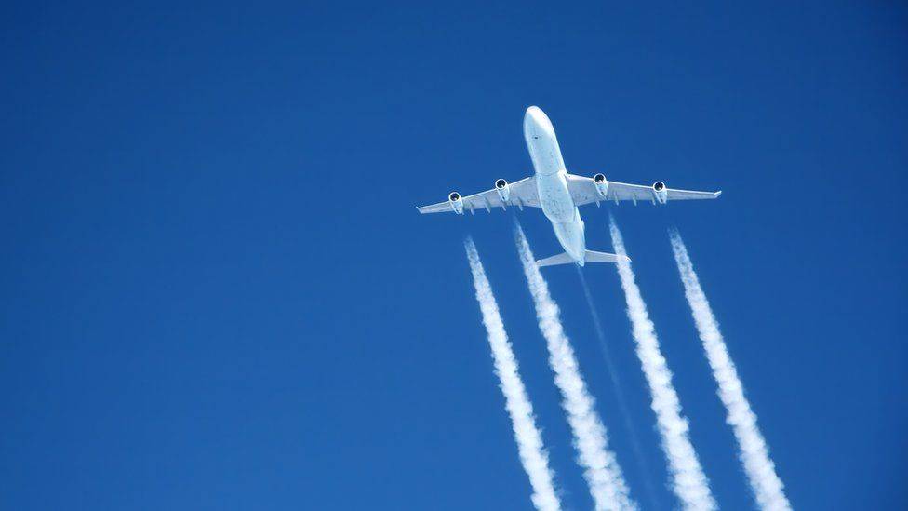
Motivation
Due to climate change, alternative aviation fuels are actively being researched
Hydrogen presents itself as the most viable alternative to kerosene-based fuels for long-haul flights
Notes:
Picture Credit: https://www.bbc.com/news/science-environment-63165607

Slide 3
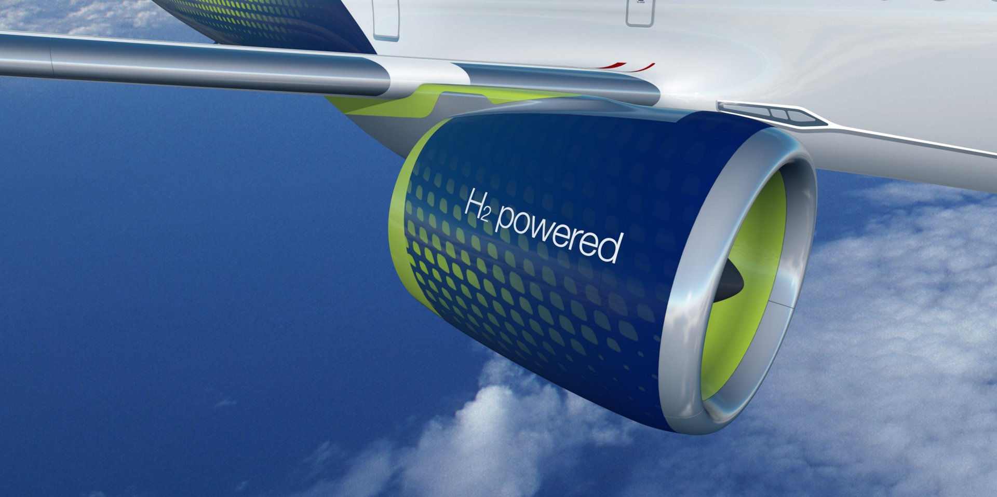
Why hydrogen?
Modern turbofan engines can run off hydrogen with limited modifications
Hydrogen eliminates carbon emissions with water being the main by-product of combustion
Notes:
Picture Credit: https://wernerantweiler.ca/blog.php?item=2021-05-20

Slide 4
Why water recovery?
Hydrogen-powered engines present a few technological obstacles to being a replacement for Jet-A fuel
Hydrogen tanks need to be stronger and more insulated to keep hydrogen in liquid form, potentially increasing weight
Using water recirculation can potentially offset these negative effects by increasing efficiency and thrust

Slide 5
Presentation Roadmap
Overview of Computational Tools
Water Recovery and Propulsion Model
Propulsion Optimization Problem
Results and Discussion
Condenser Design Space Sweep
Summary

Slide 6
Presentation Roadmap
Overview of Computational Tools
Water Recovery and Propulsion Model
Propulsion Optimization Problem
Results and Discussion
Condenser Design Space Sweep
Summary

Slide 7
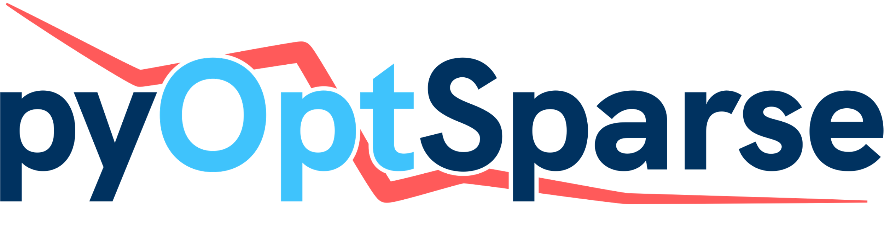
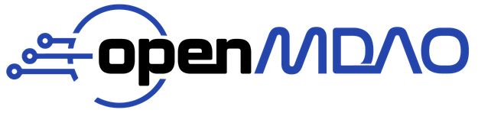
pyCycle
SNOPT
Notes:
OpenMDAO is an open-source platform for multidisciplinary design analysis written in Python
Primarily supporting gradient-based optimization, it allows users to explore large design spaces with complex models
pyCycle is a zero-dimensional engine cycle modeling tool written on top of the OpenMDAO framework
It uses modular components and a chemical equilibrium analysis (CEA) solver to converge engine designs to determine performance
The pyOptSparse framework provides a Python interface for nonlinear constrained optimizers
We use SNOPT, a gradient-based sequential quadratic programming (SQP) algorithm for large-scale constrained problems

Slide 8
Presentation Roadmap
Overview of Computational Tools
Water Recovery and Propulsion Model
Propulsion Optimization Problem
Results and Discussion
Condenser Design Space Sweep
Summary

Slide 9
Water Recovery Model
An injector component was created in pyCycle
Injects a water flow rate and uses CEA to find the new equilibrium componsition

Slide 10
Water Recovery Model
Similarly, an extractor component was created in pyCycle
Uses CEA to find the molar fraction of water and extracts a given mass fraction

Slide 11
Water Recovery Model
The injector and extractor create a feedback loop that creates a mis-match between mass flow rates
We use a nonlinear Newton solver to satisfy conservation of mass

Slide 12
Propulsion Model
We use the NASA advanced technology N+3 ultra-high bypass (UHB) ratio engine that could be available in the 2030—2040 timeframe

Slide 13
Propulsion Model
We use a Multipoint implementation of the engine allows us to consider several operating conditions in the design
We can size the engine at the “design point” and the pass flow paths and map scalars to operate at other points

Slide 14
Optimization Problem
The optimization problem was set up to converge the MDA group at each optimization iteration
The design point was TOC and the objective function was fuel burn at CRZ

Slide 15
Presentation Roadmap
Overview of Computational Tools
Water Recovery and Propulsion Model
Propulsion Optimization Problem
Results and Discussion
Condenser Design Space Sweep
Summary

Slide 16
Optimization Problem
The optimization was run for both Jet-A and H2 fuels
Each fuel was run with and without water recovery

Slide 17
Presentation Roadmap
Overview of Computational Tools
Water Recovery and Propulsion Model
Propulsion Optimization Problem
Results and Discussion
Condenser Design Space Sweep
Summary

Slide 18
Results
The optimization converged for all four permutations
The optimizations took between 36-48 minutes and 20-30 major iterations on a laptop

Slide 19
Results
The water recovery fraction and $T_{4,RTO}$ had opposite effects on the fuel burn
$T_{4,RTO}$ was held constant for the optimizations with water recovery
Water recovery was allowed to vary until the CEA model broke

Slide 20
Results

Slide 21
Results
We see that the designs are all similar
Using hydrogen decreases $T_{4,RTO}$
Fan PR increases with hydrogen and water recovery
OPR increases due to higher FAR in core
$T_{4,ratio}$ decreases with water recovery

Slide 22
Results
Water recovery is pushed to the upper limit that the model can resolve (30% for Jet-A and 17% for H2)
Water recovery results in significant efficiency improvements

Slide 23
Presentation Roadmap
Overview of Computational Tools
Water Recovery and Propulsion Model
Propulsion Optimization Problem
Results and Discussion
Condenser Design Space Sweep
Summary

Slide 24
Condenser Design Space Sweep
The model assumes no pressure loss during vapor recovery
We performed a study to explore the design space of an exhaust water condenser

Slide 25
Condenser Design Space Sweep
The relative pressure drop in the exhaust stream was varied
Maximum performance benefits up to ~16% pressure drop

Slide 26
Summary
We developed a novel closed-loop water recovery system and implemented it in a N+3 turbofan engine
We successfully optimized the engine performance with Jet-A and hydrogen with water recovery
We presented the feasible design space to guide the design of a condenser to be used in this engine architecture

Slide 27
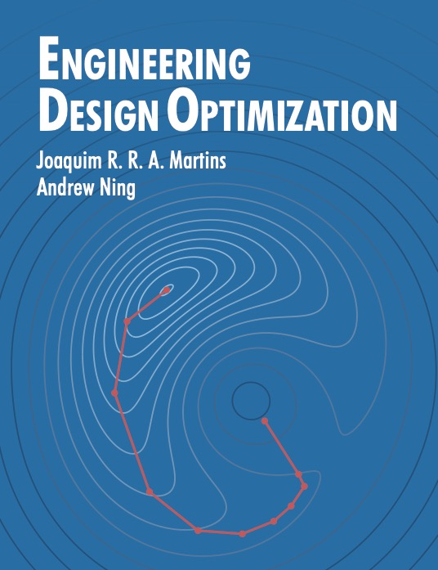
at Aviation 2023
Alasdair C. Gray, “Geometrically Nonlinear High-fidelity Aerostructural Optimization Including Geometric Design Variables”, MDO-02, Aeroelastic and Aero-Structures Optimization
Eytan Adler, “Blended wing body configuration for hydrogen-powered aviation”, Aircraft Design Optimization II
Hannah Hajdik, “Combined systems packaging and aerodynamic shape optimization of a full aircraft configuration”, MDO-04, Aerodynamic Design and Shape Optimization III
Bernardo Pacini, “Towards Mixed-Fidelity Aero-Structural-Acoustic Optimization for Urban Air Mobility Vehicle Design”, MDO-09, Aircraft Design Optimization I
Sabet Seraj, “Minimum Trim Drag for a Three-Surface Supersonic Transport Aircraft”, MDO-03, Aerodynamic Design and Shape Optimization II
M. A. Saja Abdul-Kaiyoom, “RANS-Based Multipoint Aeropropulsive Design Optimization of an Over-Wing Nacelle Configuration”, MDO-04, Aerodynamic Design and Shape Optimization III
Alex Kleb, “Extension of a Viscous Cartesian Cut-Cell Solver to the Compressible RANS Equations”, CFD-17, CFD-APA III
https://mdobook.github.io
Notes:
The MDO Lab from the University of Michigan is well represented at Aviation 2023.
Please consider viewing the talks and reading the papers written by my colleagues.
If you are interested in learning more about numerical optimization, consider my advisor Joaquim Martin's book "Engineering Design Optimization". A free pdf is available at the link in the lower lefthand corner.

Slide 28
Backup Slides

Slide 29
Full MDA

Slide 30
Full MDA

